Slide 1
Asteroid Framing Camera Cruise Phase / Mars Swing-By
Jean-Baptiste Vincent, Gabor Kovacs, Seiji Sugita
Hera SOWG
20 November 2024

Slide 2
Cruise phase plan
Minor updates following evaluation of commissioning data
To be discussed with investigation team
Updated planning spreadsheet to ESOC by end of November. OK ?
Cruise:
update exposure times, remove 16Cyg, add M42 (Orion Nebula)
Mars: minor updates to timeline
low cadence imaging 9 days before CA
faster cadence start at CA-25h, increase at CA-2h
questions about use of both AFCs

Slide 3
Every 6 months, both cameras
Objective | Observing constraints | Obs Mode/ Attitude | Observing sequence
Bias | No bright object in FoV, point away from Sun | any attitude, even during slew | 5x 0.224ms
Dark | No bright object in FoV, point away from Sun and Galactic center | any attitude, even during slew | 5x 1000s
Standard star (radiometric calib) | Point at Vega | 3x3 raster +-1° | 10x 12ms
Standard star (radiometric calib) | 16 Cygni in FoV | 3x3 raster +-1° | 10x 1000ms
Extended object | M42 (Orion Nebula) RA: 05h 35m 17.3s; DEC:−05° 23′ 28″ | Boresight to target | 10x 4000ms
Star field (distortion measurement) | RA: 07h 21m; DEC:-25d 34m RA: 04h 25m; DEC:+15d 10m | 3x3 raster +-1° | 500ms, 1000ms, 1500ms

Slide 4
Mars swing-by hera_plan_v170_20241118_001, pointing locked to Mars center
Time | Target | Observing sequence
CA – 9 days | Mars 10 to 90 px | 2 exposures every 24h, maybe Phobos astrometry
CA – 25 hours | Mars 90 to 1020 px | 2 exposures every 30min
CA – 2 hours | Mars full frame | 2 exposures every 5min
CA – 40 min | Deimos in FoV | 1 image every 5s (~30s window of opportunity)
~170 images per camera. Can we operate both AFCs during the swing-by ?
AFC1 priority, need at least two full frame exposures with AFC2
Deimos will be observed only with AFC1
Phobos astrometry tbd, need to check observability
Camera performance not guaranteed if Sun elongation < 40°, no observations after CA

Slide 6
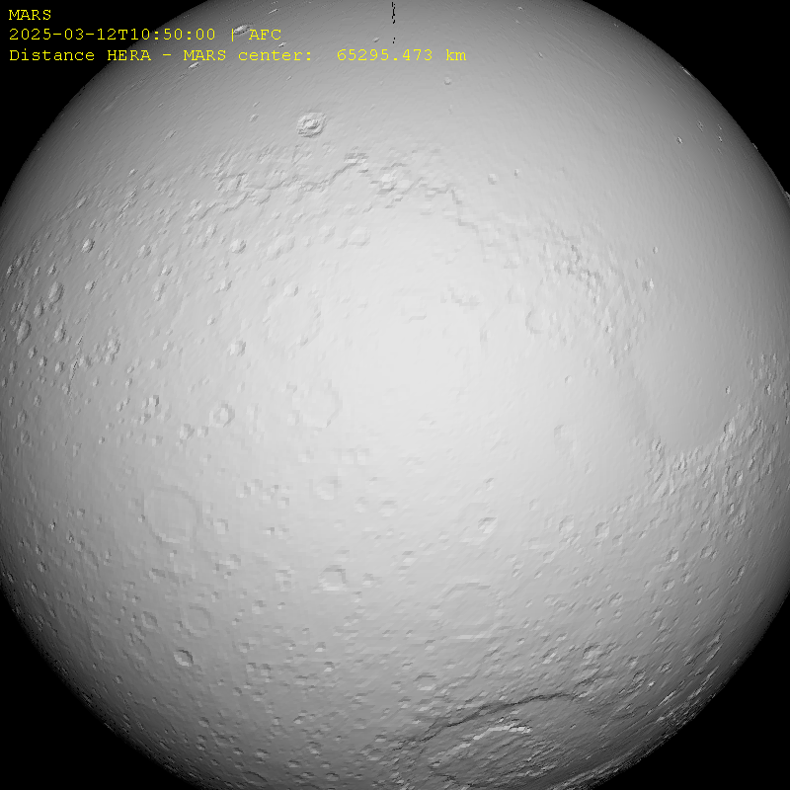
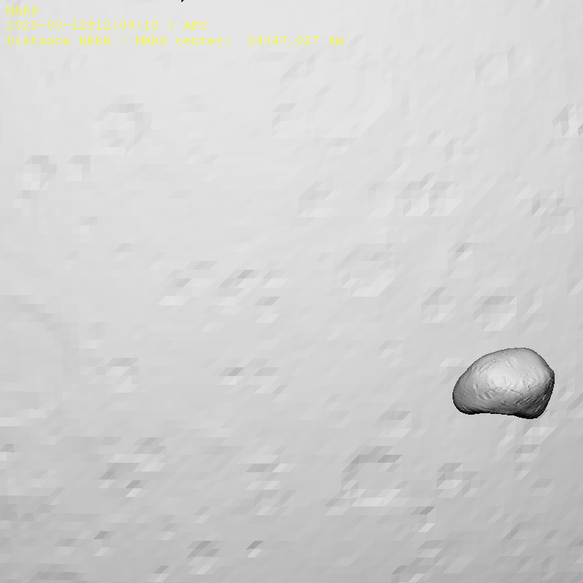
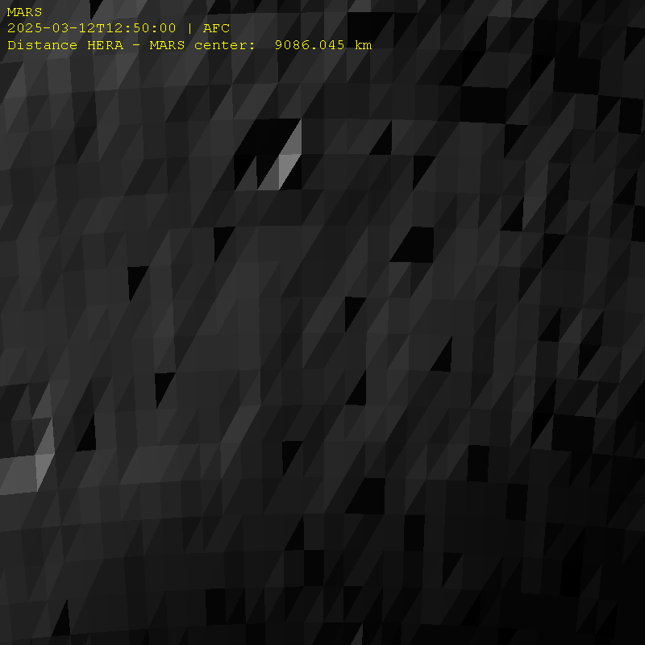
Mars swing-by hera_plan_v170_20241118_001, pointing locked to Mars center
CA -2 h
Mars > FoV
6.1 km/px
CA -1.5 h
Full frame
4.6 km/px
CA -40 min
Deimos in FoV for 30s
Mars: 1.9 km/px
Deimos: 75 m/px
Closest Approach
Mars: 800 m/px

Slide 7
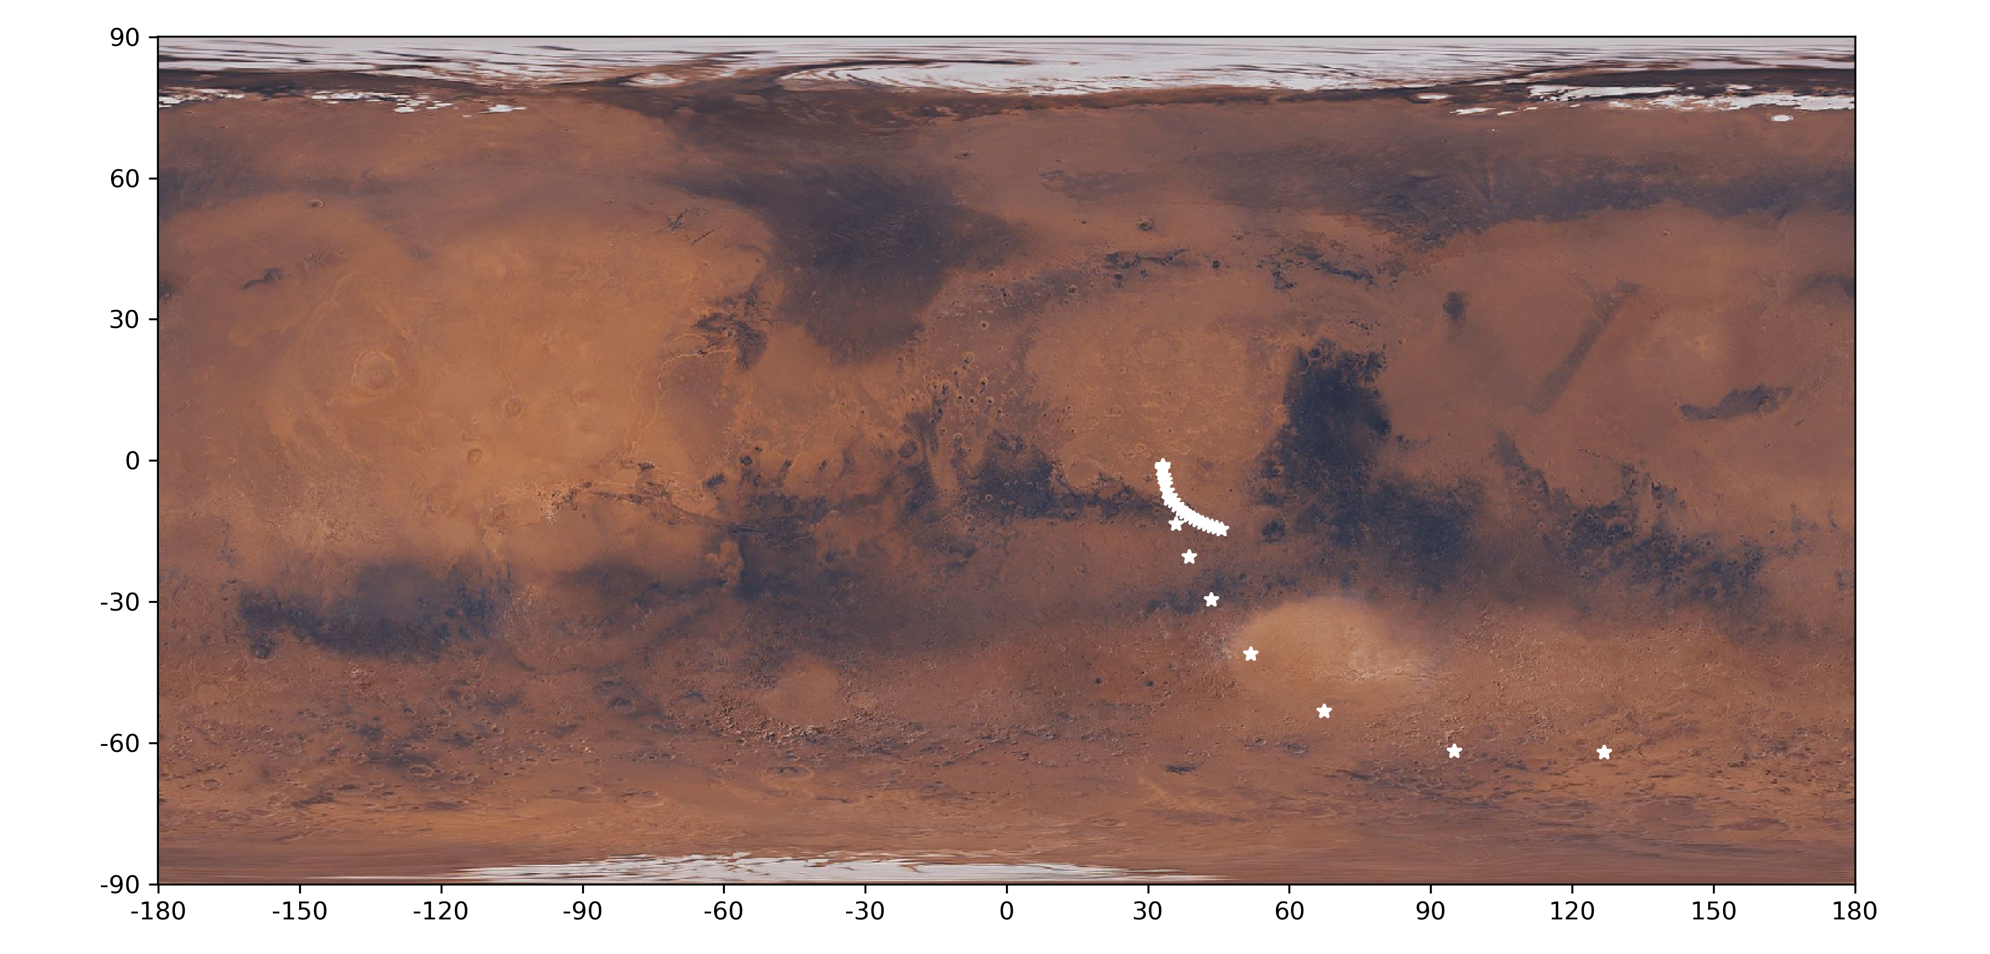

Slide 8
