Slide 1
Hera Cubesats operations C-FDSOC
Splinter – JuRa Planning and Commanding
Pâmini ANNAT, Jean JAUBERT, Philippe GUILLEMOT (CNES) Sébastien GOULET (CS Group)
Alain HERIQUE, Yves ROGEZ (IPAG)
Milan TOMIC (GomSpace)
Hera SOWG & Workshop @ESAC – 19-20/11/2024

Slide 2
Main points to be addressed during the splinter
Orbit prediction uncertainties vs JuRa programming strategy and objectives
Science Request preparation sharing between IPAG & C-FDSOC/MP operators in connection with the predefined LTP Schedule consideration
Focus on ISL configuration pre-reserved slots according to fix pattern principle (pattern to be adapted between SSTO and landing phases)
Optimization possibilities via selective JuRa data downlink
Other questions from the last MPS Q&A document sent to GomSpace and Payload teams
Other topic ?

Slide 3
Orbit prediction uncertainties vs JuRa programming strategy and objectives
Description of the issue : The performance of the orbit prediction for Juventas is currently difficult to estimate (linked to accuracy of orbit reconstruction, uncertainties of physical models, no station keeping intended, on-board autonomous orbit correction just experimental, accuracy of insertion, …). See next slide A conclusion from OMAR V1 §7.2.1 about SSTO Station-keeping study is that JuRa nominal programming strategy should not rely on a reference trajectory. ➔Very likely that the prediction and control of Juventas position on the SSTO will be difficult / not accurate Note: This could be reconsidered in case uncertainties and dispersions have reduced with time or if on-board correction of ground commanded manoeuvres or autonomous SK is validated and qualified during operations.
To be discussed : Considering this, can we think of an acquisition strategy for JuRa that would free itself from the predicted position on the orbit while being still compliant with science objectives ? Note: This point can also be related to the one about selective JuRa data downlink

Slide 4
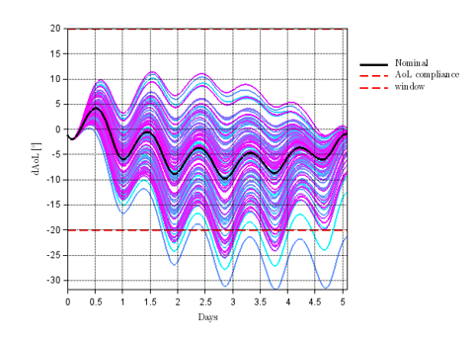
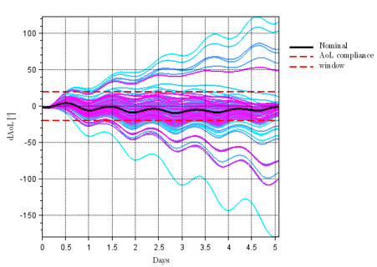
Orbit prediction uncertainties vs JuRa programming strategy and objectives
Description of the issue :
Dispersions on first SSTO 2km planning cycle in optimistic (left) and conservative (right) scenarios (see OMAR Annex E):

Slide 5
Science Request preparation sharing between IPAG & C-FDSOC/MP operators
Description of the issue :
During operations, JuRa payload team (IPAG) is supposed to send to C-FDSOC its own Science Requests for JuRa.
To be discussed :
What is the precise strategy ? Do these Science Requests cover all the needs for JuRa ? And if not, which sharing with Science Requests created by C-FDSOC operators ? What is the frequency of exchange ?
The Science Requests have to be consistent with the LTP Schedule that has been elaborated previously. How to ensure this consistency with respect to activities planned for other payloads and with respect to specific slots (JMCC, FDS, …). In particular, the management with respect to ISL / RSE slots has to be clarified (over-subscription of ISL slots, fixed patterns, …).

Slide 6
Optimization possibilities via selective JuRa data downlink
Description of the issue :
JuRa can generate and deliver data that are flagged first according to observation type (nominal, opportunistic, ranging) and then, each set contains « nominal » or « optional » science data assigned with 3 possible priority levels (high, normal, low). In asteroïd phase, these data are sent to HERA to be stored in 3 different packet stores. See next slide
To be discussed :
What is the precise strategy to split observations between nominal or opportunistic (or ranging) categories ? (in connection with issue about acquisition strategy vs orbit prediction)
What is the strategy for the transfer to HERA and then, for the download to Earth (choice of packet stores) ?
Is it possible to download just a part of an HERA packet store (or only sequential) ?

Slide 7
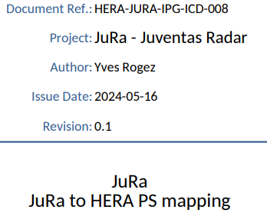
Optimization possibilities via selective JuRa data downlink
JuRa file naming follows the rule : | {jura priority=0..2}_{operation ID}_{index 0..*}.{ext}
All files inside APID 1168 (Juventas) and Type 230 (CFDP)
Hypothesis : During cruise Juventas is using a single packet store, during asteroid phase Juventas has 3 packets stores, Juventas TM priority can be ={Platform, High, Normal, Low}
 | Nominal JuRa observation sequences
 |  |  |  |  |  |  | HERA Packet Store mapping rule
 |  | JuRa TM files (ext) | Descr. | JuRa priority |  | Service SubType | Cruise Phase |  | Asteroid
 |  |  |  |  |  |  | Packet Store | Juv Priority | Packet Store | Juv Priority
Remark: |  | SCI | Science signal | 0 | high | 50 | PS Juventas | Normal | PS Juv 2 | Normal
we can group sub-types by JuRa priority to reduce the total number of sub-types if preferred |  | HK | House keeping | 0 | high | 51 | PS Juventas | Normal | PS Juv 2 | Normal
 |  | CAL | Calibration signal | 1 | normal | 52 | PS Juventas | Normal | PS Juv 2 | Normal
 |  | LOG | OBCP log | 1 | normal | 53 | PS Juventas | Normal | PS Juv 2 | Normal
 |  | OSI | Optional science signal | 2 | low | 54 | PS Juventas | Low | PS Juv 3 | Low
 |  | ACC | Accumulator (debug only) | 2 | low | 55 | PS Juventas | Normal | PS Juv 2 | Normal
 | Opportunity JuRa observation sequences => packets are not automatically downlinked, but on-demand (CCSDS Timestamp + APID + Type + SubType filter)
 |  |  |  |  |  |  | HERA Packet Store mapping rule
 |  | JuRa TM files (ext) | Descr. | JuRa priority |  | Service SubType | Cruise Phase |  | Asteroid
 |  |  |  |  |  |  | Packet Store | Juv Priority | Packet Store | Juv Priority
 |  | SCI | Science signal | 0 | high | 60 | PS Juventas | Normal | PS Juv 3 | Normal
 |  | HK | House keeping | 0 | high | 61 | PS Juventas | Normal | PS Juv 3 | Normal
 |  | CAL | Calibration signal | 1 | normal | 62 | PS Juventas | Normal | PS Juv 3 | Normal
 |  | LOG | OBCP log | 1 | normal | 63 | PS Juventas | Normal | PS Juv 3 | Normal
 |  | OSI | Optional science signal | 2 | low | 64 | PS Juventas | Low | PS Juv 3 | Low
 |  | ACC | Accumulator (debug only) | 2 | low | 65 | PS Juventas | Normal | PS Juv 3 | Normal
 | Ranging (operational data, TBC)
Remark: |  |  |  |  |  |  | HERA Packet Store mapping rule
this mode is to acquire distance to target with radar for operational purpose is to be discussed, as operational a Juv. Priority High as been set. |  | JuRa TM files (ext) | Descr. | JuRa priority |  | Service SubType | Cruise Phase |  | Asteroid
 |  |  |  |  |  |  | Packet Store | Juv Priority | Packet Store | Juv Priority
 |  | SCI | Science signal | 0 | high | 70 | PS Juventas | Normal | PS Juv 1 | High
 |  | HK | House keeping | 0 | high | 71 | PS Juventas | Normal | PS Juv 1 | High
 |  | CAL | Calibration signal | 1 | high | 72 | PS Juventas | Normal | PS Juv 1 | High
 |  | LOG | OBCP log | 1 | normal | 73 | PS Juventas | Normal | PS Juv 1 | Normal

Slide 8
Other questions from the last MPS Q&A document sent to Gomspace and Payload teams
Description of the issue :
See Q&A document : JUV-CNES-CFDSOC-MOM-0080_QA_on_Juventas_MPS_commanding

