Slide 1
Detecting Solar System Objects
with Euclid
Bruno Altieri, Benoit Carry, Luca Conversi, Pedro Gomez, Mark Kidger, René Laureijs, Roland Vavrek
08/11/2016
SSW Akersloot

Slide 2
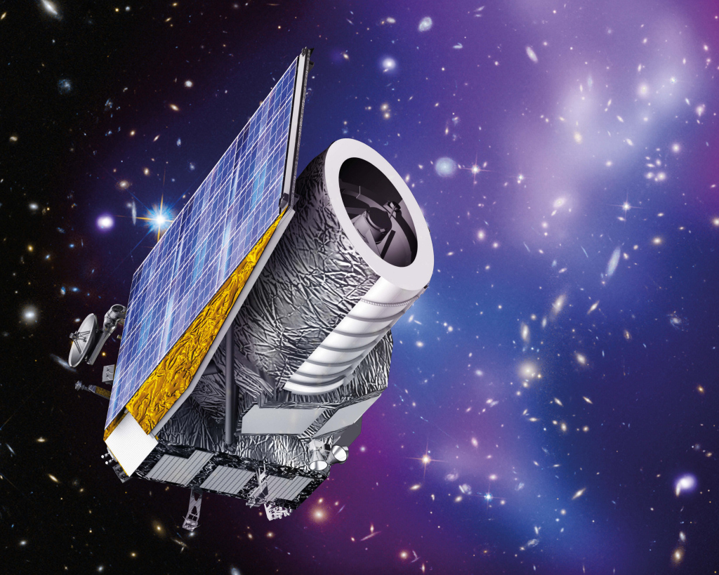
Key Systems
Wide-field telescope with 1.2 diameter primary mirror
0.69x0.74 deg2
Visual Imager
0.55-0.9 micron band
Near-Infrared
Grism Spectrometer
0.9-1.25, 1.2-1.85 micron
Photometric Imager
Y, J, H
Low noise AOCS providing very stable pointing

Slide 3
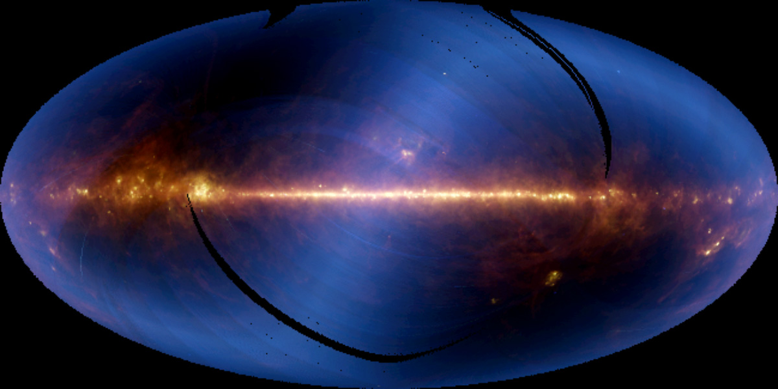
IRAS All Sky
12, 25, 60, 100

Slide 4
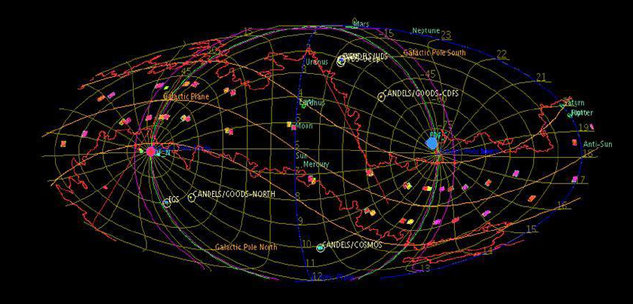
Euclid is an extra-galactic survey mission!
Survey avoidance areas:
Low ecliptic latitudes (beta < 15 deg)
Low galactic latitudes (b < 20 deg)
High extinction regions (E(B-V) > 0.08)
sky as seen by Euclid
in mollweide projection ESSPT (P. Gomez)

Slide 5
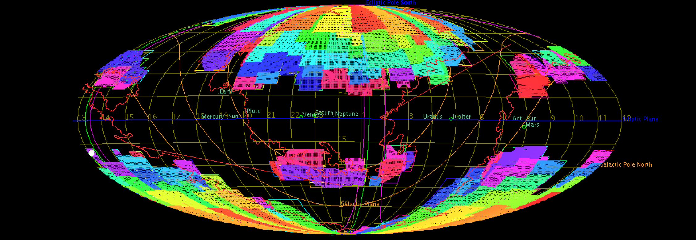
Euclid Reference Survey (2015)

Slide 6
Survey key parameters
Total wide survey area: 15,000 deg → more than 30,000 fields
Each field consists of 4 “dither” pointings
Total duration per visit ~4400 seconds
VIS: 24.5 mag (10 sigma extended) → 30 galaxies/arcmin2
NIR: Y, J, H: 24 mag (5 sigma point)
Grism spectroscopy [0.92-1.3] [1.25-1.85], R=260 → ~21 mag
Spatial resolution:
VIS: 0.1 arcsec pixels, 0.15 arcsec FWHM
NISP: 0.3 arcsec pixels

Slide 7
The predictions and figures in this presentation are taken from
Benoit Carry (Observatoire de la Cote d'Azur):
Solar System Science with ESA Euclid
A&A 2016 - submitted

Slide 8
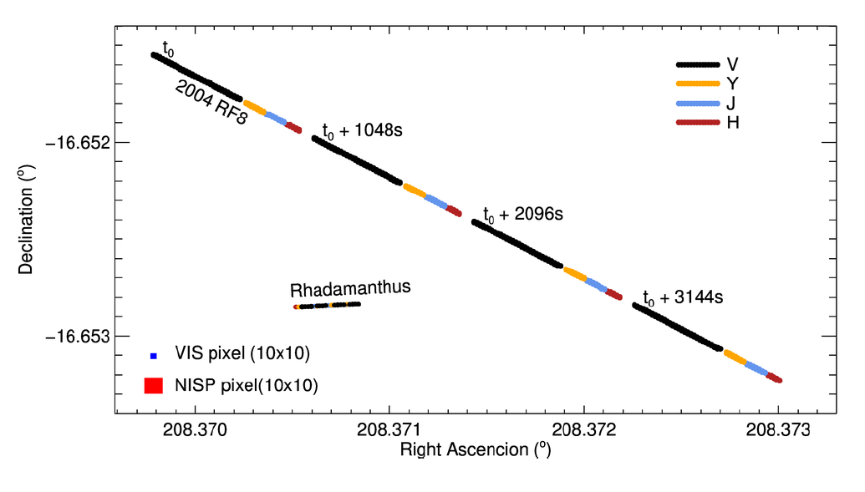
B. Carry, 2016
VIS 23.5 mag
Simulation by
Luca Conversi

Slide 9
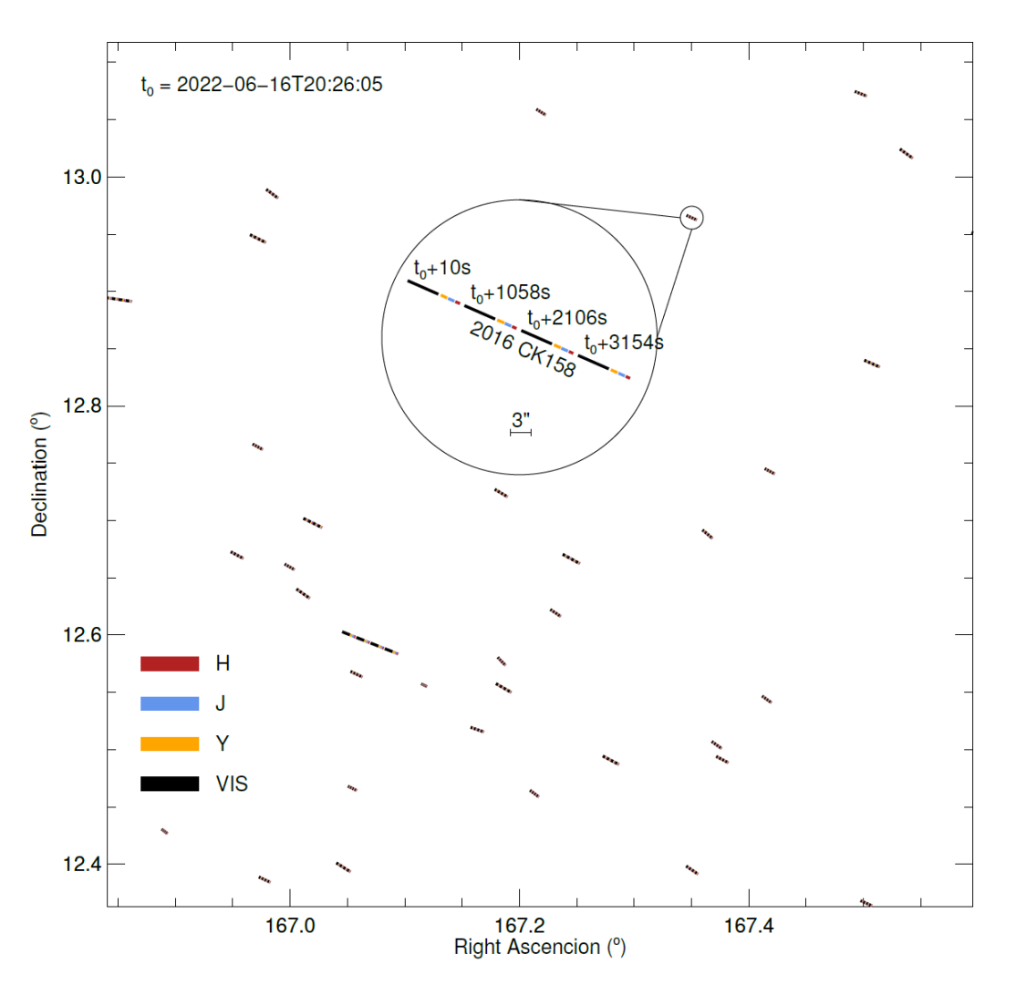
Example SSO simulated detections in one Euclid field
Simulation
RA: 167.218 deg Dec: 12.740 deg l,b = 97.74, -60.12 deg
2022, June the 16th
at 20:26:05 UT
2016CK158 is an outer main belt (OMB) asteroid.
B. Carry, 2016

Slide 10
Classes of SSOs assessed for Euclid
B. Carry, 2016

Slide 11
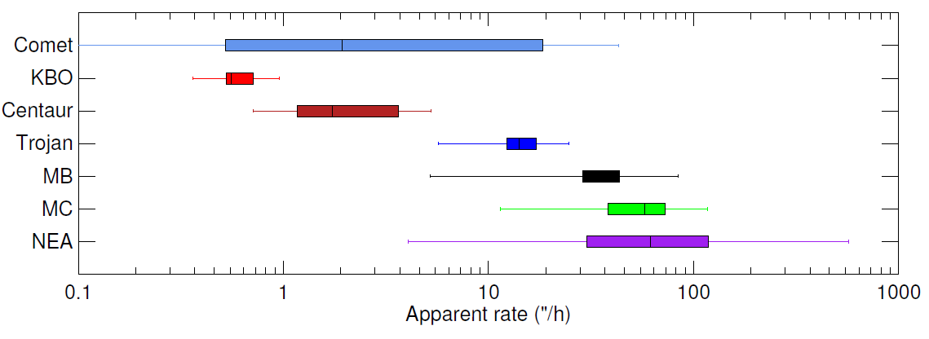
Apparent rate of SSO populations
B. Carry, 2016
KBO: Kuiper Belt Object
MB: Main Belt
MC: Mars Crosser
NEA: Near-Earth asteroid

Slide 12
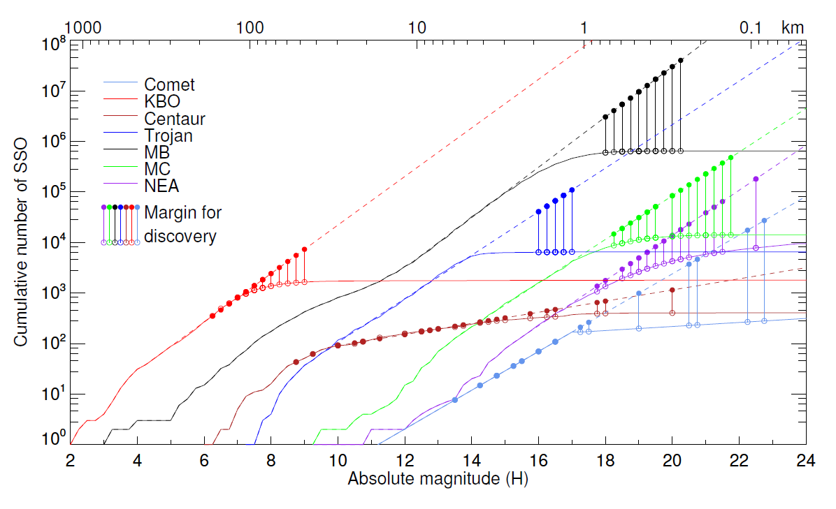
Predicted detections
B. Carry, 2016

Slide 13
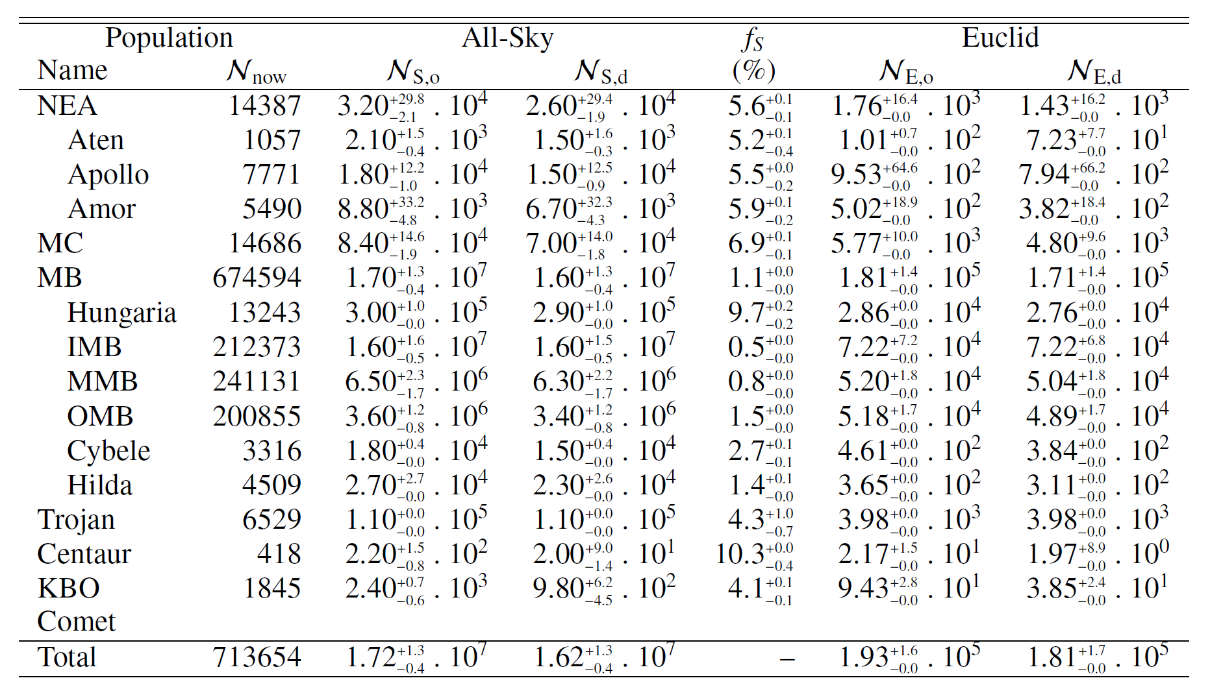
Expectation for the Euclid wide survey
Notes:
F-s is the fraction of the known population residing in the Wide Survey Area

Slide 14
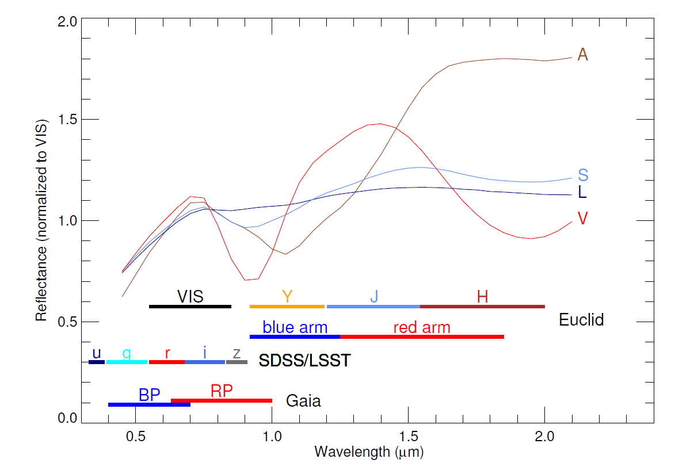
Spectral Classification
Euclid VIS + NIR bands provide the capability to perform reliable spectral classification
Less degeneracies with NIR photometry
B. Carry, 2016

Slide 15
Opportunities with Euclid
Predicted detection of 1.9-3.5 ×10⁵ of known SSOs in the Euclid Wide Survey
Similar number of new SSOs expected → but LSST will overtake
Stability and high resolution enables detection of:
multiple systems (~15% of total fraction is multiple)
object activity
light curves (also by multiple systems)
→ data to be combined with Gaia and LSST
Unambiguous classification for most Euclid detections

Slide 16
To be investigated
Spectroscopic analysis → to be studied
Euclid Deep field (40 deg²) and calibration observations
→ Provide more epochs….. to be studied
Planet IX….NIR observations might be an asset

Slide 17
Once in operations….
Short timescale
Euclid will have “immediate” announcement of interesting detections
….assuming availability of SSO predictor/identifier
Long timescale
Dedicated pipelines for the full analysis of the position transients
Need to set up a ground based follow up programme
→ at the moment follow up using large telescopes seems to be the better option
nevertheless a follow up network is still useful
Simultaneous observations of Euclid and LSST (at twilight)…..

Slide 18
Ongoing and future activities
SCI-O Faculty study: Detection and extraction of solar system objects using Euclid data
One year EXPRO contract stating in November 2016 with CAB/ESAC.
More detailed assessment of the Euclid detection envelope
Mining the KIDS for searching SSOs – see poster by Bruno Altieri
Simulations using the Euclid simulation environment
Vavrek: moving objects with NIR detecting system
Conversi: moving objects in images
Euclid SSO workshop 24 Nov
→ definition of workpackages for a SSO processing function

