Slide 1
Use of Solar Wind Electron Measurements in Predicting Interplanetary Magnetic Field Direction
A. P. Walsh¹, G. A. Graham², I. J. Rae², C. J. Owen² et al.
1. ESAC, 2. UCL-MSSL. Thanks to SCI-OD & UCL IMPACT

Slide 2
Introduction – Solar Wind Electrons
Electron distributions in the solar wind have 3 components:
Core
Thermal, isotropic
Halo
Suprathermal, isotropic
Strahl
Suprathermal, field-aligned
Suprathermal = More particles at higher energies than for a Maxwellian = Not in thermal equilibrium
B
log₁₀(n)
VDF = Velocity Distribution Function or ‘Distribution’, f(x, y, z, v_{x}, v_{y}, v_{z})

Slide 3
Why is the Strahl Interesting?
Strahl is thought to originate and be accelerated in the corona, so understanding strahl can help us constrain coronal heating.
We don’t know the formation mechanism of the halo – that it is formed from the strahl is the leading hypothesis.
Solar wind heat flux is mostly carried by suprathermal electrons, despite them making up only 5% of the total electron population.
Strahl can be used to trace the topology of the interplanetary magnetic field – important for connecting in situ and remote sensing measurements.

Slide 4
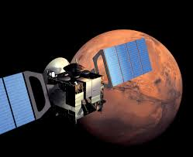
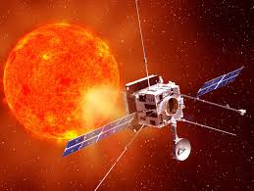
(A More Prosaic) Motivation
Can you use the strahl as a reliable predictor of the interplanetary magnetic field direction?
Useful for spacecraft without a magnetometer (MEX)
Useful for calibrating magnetometers (Solar Orbiter)
We want to produce an automatic tool that identifies the strahl in solar wind electron data and extracts magnetic field direction from it. To do this we need to understand strahl width.

Slide 5
Strahl Width?
Width = the width of the strahl distribution in terms of pitch angle.
Pitch angle is the measure of how closely aligned to the magnetic field a particle’s motion is:
We define the width as the FWHM of the flux of strahl electrons as a function of pitch angle.
B
Narrow Strahl
Wide Strahl
pitch angle vs. electron flux for a single particle energy.

Slide 6
Complication: Strahl Variability & Evolution
The strahl varies in width and intensity as a function of heliocentric distance
Two competing processes:
Adiabatic Focussing
As the strahl moves outward it becomes narrower.
This effect weakens with distance
Pitch Angle Scattering
As the strahl moves outward it becomes wider.
Scattering behaviour is still unexplained: wave particle interactions, turbulence?
Owens et al., JGR 2008

Slide 7
So, What Do You Observe?
Strahl width increases as a function of radial distance.
Scattering dominates over focussing outside 1 AU.
Different rates of change of width at different energies
This can help constrain the scattering mechanism.
BUT:
Ulysses observations taken at different latitudes
Relatively short distance range
We need to do better
Hammond et al., 1996

Slide 8
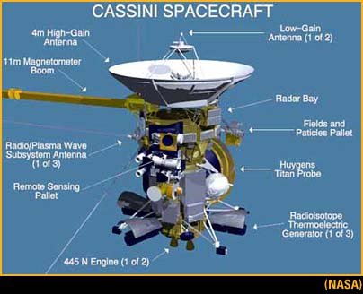
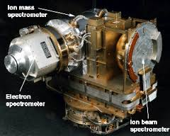
Dataset: Cassini Cruise Phase

Slide 9
Problem: Limited Instrument Field of View
To reliably determine strahl width we need to measure a complete pitch angle distribution.
CAPS-ELS doesn’t measure the whole sky, but does actuate.
This means we sometimes need to build up a complete pitch angle distribution over several measurements.
This introduces time aliasing as a problem.
Young et al., 2004

Slide 10
Solution: Solar Wind Flux Tubes
200
Regions of lower variability magnetic field separated by rotational or tangential discontinuities.
Stable plasma conditions inside a flux tube.
150
100
Change in B vector (deg)
50
0
Borovsky et al., 2008
0hrs 10hrs 20hrs

Slide 11
Identifying Strahl Width
1.0AU
4.8AU
Construct a complete pitch angle distribution from several measurements.
For each electron energy bin, fit to the sum of two gaussians one centred on PA 0, one on PA 180 (strahl going in either direction relative to B) plus a constant background (the halo).
Filter out poor fits & measurements with no clear strahl signature above background.
Extract the FWHM.

Slide 12
Results
*
Our Results
Linear fit
Error on fit
Fit to Ulysses results
Error on fit
Consistent with Ulysses
Much smaller errors
Strahl width increases with increasing distance
But, for higher energy electrons, this happens more quickly

Slide 13
Width Increase as a Function of Energy
We see a modest increase in broadening rate with increasing electron energy.
Contradicts Ulysses results
Contradicts model including adiabatic focussing and pitch angle scattering of a constant rate (with time, distance and energy).
Suggests preferential scattering of higher energy electrons (not really expected from time of flight effects).
Our Results
Linear fit
Fit to Ulysses results
Model based on Ulysses Results

Slide 14
Consequences for the Scattering Mechanism
It is likely that there are several competing mechanisms that can scatter strahl electrons.
But the dominant process has an explicit energy dependence, preferentially scattering higher energy electrons.
Resonant interaction with broadband whistler mode waves is the most likely candidate (Pagel et al., 2007; Saito & Gary 2007).
This is a promising way of generating the halo from the strahl (e.g. Stverak et al., 2008).
Work submitted to JGR (Graham et al., 2017)

Slide 15
Next Steps
Use these results to constrain an automatic algorithm that can identify strahl in any solar wind electron data.
Extract interplanetary magnetic field direction.
Test on Cluster data (PEACE + FGM).
This will give us the means to produce a huge database of strahl measurements to work on.
Apply to MEX data and maybe provide an upstream interplanetary magnetic field dataset for Mars.

