Slide 1
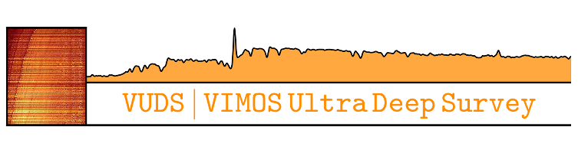

The VIMOS Ultra Deep Survey: The Lyman-alpha escape fraction from z~2 to 5
J. Pforr (Research Fellow),
B.C. Lemaux, P. Cassata, B. Ribeiro, O. Le Fevre, and the VUDS team
WORK IN PROGRESS
TWEETING

Slide 2
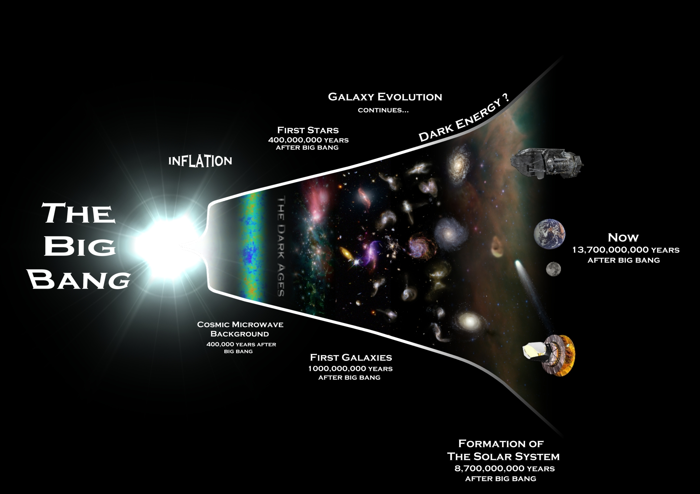
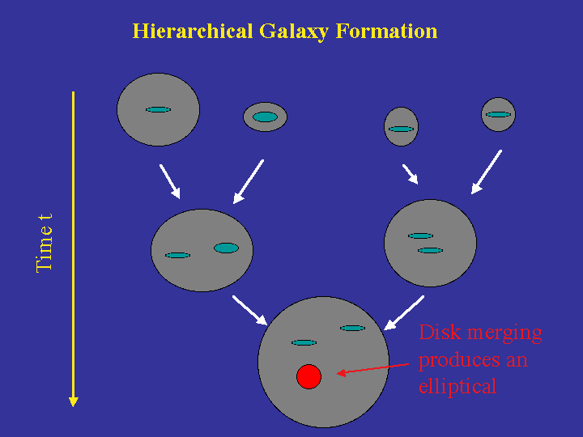
It all started with the Big Bang!
Hierarchical galaxy formation embedded in current cosmological model
Constrain galaxy formation by using data:
  Determine age, stellar mass, star formation history (SFR, metallicity, redshift) of galaxies
  stellar population properties independent of galaxy formation model
  ➔ constraints on galaxy formation model
  ➔ conclusions on formation/evolution of
  galaxies with cosmic time
  ➔ conclusions on Reionization
Notes:
Derived properties as function of redshift e.g. stellar mass function, evolution of SFR with redshift, Complete picture of galaxy formation and evolution, Comparison with model predictions
Points with error bars show the SMFs derived using the 1/ Vmax method. The solid curves show the SMFs derived with the maximum likelihood analysis, while the shaded regions represent their 1σ and 2σ uncertainties.
Plot madau for SFRs… madau 1998 >> PLOT!!! star formation rate per comoving volume vs redshift, no dust corrections, with corrections, flat slope at higher redshifts, no decrease

Slide 3
Lyman-α λ1216Å emission
Lyα emission:
  Energy needed to excite H from ground to first level
  neutral H ionized around newly-formed stars (O, B stars), recombination of ionized H (often into excited state first, then cascading down) -> Lyα emission
  strongest when ionizing stars are numerous (i.e. high star formation rate) and interstellar medium (ISM) is dust free
identify high-redshift, young, star-forming galaxies easily through Lyα emission line (first galaxies expected to be strong Lyα-emitters (LAEs))
  Lyα a great tool for high-redshift galaxy evolution

Slide 4
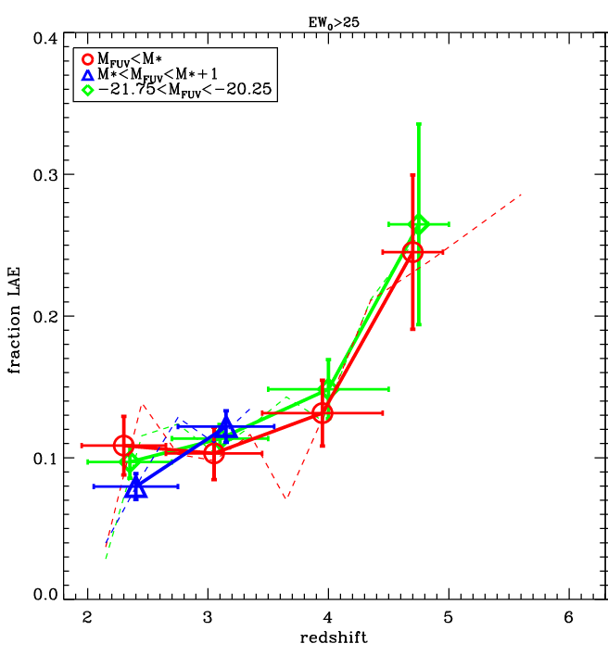
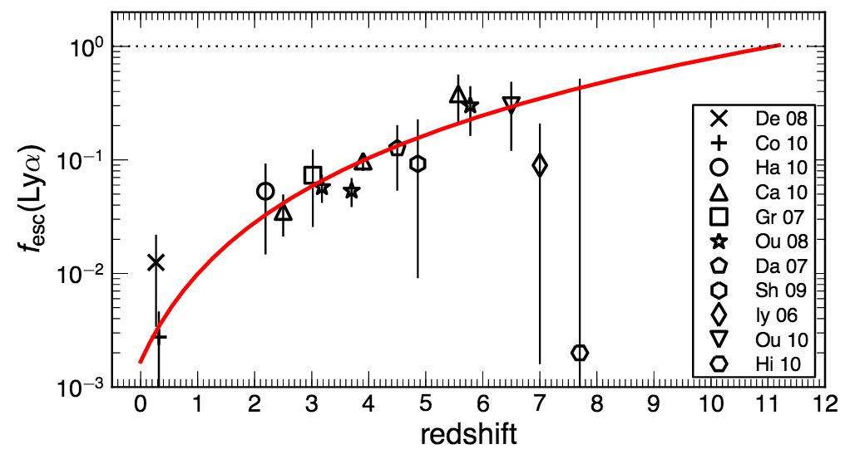
Lyα escape fraction
Lyα escape fraction = fraction of Lyα photons that escape the host galaxy
decrease due to increasing dust amounts in the ISM
increase as Reionization ends
Cassata+2015
LAE fraction
Hayes+2011
redshift
  enables pinpointing completion of Reionization and study of the evolution of dust build-up in galaxies with cosmic time
  Precise knowledge of Lyα escape fraction and its evolution is crucial

Slide 5
Project Motivation
First galaxies (z>6) play crucial role in Reionization of the Universe.
Search for and study of high redshift and first galaxies one of the main drivers of future missions such as JWST.
First galaxies expected to be strong Lyα-emitters (LAEs)
As galaxies build up dust, Lyα emission is expected to be (partly) absorbed
Current data is scarce; future spectroscopic, high-redshift galaxy studies will rely heavily on LAEs.
Through determination of galaxy properties (mass, age, SFR etc) conclusions can be drawn for galaxy evolution, Reionization and galaxy formation models.
  Lyα a great tool for high-redshift galaxy evolution
=> # of LAEs, escape fraction expected to decline over time
Notes:
Derived properties as function of redshift e.g. stellar mass function, evolution of SFR with redshift, Complete picture of galaxy formation and evolution, Comparison with model predictions
Points with error bars show the SMFs derived using the 1/ Vmax method. The solid curves show the SMFs derived with the maximum likelihood analysis, while the shaded regions represent their 1σ and 2σ uncertainties.
Plot madau for SFRs… madau 1998 >> PLOT!!! star formation rate per comoving volume vs redshift, no dust corrections, with corrections, flat slope at higher redshifts, no decrease

Slide 6
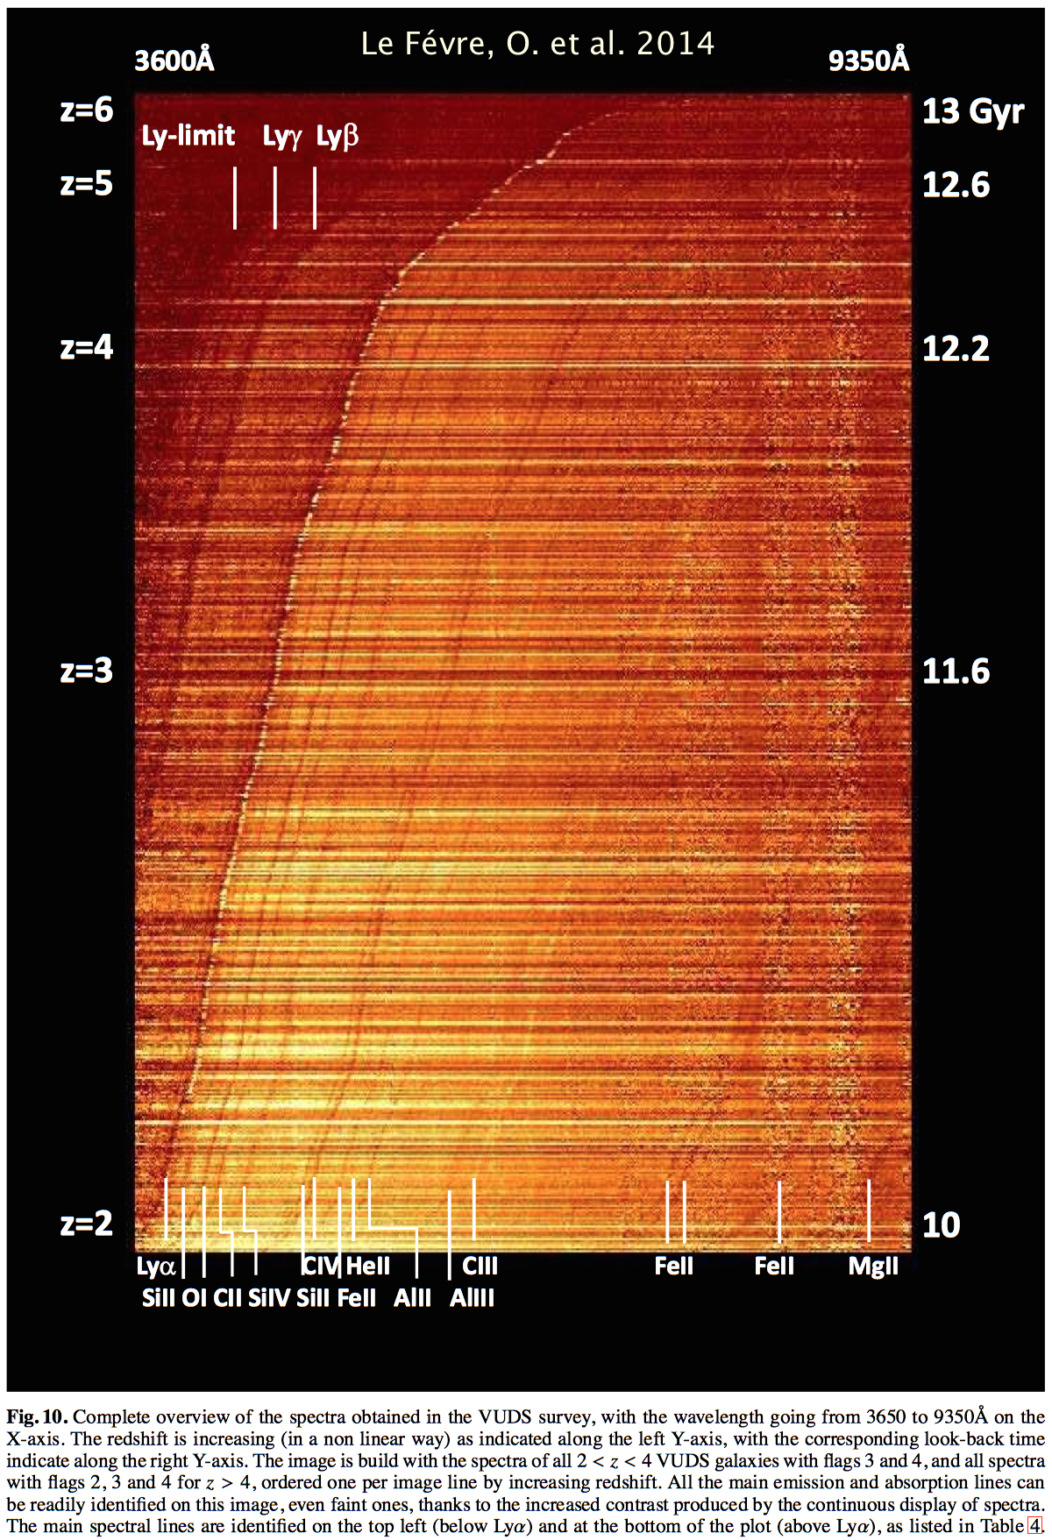
Data: VIMOS Ultra Deep Survey (PI: Le Fevre)
    Optical spectroscopic redshift survey of ~10.000 faint galaxies with 2 < z ≲ 6 with VIMOS @ VLT
    1 deg² in 3 separate fields: COSMOS, ECDFS, VVDS-02h (extensive multi-wavelength information)
    target selection mainly based on photo-z
    integration times of 14h
    91% completeness in redshift measurement for most reliable measurements down to i_{AB}=25
    ~75% redshift success rate overall
    Sample here: ~4000 objects, ~1400 w/ EW>=5, ~550 w/ EW>=25, ~260 w/ EW>=50

Slide 7
VUDS redshift distribution
Sample used in this work
Le Fevre et al. 2015
Caution: Incompleteness below z=2.5 and above z~5 due to selection effects
More galaxies at higher redshifts
from VUDS

Slide 8
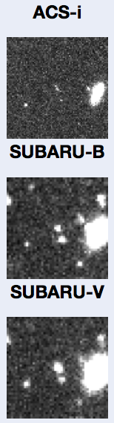
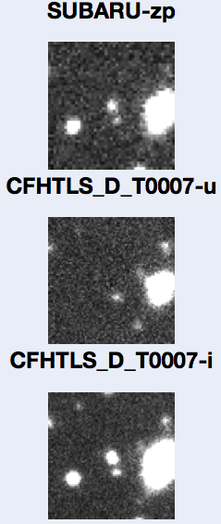
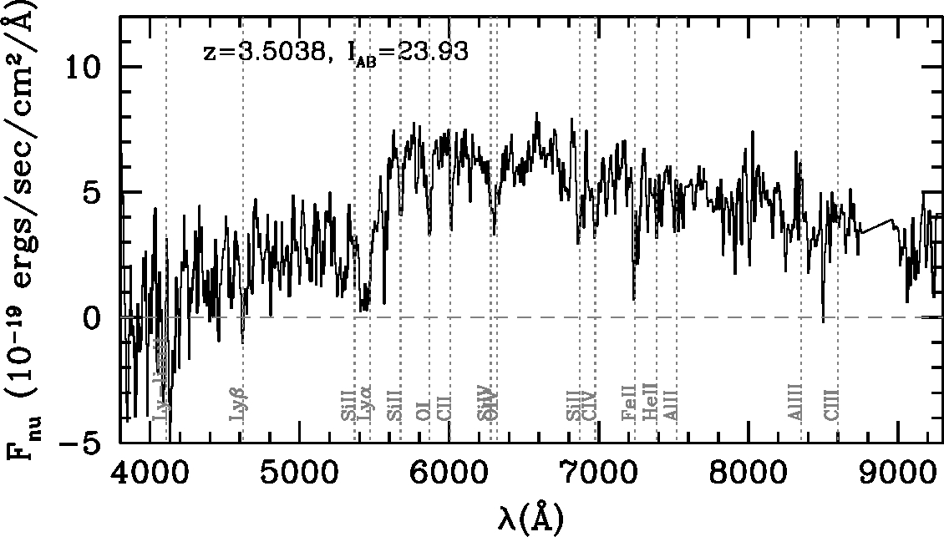
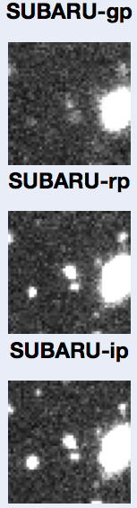
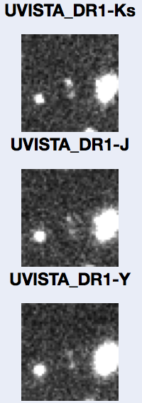
Examples of the brightest galaxies
z=3.5038, M_{FUV}=-21.7, log M*=10.6
Notes:
Flag 4, 510807732, -21.7, 10.6

Slide 9
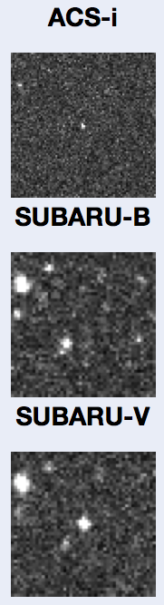
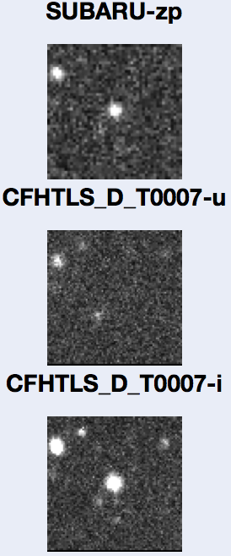
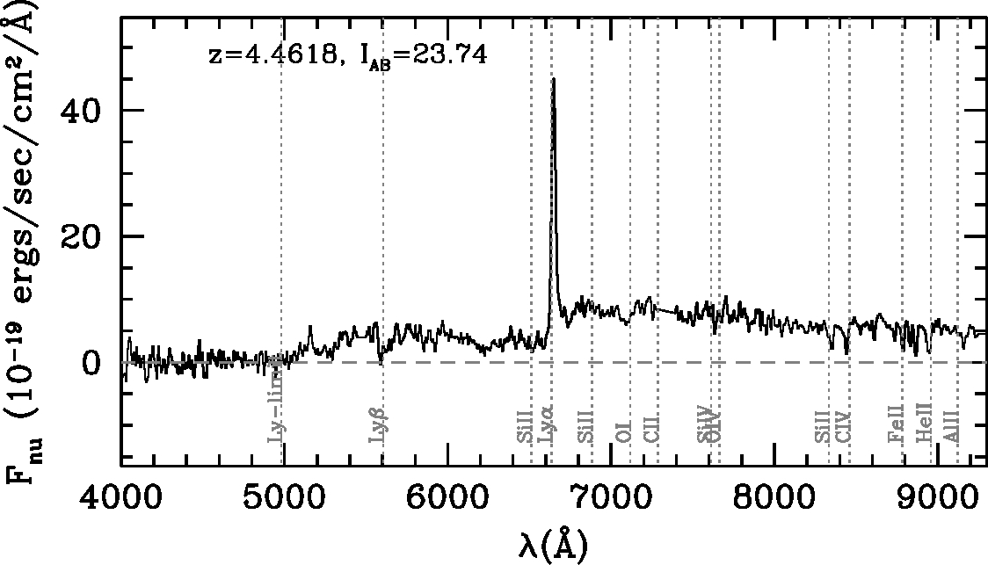
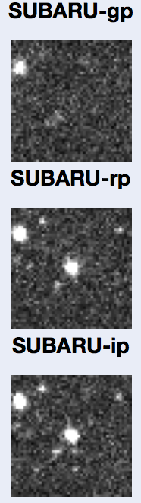
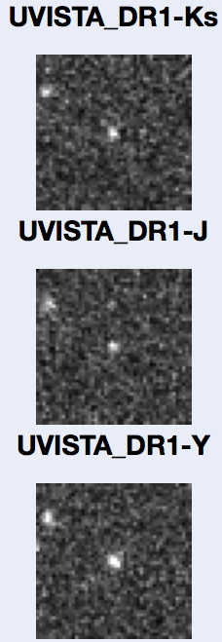
Examples of the brightest galaxies
z=4.4618, M_{FUV}=-22.5, log M*=10.3, EW= 51A
Notes:
510786441, flag 4, -22.5, 10.3

Slide 10
Dust, stellar mass, M_{FUV} distributions of the VUDS sample
  Higher EW objects have lower E(B-V), lower stellar mass, brighter M_{FUV}.
WORK IN PROGRESS
Pforr et al., in prep.

Slide 11
Lyα EW and Luminosity of the VUDS sample
WORK IN PROGRESS
Pforr et al., in prep.

Slide 12
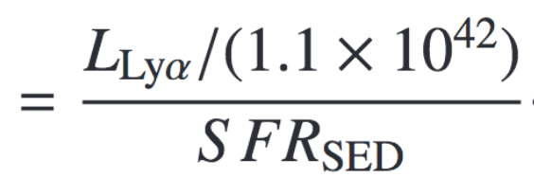
Dependencies of Ly α escape fractions of LAE
see also Cassata et al. 2015 for earlier work on VUDS sub-sample for fesc LAE and E(B-V)
WORK IN PROGRESS
Pforr et al., in prep.

Slide 13
Mass dependency of global Lyα escape fraction
TL:DL
WORK IN PROGRESS
Pforr et al., in prep.,

Slide 14
Summary and conclusions
VUDS finds high and low-EW LAE across the entire redshift range 2<z<5
On average:
  Ly-α SFRs are on average ~1-2 magnitudes lower than SED-fit SFRs.
  Higher EW objects have higher Ly-α Luminosity, lower stellar mass, lower E(B-V), brighter M_{FUV}.
  f_{esc} is higher for higher EW LAE at 2<z<5
  f_{esc} is higher for lower mass LAE at 2<z<5
  f_{esc} is lower for higher E(B-V) in LAE at 2<z<5
  Global f_{esc} is higher for lower mass galaxies at 2<z<5
f_{esc} varies on individual object basis likely due to kinematics, distribution, metallicity of ISM

