Slide 1
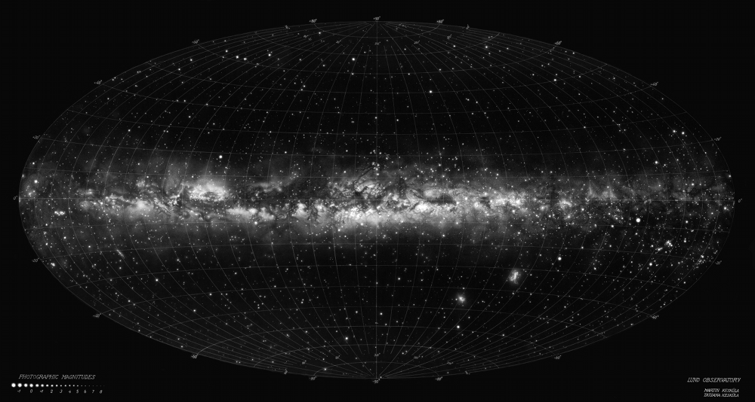
A Gaia DR2 study of the Hyades star cluster Daniel Michalik¹ with Jos de Bruijne, Stella Reino ¹esa/sci Research Fellow
Wetter

Slide 2
Gaia (launched 2013)

Slide 3
Gaia space astrometry
Goal: statistically representative map of the Milky Way
A billion (10⁹) stars
Very accurate parallaxes and annual proper motions
Uncertainties of tens of micro-arcseconds
Magnitude limits: 3 < G < 21

Slide 4
Gaia scanning the sky

Slide 5
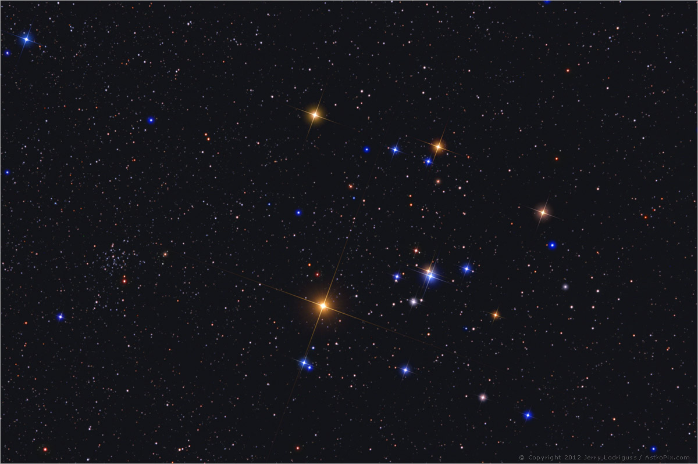
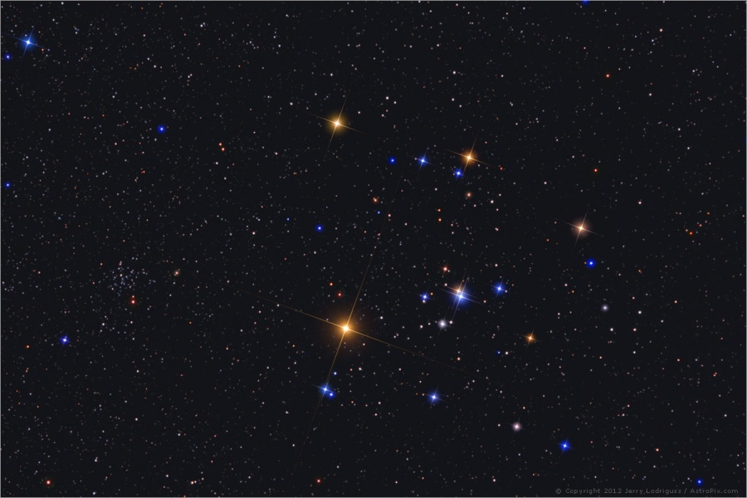
Hyades = nearest open cluster
Photo: Jerry Lodriguss

Slide 6
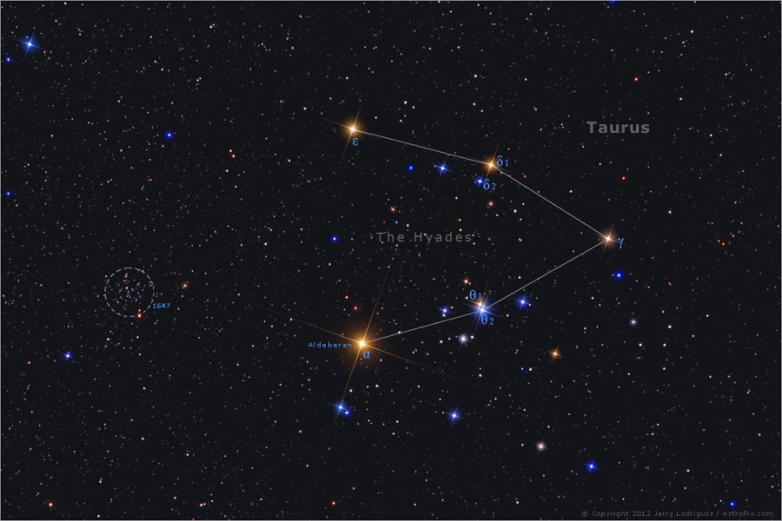
Hyades = nearest open cluster
Photo: Jerry Lodriguss

Slide 7
Introduction to Hyades
Distance ~46 pc
No notable expansion/contraction/rotation
Age ca. 600-800 Myr
Between 251 (Gaia dr1/tgas), 724 (ppmxl), ~515 (Gaia dr2 release paper) confirmed members

Slide 8
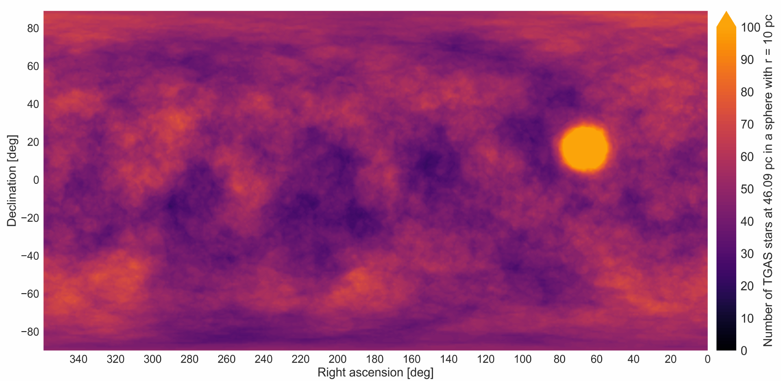
Stellar density in 10pc radius
Reino et al. 2018

Slide 9
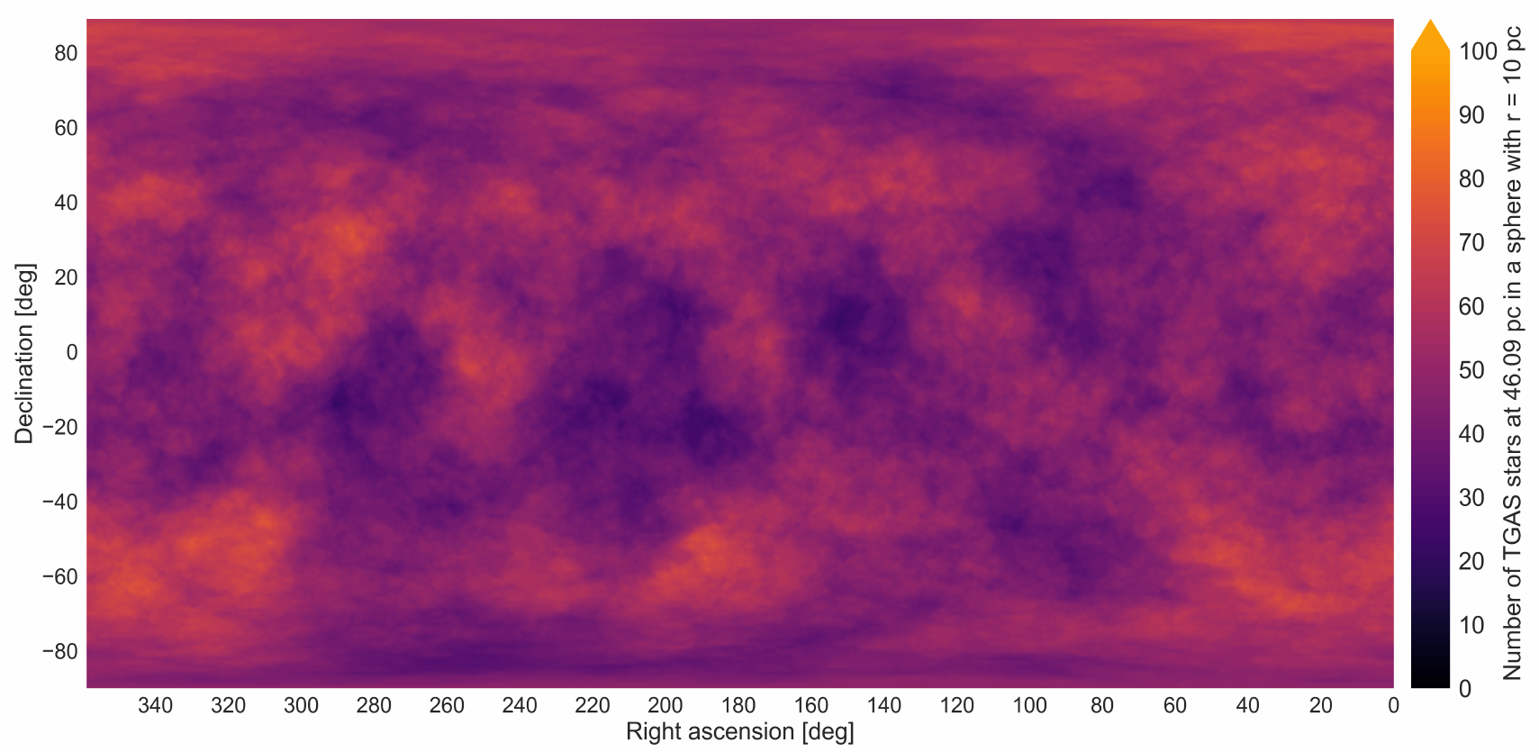
Stellar density – Hyades subtracted
Reino et al. 2018

Slide 10
Hyades morphology
Spherical core, tidal radius ~10 pc
Extended halo, flattened along the Galactic plane
Mass segregation and deficient of low mass stars

Slide 11
Projected positions of members
Flattening along the Galactic plane is clearly visible
Reino et al. 2018

Slide 12
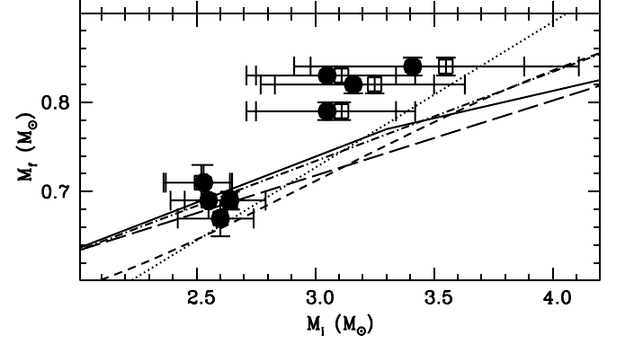
Initial-final mass relation (IFMR)
How old are the Hyades?
Accurate age → estimate mass of progenitor stars of white dwarfs
Discrepancy between typical ifmr and the Hyades WDs
Salaris & Bedin 2018

Slide 13
A Gaia DR2 study of the Hyades
Robust membership determination:
Based on kinematics (agreement with cluster motion)
Searching up to 5 tidal radii from the centre
Iterative process: refine cluster barycentre and motion
Astrometric and photometric quality checks
Currently 1035 member candidates (827 after filtering)

Slide 14
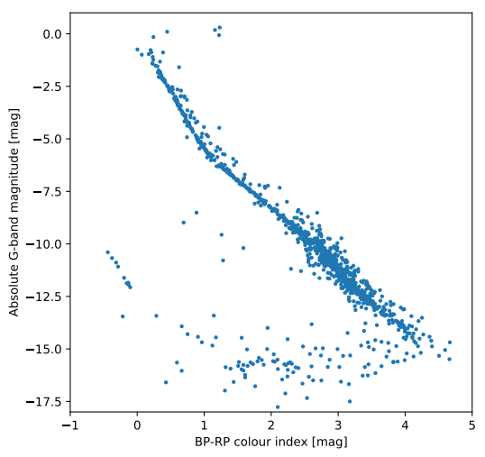
CMD based on kinematics

Slide 15
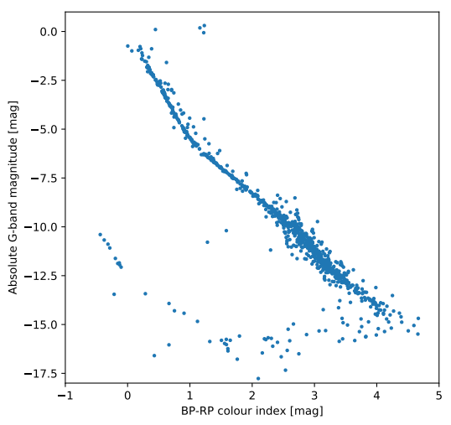
+ astrometric quality filters

Slide 16
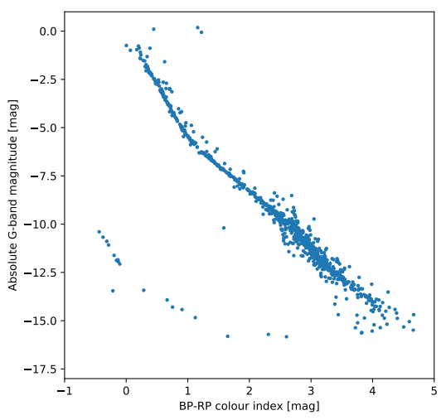
+ photometric quality filters

Slide 17
A Gaia DR2 study of the Hyades
Binarity
Gaia dr2 assumes single star behaviour
(Dis-)Agreement with single star model indicates binarity

Slide 18
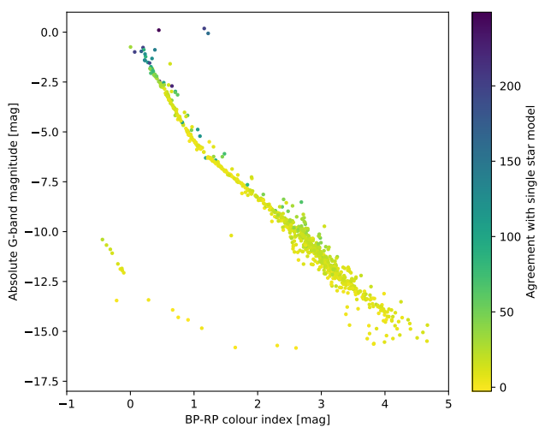
Coloured by single star behaviour

Slide 19
Goal of the DR2 study
Find fainter members (brown dwarf regime)
Identify evaporated members (many tidal radii away)
Follow-up on peculiar members
Study of cluster morphology and the dynamical evolution
Yet another cluster age to claim...

Slide 20
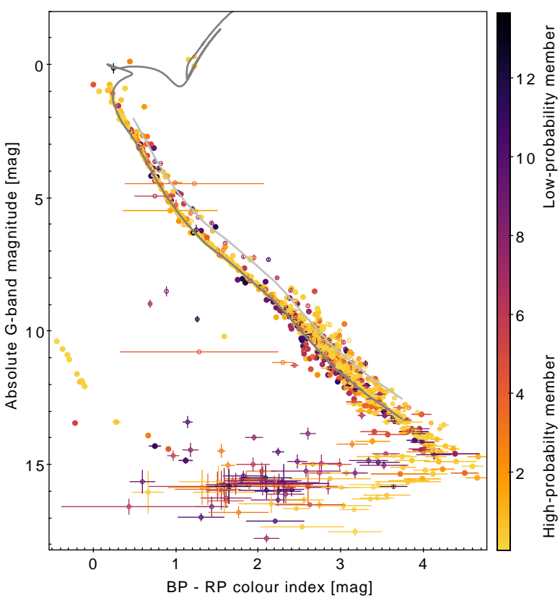

Slide 21
Messy turn-off: rotation, magnetic stars, etc
790 Myr isochrone
A known
MS+WD binary
Binary sequence
Main sequence
broadening: binaries?
A white dwarf
on the DQ
cooling track?
Brown dwarfs
Contamination
can be reduced
by quality filters

Slide 22
Closing remarks
Bright stars are missing from Gaia
Stars down to G ~ 15 mag have radial velocities → can be used to quantify contamination with interlopers
Star cluster is resolved
Kinematic modelling of parallaxes to study Gaia systematics

Slide 23
Fly-by movie (coloured by BP-RP)
Movie: Gagne & Michalik

