Slide 1
ESAC 2017 JWST Workshop
NIRSpec MSA Planning Tool (MPT)
Hands on experience
Inspired by a JDOX page in preparation (L. Ubeda) and based on NIRSpec GTO program

Slide 2
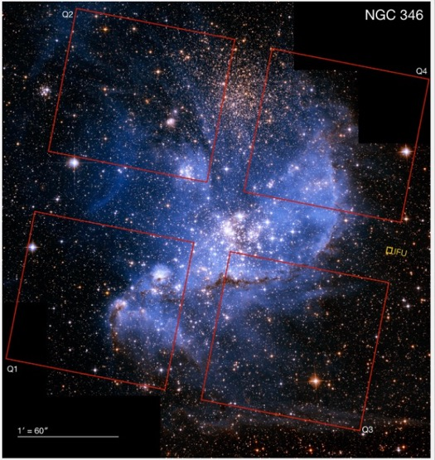
Task Description
Goal: Plan a NIRSpec MOS observation to capture high resolution spectra (R 2700) between 1.7 and 3.1 μm of the population of pre-main sequence stars in the the star forming region NGC 346 of the SMC. Existing HST/ACS data are used to derive the input catalogue and the relative astrometry. There is no need of pre-imaging.
Material Provided:
Star catalogue from Gouilermis et al. 2006
Results of the Visibility tool
Exposure parameters and observing strategy
Image of NGC346 based on HST/ACS Go Program 10248 (PI. Nota)
With the footprint of the MSA quadrant Field of View

Slide 3
Input Catalogue
Star catalogue from Gouilermis et al. 2006 based on ACS data
ACS F555W (V) and F814W (I) photometry for > 99,000 objects
Published catalogue has been reformatted and weights have been assigned:
Astrometry accuracy: 10 mas
source type |  | weight value
upper main sequence | UMS | 10
pre-main sequence | PMS | 100
red giant branch | RGB | 40
other |  | 1

Slide 4
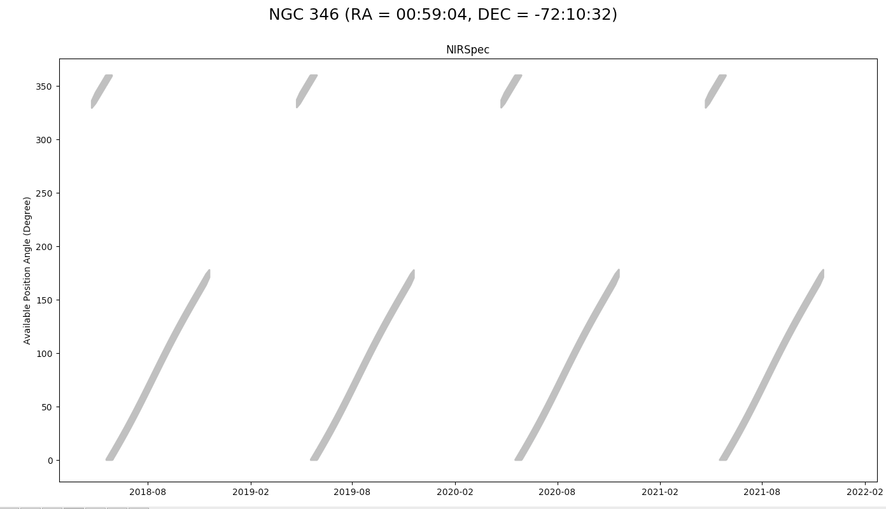
Output of Visibility tool
Apertire Position Angle
Note that for NIRSpec Aperture Position Angle=V3PA+138 deg

Slide 5
Exposure Parameter and Observing strategy
Requirement : spectra (R 2700) between 1.7 and 3.1 μm
Configuration Grating/Filter = G235H/F170LP
Readout Pattern: NRSIRS2RAPID (low readout noise mode that stores all detector reads)
NGROUPS =65 (900 second exposure time)
Integrations per exposure = 2
Autocal = none
Slit Setup = 3 shutter Slitlet with Nodding
NO Dither

Slide 6
Overview of the steps required
Import the catalogue
Define a list of primary candidates
Create a initial plan - analyze results
If time allows - create a second plan

Slide 7
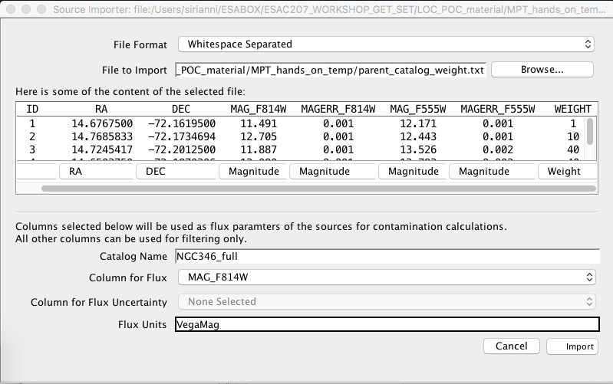
1- Importing the Catalogue
Preliminary Steps
Start APT (version 25.2.3 for this hands on session)
Create a new JWST proposal
For this session there is no need to fill in Proposal Information or Target details
Create a new observation folder and select the MSA planning tool
Import the catalogue
Select File format : white-space separated
Browse to the location of the file and upload it
Change the column type from “Ignore column” to “ Magnitude” in all magnitude columns
Insert the Catalogue Name ” NGC346_full”
Select a column for Flux
Fill in the flux unit (Vegamag in this specific case)
Click on IMPORT

Slide 8
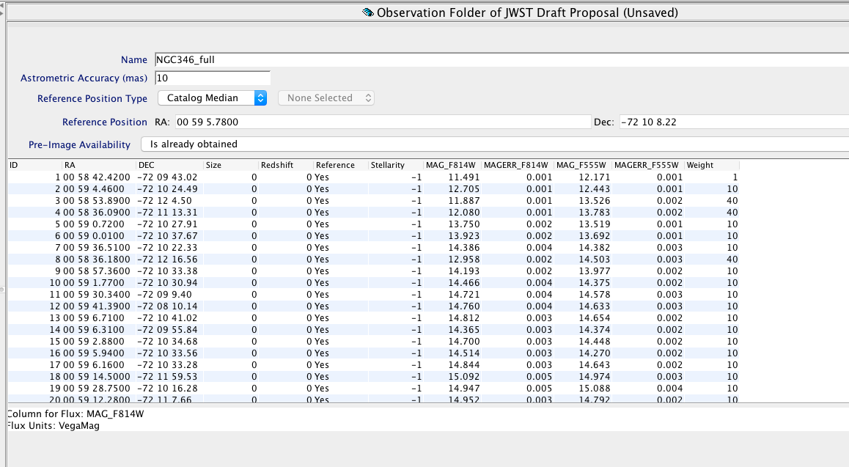
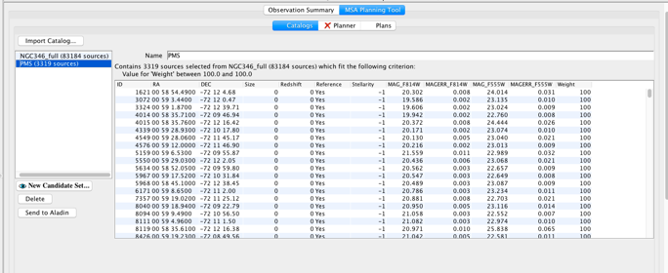
2- Selecting the list of primary targets
We are going to select all pre-main sequence starts (they have a weight of 100 in the catalogue)
Single click on the catalogue name
Insert the astrometry accuracy : 10 mas
Leave the Reference Position Type as “Catalog Median”
Set Pre-image availability to “Is already obtained”
Create New candidate Set
Select the main catalogue NGC346_full
Click on “New Candidate Set”
In the pop up window, name the new set as “PMS”
Add Filter “New Weight Filter”
Select Min=100 and Max=100 (we isolate all pre-main
sequence stars in the catalogue”
Click on “make Candidate set”

Slide 9
3- Create an initial plan
Select “Planner”
Select Aperture PA =100
Select the Primary Candidate List: “PMS”
Filler List: none selected
Check the “Nod in Slitlet” checkbox
Leave Dither type to “No Dither”
Exposure Set up:
G235H/F170LP
NRSIRS2RAPID
65 groups
2 integrations
Set step size for the search Grid to 10” (5” is recommended given the density of objects. See Poster by E.Wislowski but takes more time)
Set number of MSA Configurations to 3 (3 different MSA configurations to increase the number of observed targets)
Name the plan as ”Plan_100_nod_step10’
Click Generate Plan (it will take about 3-4 minutes)

Slide 10
3- Analysis of the plan generated
9 pointings (3 MSA configurations, each with 3 three point nod)
For each pointing between 58 and 62 targets are observed
Select the first 3 pointings (one nod-set)
Send targets to Aladin, check location of targets over a DSS image
Select all 9 pointings – check total number of stars in at least one exposure (173)
Select 1 pointing, c1e2, click on “Show”
Analyze shutter diagram (green dot = primary target observed in the selected exposure, green cross = primary target observed in other exposures of the plan, black dot = contaminant, red shutter = failed open shutter)

Slide 11
4- Create another plan
There are many possible optimizations and considerations:
You should experiment with different aperture position angles (the optimization of the MSA configuration depends on the orientation on the sky). Please note that specifying a restricted Aperture PA will impact scheduling.
You may also experiment with adding a large dither to bridge the detector gap (20 arcsec in dispersion direction). Our recommendation is to use Fixed Dithers to obtain the largest number of matched sources. See how many sources you are able to observe at BOTH locations.
If there are strong requirements on the flux accuracy the user should try to minimize slit losses and capture targets fairly centered in the slit . In order not to lose more than 25% of the flux compared to a well centered source, the user can change the source centering constraint from “Entire Shutter” to “Constrained” (this will reduce the number of sources somewhat).
Reducing the step of the search grid from 10” to 5” while increasing the calculation time, will most likely increase the number of targets observed in each pointing.

