Slide 1
NIRSpec Multi-Object Spectroscopy of distant galaxies === screenshots ===
Science case 3.2

Slide 2
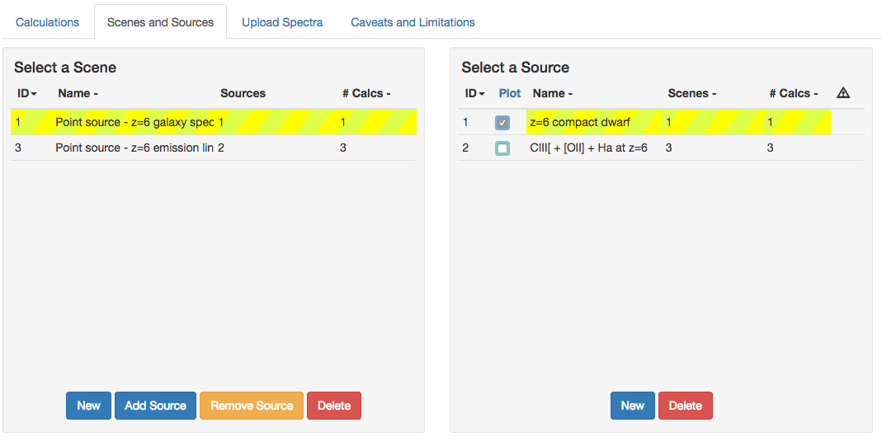
ETC screen shots

Slide 3
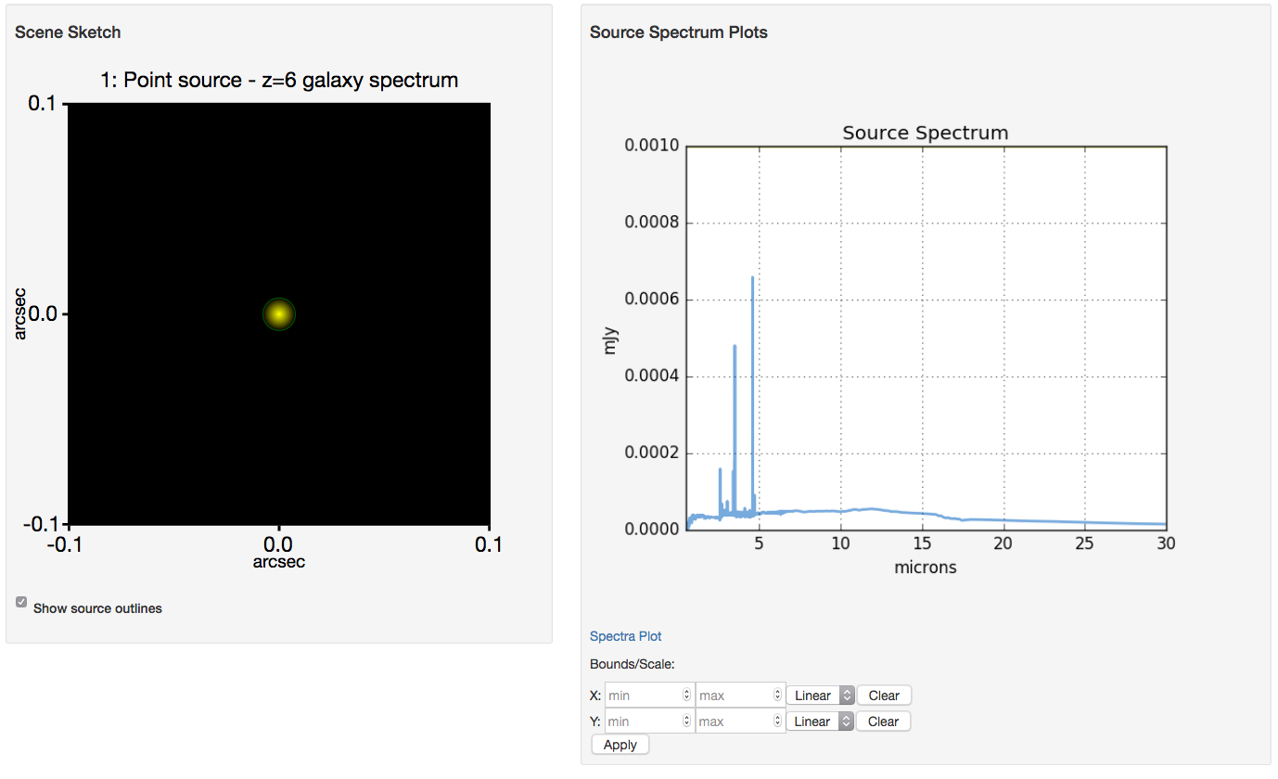
ETC screen shots

Slide 4
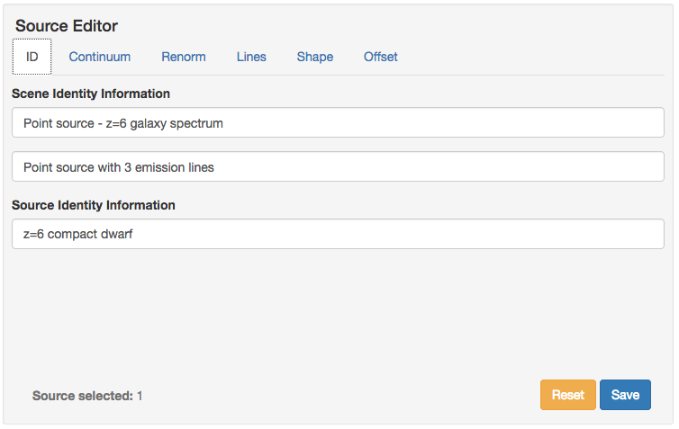
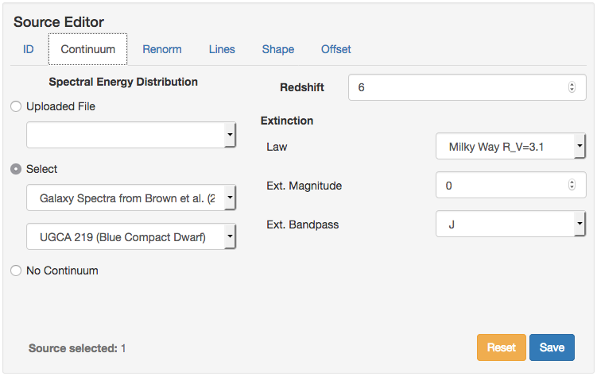
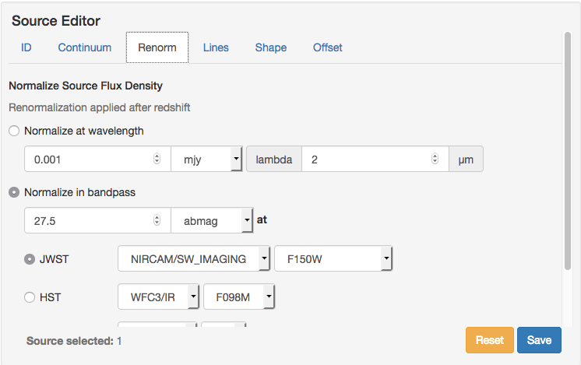
ETC screen shots

Slide 5
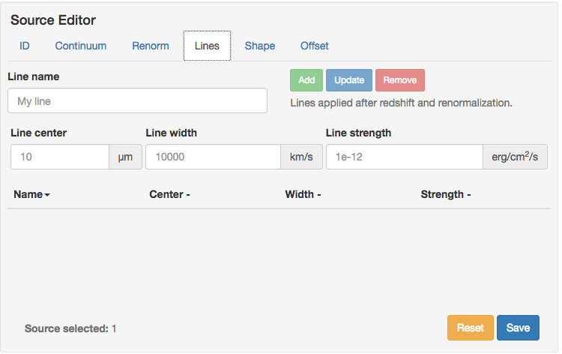
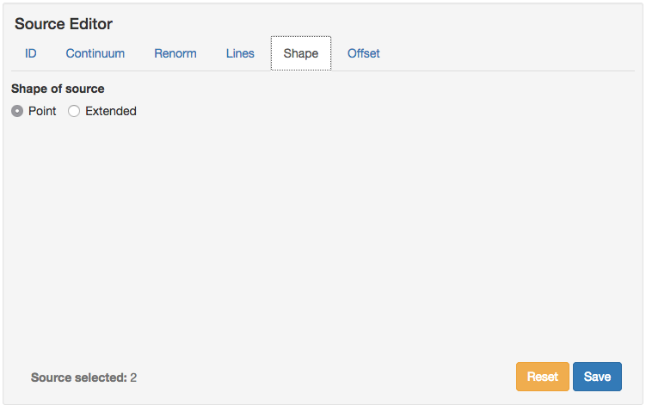
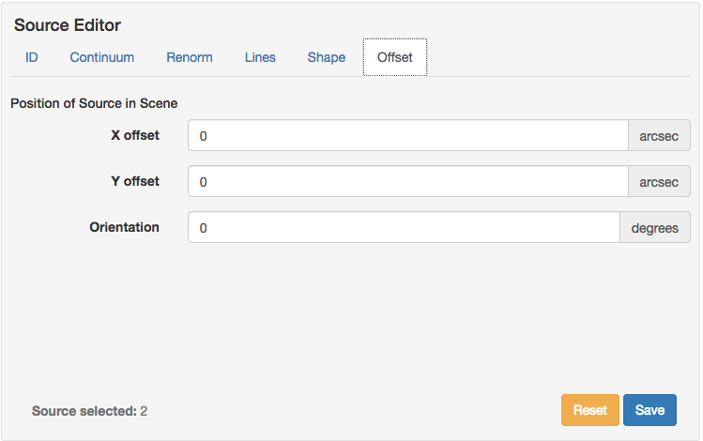
ETC screen shots

Slide 6
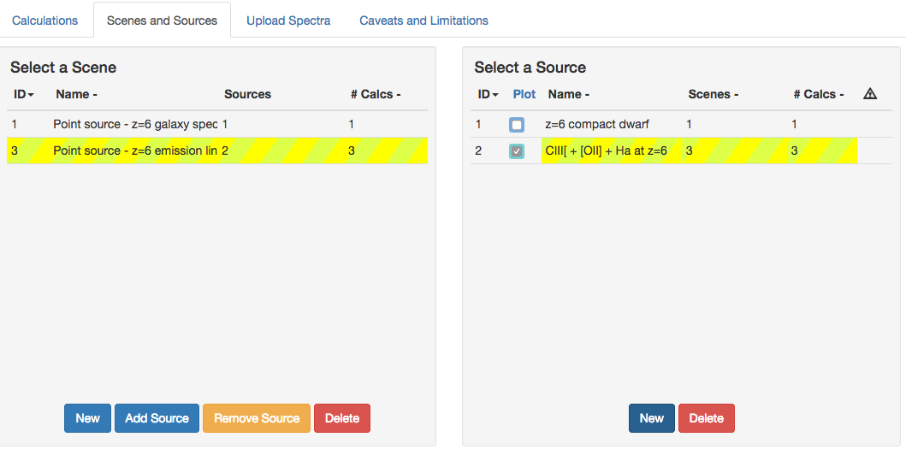
ETC screen shots

Slide 7
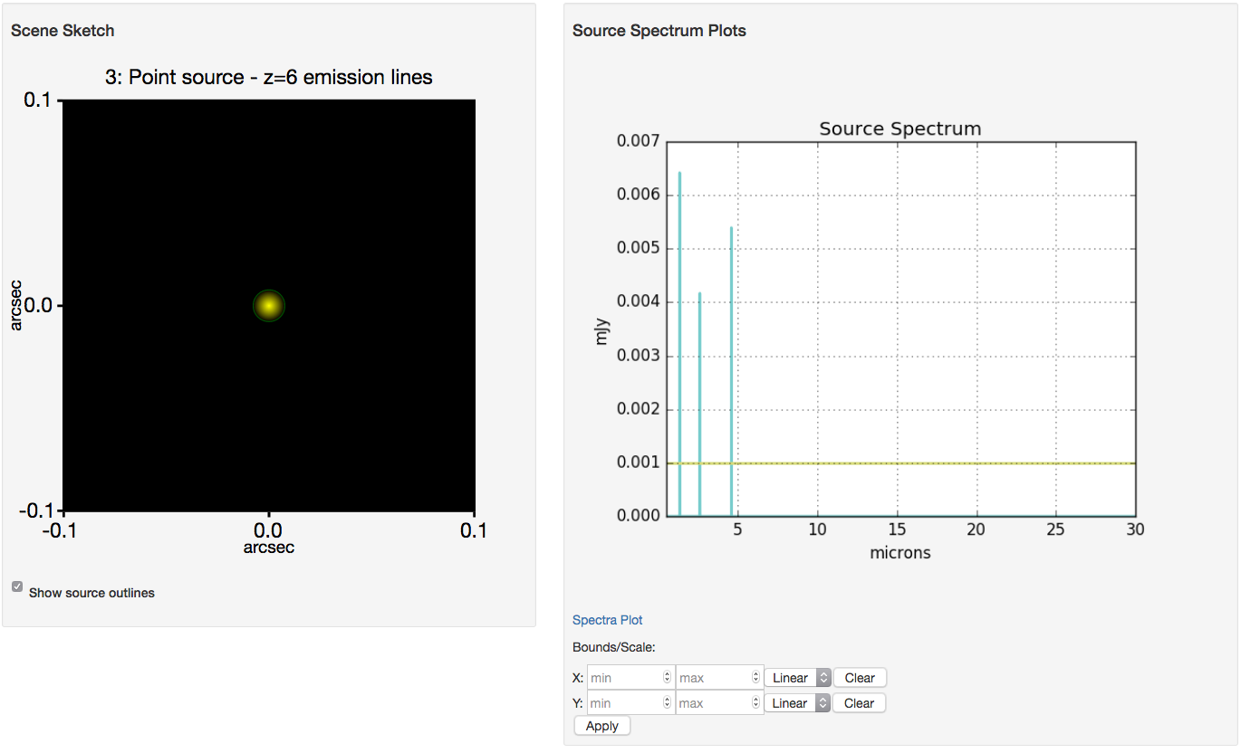
ETC screen shots

Slide 8
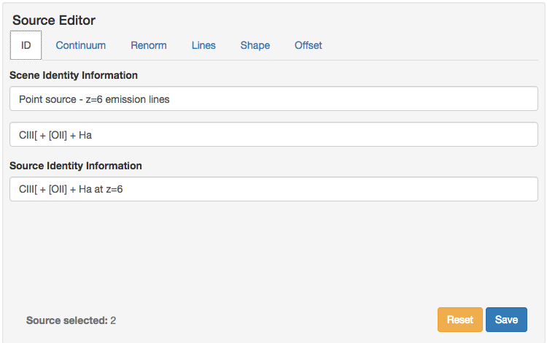
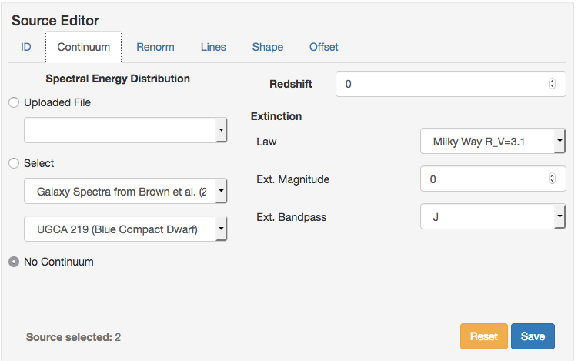
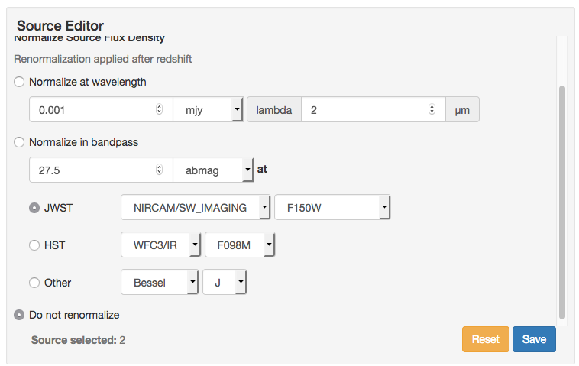
ETC screen shots

Slide 9
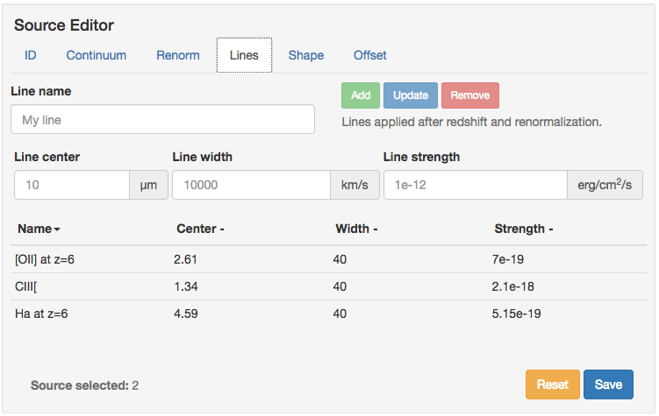
ETC screen shots

Slide 10
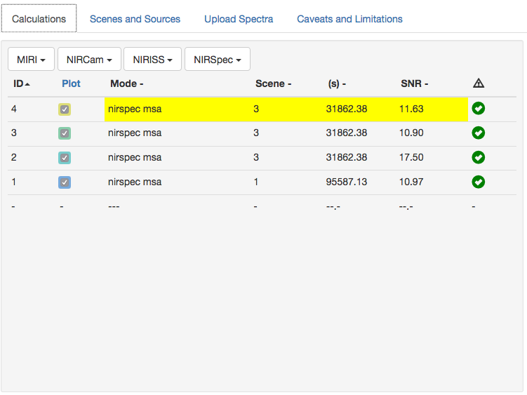
ETC screen shots
Same type of screen shots for computations 4, 3 and 2 (medium spectral resolution configurations F100LP/G140M, F170LP/G235M and F290LP/G395M).
Showing only one of them.

Slide 11
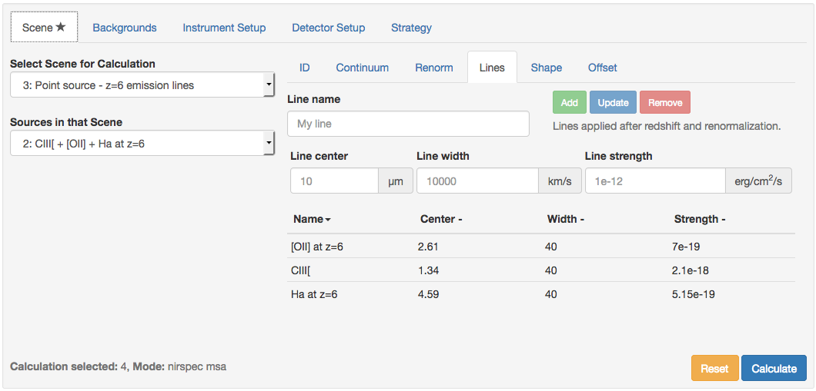
ETC screen shots

Slide 12
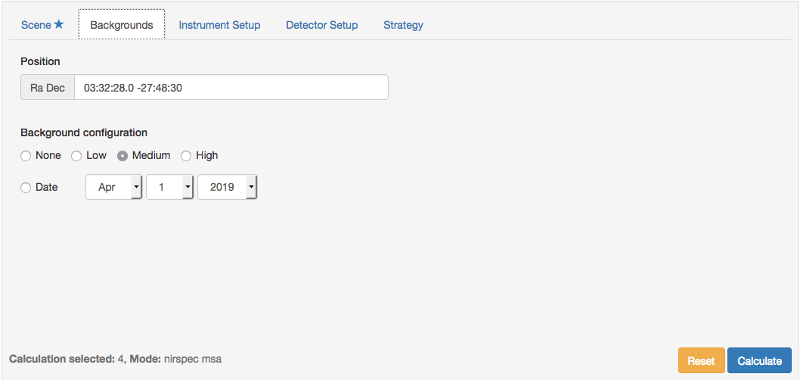
ETC screen shots

Slide 13
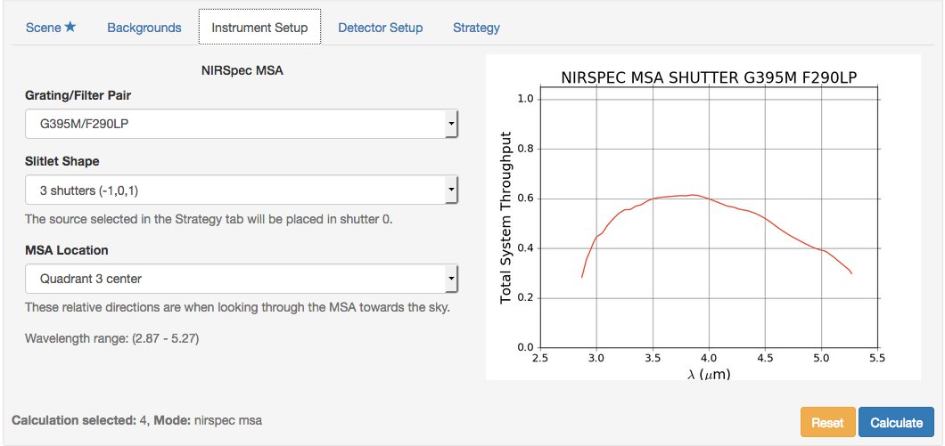
ETC screen shots

Slide 14
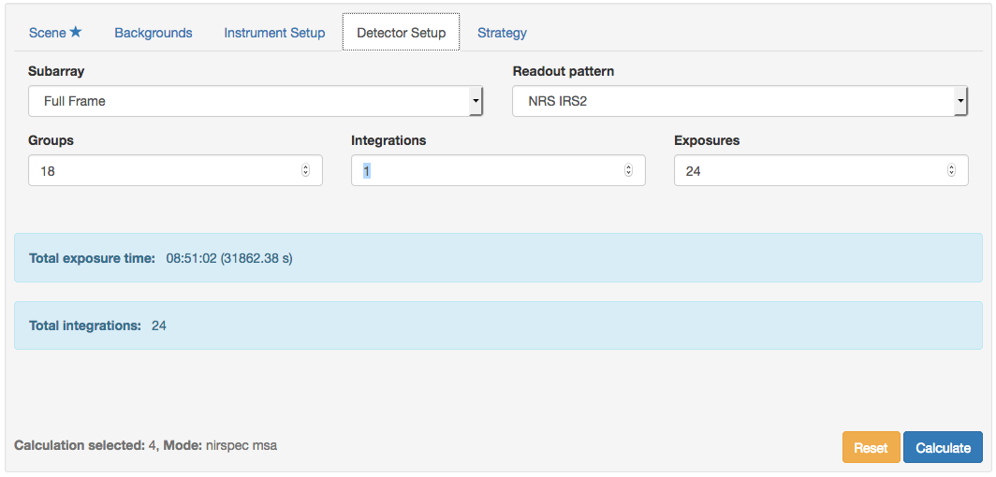
ETC screen shots

Slide 15
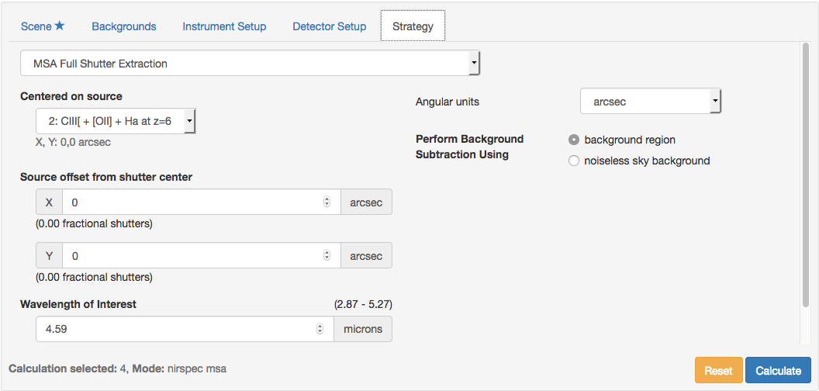
ETC screen shots
CAUTION: the users will likely get a “red flag” for the wavelength of interest when preparing the workbook and will have to change them to a suitable one (the wavelength of the line)

Slide 16
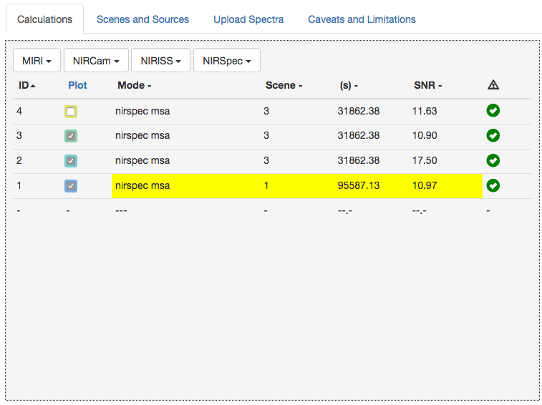
ETC screen shots
CLEAR/PRISM

Slide 17
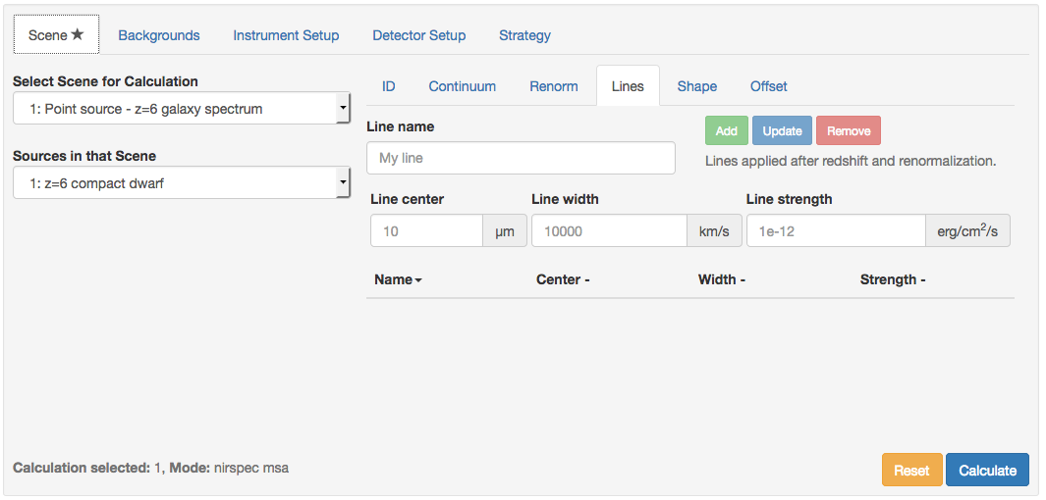
ETC screen shots

Slide 18
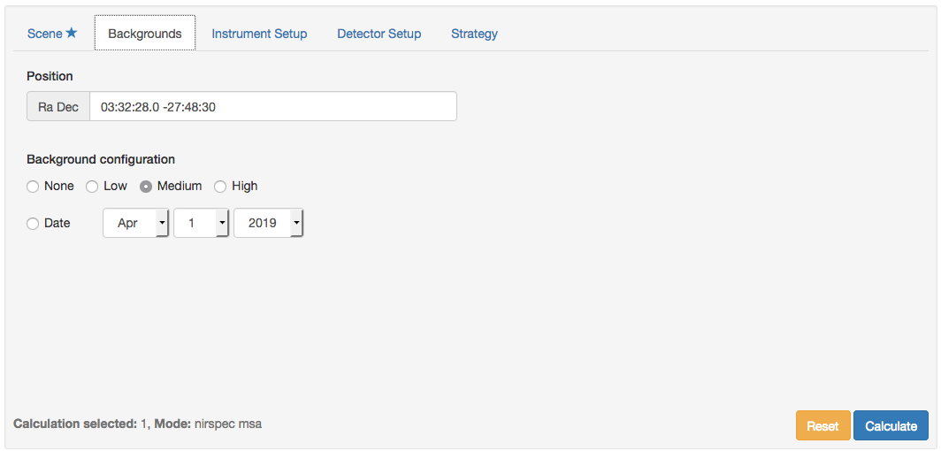
ETC screen shots

Slide 19
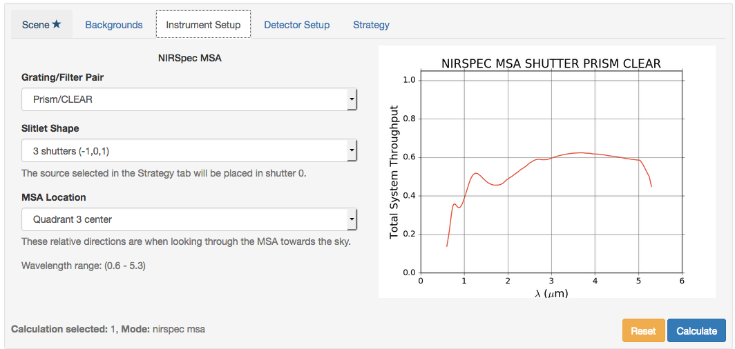
ETC screen shots

Slide 20
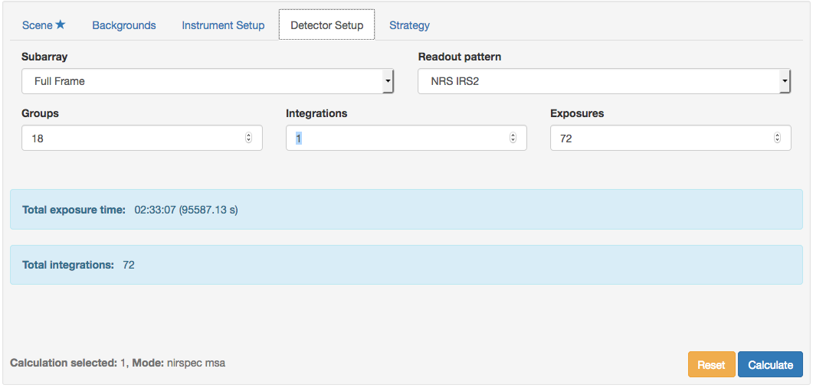
ETC screen shots

Slide 21
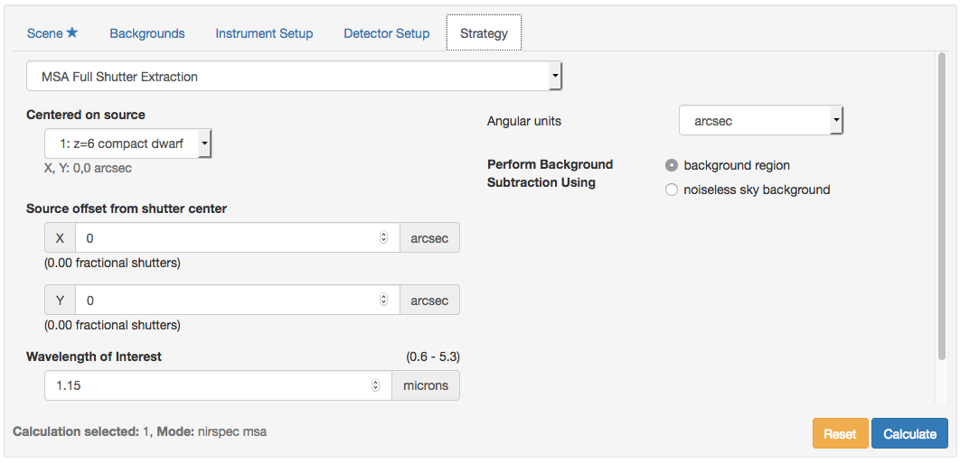
ETC screen shots

Slide 22
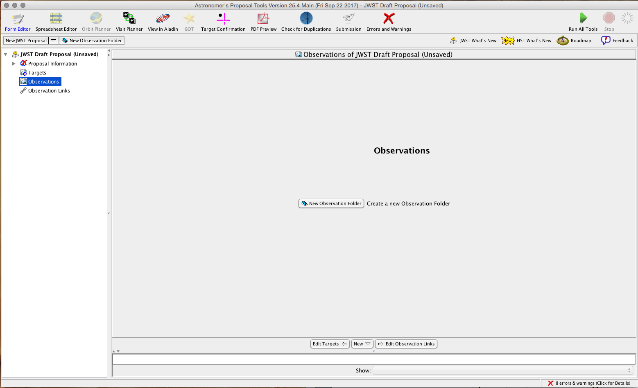
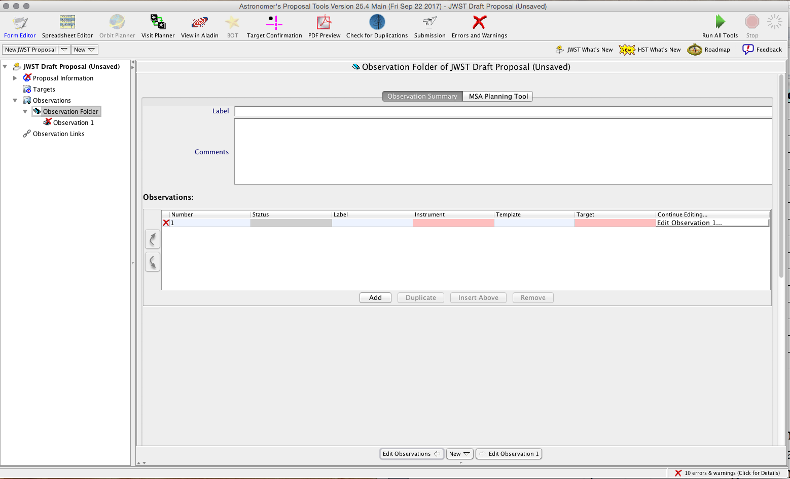
APT screen shots

Slide 23
The structure of the observation…
CLEAR/PRISM
F100LP/G140M
F170LP/G235M
F290LP/G395M
Nodding position #1a
8
3
3
3
Dither position #1
8
Nodding position #1b
3
3
3
Nodding position #1c
8
3
3
3
Nodding position #2a
8
3
3
3
Dither position #2
Nodding position #2b
8
3
3
3
Nodding position #2c
8
3
3
3
Nodding position #3a
8
2
2
2
Dither position #3
Nodding position #3b
8
2
2
2
8
2
2
2
Nodding position #3b
In the APT, the 2s will be replaced by 3s (total of 27 exposures)

Slide 24
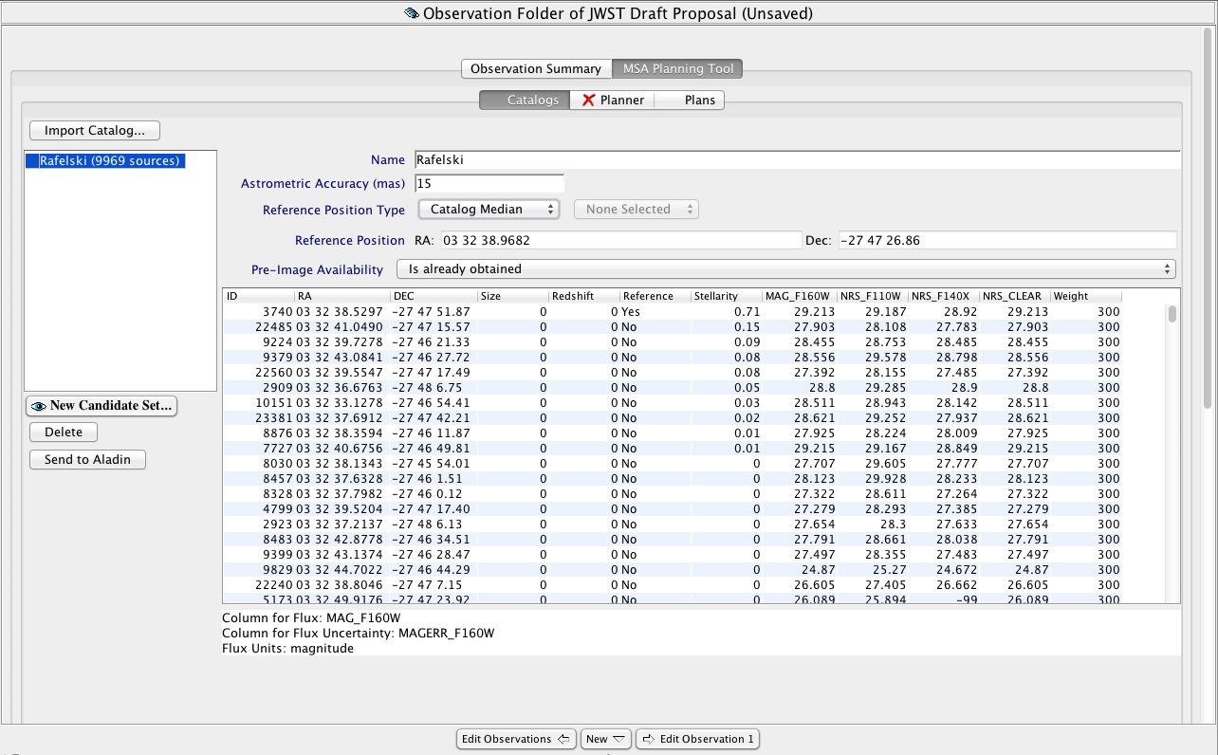
APT screen shots

Slide 25
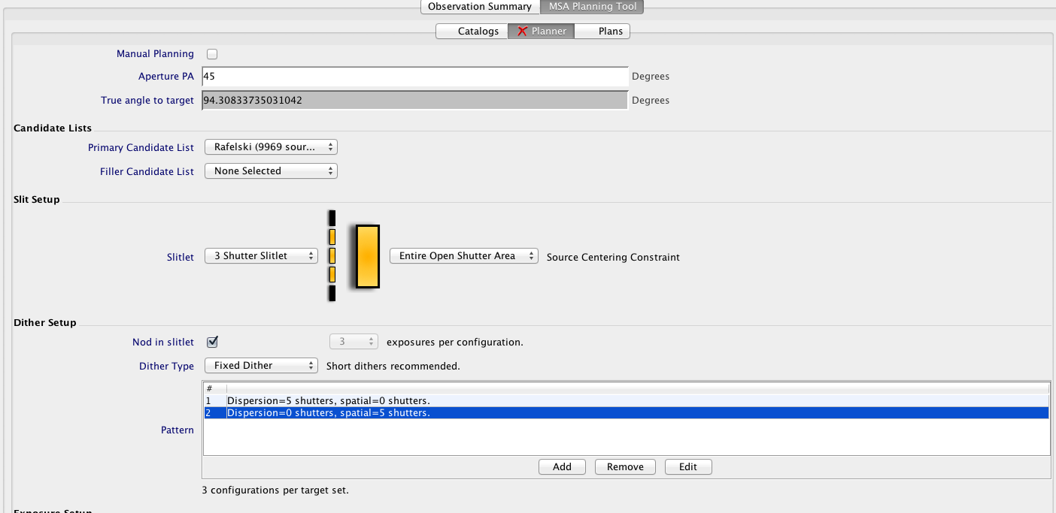
APT screen shots

Slide 26
APT screen shots

Slide 27
APT screen shots

Slide 28
APT screen shots

