Slide 1
SCI-SX Product Assurance
PA Experience with Docker-based Development
ESAC – 06/11/2020
SCI-SX PA Team
Notes:
We wanted to do this tech talk because we have been investigating the use of Docker and we have applied it to a Product Assurance case. Throughout the process we have gained some experience within the PA Team and we think it may be very helpful for missions and projects within SCI-S.

Slide 2

Outline
What is Docker?
Benefits of using Docker
Docker facts
Product Assurance experience
A consequence of our experience
Source: https://www.datadoghq.com/docker-adoption/
Notes:
We will first see what Docker is for those who doesn’t know, which are the benefits of using it
And then we will explain our experience with Docker in the development of a project and what we have made from this experience.

Slide 3
WHAT IS DOCKER?
Notes:
Let’s first see what Docker is

Slide 4
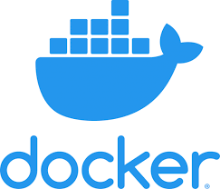



What is Docker?
Notes:
Docker is mainly a Software development platform and a kind of virtualisation technology that makes easy to develop and deploy applications in different hosts, like Windows, Linux and MAC Operating Systems.
Applications run the same no matter where they are or what machine they are running on and without any compatibility issues, always that they are inside Docker containers. We will explain what a container is later, but
This basically means that the application stays system agnostic, making software simpler to use, requires less work to develop and is easy to maintain and deploy.

Slide 5
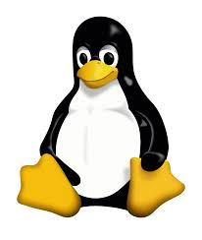
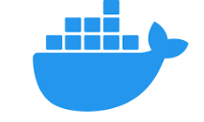
What is Docker?
Notes:
Let’s say you have the docker engine running in your machine.
Docker allows to deploy containers. Containers are basically units packaging applications and dependencies inside.
Basically, everything that an application needs to run.

Slide 6
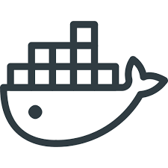
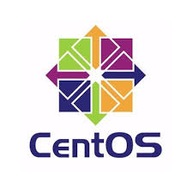
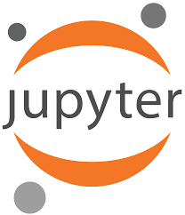
What is Docker?
Notes:
For instance, you can run a container with a Linux OS like Cent OS and a Jupyter platform inside, so you can run your own Jupyter notebooks.

Slide 7
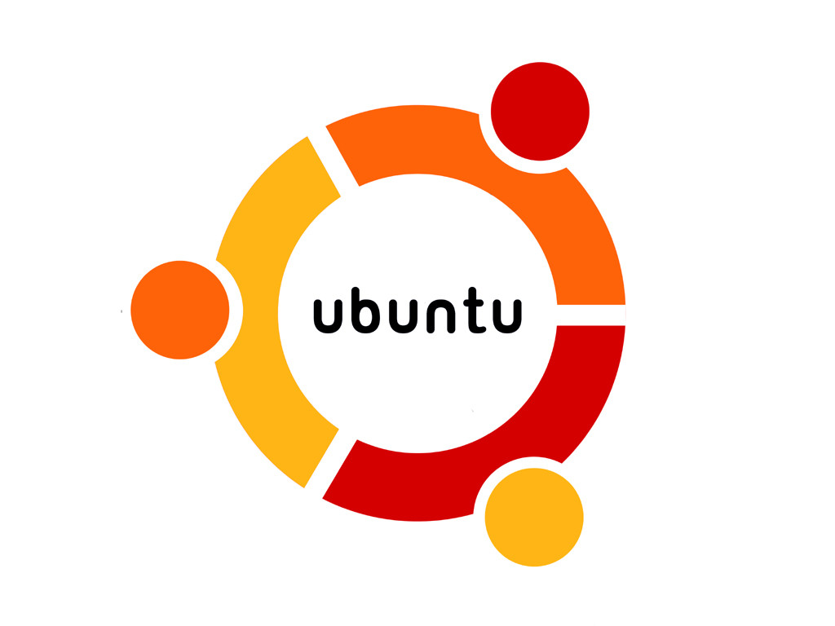
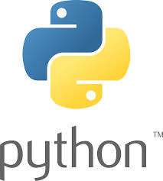
What is Docker?
Notes:
But you can run multiple containers with different applications in the same machine.
Let’s say you run another container with a PostgresSQL database inside that contains some scientific data that you want to analyse, but this can only run in Ubuntu for some reason.
So you deploy another container with that database. And then, you make both containers to communicate between them, so you can access your data from the Jupyter notebook.
You can have both containers with different operating systems working in the same machine and talking to each other.

Slide 8
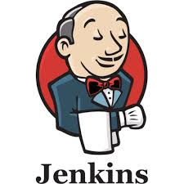

What is Docker?
Notes:
And then maybe you launch a third container that will run some tests and analyse the code according to some programming rules.
And, for this, you run another container with Jenkins and SonarQube, which are tools that we typically use in ESAC projects.

Slide 9
What is Docker?
SHARED RESOURCES
Notes:
All these containers act like little micro computers, each with their own operating system and their own isolated CPU, memory and network resources.
And because of this, they can be easily added, removed, stopped and started again without affecting each other or the host machine.
You may say that this is like having virtual machines. I'm sure many of you have had cases in which you needed to run a virtual machine for a specific application.
However, unlike virtual machines, the container resources are shared directly with the host machine. This allows to quickly run many containers, while only a few VMs can usually be run.
This is because a VM runs a full operating system, and is expensive in terms of resources. Docker communicates directly with the system kernel, and this is why it can run the same in almost any operating system.
I don’t want to go into very technical details but basically this means that Docker uses less disk space, runs faster and, as I just said, it is portable to any system.

Slide 10
What is Docker?
Operating System
Notes:
So, just to summarize, with Docker we can work in any operating system supporting it.

Slide 11
What is Docker?
Docker Engine
Operating System
Notes:
The Docker engine will interact with the OS directly

Slide 12
What is Docker?
Application level
Docker Engine
Operating System
Notes:
It will orchestrate different containers with different applications, each of them completely isolated from each other, but communicating through dedicated channels.

Slide 13

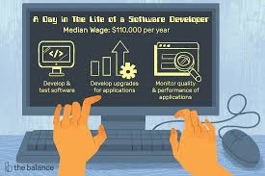
What is Docker?
Application level
Docker Engine
Operating System
From DEV
To OPS
Notes:
And we can do this from Development to Production, so covering the full software production chain.

Slide 14
What is Docker?
build
run
Docker file
Docker image
Docker container
Notes:
How does this practically work for a developer? Well, first, a Docker file is created with basic instructions about the content of the container. This is basically the source code.
From the Dockerfile an image is built, and this is like a binary file.
And, finally, an instance of that image is executed as a container, which will be running in your system as a process.

Slide 15
DOCKER BENEFITS
Notes:
Which are the benefits of using Docker?

Slide 16
Why “dockerize”? (I)
Easy to create, deploy, and run applications
Easy to reproduce and fix bugs
Easy clean app removal
Self-contained packages
Usability
Huge increase in Return On Investment due to the reduced infrastructure needs
Extremely fast: launching containers is as fast as running a machine process
Efficiency
Notes:
There are many benefits of using Docker. First of all, Usability. It is easy to create, deploy and run applications.
In consequence, it is easy to reproduce and fix bugs, easy to clean and remove applications, and provides with self-contained packages
Secondly: Efficiency: because it has a huge return on investment due to the reduced infrastructure needs and works extremely fast, as I mentioned before.

Slide 17
Why “dockerize”?(II)
Standardised environment for development, build, test, and production
Version controlled: straightforward to rollback to a previous version
Consistent environments from development to production
Resources control by isolation and segregation of applications and resources
Eliminates the “it works on my machine” problem
  Less time spent setting up environments
  More reliable and easier to maintain production infrastructure
Portability across different platforms
Maintainability
Reusability
Portability
Notes:
Maintainability and reusability: because it provides a standard environment for all development phases, it is version controlled, provides consistent environments, allows to have a control over resources for each application and eliminates the “it works on my machine” problem.
This problem typically happens in software development when a given application can only be run in one machine and, when installed in another machine, there are problems to make it work.
Finally, it is portable since it can run in different machines having just Docker installed.

Slide 18
DOCKER FACTS
Notes:
Let's now see some facts about Docker, how much Docker is used in the software development industry.

Slide 19
Docker facts
Nearly one quarter of Companies have adopted Docker
Docker now runs on more than 20% of hosts
The average size of a Docker Deployment has grown 75% in one year
The median Docker organization runs eight containers per host
Docker usage rates increase with infrastructure size
Half of Docker environments are orchestrated
Notes:
Nearly one quarter of companies in the SW development sector have adopted Docker
Docker runs in more than 20% of hosts
The average size of Docker deployments has grown 75% in one year
The median Docker organisation runs 8 containers per host
Docker usage rates increase with infrastructure size, meaning that once companies start using Docker, they continue using it
Half of Docker environments are orchestrated, meaning that they are complex Docker environments
So, there must be a reason to use it. And no, I’m not getting money from Docker, I promise, It is really good.
Now, Jose will explain a practical case we have analysed to come to this conclusion.

Slide 20
PA EXPERIENCE WITH DOCKER
Notes:
Thank you Luis.
Good afternoon.
So now we are going to present a PA project and one consequence of it.

Slide 21
PA Quality Data Analysis Improvement
One of the PA Team objectives is to analyse the quality data to identify common problems and areas of improvement
PA is supporting different missions/projects:
  The quality data is isolated
  The main goal of the quality data is to support each mission/projects separately. There is not a common goal.
So… it could be nice to have a single repository to analyse the quality data from all missions/projects supported.
Notes:
The PA Team wanted to analyse quality data of different missions to detect trends, patterns, and important areas of improvement.
But the problem is that the data is isolated in the different missions. So the PA team started a new project to group the quality data of different missions into a single repository.
NEXT

Slide 22
PA Solution:
Cross Mission Quality Product System
AS the PA Team
WE WANT TO have a single repository containing quality data of all missions/projects supported
SO THAT we can analyse it to find improvements applicable to all missions/projects
The characteristics of this system are:
Centralised system for analysis and reporting
Multi-mission and multi-project/repository and
Multi-language support
Independent environment to not interfere with development
Aligned with the different environments
Notes:
The name of the new project is “Cross Mission Quality Product System”, and as we have said, the purpose of it is to have a single repository of metrics to analyse quality data.
One of the main challenges of this project is to manage the heterogeneity of the different development processes: (because) the missions use different programming languages, they have different development practices, and they use different development environments.
NEXT

Slide 23

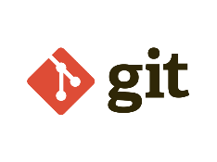


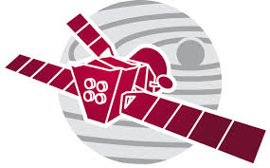
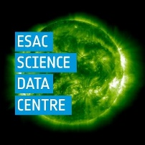

Current configuration of the missions/projects
Solar Orbiter SOC environment
BepiColombo SOC environment
(… and more)
ESDC environment
MAPPS environment
Notes:
So… Currently, the PA solution for obtaining Software Quality Metrics is embedded into the different development environments of the missions supported.
And we need a solution able to manage all these different environments, and here is where Docker can help us.
NEXT

Slide 24
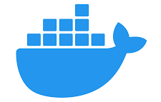
PA Solution:
Cross Mission Quality Product System
(… and more)
Cross Mission
Quality Product
Environment
Notes:
In this new project, we have created a separated environment able to access the existing source code repositories.
NEXT

Slide 25
PA Solution:
Cross Mission Quality Product System
Solar Orbiter SOC environment
BepiColombo SOC environment
(… and more)
Cross Mission
Quality Product
Environment
ESDC
environment
MAPPS SOC environment
Notes:
Also we have encapsulated the different development environments of the missions in Docker containers, isolating them from each other and from the new environment.

Slide 26
PA Solution:
Cross Mission Quality Product System
Solar Orbiter SOC environment
BepiColombo SOC environment
(… and more)
Cross Mission
Quality Product
System
ESDC
environment
MAPPS SOC environment
Notes:
And now we are able to checkout the source code, build and run tests, using a copy of the development environment of the corresponding mission.
Finally, we are able to extract the quality metrics of all those software products, and put them into a single repository.
And that’s it. This is the project…

Slide 27
THE PA DOCKERISED CONTINUOUS INTEGRATION SYSTEM
Notes:
And this has had a consequence… The PA Dockerized Continuous Integration System
NEXT

Slide 28
Outcome of the PA Project:
PA Dockerized Continuous Integration System
As a side effect of the Cross Mission Quality Product System we have created a set of dockerized tools that can support missions/projects in setting up their Continuous Integration environment.
Continuous Integration (CI) is the practice of merging all developers' working copies to a shared mainline several times a day. It doesn’t get rid of bugs, but it does make them easier to find and remove.
Notes:
OK… We are not Amazon and this is not Amazon Web Services… but we have realized that the tools that we have implemented can be used by any mission to set up their development environment.
And what is Continuous Integration?
For those that are not familiar with the concept, Continuous Integration is a software development practice that encourage developers to integrate their code often during the development. The goal is to avoid a stage late in the development dedicated only to integration, where there could appear too many integration problems and there could not be too much time to fix them.

Slide 29
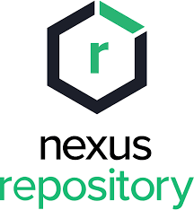
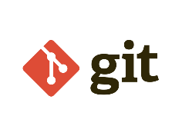
Continuous Integration Tools
2
Jenkins and dev tools
shared environment
3
1
4
Step 1: checkout code
Step 2: build and unit test
Step 3: measure quality
Step 4: release binaries
Notes:
In this slide you can see the tools involved in a simple Continuous Integration pipeline. The pipeline is about: Checking out the source code, Build and run Unit Tests, measure quality and release binaries to a repository. Please note that both Jenkins and the development tools are configured in the same box.
NEXT

Slide 30
PA Dockerised Continuous Integration System
2
Development
Environment
3
1
4
Step 1: checkout code
Step 2: build and unit test
Step 3: measure quality
Step 4: release binaries
  Dockerized development environment: containing all tools and libs needed for development
  Dockerized Jenkins with initial setup (plugins, credentials, LDAP)
  Dockerized Sonarqube with the latest quality models from the PA Team
Notes:
The most significant change that we have introduced is the separation of Jenkins and the Development Environment and we have dockerized them: please remind that it was needed because we wanted to use the same instance of Jenkins to build software of different missions.
So the dockerized tools provided are:
- A box with the development environment that can be used by Jenkins and also locally by developers out-of-the-box.
- An instance of Jenkins that is preconfigured with all plugins needed, LDAP access and the tools needed to configure any credentials needed to connect to other tools… in a secure way.
- And an instance of Sonarqube preconfigured with the quality standards recommended by the PA Team.
NEXT

Slide 31
BENEFITS OF USING THE PA DOCKERISED CONTINUOUS INTEGRATION SYSTEM
Notes:
So… What are the benefits of using these tools dockerized and enhanced by the PA Team?

Slide 32
Benefits of using the PA Dockerised Continuous Integration System
Continuous Integration environment ready to be used
Infrastructure as code
Provided scripts for integrating other tools, managing credentials and also LDAP
Common templates to build software projects
Automated set-up of Jenkins Jobs
PA recommended instance of Sonarqube
Conclusion:
A fully configured Software Build Pipeline (CI) can be started in a few minutes
The development of these tools can be done as a separated software project, from which several missions/projects could benefit
Notes:
With these tools we have:
A Continuous Integration environment ready to be used. It can be easily set up for development. But it can also be started in parallel in a different environment: for debugging any error, for the development of improvements to this framework, to test an upgrade of Java or Python… whatever.
It is possible because we manage the infrastructure as code. And this practice is mainly that the infrastructure is declared in files, that can be executed by other tools, avoiding manual interaction. These files can also be included in a version control system. The added value of this practice is that it reduces the costs of setting up the infrastructure (in terms of people and effort needed) and it is faster. And it also removes the risks associated with human errors like manual misconfiguration.
Another point, the PA Team has added scripts to integrate other tools, to manage credentials, and also LDAP. BTW… now, we have the knowledge to configure programmatically any plugin of Jenkins that you may need.
We also provide a set of templates for building software products. Imagine that you have hundreds of software products: you may want that all of them are built in the same way.
We also allow the creation of Jenkins Jobs programmatically: those hundreds of software products that had a common way to build, have to be added manually to Jenkins. What we say here is that we have also a solution to automate this.
Finally, we also provide an instance of Sonarqube already configured with the recommendations of the PA Team.
In summary:
We provide a fully configured Software Build Pipeline that can be started in a couple of minutes.
And the development of these tools can be done in a separated project, from which several missions or projects could benefit.

Slide 33
Common system
Mission 1
Development Environment 1
Mission 2
Development Environment 2
Mission N
Development Environment N
Same tools but separated configuration per mission/project
Notes:
So, we know the culture of ESAC. We know that missions and projects like standards but they also like the flexibility of taking their own decisions. This is something that has always been encouraged from the PA Team.
And here, what we propose is, for the missions and projects that may be interested, an scenario in which they can share the same tools, the same software development practices, and a common way to build software, but in different environments and with different configurations according to each mission or project needs.
Aaaaand… That’s it!
Now, I give the floor to Luis for an announcement.

Slide 34
Training announcement
PRODUCT ASSURANCE TRAINING:
DOCKERISED CONTINUOUS INTEGRATION SYSTEM FOR SCIENCE MISSIONS
ONLINE – 25th of NOVEMBER
Notes:
Now, here it comes the announcement.
We will be organising a training called PA Dockrised Comtinuous Integration System for Science Missions on the 25th of November.

Slide 35
Training announcement
Objective: How to use a Continuous Integration Dockerised environment and get knowledge to Dockerise your own applications
Prerequisites: check registration page
Date: 25th of November
How: online, including explanation and practical exercises
Attendance: first 15 people registered (more sessions will be organised if needed)
Duration: 1 day
Agenda:
  Training introduction
  Set up training environment
  How to create a development environment with Docker
  How to set up a Continuous Integration environment with Docker
Notes:
The objective of the training is to explain how to use a Continuous Integration Dockerised environment and get knowledge to dockerise your applications.
It will have some recommended pre-requisites, please check the registration page for this.
It will be organised, as I said, on the 25th of November,
will be performed online, including different explanations, examples and practical exercises.
Up to 15 people will be able to attend the training, but more editions can be organised later if required.
The duration of the training will be 1 day
and the Agenda includes an introduction with the presentation of the system Jose just mentioned, a basic setup for the training, instructions on how to create a development environment using Docker and, finally, a dedicatd part for setting up a CI environment using Docker.,

Slide 36
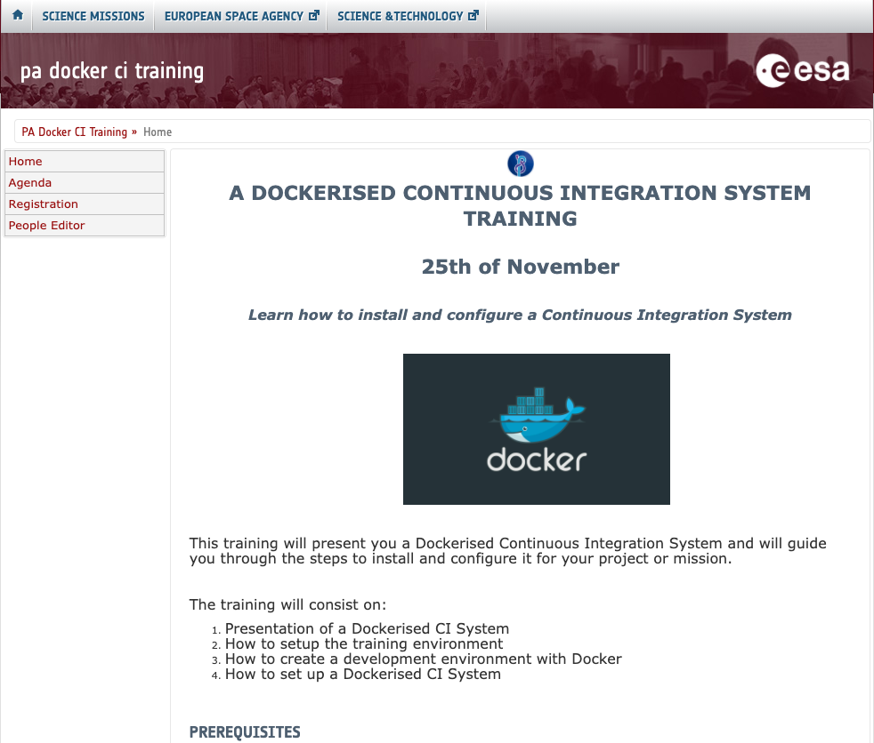
Training Registration – Registration page
Notes:
This is an image of the registration page, with the URL.
We will send an e-mail very soon to the whole SCI-S.

Slide 37
PA Support to SCI-S Missions
The system presented here has been fully developed by the PA Team
It will be explained in detail during the Training
It is available for science missions
Support with installation and configuration can be provided to missions with PA Support
Notes:
And, finally, just to summarise some ideas we want to communicate during this tech talk:
The system presented has been fully developed by the PA Team
It will be explained in detail during the Training
It is, of course, available for SCI-S missions and projects
And support with installation and configuration can be provided to the missions with PA Support

