Slide 1
History of Rosetta
Gerhard Schwehm, ESA (retired)
Philae Landing, 10th Anniversary Event, ESA-ESTEC, 12 November 2024

Slide 2
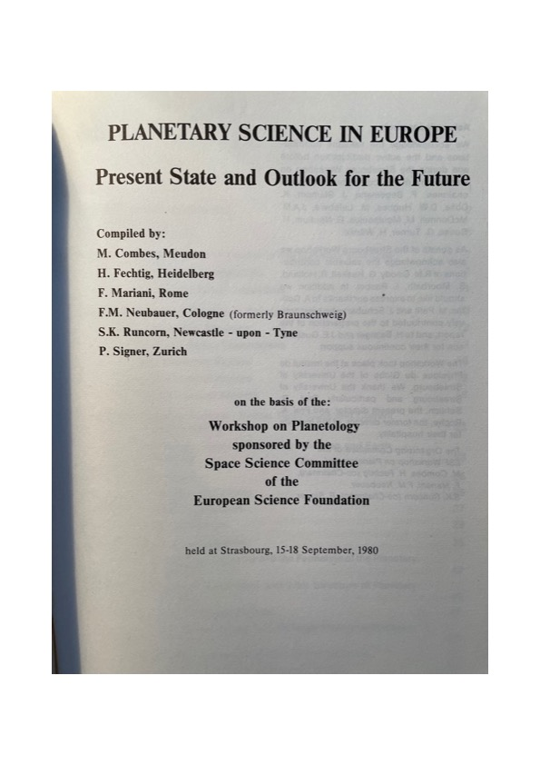
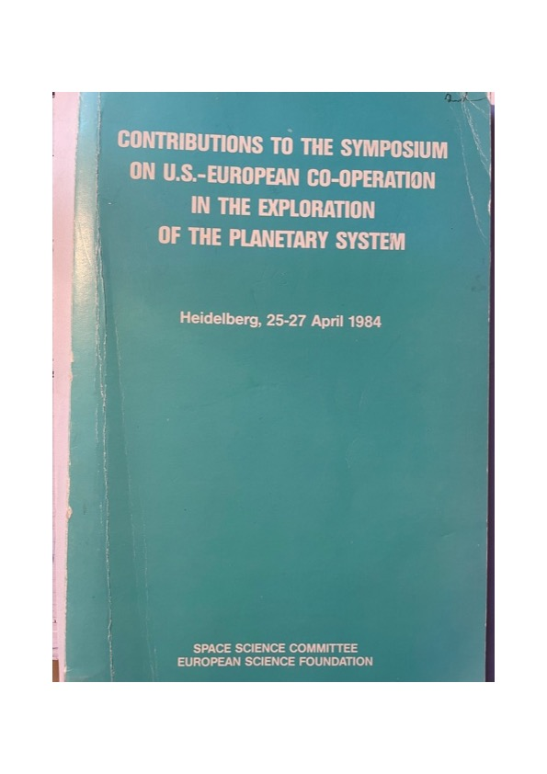
In the early 1980‘s there was a spirit of optimism among the European Planetary Scientists:
We wanted our own planetary missions.
We were convinced that we had the technical and scientific capabilities to lead exploration missions.
One should keep in mind that in the early years the Agency had explicitely stated that it would not embark on interplanetary missions.
Ulysses changed that and –of course- Giotto

Slide 3
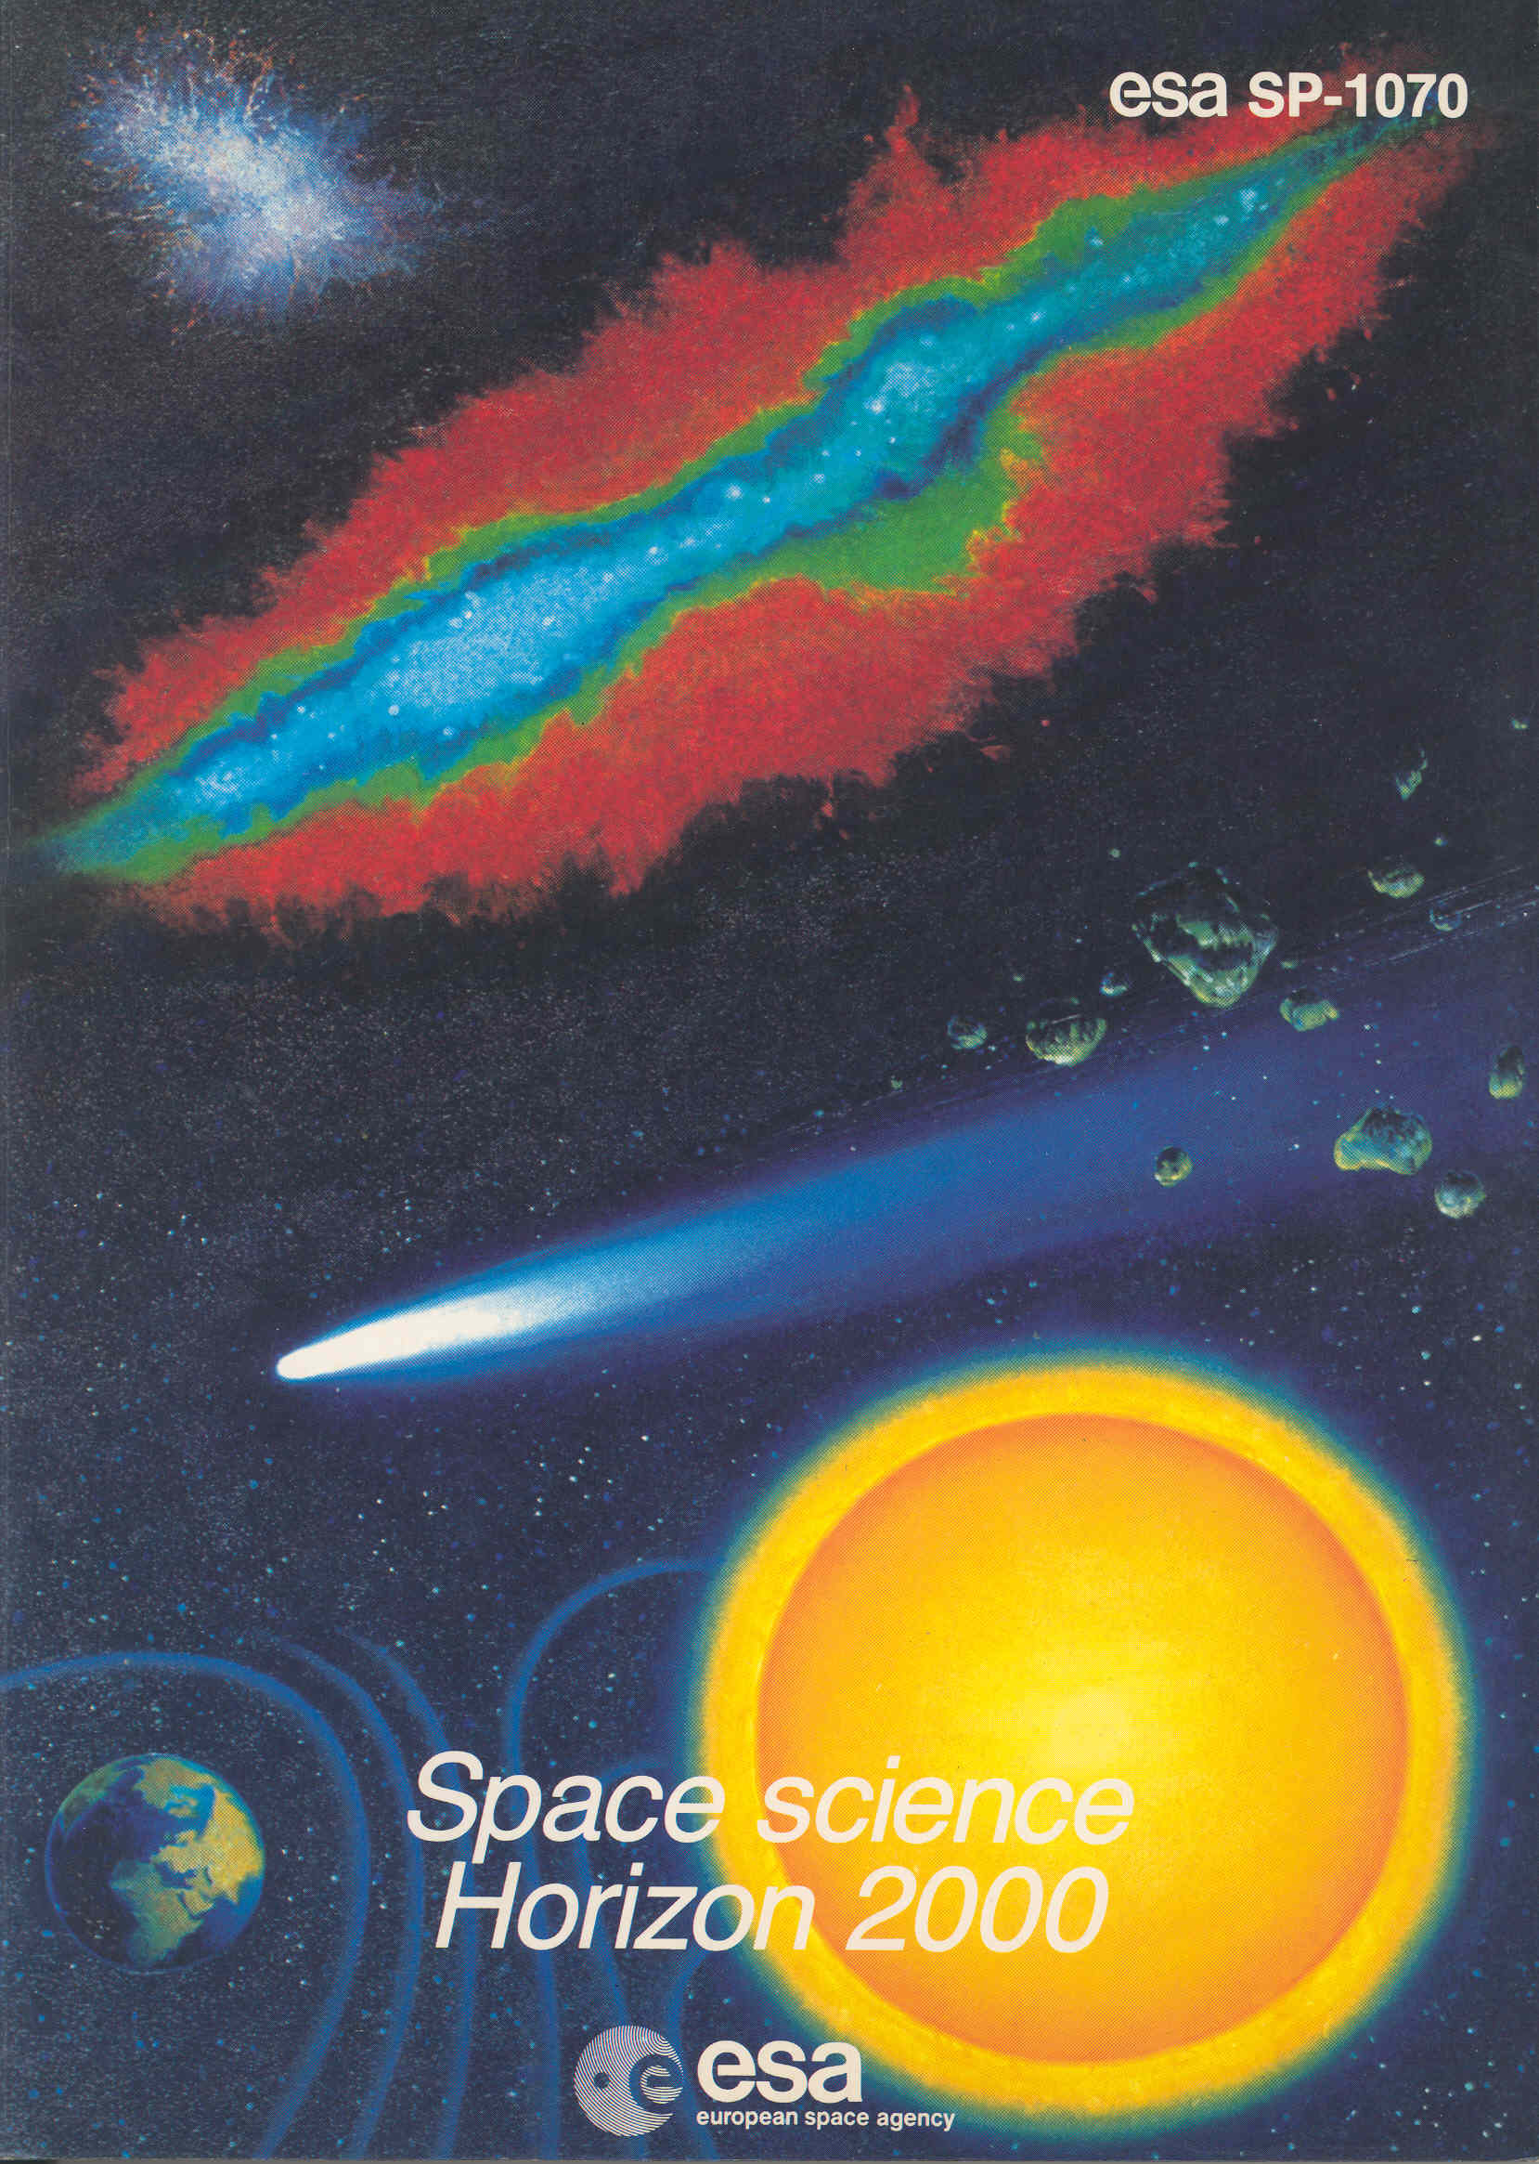
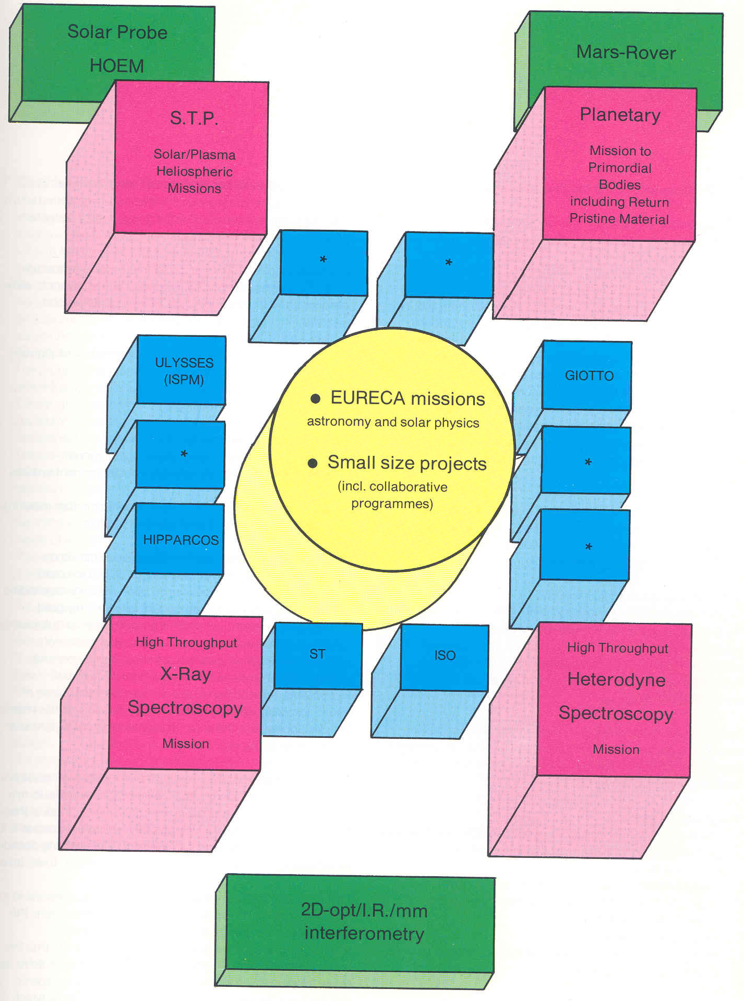
For the ESA science programme the big change came 40 years ago: Space Science Horizon 2000

Slide 4
Space Science Horizon 2000 changed everything. Roger Bonnet’s bold idea to implement a long-term programme that
would enable the European Science Community to develop challenging and complex missions opened the door for planetary exploration.
The story goes that Prof. Johannes Geiss (Univ. Bern) and Prof. Hugo Fechtig IMPK Heidelberg) sketched the idea for a
planetary cornerstone mission on a beer mat. As you can see it found its way into the programme!
What a task and what a challenge for the community!
I could tell the history of Rosetta as a story of my career in ESA:
Around this time 40 years ago I was interviewed for the post of Planetary Scientist in the Space Science Department of ESA.
One of my first tasks was to attend the meeting of the NSF/ESF Primitive Bodies Science Study Group (PBSSG) that was chaired by
Profs. Laurel Wilkening and Dieter Stöffler to define potential collaborations for missions to small bodies.
In May 1985 upon the invitation by G. Haskell – the co-ordinator for solar system missions -,
a small team met at ETH Zürich to prepare a proposal to be presented to the SSWG.
We proposed CNSR, which was accepted by SSWG and a day later approved as candidate for the Planetary Cornerstone.
One can regard 20 May 1985 as the Birthday of Rosetta
The first publication: The Comet Nucleus Sample Return Mission, ESA SP-249, December 1986

Slide 5
For me the first years of development of CNSR were some of the most exciting years in my career.
You have to imagine that we started before anybody had ever seen the nucleus of a comet!
Giotto was to be launched in July 1985, the encounter was 13/14 March 1986.
A lot of new technologies had to be developed
I was Study Scientist for CNSR. Proposed by Eberhard Grün the mission was named Rosetta beginning of 1986.
At the same time I was Deputy Project Scientist for Giotto and in 1986 I had the the pleasure to be Study scientist for CAESAR, a Comet Coma Sample Return proposed by J.A.M McDonnell, Univ. of Kent, who was a member of the CNSR Definition Team.
We had a dedicated budget for Technology Studies and with the TRP programme we could study key enabling technologies: the sampling device – the drill on the Rosalind Franklin Lander has got quite some Rosetta heritage – and for us wonderful trips to Venice; the sample return cannister (for low temp preservation on the return leg), properties of ices at low temperatures, Low-temperature Low-intensity solar arrays, near nucleus navigation, you name it.
Mission Analysis provided the potential mission scenarios, i.e. launch date – target combinations and the mass that could be delivered at the comet, covering a large time interval as we didn’t know the launch date at that time.
It was done for US and European launchers and for chemical and Solar Electric Propulsion Missions. At that time the Agency was developing SEP thrusters, and we had to study, how such an ESA/NASA collaboration could work (e.g. RTGs, sample distribution). For Cassini-Huygens that was much easier: there was a clear interface: ESA provided the probe

Slide 6
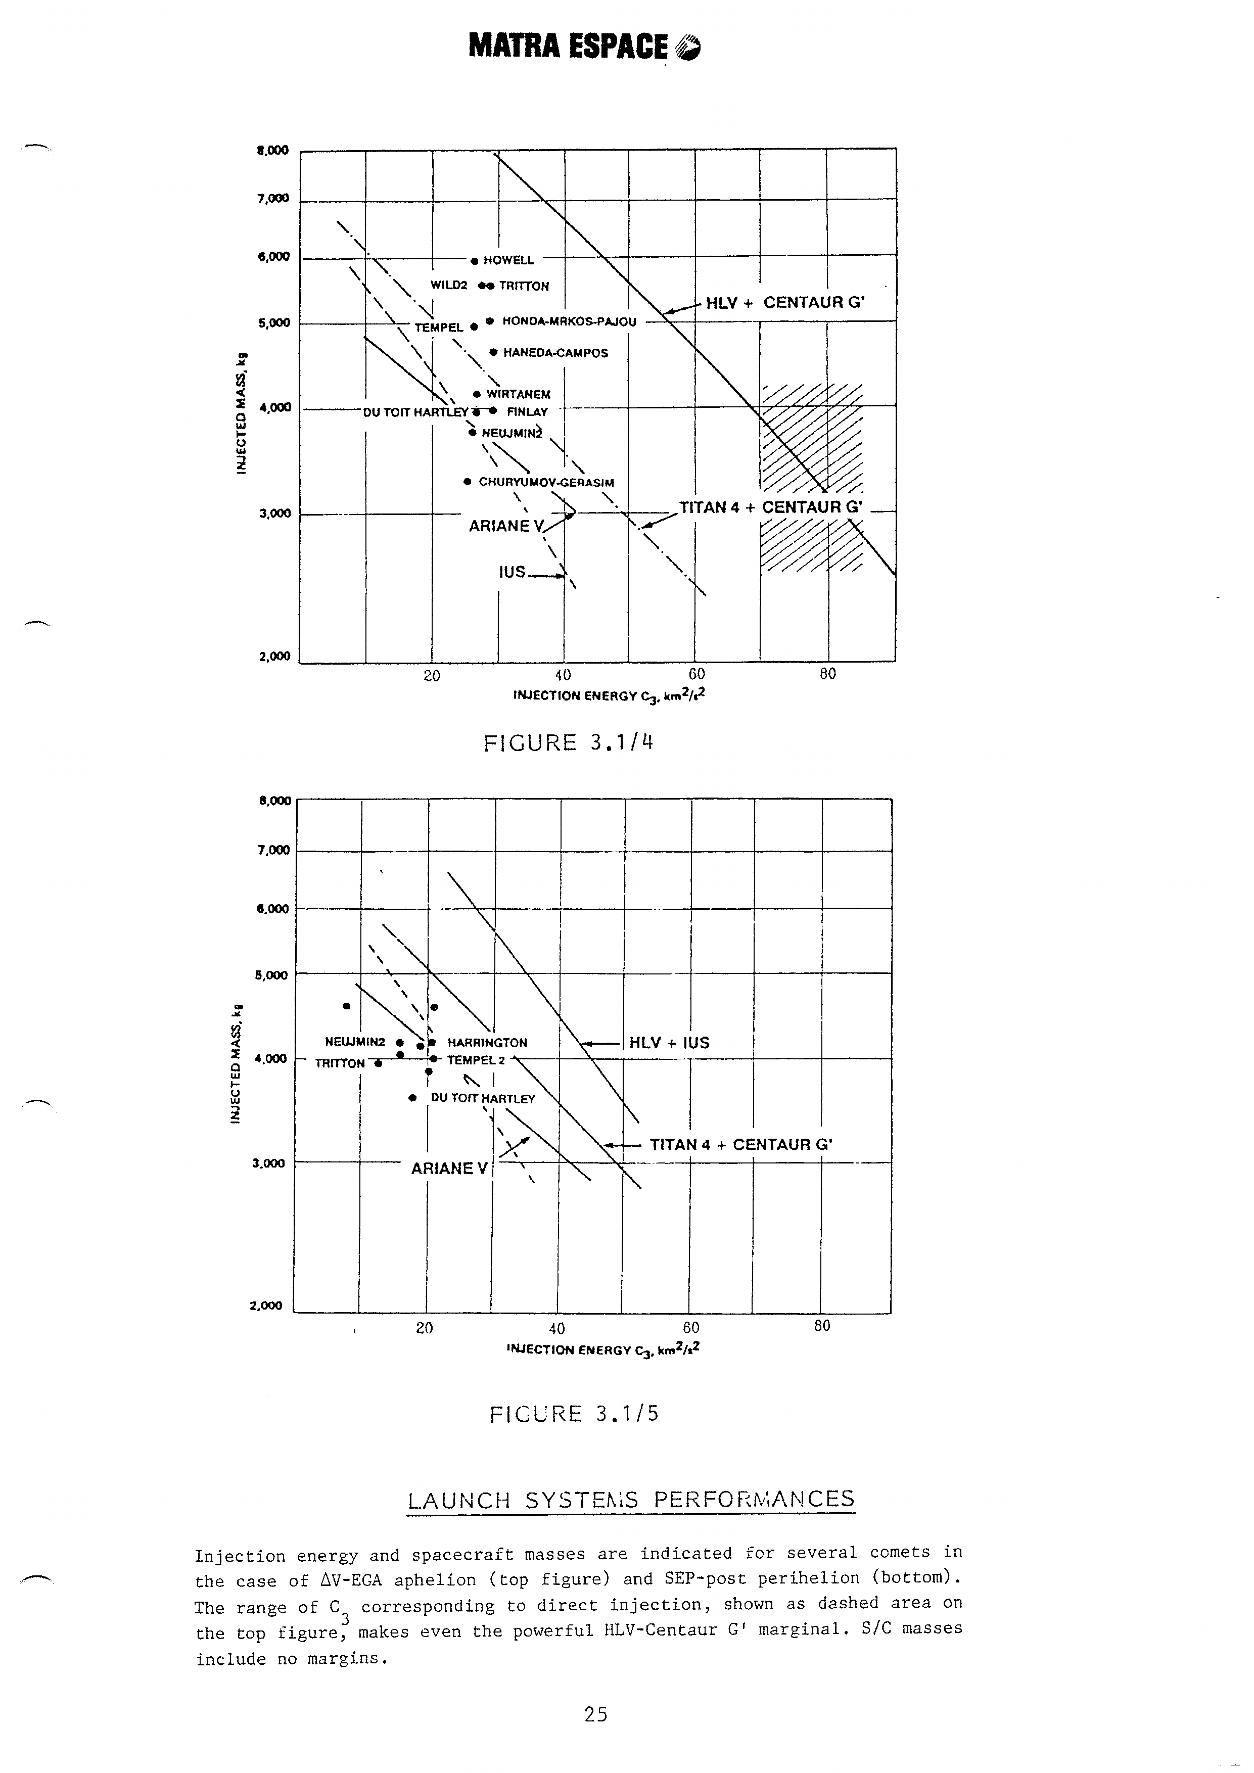
Example for launch system
performance studies.

Slide 7
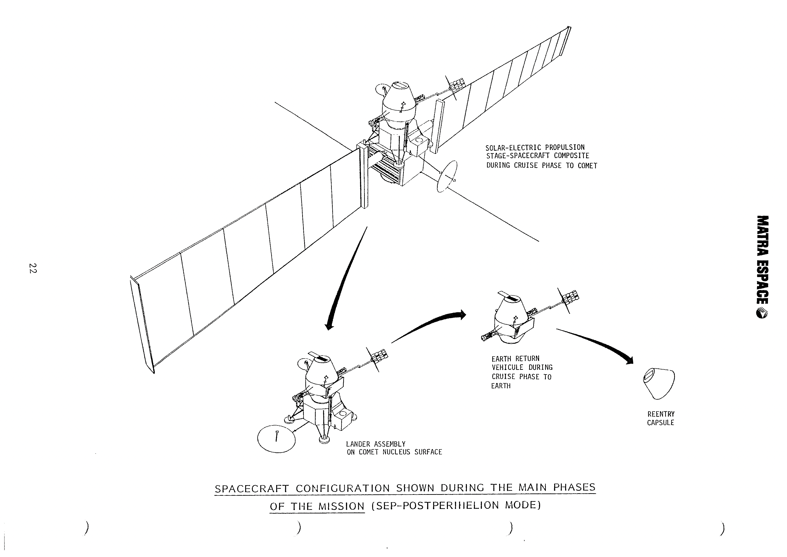

Slide 8
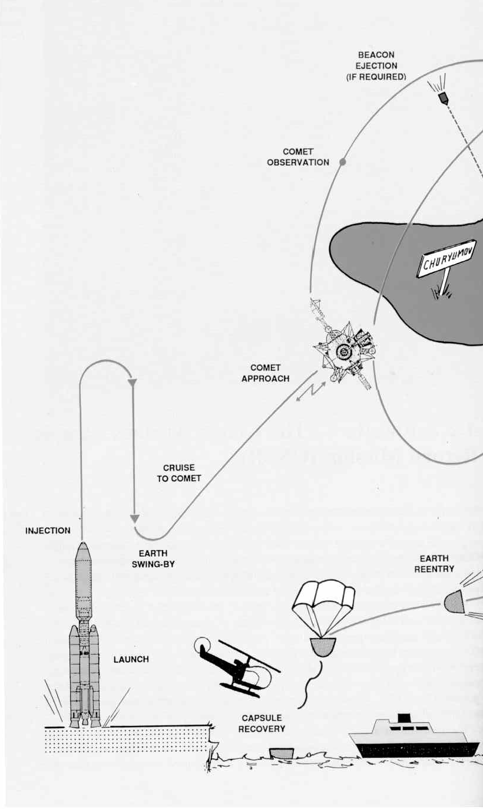
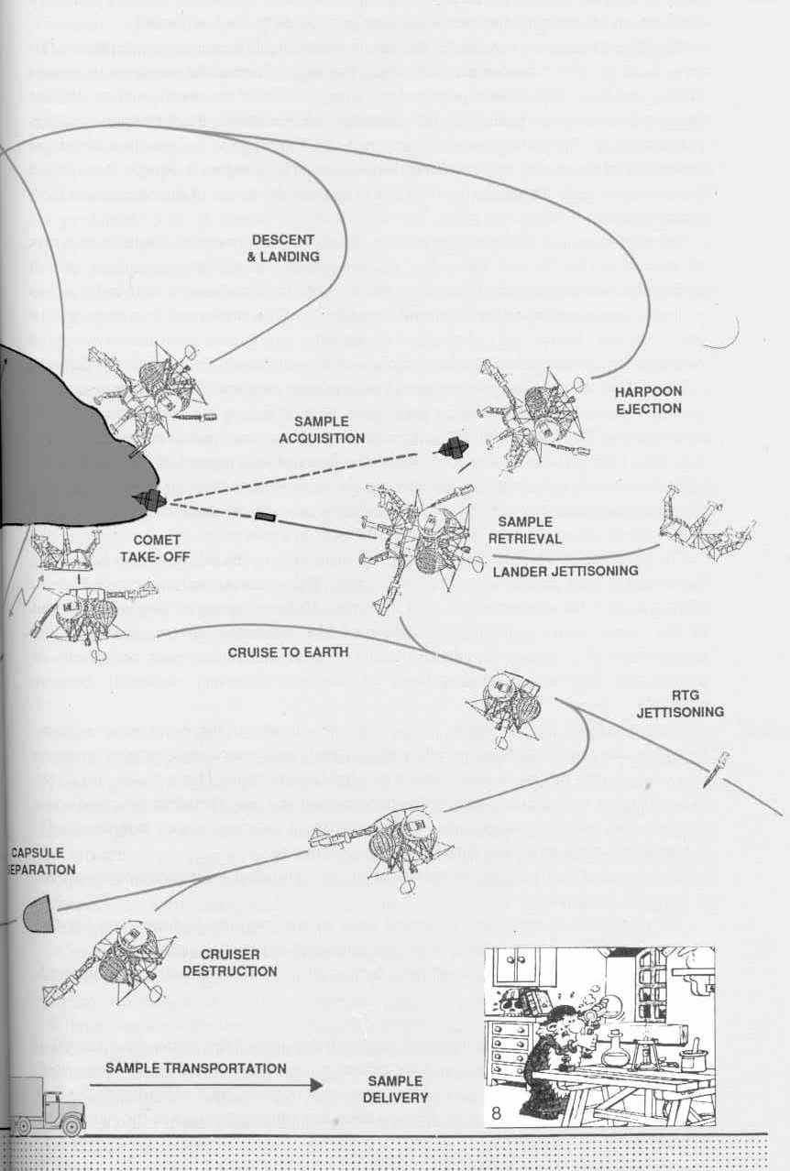
The Comet-Nucleus Sample-Return Scenario

Slide 9
The Members of the CNSR Science Definition Team
European delegation:
E. Grün (Co-Chairman) Max-Planck-Institut fur Kernphysik, Heidelberg, West Germany
F. Begemann Max-Planck-Institut fur Chemie, Mainz, West Germany
P. Eberhardt Physikalisches Institut, Universitat Bern, Switzerland
A. Coradini Istituto Astrofisica Spaziale - CNR, Rome, Italy
M. C. Festou Institut d'Astrophysique, Paris, France
Y. Langevin University Paris-Sud, Paris, France
J. A. M. McDonnell University of Kent, Canterbury, UK
C. T. Pillinger Open University, Keynes, UK
G. Schwehm ESA/ESTEC, Noordwijk, Netherlands
D. Stöffler Universitat Munster, Munster, West Germany
H. Wänke Max-Planck-Institut fur Chemie, Mainz, West Germany
R. M. West European Southern Observatory, Garching, West Germany
U.S. Delegation:
T. J. Ahrens (Co-Chairman) Caltec, Pasadena, California
H. Campins Planetary Science Institute, Tucson, Arizona
D. E. Brownlee University of Washington, Seattle, Washington
S. Chang NASA Ames Research Center, Moffett Field, California
W. Harris JPL, Pasadena, California
G. J. Wasserburg Caltec, Institute of Technology, Pasadena, California
J. A. Wood Harvard-Smithsonian Center for Astrophysics, Cambridge, Massachusetts

Slide 11
In the Executive Summary of Rosetta Comet-Nucleus Sample-Return the SDT stated:
‘Rosetta therefore provides a unique opportunity to address one of the major scientific problems of planetary sciences – the origin of the solar system- while bridging the gap to key issues of modern astrophysics: molecular clouds and their evolution, protostellar nebulae, sources and sinks of interstellar grains.‘
ESA SP-1125 Rosetta – Comet-Nucleus Sample-Return. Mission and System Definition Document, ESA 1991
In 1993 we had to switch from a CNSR to an Orbiter with Lander. Due to programmatic difficulties NASA had to drop out of the joint mission. We claimed (better we had to convince the ESA Advisory Structure) that we would preserve the original objectives of the mission by
‘bringing the lab to the comet instead of bringing the comet into the lab.‘
I.e. the proposed scenario was worth a Cornerstone Mission

Slide 12
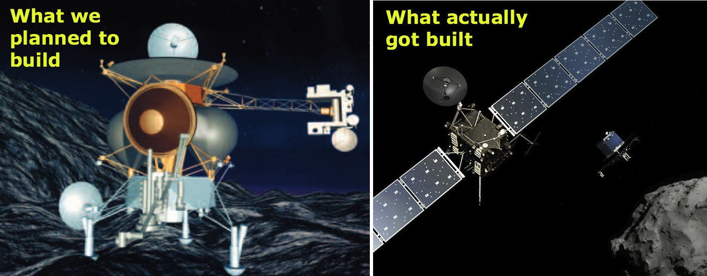
What actually was launched
The first study: a Joint Project with NASA based on the MMkII spacecraft
Rosetta orbiter with Philae lander

Slide 13
The Rosetta Science Management Plan was approved by SPC during its session 7-8 November 1994.
In the same session the new target of the mission, comet 46P/ Wirtanen, was approved.
The AO for the payload was issued in March 1995, the deadline for the proposals was 1 July 1995.
For the SSWG mtg on 10-11 January 1996 I had prepared the paper on the payload selection.
The Independent Peer Review Committee had been chaired by H. Wänke,
NASA had performed its own review, however, participated in the meetings of the ESA team.
We had a ‘normal’ project and worked towards a launch in January 2003
However, it wasn’t so normal, the payload struggled with funding problems, one instrument was withdrawn.
The mission had four Project Managers: John Credland, Bruno Gardini, Michel Verdant, before John Ellwood
joined in 2000.
We managed to be ready in 2002 – but on 11 December 2002 the first flight of the Ariane 5 ECA failed.
We had to redefine the mission scenario.
Thanks to the prior work by M. Hechler a new mission scenario with 67P/ Churyumov-Gerasimenko as
target could be presented within a couple of weeks.
The new mission scenario was approved by SPC already in February 2003.
Off we were for the launch on 2 March 2004

Slide 14
There were a couple of events that had negative impact on the mission development that are worth mentioning:
The Challenger disaster on 28 January 1986 ( we got the news when we were about to start the 2nd SDT meeting in Caltech)
The Ariane 5 failure on 4 June 1996 with the four Cluster S/C and its impact on the ESA science budget.
We overcame these obstacles and Rosetta became a mission you all can be proud of.

