Slide 1
Coordinating observations among ground and space-based telescopes
Erik Kuulkers
INTEGRAL Project Scientist
European Space Agency (ESA)
ESTEC, The Netherlands
SciOps2019
Notes:
I am the Project Scientist of ESA’s gamma-ray observatory INTEGRAL, and often involved in coordinated observations with facilities in space and on the ground.

Slide 2
On behalf of:
Matthias Ehle, Carlos Gabriel, Aitor Ibarra, Peter Kretschmar, Bruno Merín, Jan-Uwe Ness, Emilio Salazar, Jesús Salgado, Celia Sánchez, Richard Saxton
(ESAC/ESA, Spain)
SciOps2019
Notes:
The ideas about improving coordination presented in this talk did not came from me alone. We are a group of people at ESAC, Spain, the one in bold is pulling the truck.

Slide 3
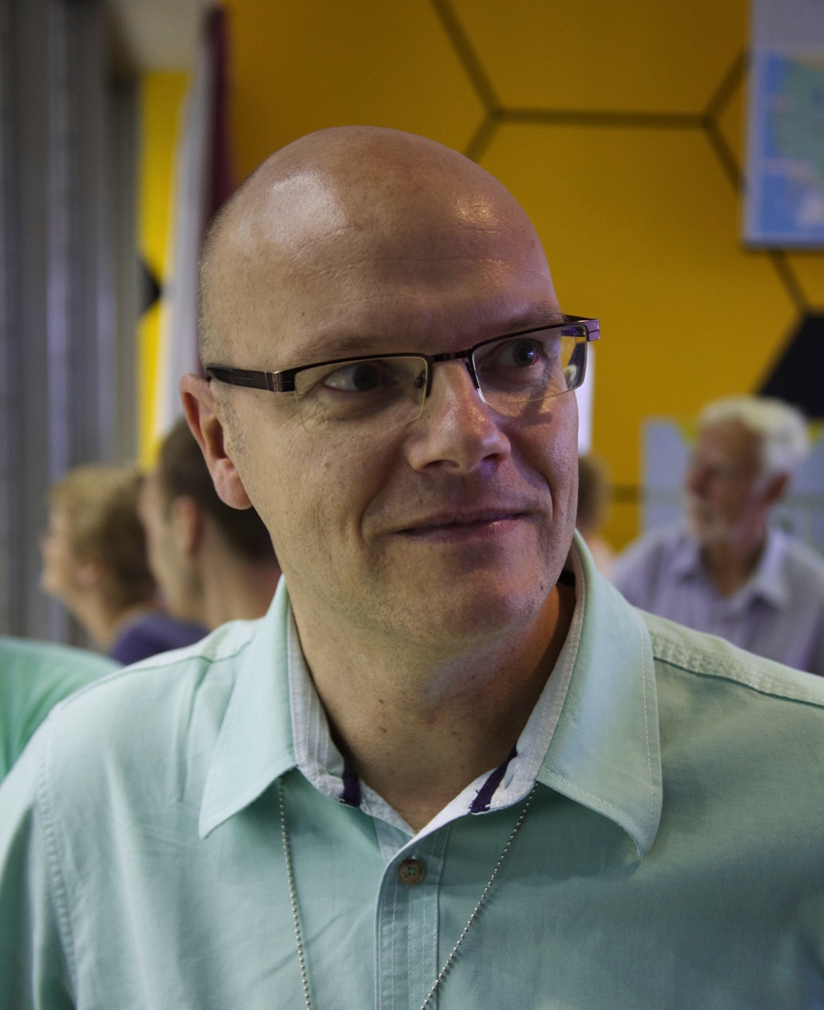
20 November, 2019. A Wednesday….
Presentation outline:
Coordinating observations: the old way
Some like it hot: multi-messenger
Coordinating observations: the new way
Conclusions
SciOps2019
Notes:
I will present to you how we did coordination in the past. Then I move to the new astronomies, and show how we envisage coordination in the future.

Slide 4


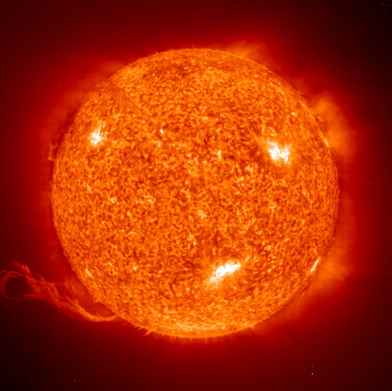

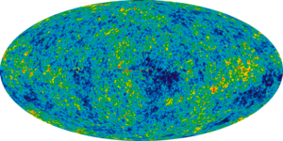

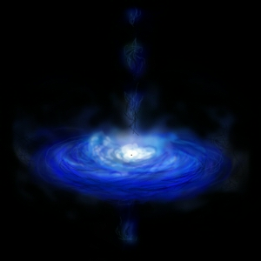
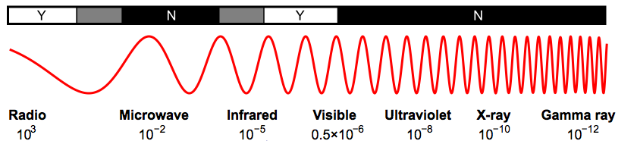
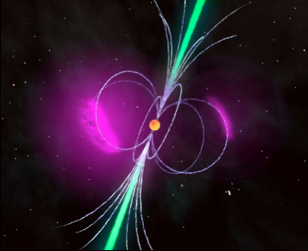
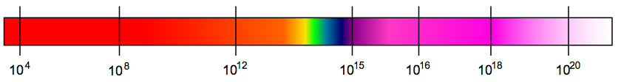
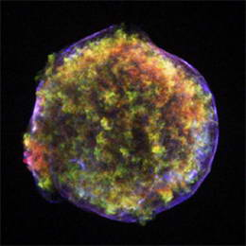
The electro-magnetic (EM) universe
Dark Nebula
Dim, young star
Our Sun
Globular Cluster
CMB
Accretion
Wavelength (m)
Relativistic acceleration
Frequency (Hz)
Explosions
Notes:
At each wavelength (or frequency) observing a particular window to the universe.
There is an increasing demand in coordinating observations in different wavelengths. Why is that?

Slide 5
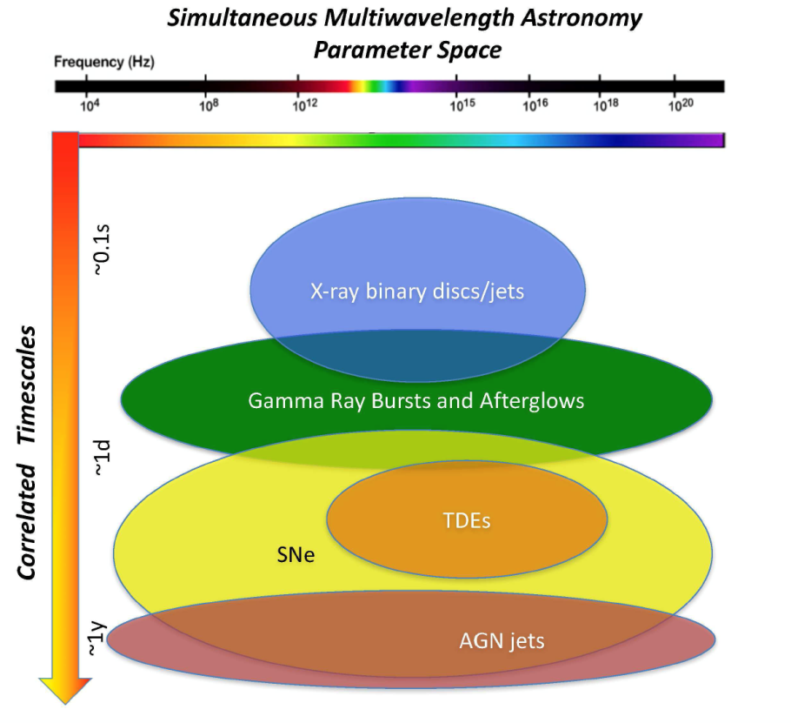
Time-Domain multi-wavelength (EM) astronomy
Increasing interest to simultaneously observe same target at different wavelengths at various time scales
Some numbers:
  XMM-Newton: ~12% of observations are coordinated with other observatories (e.g., NuSTAR, HST, Chandra, VLT, Swift)
  INTEGRAL: ~10%
  NuSTAR: ~30%
e.g., Middleton et al. 2017, New Astronomy Reviews
Notes:
Various objects in the universe not only emit at different wavelengths, but also show variability on different time scales. Examples are X-ray binaries, gamma-ray bursts, tidal disruption events, supernovae.
There is not only increasing interest to simultaneously observe the same target at different wavelengths. Various sources vary on different time scales.
Here are some examples: about 12% of XMM-Newton’s observations are coordinated with other facilities. For INTEGRAL the number is about 10% and for NASA’s NuSTAR it is about 30%.

Slide 6
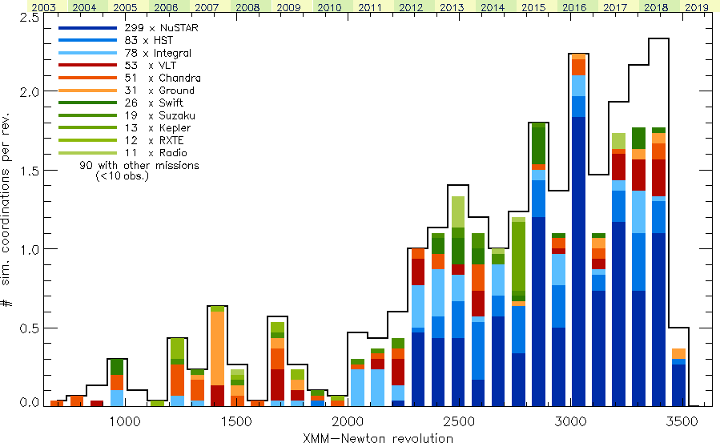
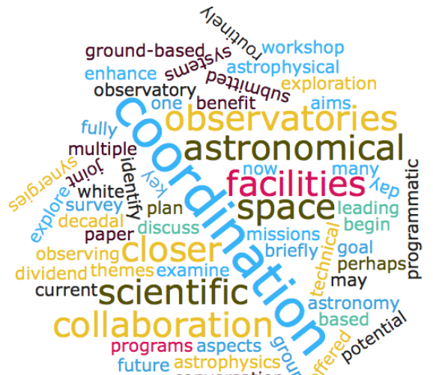
Coordination: XMM-Newton
2003
2019
Notes:
The interest in coordinated observations has increased over the years. Here’s an example for XMM-Newton. To manage these observations you need clear coordination, as well as communication

Slide 7
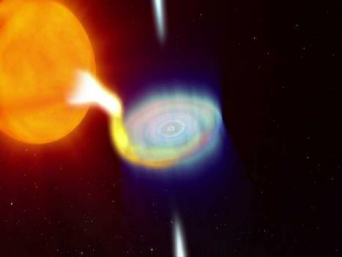
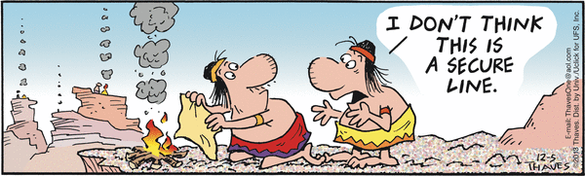
Coordination in the old days - example
June 2015:
V404 Cygni / GS2023+338 “Wake-up” of black-hole binary transient after 26 years being dormant
8−10 M BH + ~0.6 M K-giant
Orbital period ~6.5 days
Closest black-hole binary @ 2.4 kpc
Notes:
How did we do coordination in the old days? I will show you an example.
In June 2015 something happened what many astronomers were waiting for. The closest black-hole X-ray binary transient became active again.

Slide 8
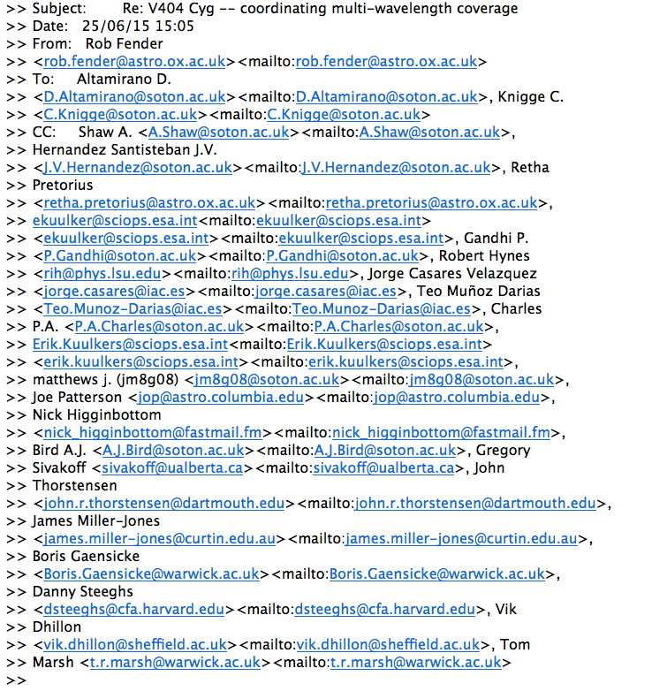
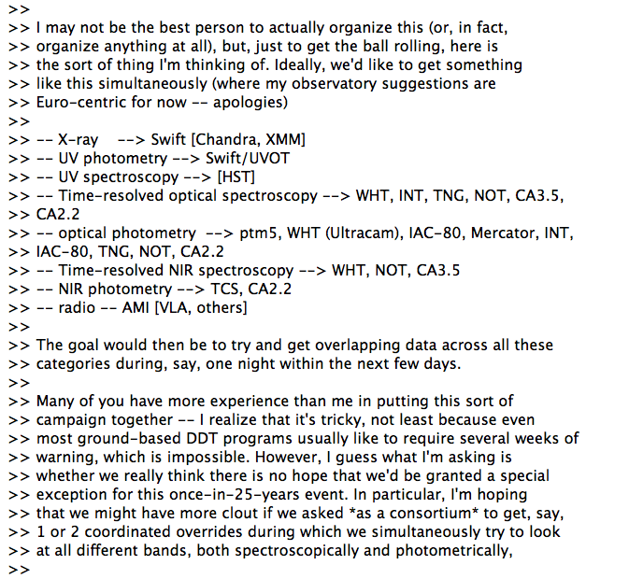
Coordination in the old days - example
Notes:
Everybody got excited and “coordination” was done ad-hoc and mainly by e-mail.
Here I show you how the communication went at the beginning of the outburst.

Slide 9
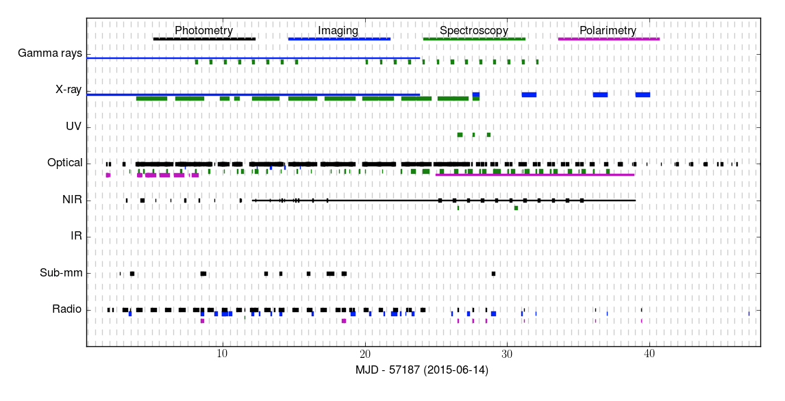

Coordination in the old days - example
(Credit: Tom Marsh, University of Warwick, UK)
Ad-hoc, manual, multi-wavelength coordination campaign during the 2015 outburst of V404 Cygni
Notes:
All this ad-hoc collaboration was put in a spreadsheet by hand, which led to the following observation plan, which enabled us to set up the observation campaign,

Slide 10
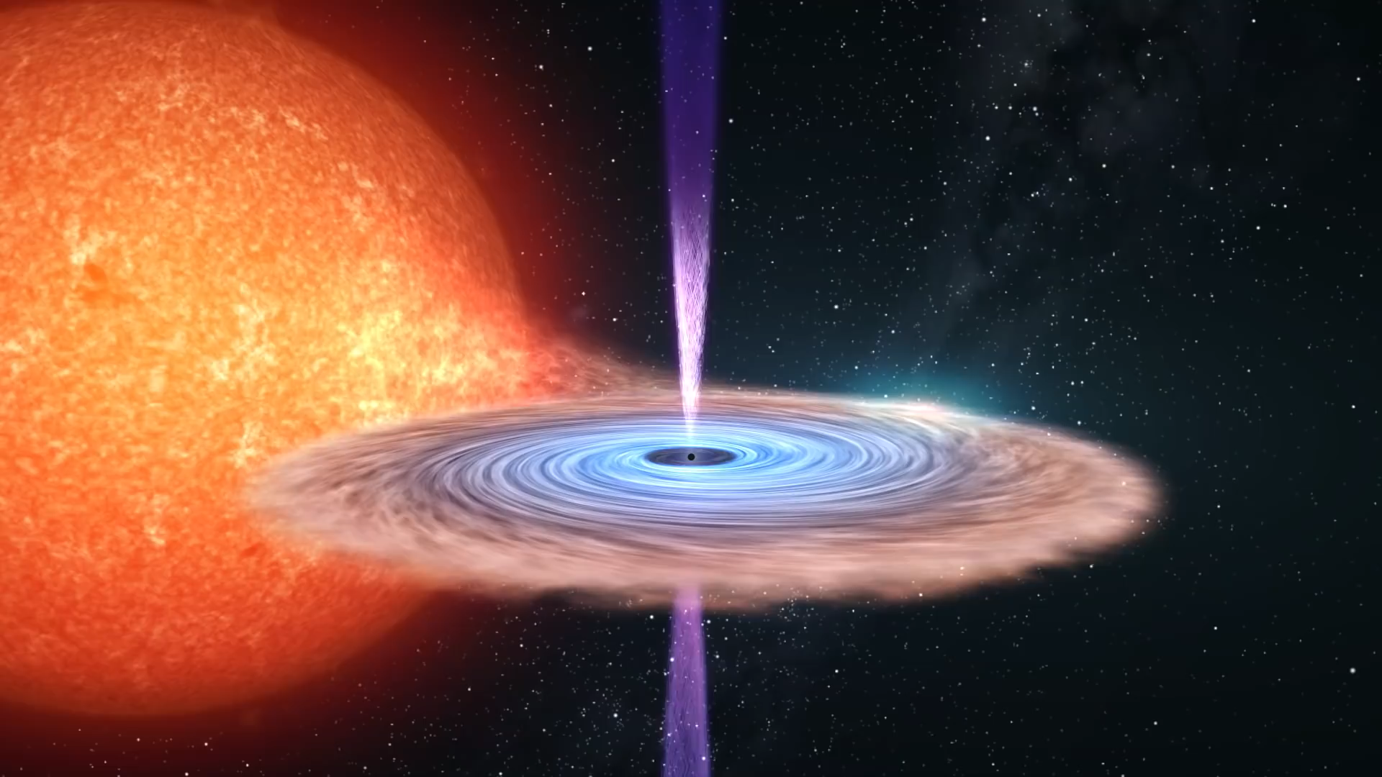
Coordination in the old days – example result
June 15
June 29
2015
Multi-λ: ~19 orders of magnitude from 150 Mhz to 10 TeV
Notes:
This led to a wonderful dataset, covering the whole electro-magnetic spectrum.

Slide 11
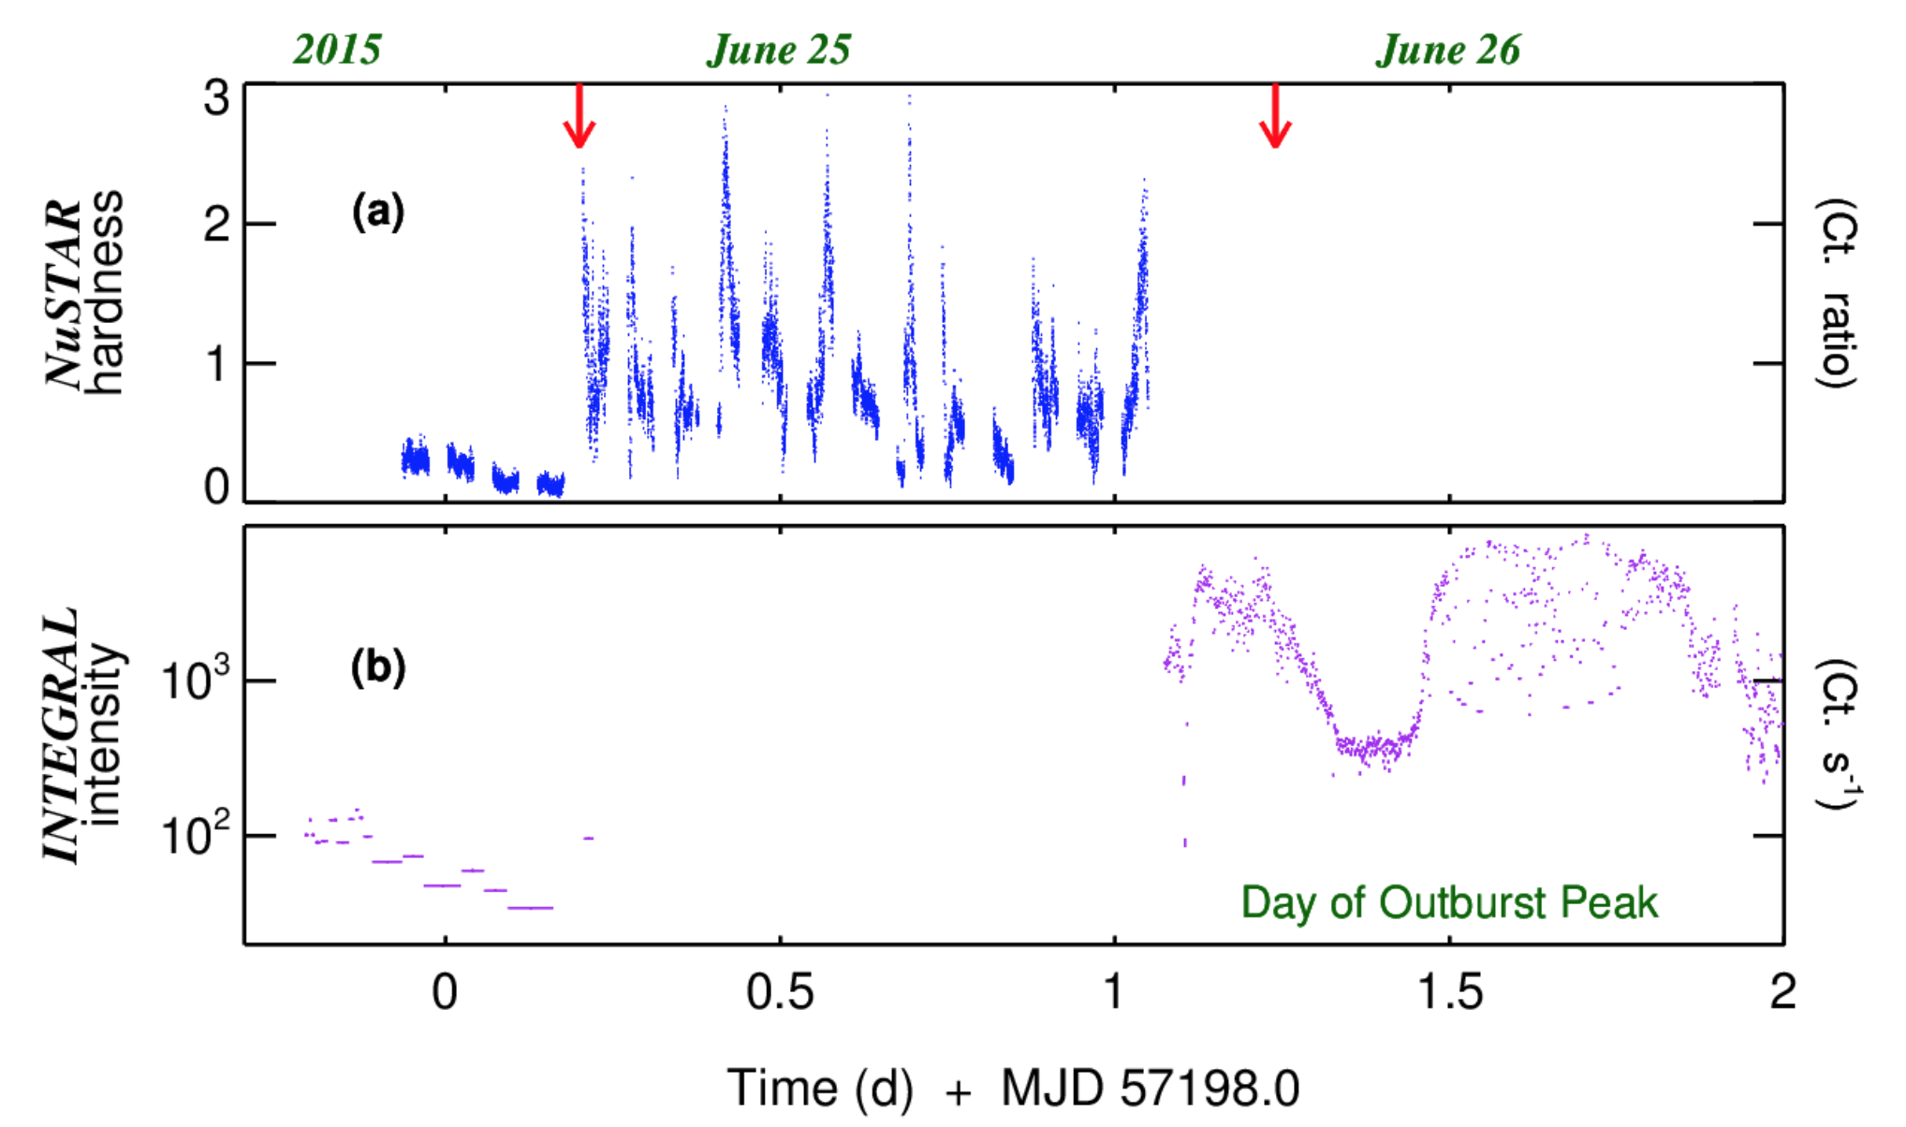
Coordination in the old days – example result
uh-oh…
Gandhi et al. 2017, Nature Astronomy
Notes:
It’s not all glory. This is what can happen if you do manual ad-choc coordination…

Slide 12
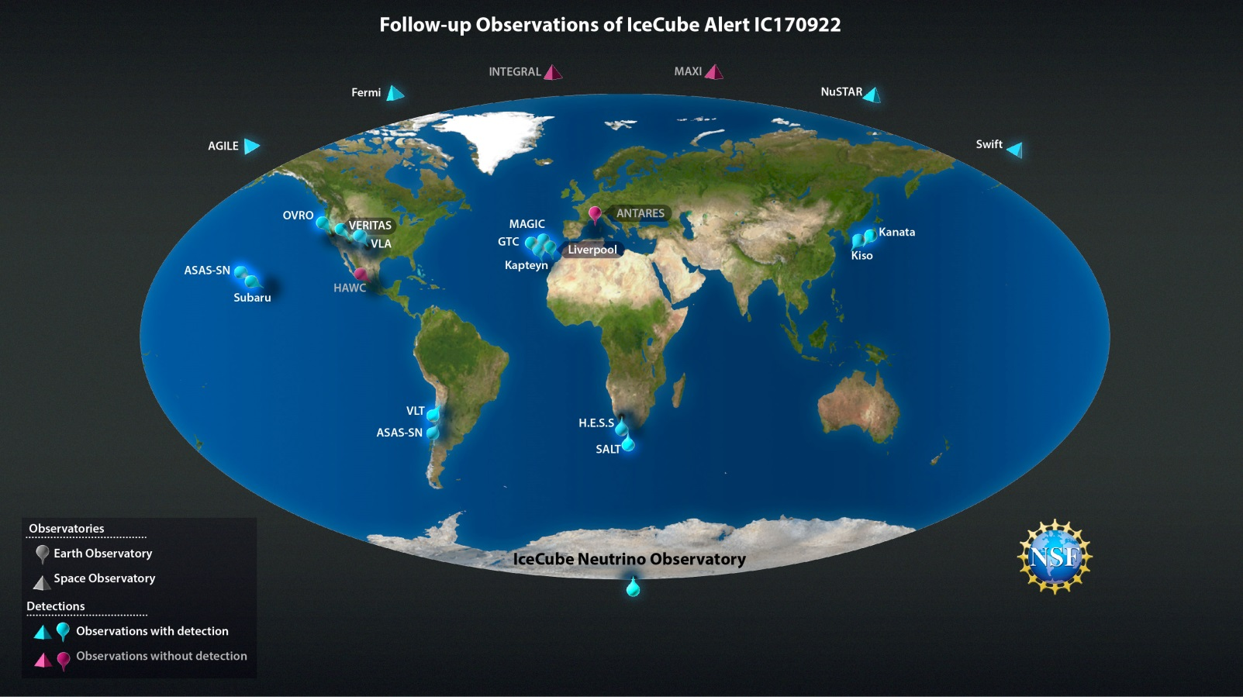
2017: the astrophysical landscape changes…
22 September 2017
IceCube high-energy neutrino event:
IceCube-170922A
~20 ground- and space-based observatories
Notes:
In 2017 the astrophysical landscape changed …
On 22 September 2017 the IceCube Neutrino Observatory alerted the international astronomy community about the detection of a high-energy neutrino. Approximately 20 observatories on Earth and in space made follow-up observations. Involved were a total of more than 1,000 scientists from many countries around the world.

Slide 13
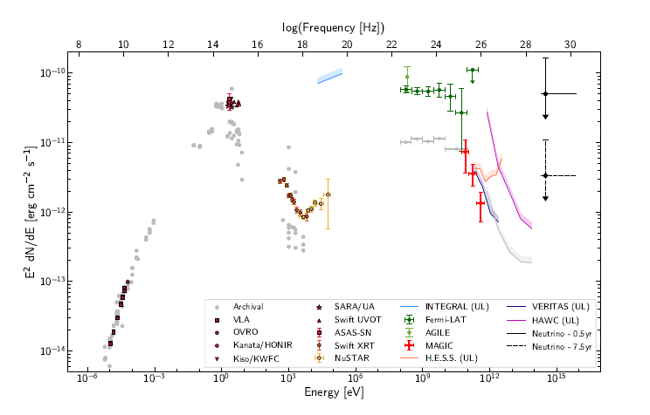
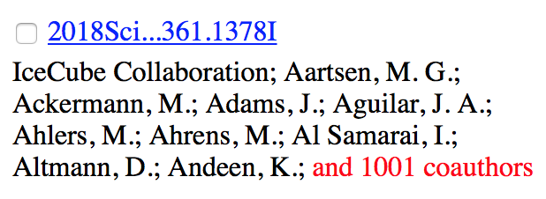
1010 scientists working together…
IceCube-170922A =
flaring γ-ray blazar
TXS 0506+056
Aartsen et al. 2018, Science
Notes:
The source of the very high energy neutrinos was found to be a flaring gamma-ray blazar, TXS 0506+056. Besides neutrinos, the observations made across the electromagnetic spectrum included gamma-rays, X-rays, and optical and radio radiation.

Slide 14
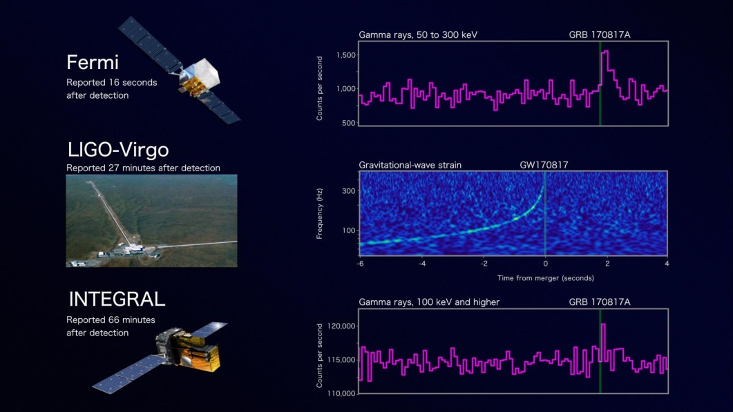
Gravitational waves and gamma-rays…
17 August 2017:
GW170817 GRB180817A
Notes:
One month earlier, however, there was an event which overshadowed this.
On 17 august 2017 for the first time prompt gamma-rays were detected coincident with Gravitational Waves, produced by colliding neutron stars.

Slide 15
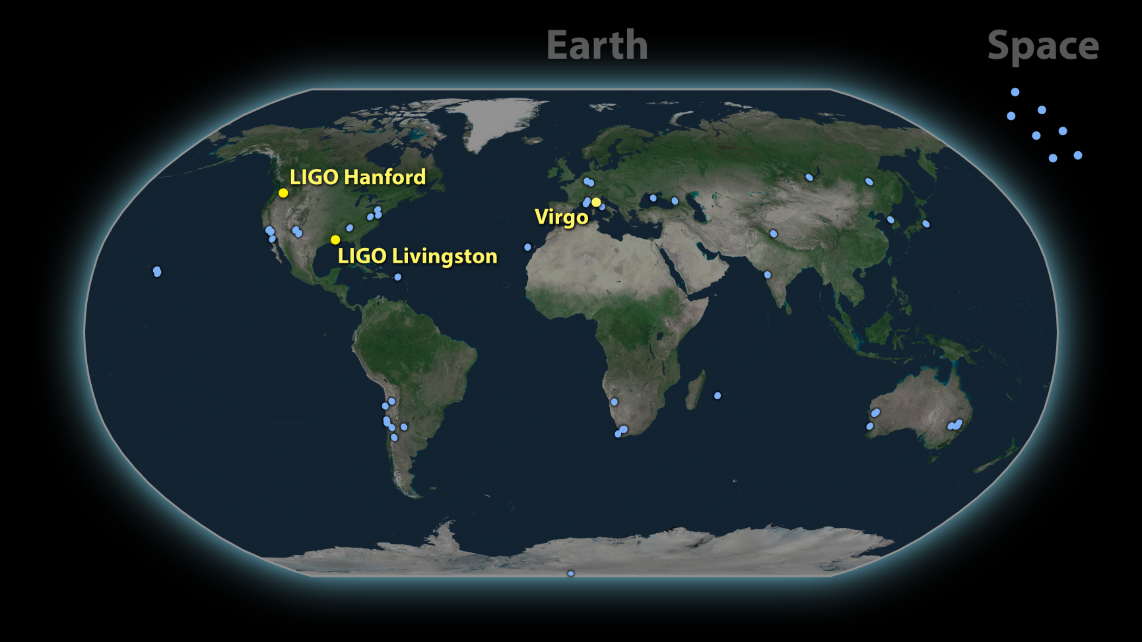
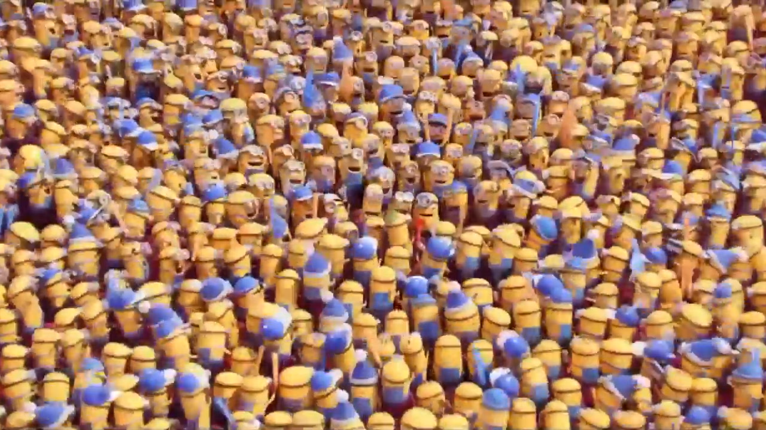
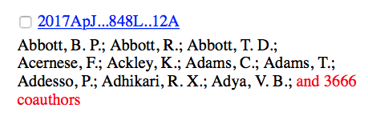
Worse: 3676 scientists working together…
If it is not enough…
~70 ground- and space-based observatories
Notes:
This prompted an even bigger collaboration

Slide 16
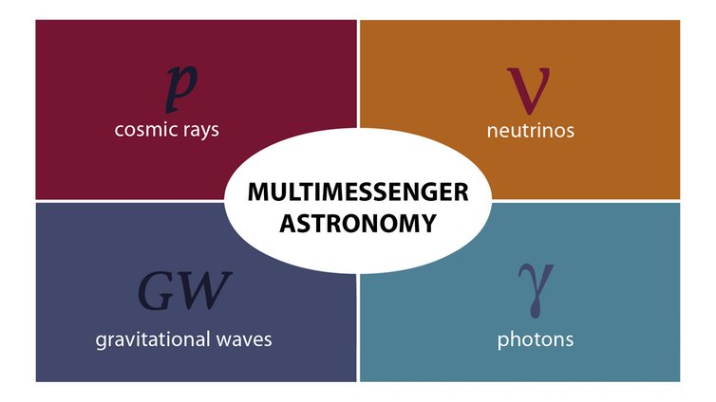
Multi-Messenger…
time-domain
+
=
time-domain multi-messenger (astro)physics
Notes:
These events opened up a new window on the universe, and Multi-Messenger astrophysics became mainstream.

Slide 17

Multi-Messenger – it’s hot…
Conference on Multi-Messenger Astronomy in the Era of LIGO-India, 15-18/1/2019
INTEGRAL looks AHEAD to Multi-Messenger Astrophysics, 11-15/2/2019
The New Era of Multi-Messenger Astrophysics, 25-29/3/2019
The Multi-Messenger Physics and Astrophysics of Neutron Stars, 22-26/4/2019
Enabling Multi-Messenger Astrophysics in the Big Data Era, 25-26/4/2019
Multi-messenger astronomy with SKA precursors and pathfinders. 13-15/5/2019
Gamma-Ray Bursts and Related Astrophysics in Multi-Messenger Era, 13-17/5/2019
Inference for Multi-Messenger Astrophysics Workshop, 30/5/2019
EWASS 2019: Cosmology and Multi-Messenger Astrophysics with Gamma-Ray Bursts, 24-25/6/2019
IGC@25: Multi-Messenger Universe, 24-27/6/2019
Compact Objects and Energetic Phenomena in the Multi-Messenger Era, 14-16/7/2019
The New Era of Collaborative Multi-Wavelength and Multi-Messenger Astronomy, 22-24/10/2019
Multi-Messenger Astrophysics in the Gravitational Wave Era, 24-25/10/2019
ESA/ESO Workshop 2019 “Cross Facilities Collaboration in the Multi-Messenger Era”, 19-22/11/2019
Multi-Messenger and Neutrino Astronomy, 17-19/12/2019
…
Notes:
Doing Multi-Messenger astronomy is extremely hot nowadays. See how many conferences and workshop advertise multi-messenger 2019… Basically the whole year you can devote to the topic.

Slide 18

Time-domain multi-messenger (astro)physics…
Requires improved coordination
& communication!
Notes:
To manage the various observations you need coordination & communication

Slide 19
Current efforts… (examples) - I
AMON – The Astrophysical Multimessenger Observatory Network - www.amon.psu.edu
Astronomy ESFRI – Research Infrastructure Cluster (ASTERICS) - www.asterics2020.eu
DWF – Deeper Wider Faster programme - dwfprogram.altervista.org
Gravitational Wave Treasure Map - treasuremap.space
SCiMMA– Scalable Cyberinfrastructure to support Multi-messenger Astrophysics - scimma.org
SmartNet – Simultaneous Multiwavelength Astronomy research in Transients NETwork - www.isdc.unige.ch/smartnet/
etc…
Notes:
There are efforts to improve coordination and communication. Examples are AMON, ASTERICS, DWF

Slide 20
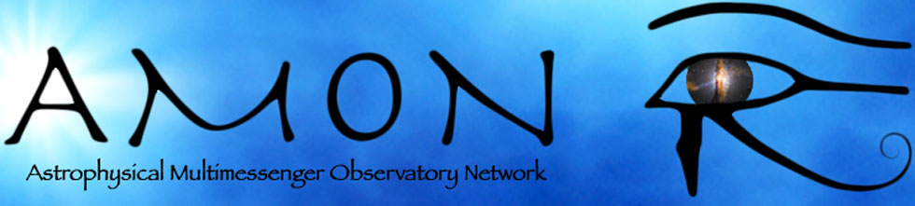
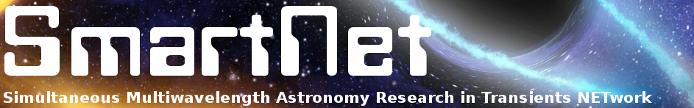

Current efforts… (examples) - II
AMON - real-time correlation analysis of high-energy signals across all known astronomical messengers – photons, neutrinos, cosmic rays, & gravitational waves → “triggering” and “follow-up”
SmartNet – Networking platform for astronomers - ease and improve the many multi-wavelength campaigns
Gravitational Wave Treasure Map - coordinate electro-magnetic follow-up of gravitational-wave events → report planned and executed observations & query reports of other observers, in a programmatic way
Swift, Las Cumbres Observatory, SAGUARO (Catalina Sky Survey) & Fermi/GBM
Notes:
AMON is a platform to announce transient events from all messengers. It’s more geared towards triggering prompt and follow-up observations.
Smartnet is a kind of network platform for astronomers, but mostly dedicated to X-ray transients.
GW treasure map – : enable coordination between observatories in order to minimize unnecessary overlap in these searches and find the counterpart as quickly and as efficiently as possible. But focus is on GWs

Slide 21
Coordination starts with basic needs…
Target visibility:
Target – facility/instrument – time period
Observing schedule (past, current, future):
Facility/instrument – time period – target
Nowadays, many ground- and space based observatories provide tools + web info
Notes:
Coordination starts with the basics: you need to know from each other:
When can facility X observe what and what will facility X observe when?
Tools exist

Slide 22
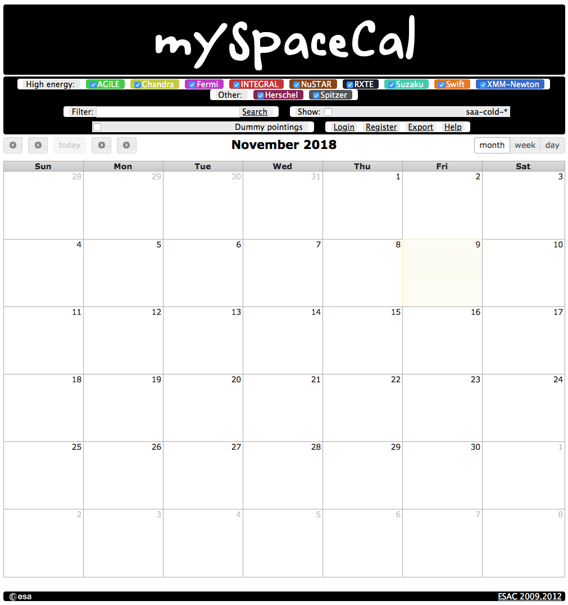

~11 years ago, a dream: one calendar – utopia?
X
But:
Formats change...
Machine parsing of web pages = tricky and prone to errors
→ can lead to significant maintenance effort for small changes
mySpaceCal.com
Notes:
About 11 years ago, I had a dream. I wanted 1 calendar with entries on what is or was observed at a certain day, and I wanted to select the facilities I was interested in.
As you can see the calendar nowadays is empty. It doesn’t mean the facilities do nothing. No, the weboutput has changed. Since the calendar is not maintained it has become useless.

Slide 23

Can we do better?
Yes, we can
All observatories provide observing schedules (also?) in standard format
Same for target visibilities
1 & 2 → automatically retrievable: TOOLS → SERVICES
But: need to agree common basic terminology for time stamps, target, coordinates, etc.
Standardise the input parameter
Standardise the output information and format
Virtual Observatory
protocols
How? See talk Jan-Uwe Ness on Multi-mission coordinations – Thursday 10:00-10:20
Notes:
Can we do better? Yes we can.

Slide 24
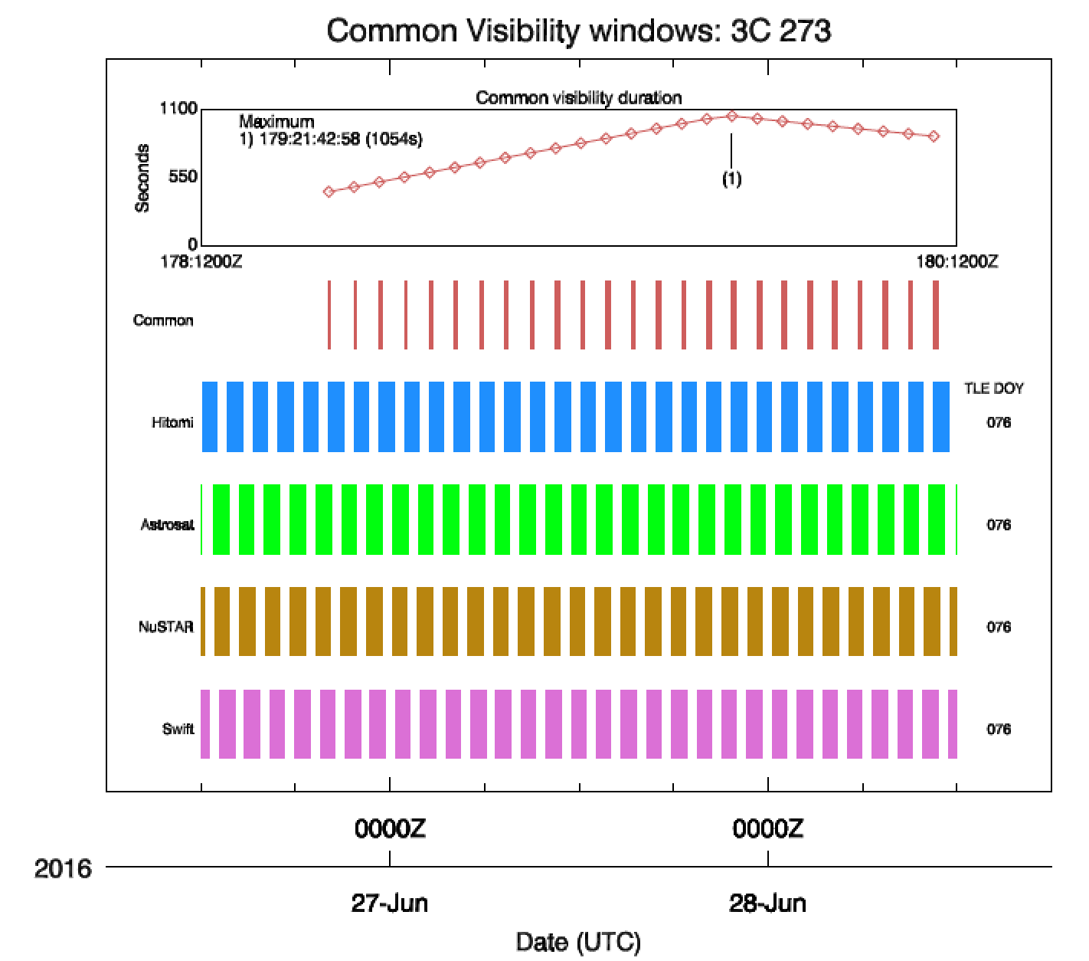
Yes, we can!
Simple example of
client for visibility info:
User builds tool to compile info
and display
Notes:
Now, as the facilities provide the standardised service, the community can build their tools to access and process the information in any way they like. For example, you can improve coordinated observations, by finding the optimum overlap in visibility.

Slide 25

Can we do even more better?
Yes, we can… we may need a new forum?
SciApp: collaboration application, based on web mobile technologies, designed to facilitate management of observation campaigns, writing of articles and general exchange of knowledge in a specific area – beta developed at ESA/ESAC
  Simple, intuitive, easy-to-read interface
  Target visibility checks
  Visibility checker
  Image and data storage and exchange
  Real-time access to alerts
  Basic data visualization, e.g., light curves
  Virtual Observatory compliant
  Easy access to database results, e.g,., Vizier, NED, SDSS, 6DF, Catalina, ...
  Database of candidates and publications
  Skill database of all people registered
https://sciapp.esac.esa.int
Notes:
When collaborating with many people we also need ways to improve our communications.
At ESAC an application was developed under a student trainee program…
Bit like Slack more focused on the astronomers needs and it is free…

Slide 26
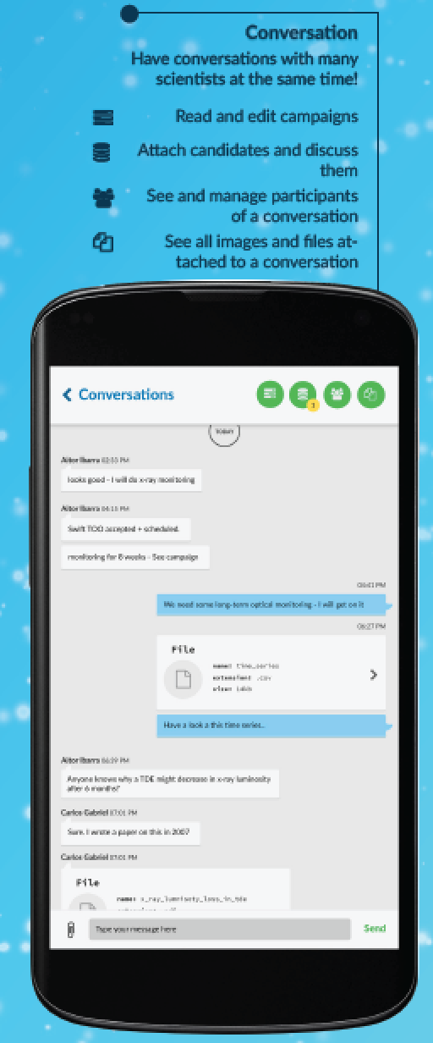
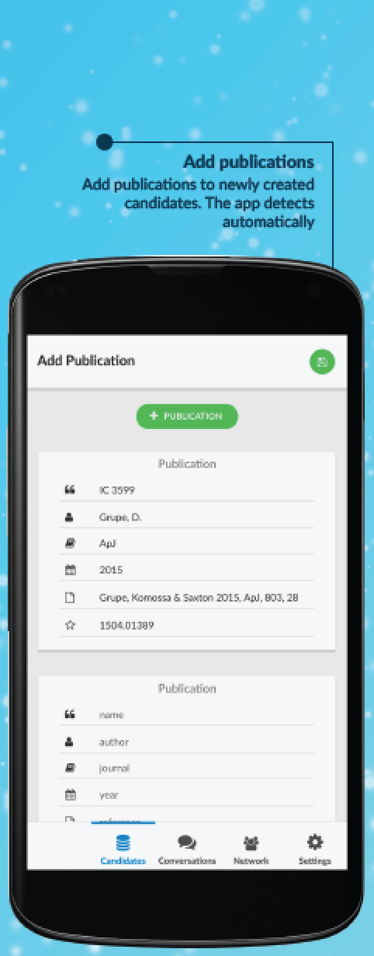
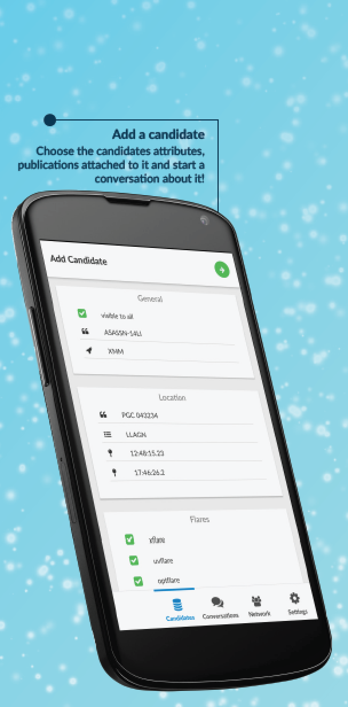
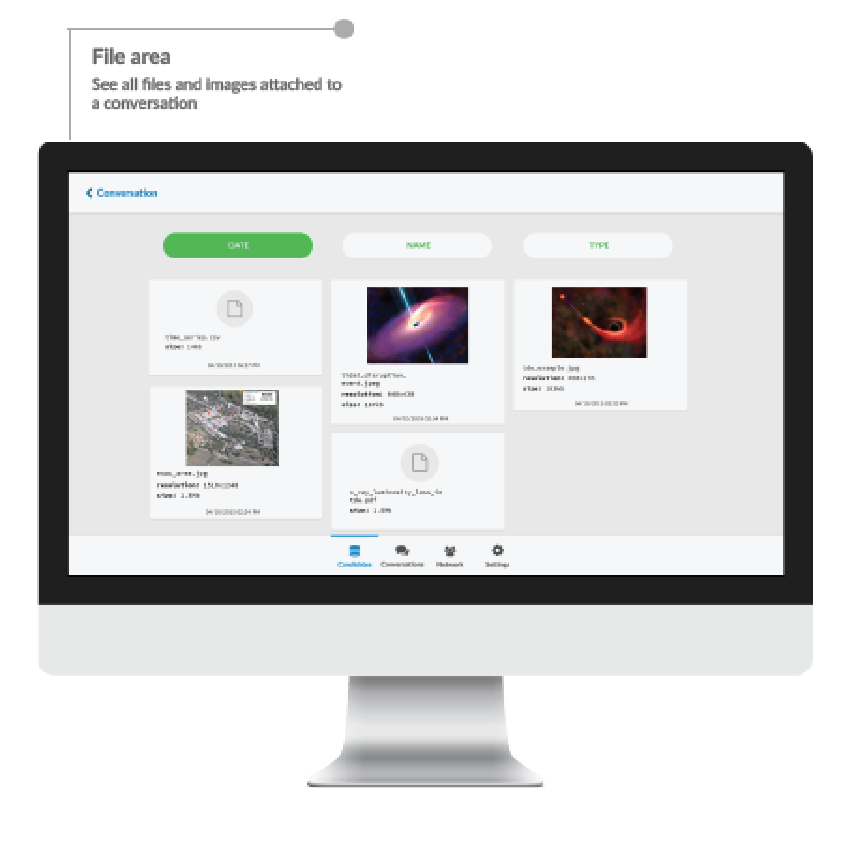
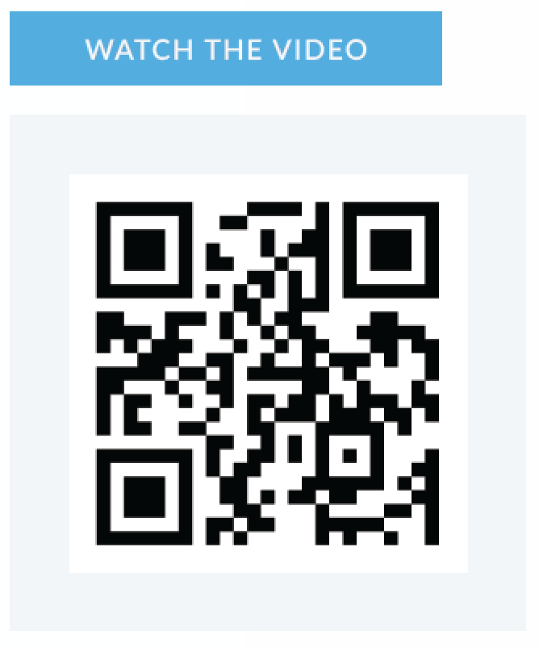
Collaboration application - SciApp
Notes:
It is web based and it runs on all your devices

Slide 27
Conclusions
One format fits all?
Short-term (+ mid- & long-term) schedules in standard format (service)
Visibility (output) in standard format (service)
Interface with explicitly machine readable information (clients)
In order to work: need ground- and space based facilities onboard!
Synergy / coordination forum?
Collaboration application → SciApp?
  Simple, intuitive, easy-to-read interface
  Image / data storage & exchange
  Build-in visibility checker & observation schedules
Needs further development…

Slide 28




Erik.Kuulkers@esa.int
@ekuulkers
Thank you
SciOps2019

Slide 29
Back-up…

Slide 30
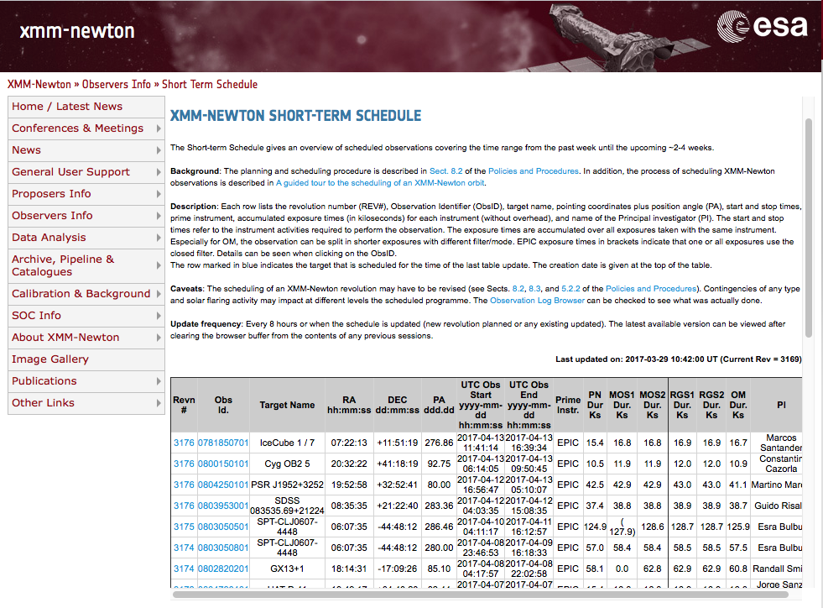
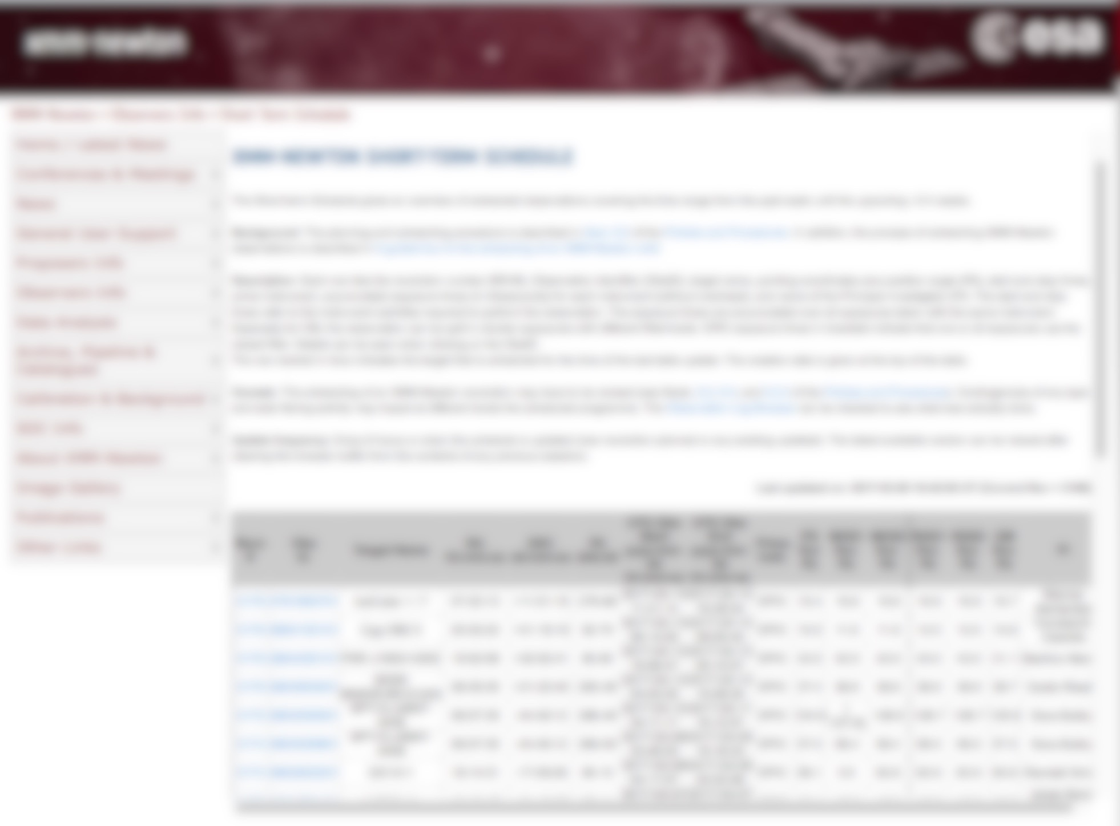
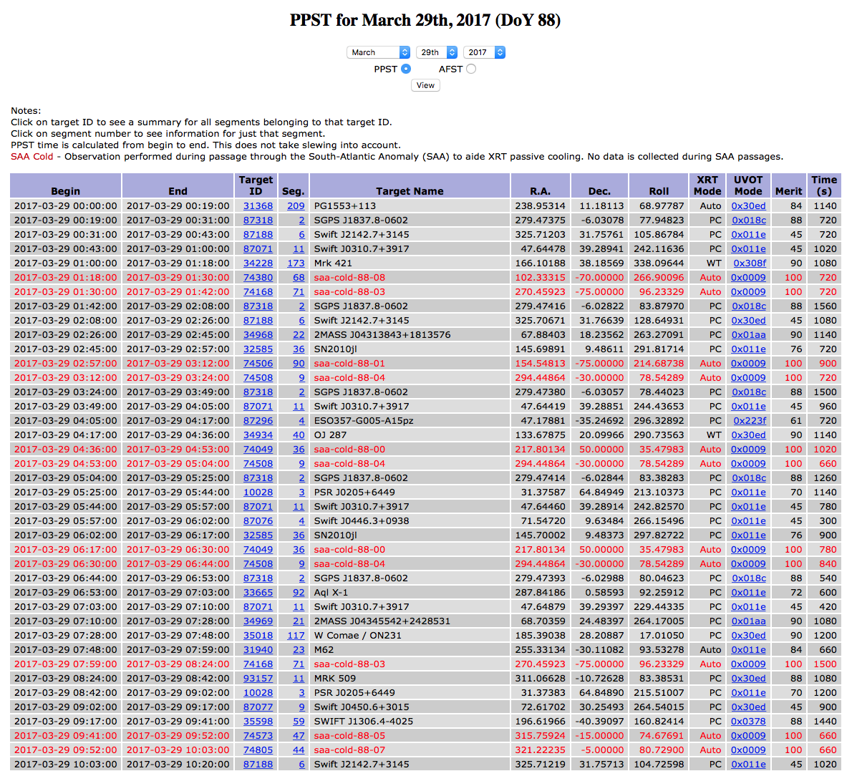
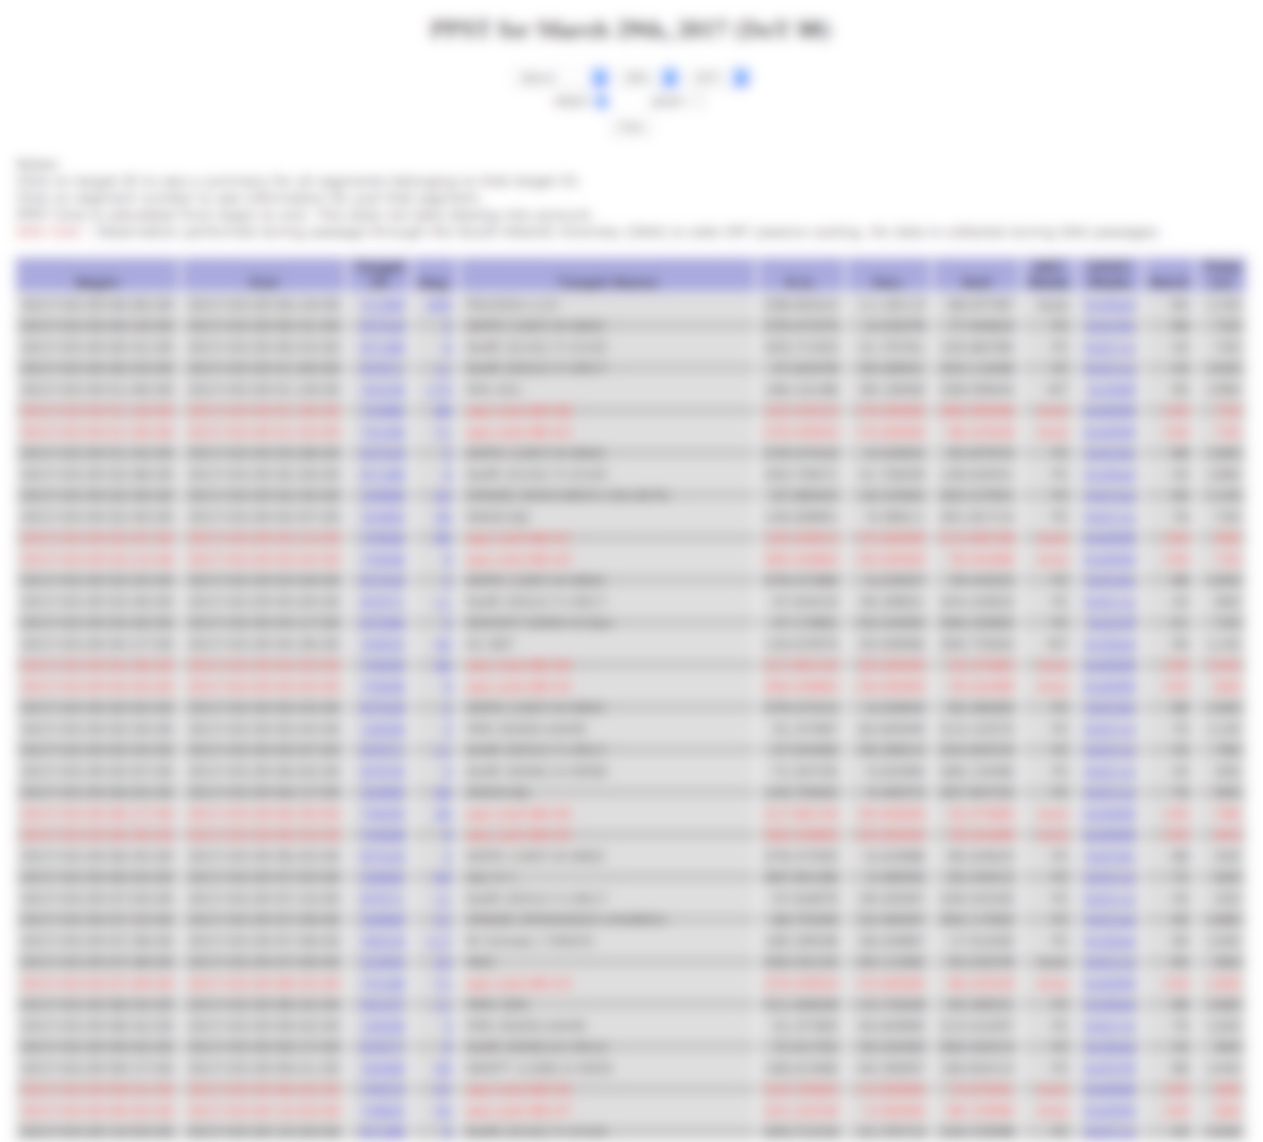
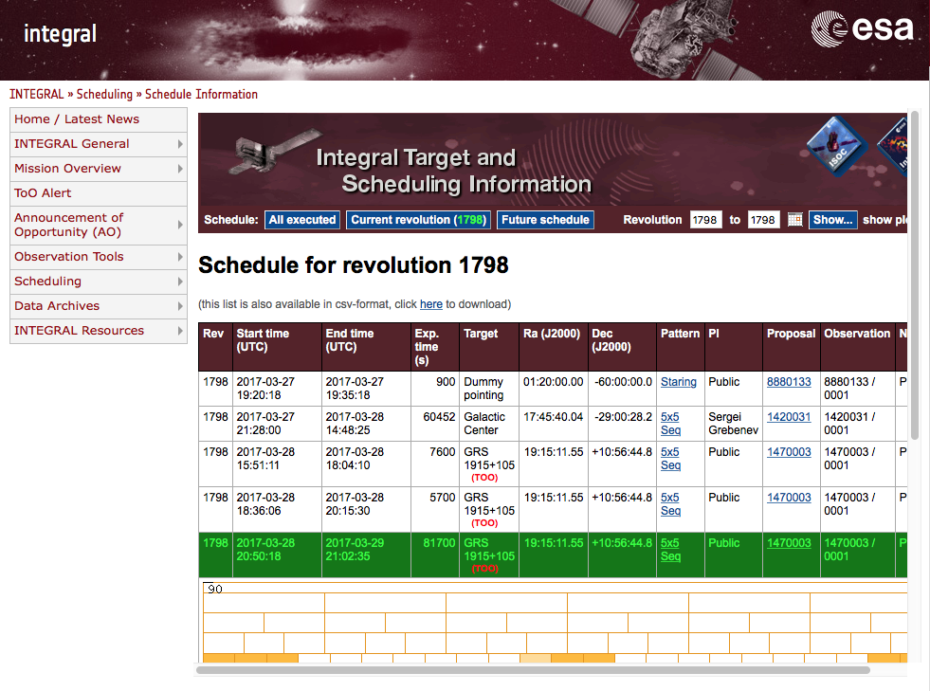
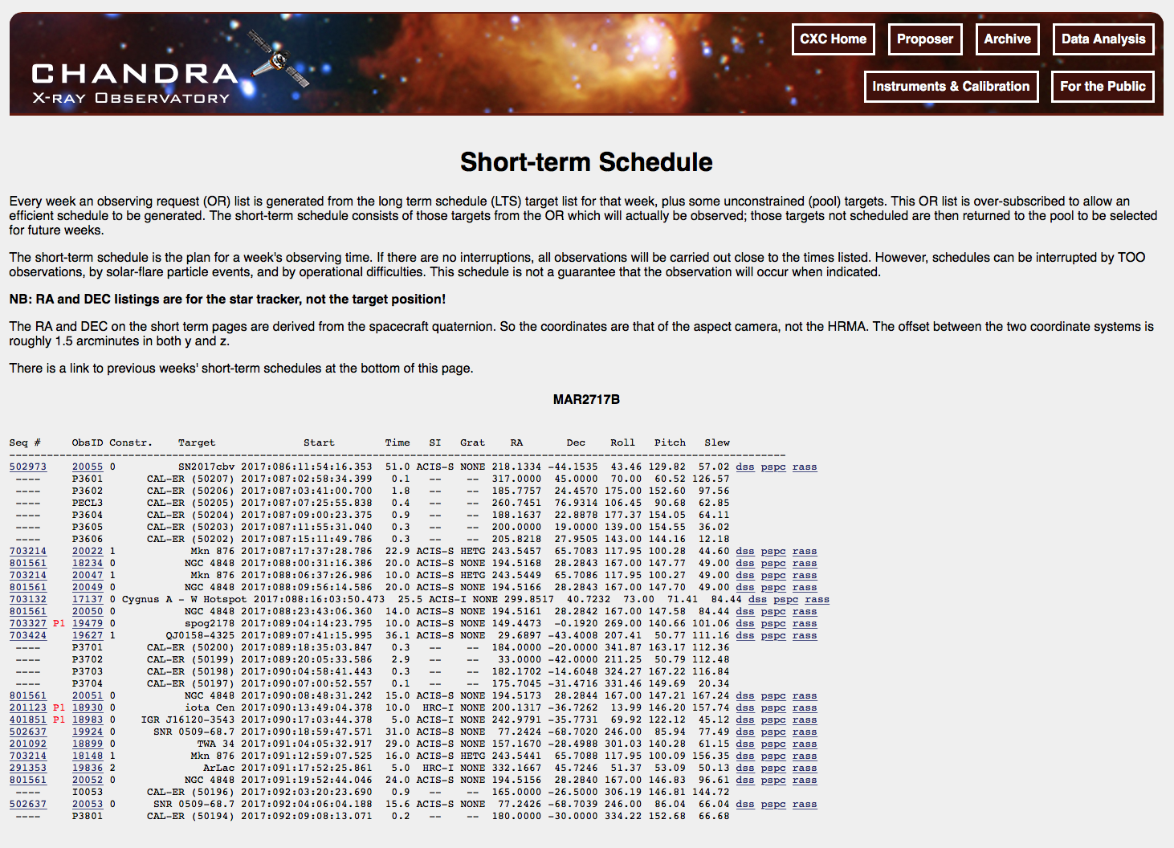
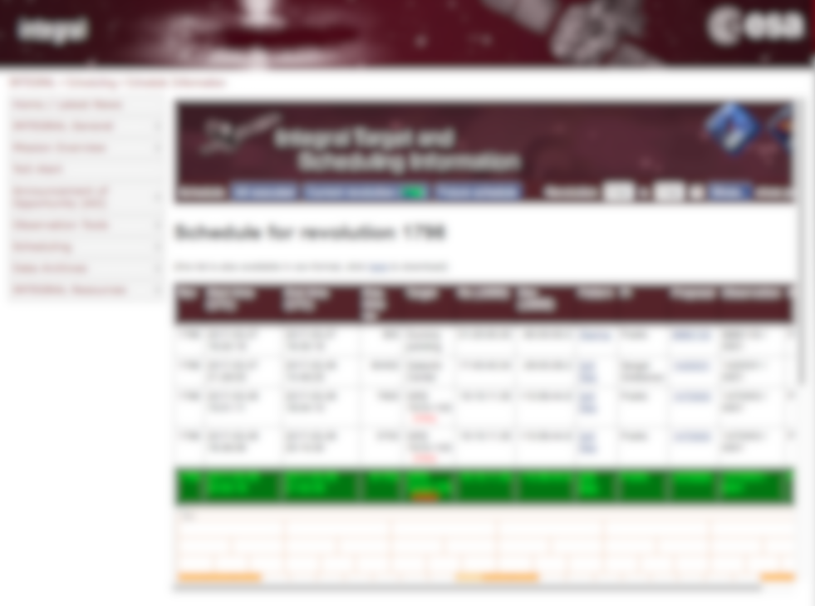
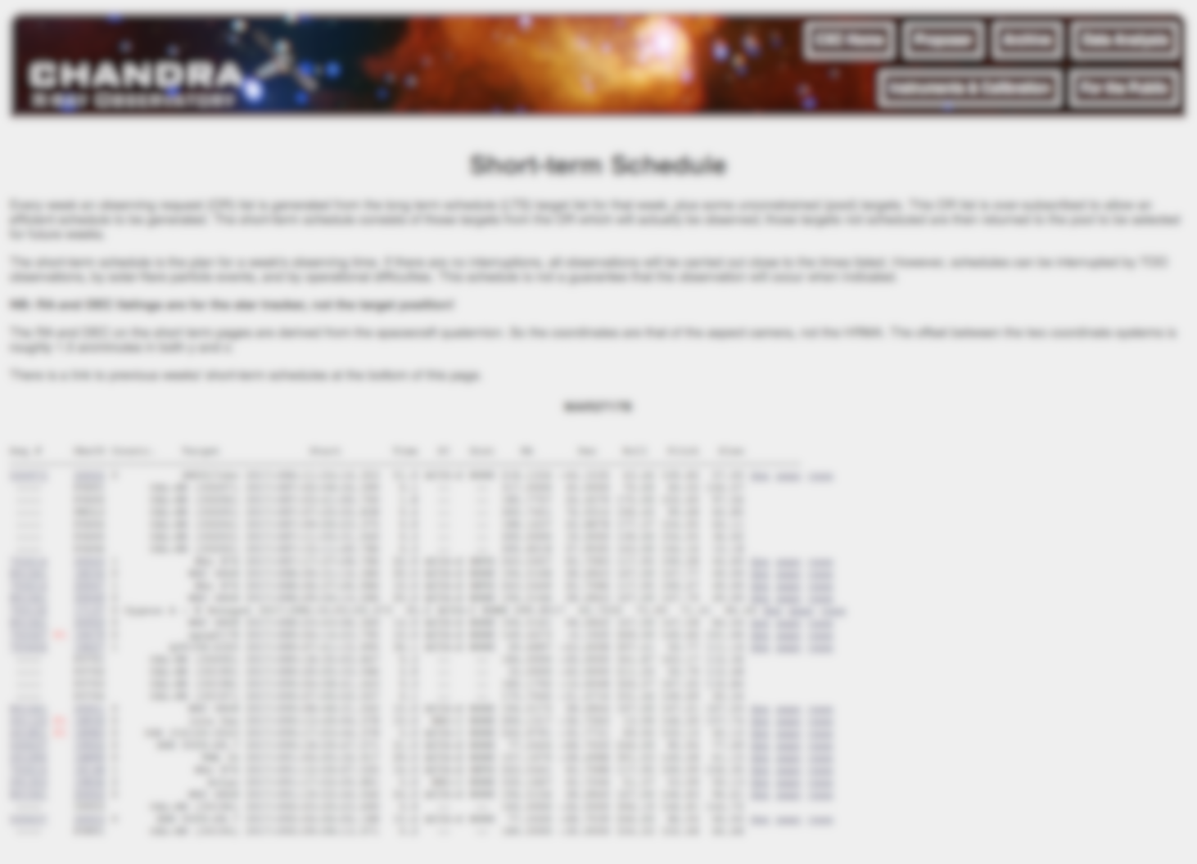
Observing schedule today - examples
Notes:
Here I show you examples of how we nowadays display information of an observing schedule on the web

Slide 31
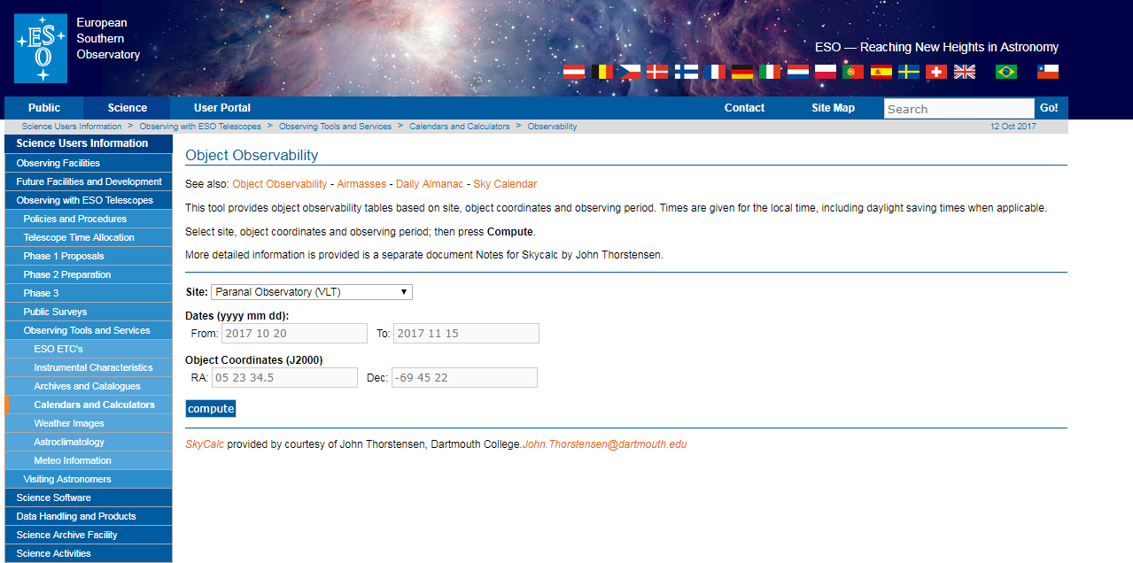
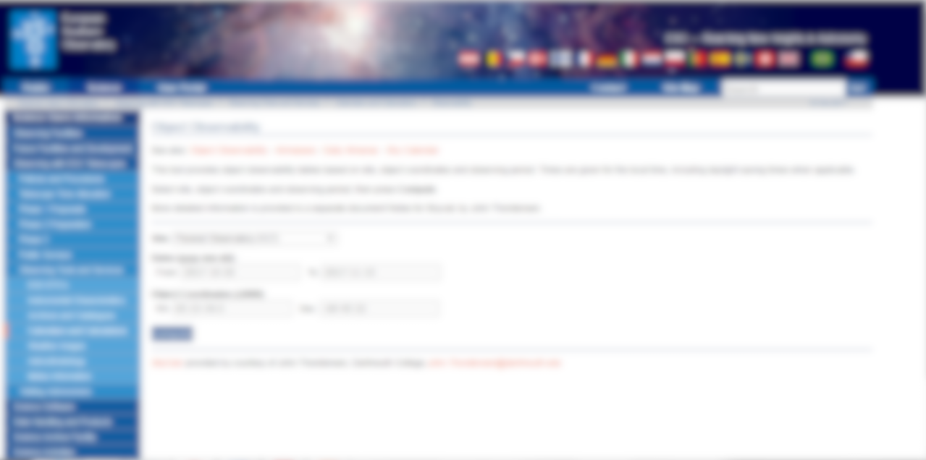
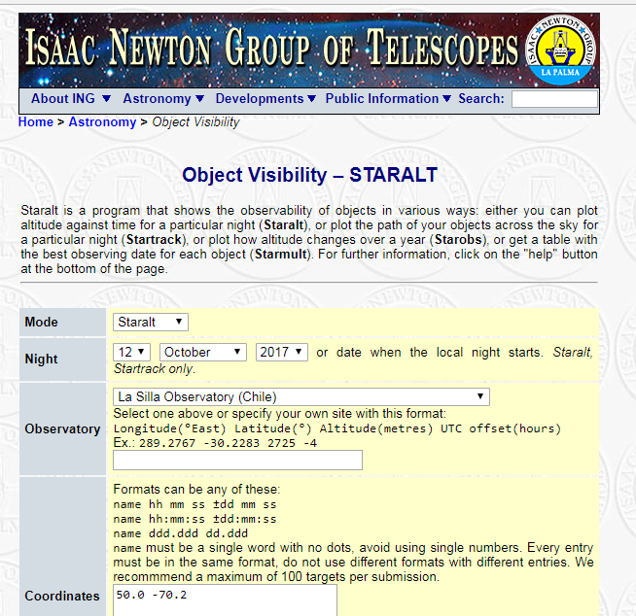
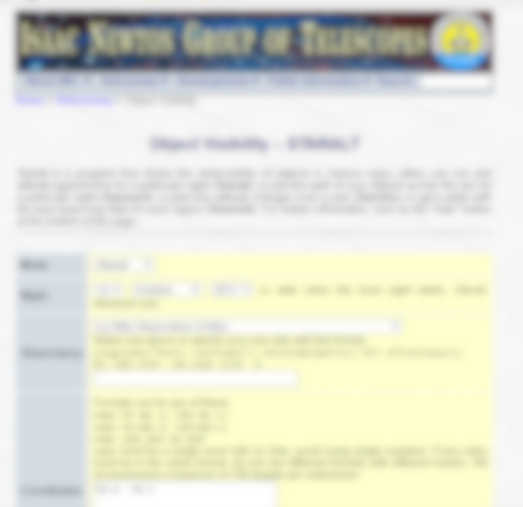
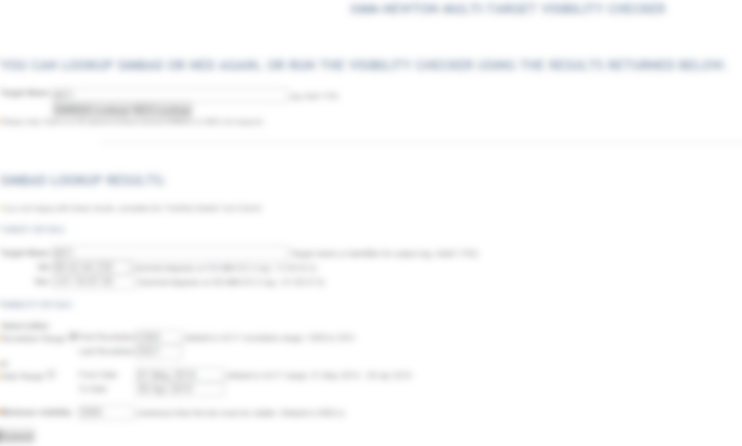
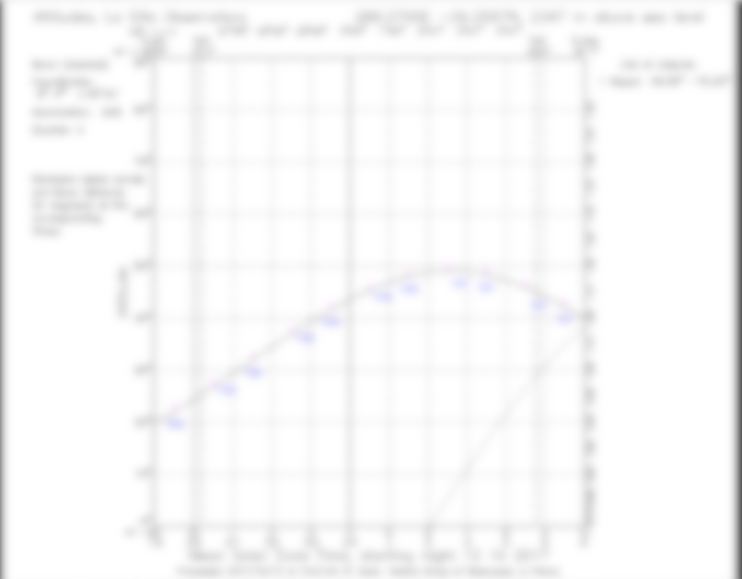
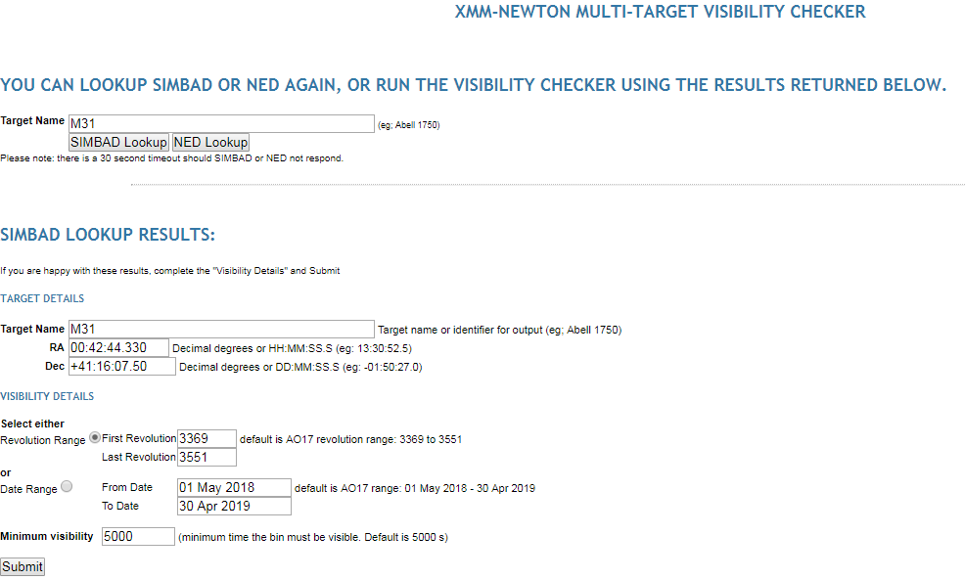





Target visibility today - examples
Notes:
And here are some examples of how we display visibilities of a certain object in the sky.

Slide 32

Yes, we can!
Simple example of a
client for
visibility & schedule info
User builds tool to
compile info & display
Notes:
Now, as the facilities provide the standardised service, the community can build their tools to access and process the information in any way they like. For example, you can improve coordinated observations, by finding the optimum overlap in visibility.

Slide 33

Why different wavelengths?
Notes:
Why do we want to observe the universe at different wavelengths?
Basically because at different wavelength you get different information. As an example I show you myself seen in the infra-red (left) and in visible light.

Slide 34




Different information at different wavelengths!
Notes:
The same holds for objects in the universe. As an example I show a Galaxy (M31) as seen at different wavelengths. Each wavelength reveals different information. Combined you get the whole picture.

