Slide 1
ESO Telescopes Scheduling
Marina Rejkuba
Nando Patat, Lowell Tacconi-Garman
ESO

Slide 2
Outline
ESO Observatory Scheduling: context
Multi-site
Multi-instrument, different types of instruments
Large variety of science programmes
Long Term Schedule vs Short Term Schedule
Telescope Time Allocation Input & process
New Time Allocation Tool

Slide 3
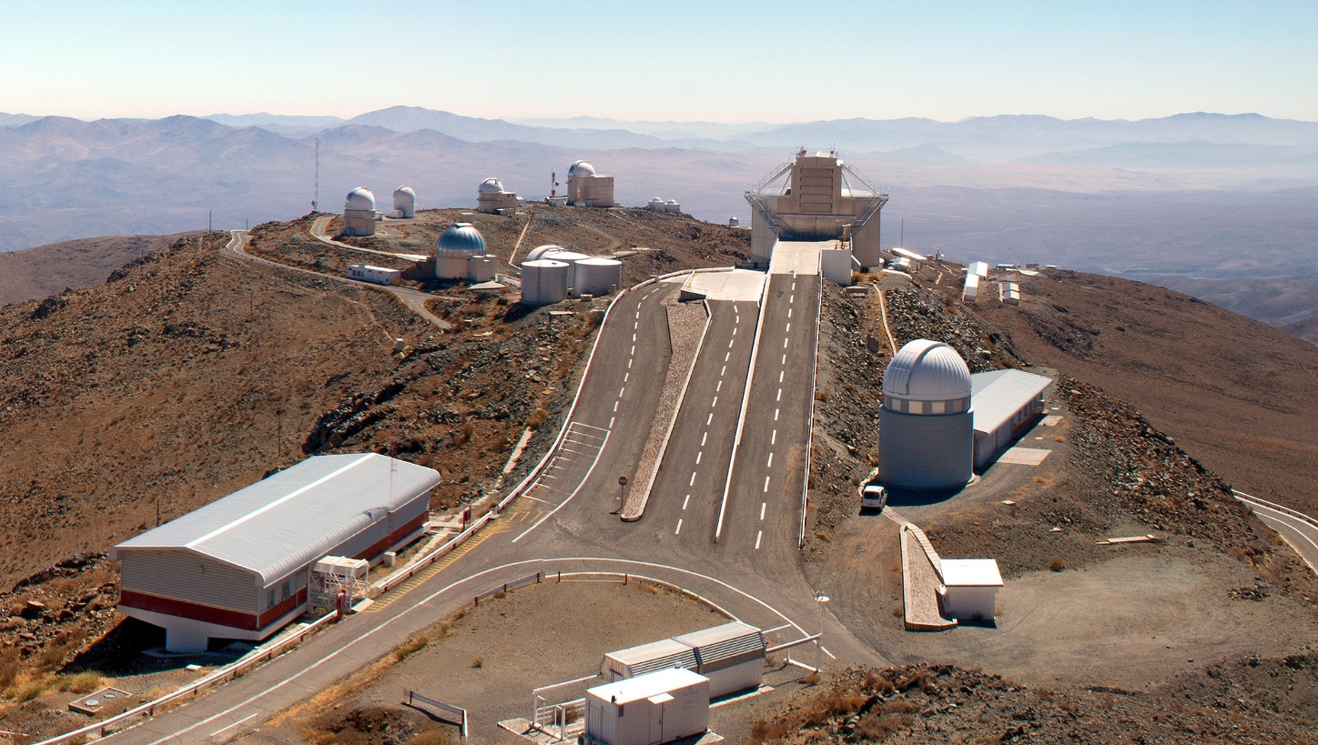
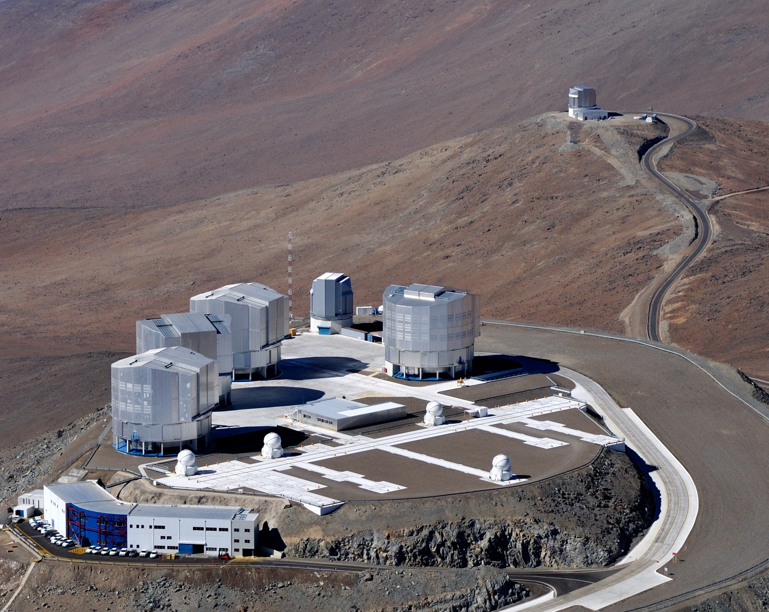
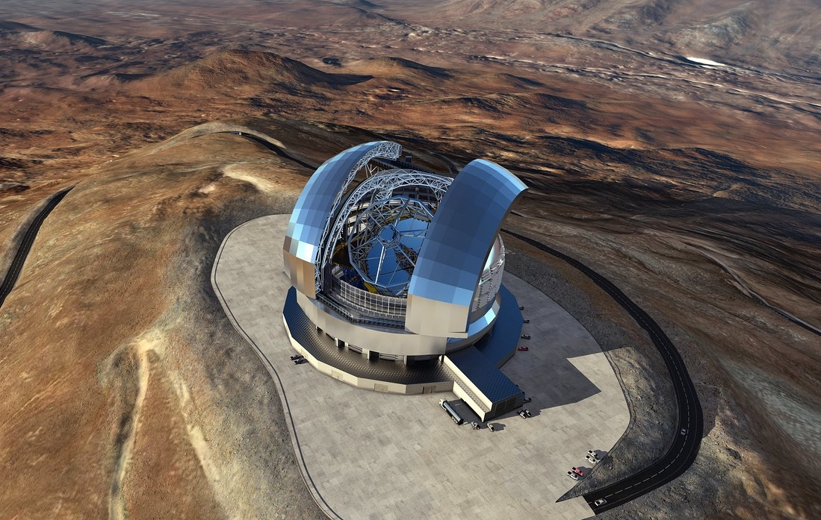
ESO Sites

Slide 4
La Silla Paranal Observatory

Slide 5
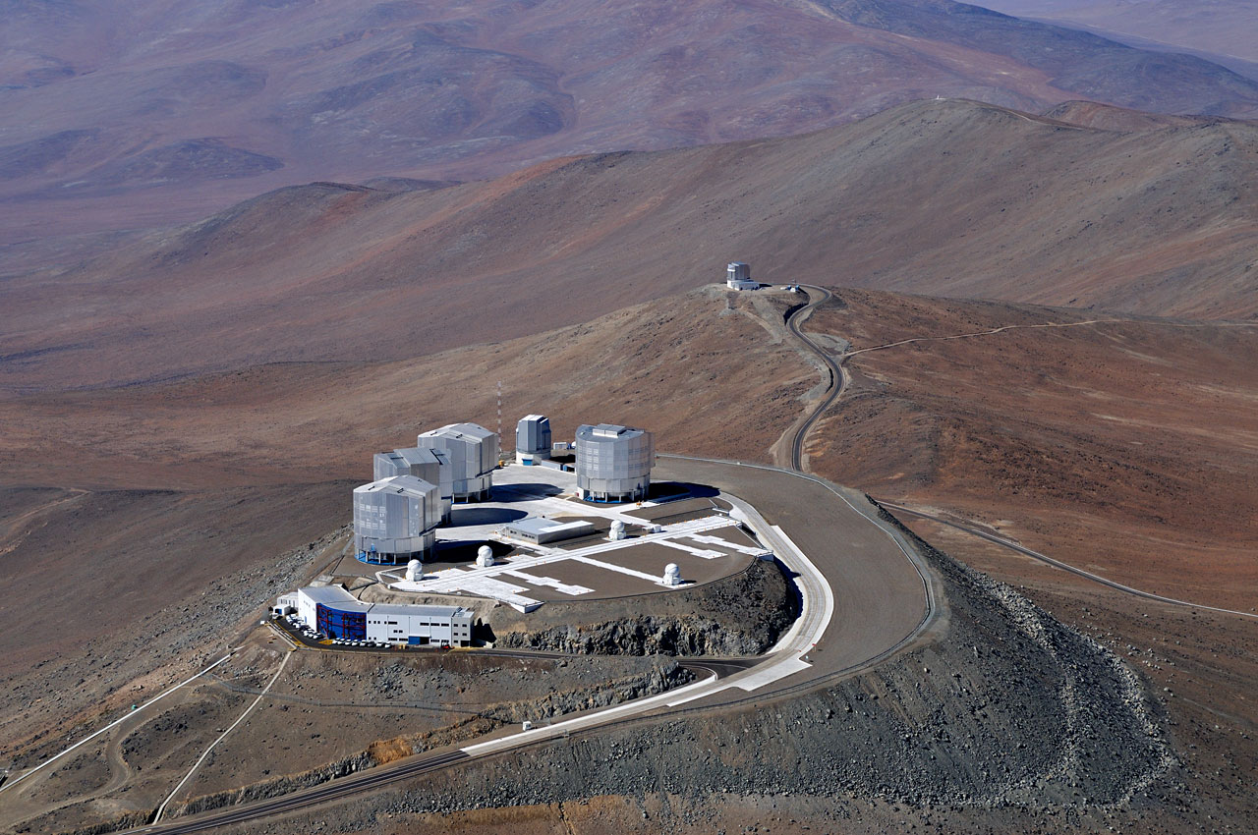
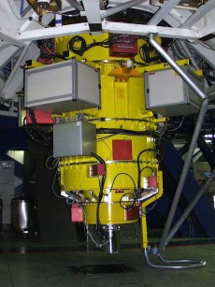
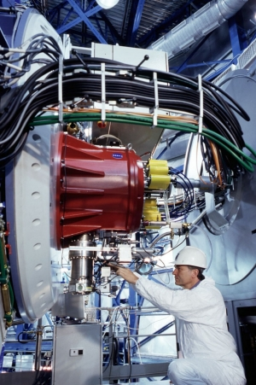
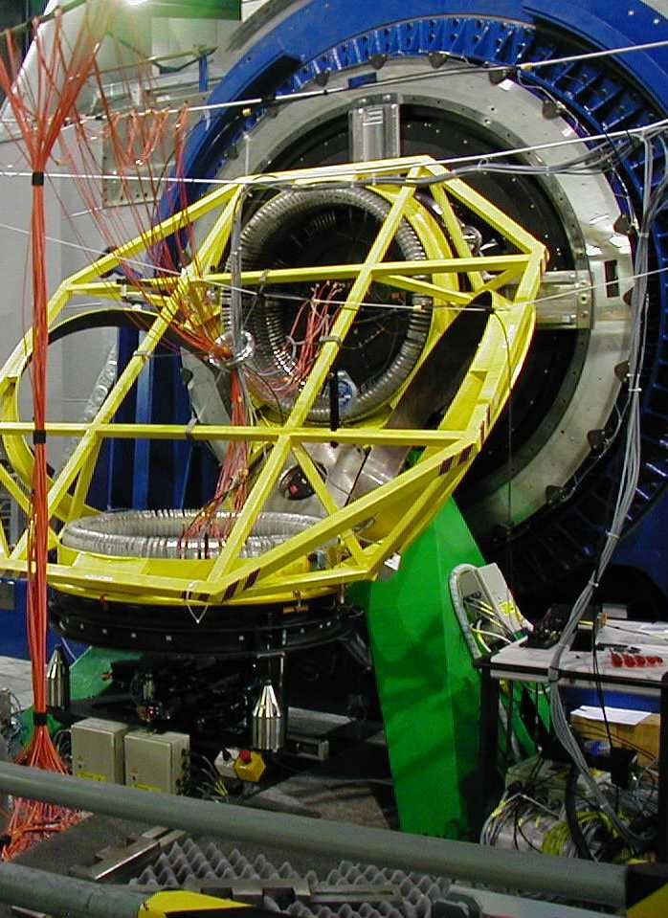
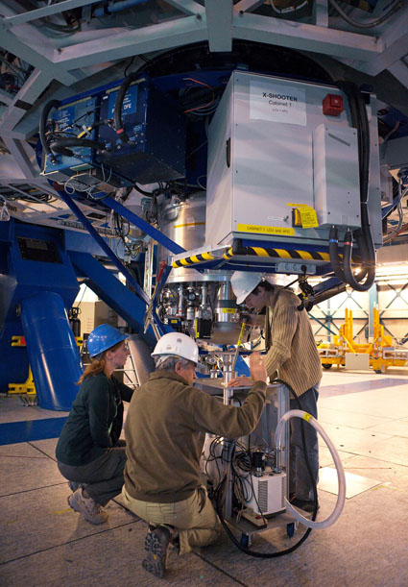
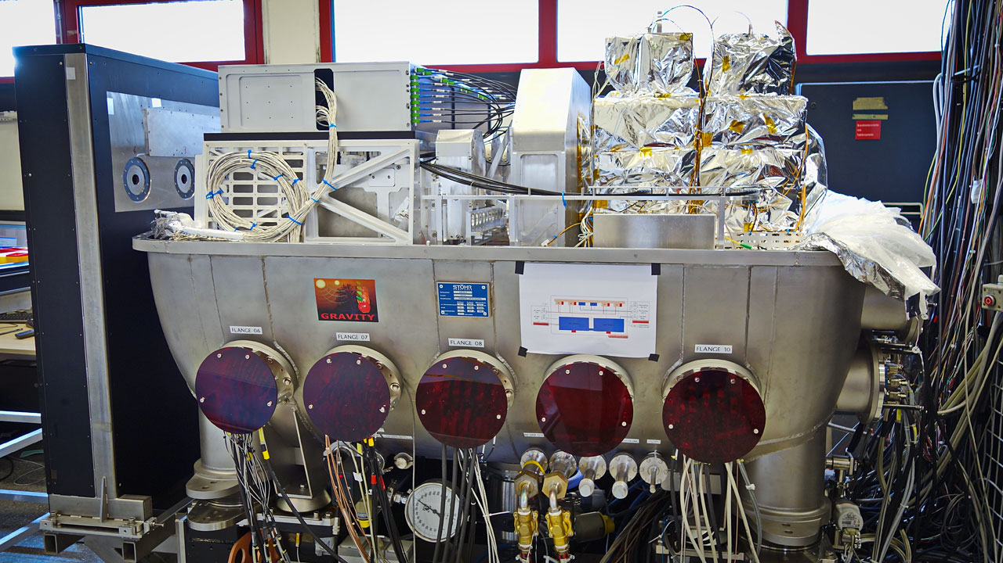
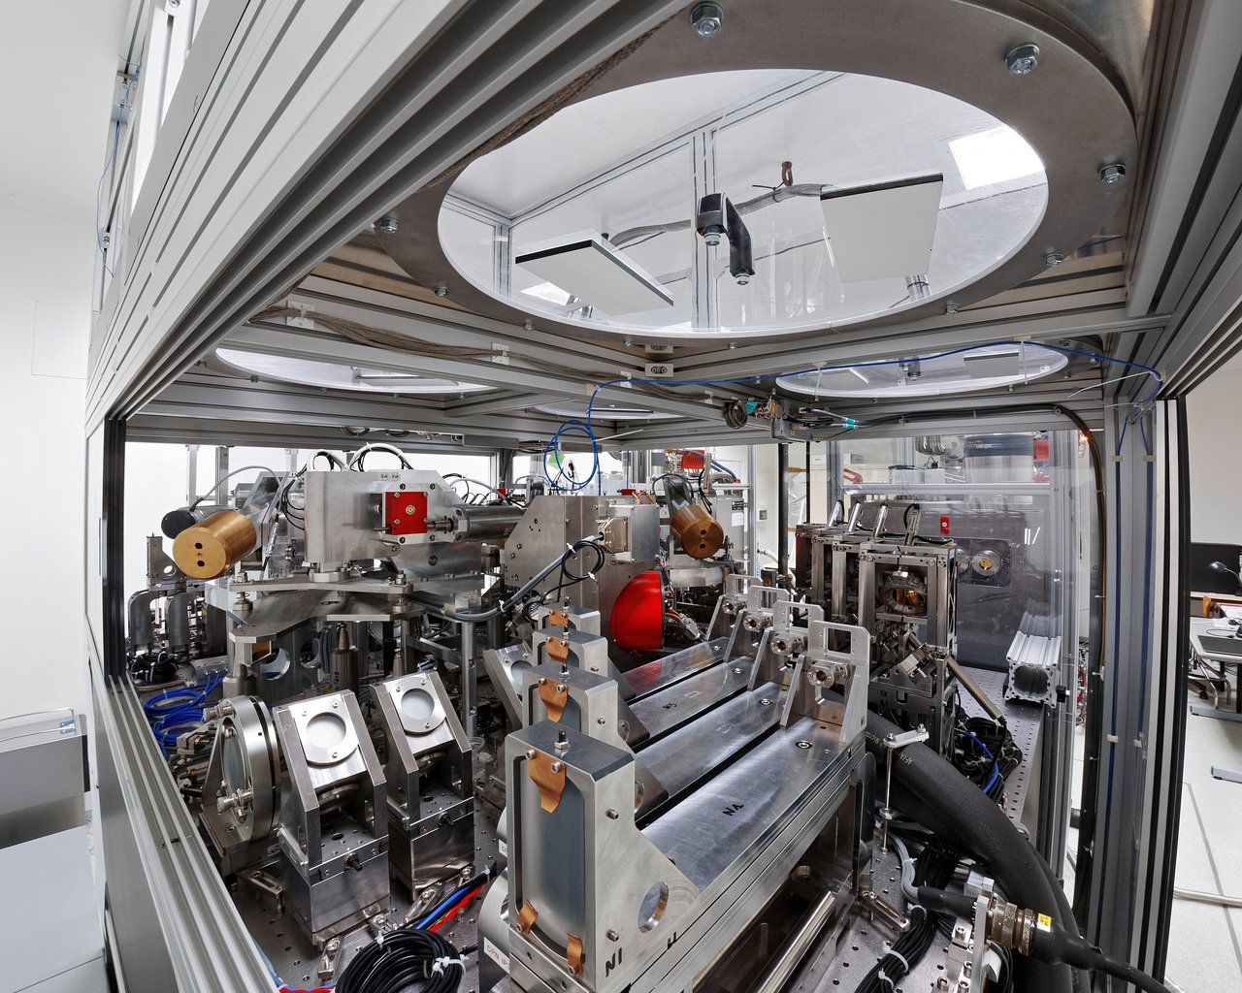
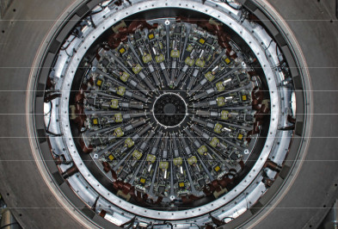
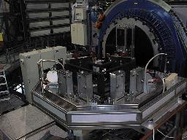
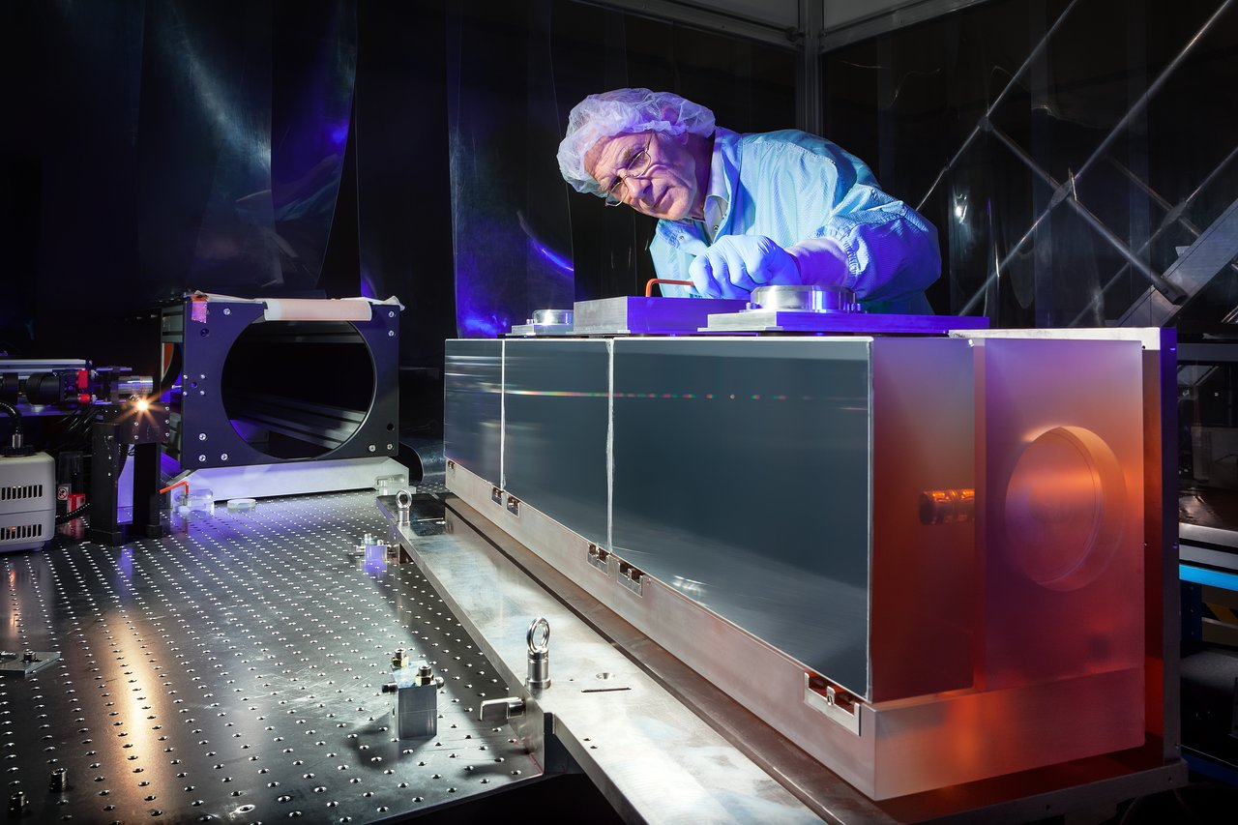
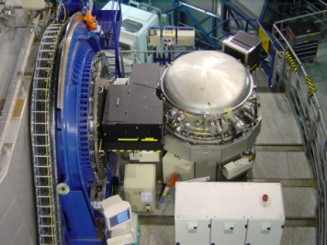
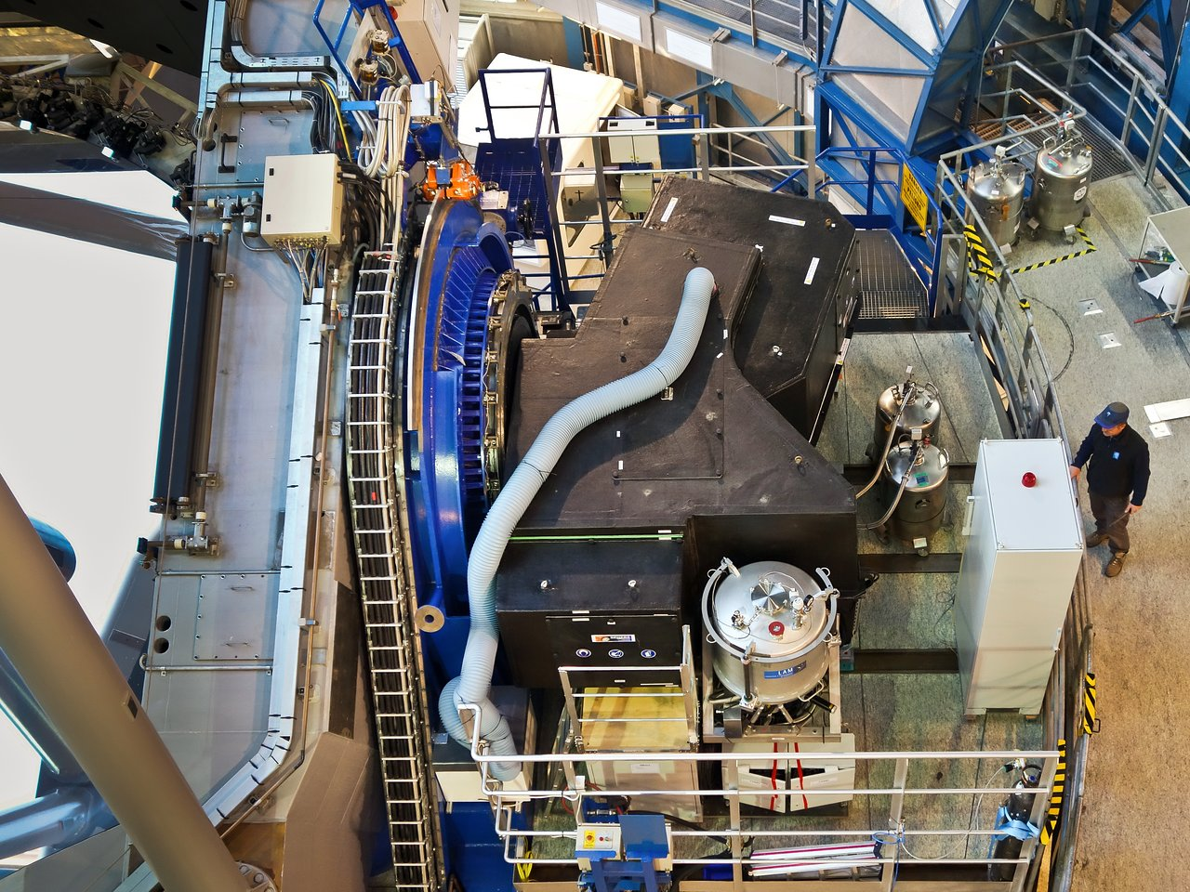
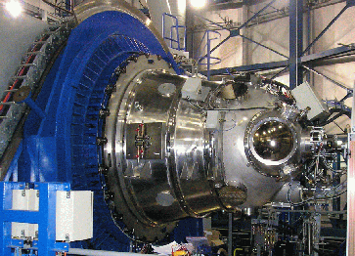
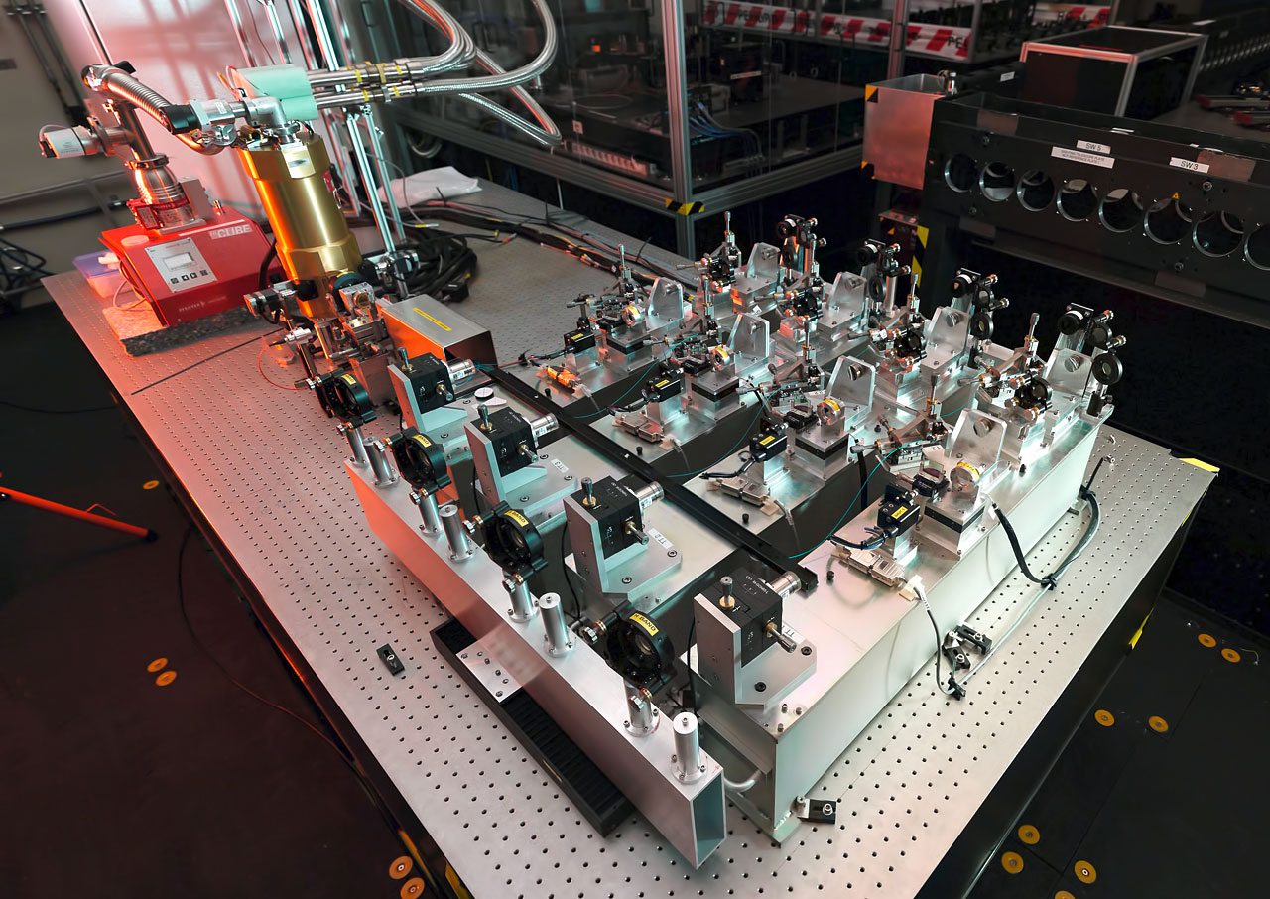
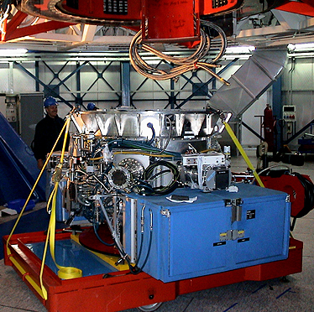
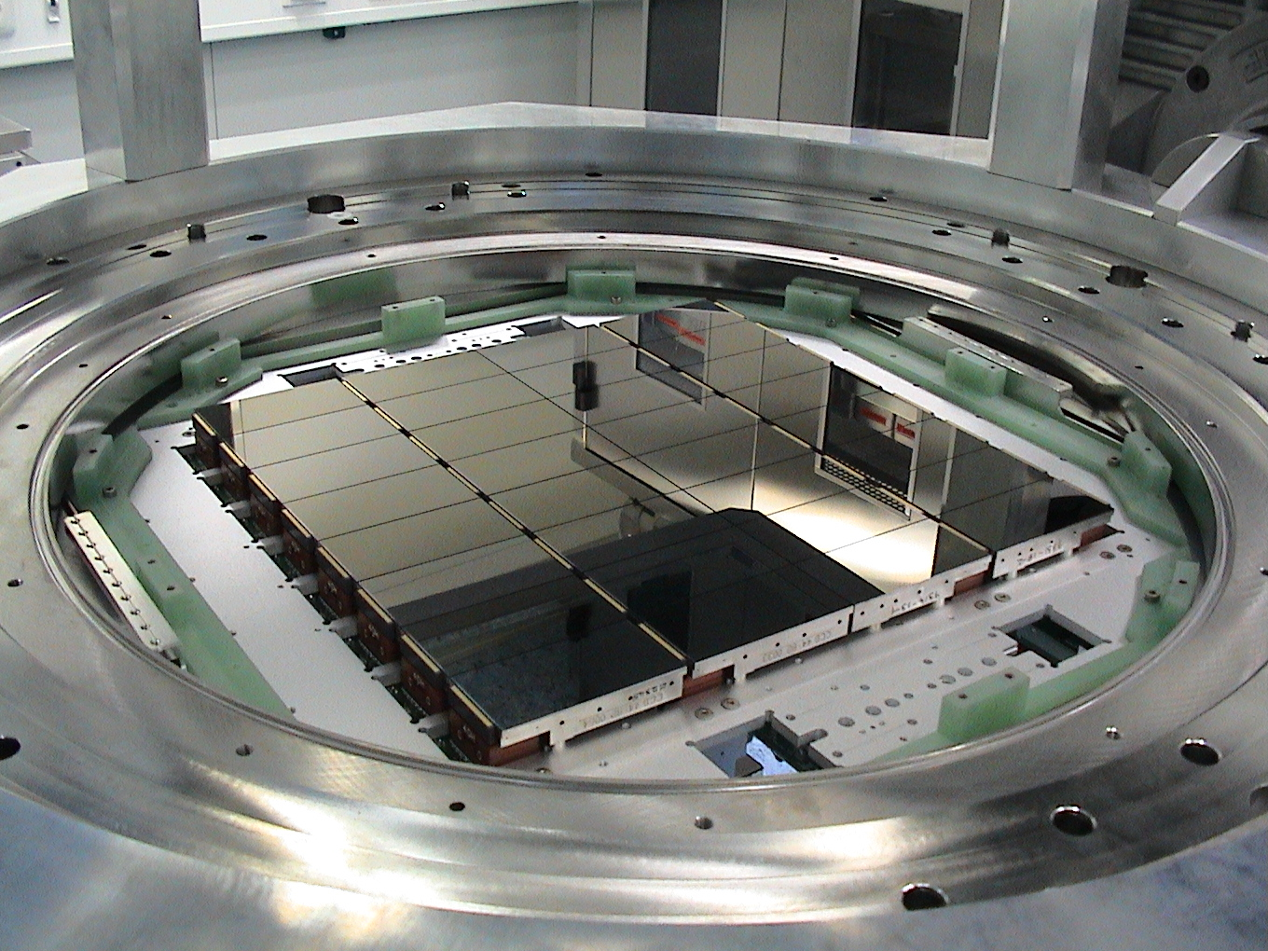
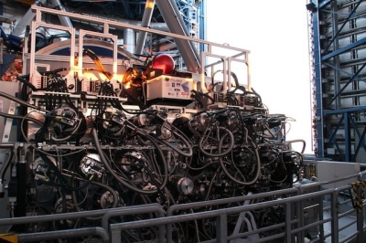
17 Instruments:
Imaging, Spectroscopy, IFU, AO, SAM,
Coronagraphy, Polarimetry, Interferometry

Slide 6
Number of proposals per site
~900 proposals
Every 6 months

Slide 7
Diversity and Flexibility
Observing Modes
Visitor (Classical) Mode
Service (Queue) Mode
Observing Programme Types
Normal – high priority, medium, filler type
Monitoring Programme – relatively small but long time
Target of Opportunity, Rapid Response Mode
Large Programme – 10 nights or longer
Public Surveys – imaging, spectroscopic surveys
Calibration Programme
Guaranteed Time Observations
Coordinated proposals with XMM

Slide 8
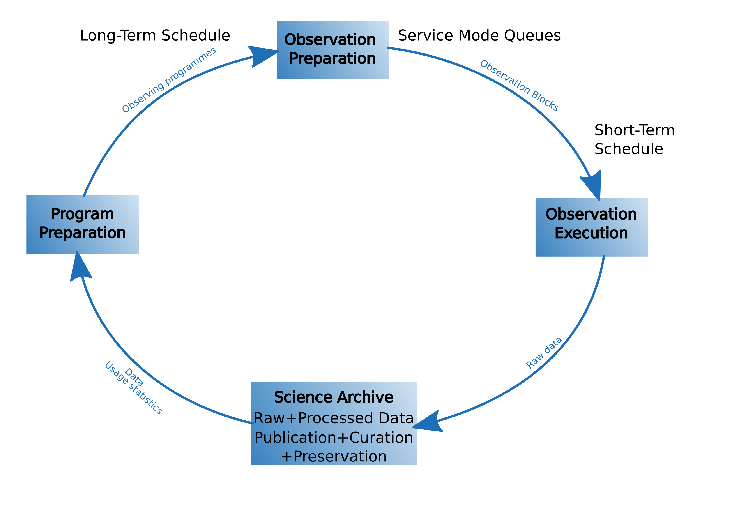

Slide 9
Telescope Time Allocation
Today
Call for Proposals every 6 months
OPC evaluates ~900 proposals (~1600 observing runs) → ranked list
Conversion of OPC ranked list into Telescope Schedule Web-letter release
Schedule maintenance (changes)
Director’s Discretionary Time (~60/semester)

Slide 10
Telescope Time Allocation Input
Science Operations Policy (SM/VM/GTO/ToO/RRM/…)
Ranked list of proposals from the OPC
Observatory constraints (fixed)
Commissioning and Maintenance
Calibration plan – fraction of SM allocation
Ongoing commitments
Large Programmes, Surveys, Carryovers
Technical feasibility for science proposals
Constraints: sky transparency, moon, atm turbulence
VLTI baselines, ESPRESSO 4UT mode, FORS2 blue CCD
Laser collisions

Slide 11
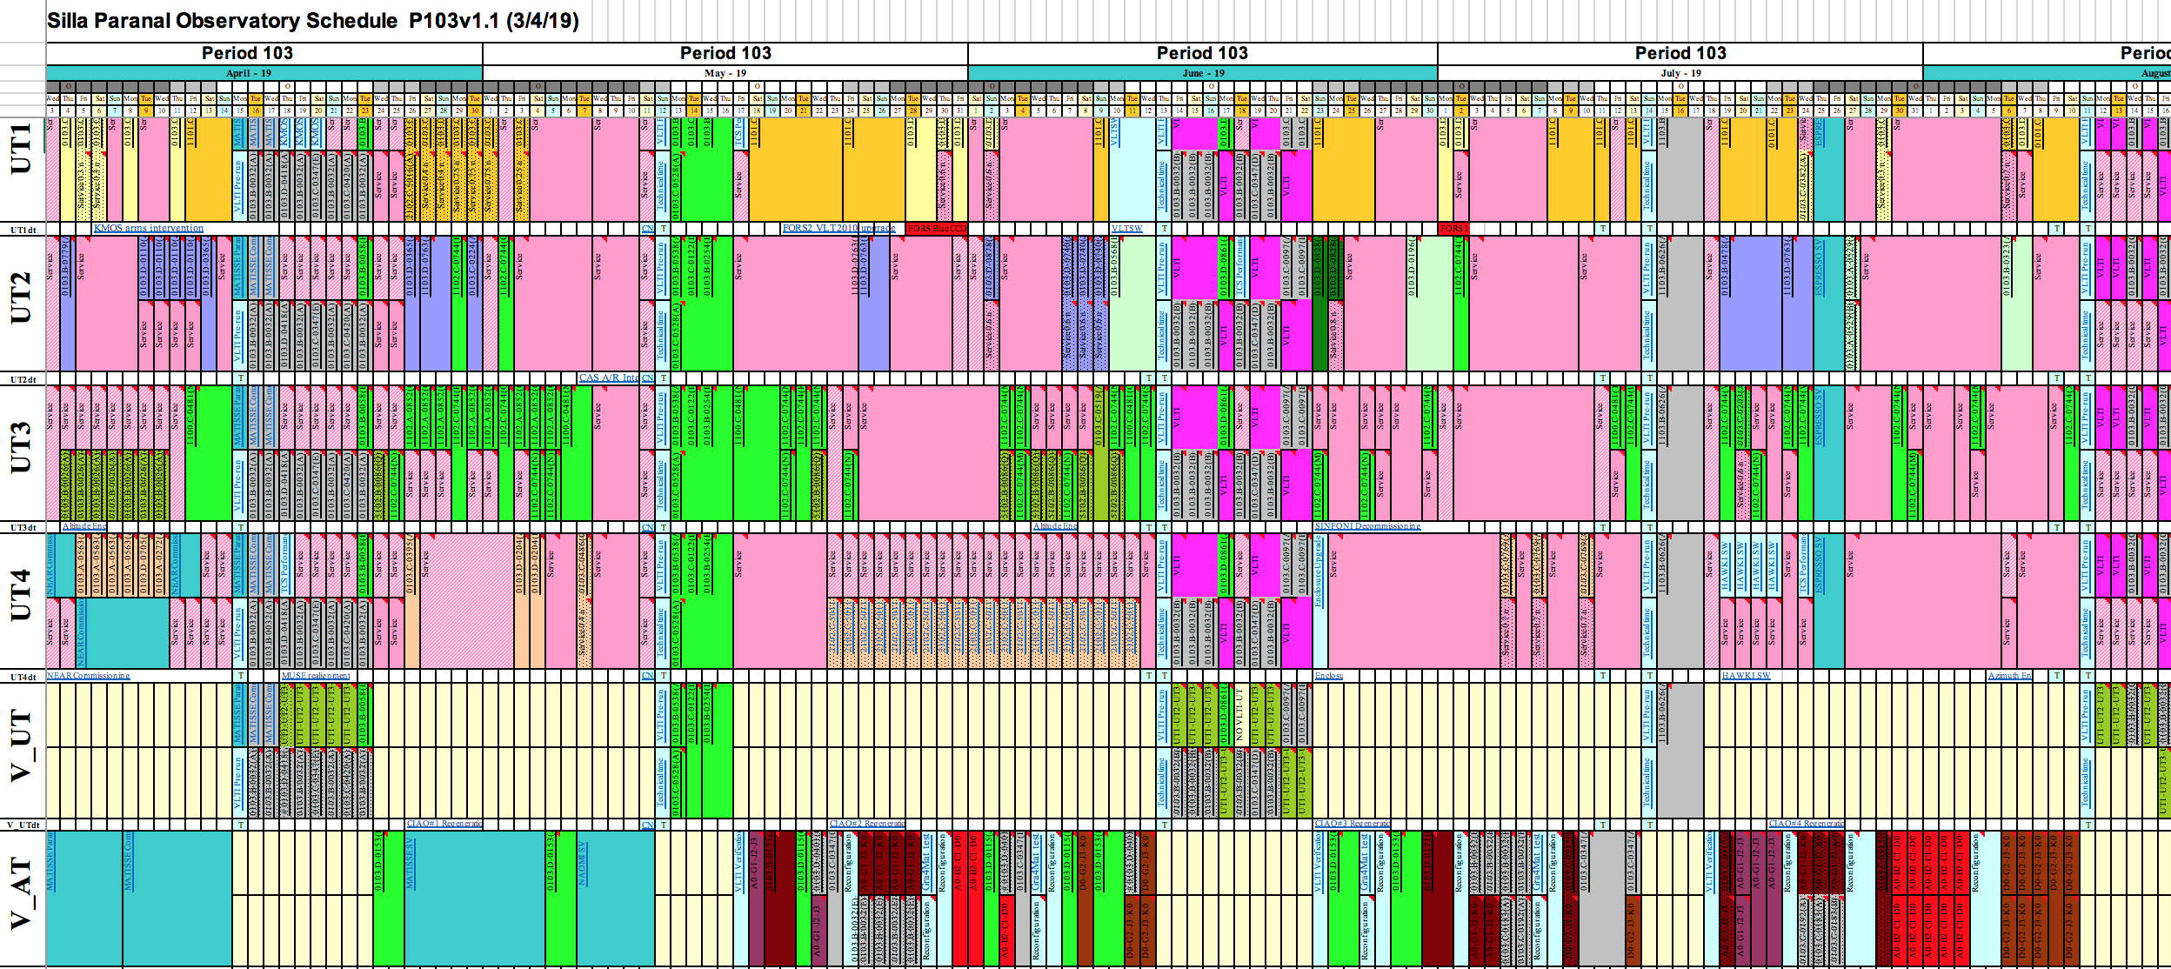
VLT+VLTI Long Term Schedule

Slide 12
Short Term Scheduling
Step 1: Observations Filtering
airmass, sky transparency, moon, PWV, GL fraction, τ₀
image quality as a function of airmass & filter (λ)
wind, AO friendly atmosphere, availability of laser, inst. configuration
sidereal time, absolute time (include long-term schedule)
Result: Observable vs. Non-observable queue
Step 2: Observations Ranking
scientific ranking of the programme
combined probability of the realization of observing constraints
time critical score + setting target score
user priority, group score, group contribution
Result: ranked list + rank justification

Slide 13
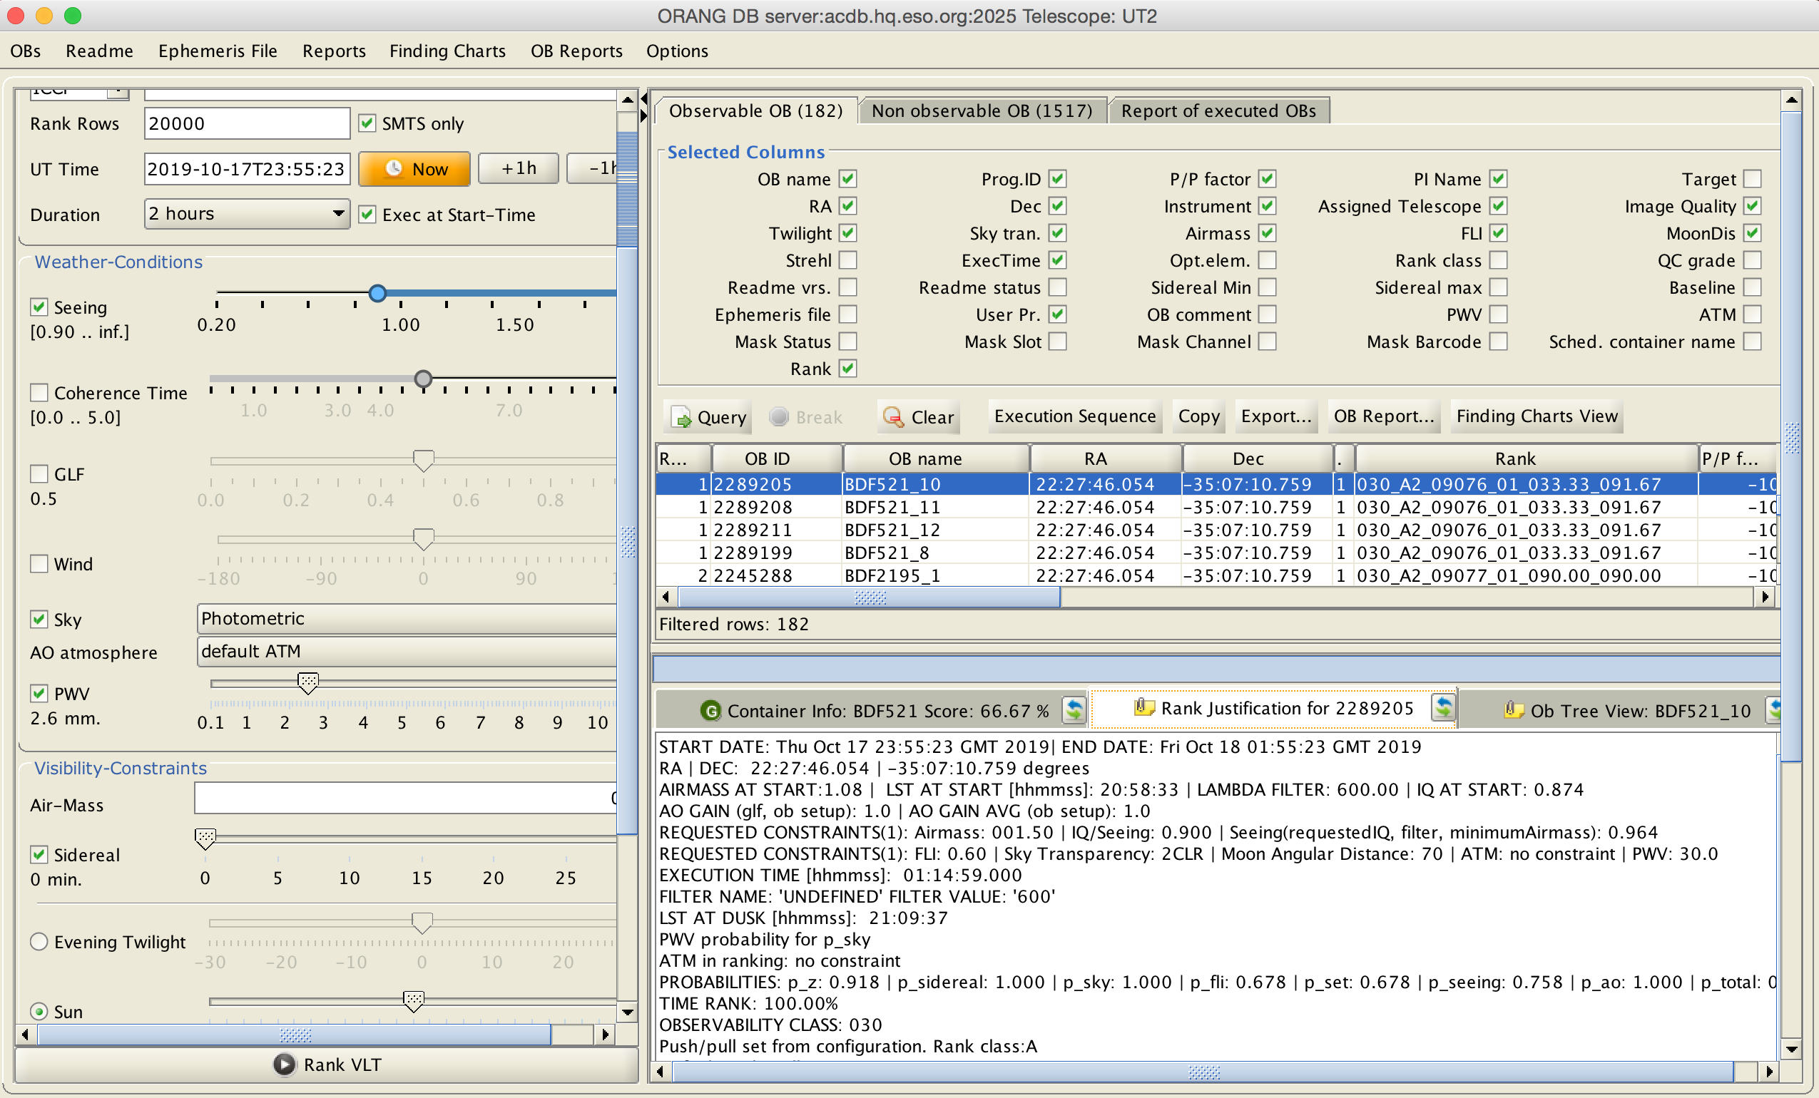
Short Term Scheduling

Slide 14
“Cross Facilities Collaboration in the Multi Messenger Era”
Currently – regular Call for Proposals (March/Sept)
Target of Opportunity
Rapid Response Mode
Director General Discretionary Time
Joint ESO VLT-XMM Proposals
Up to 80 hours; offered in yearly calls (odd periods)
Time Allocation Working Group Recommendations
Larger time allocations and yearly call
Faster turnover – fast track channel

Slide 15
New Time Allocation Tool (TAtwo)
Close the loop: Long – Short Term Schedule
Dynamical scheduling/changes
Getting ready for ELT
Time Allocation Working Group Recommendations
Yearly call for Proposals (OPC evaluation)
Fast track channel (Distributed Peer Review?)
Realistic constraints including time constraints & linking between observations

Slide 16
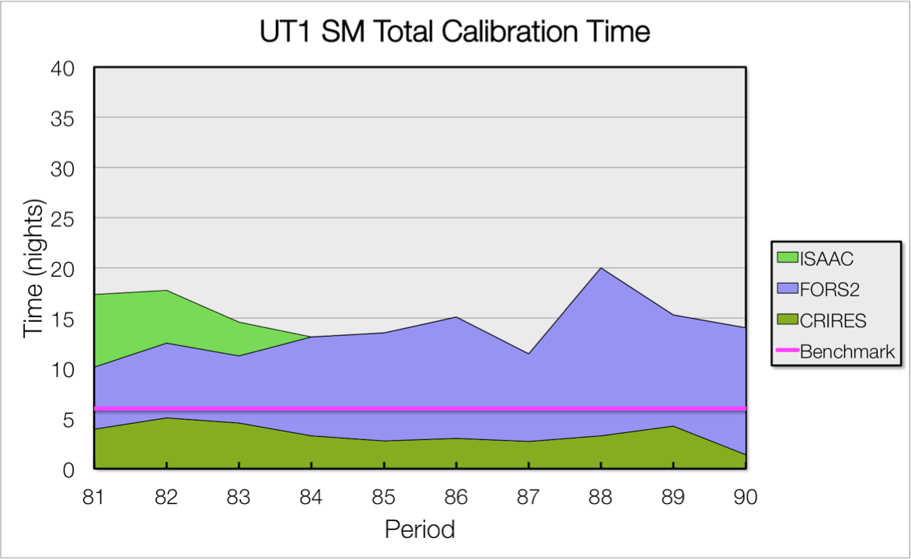
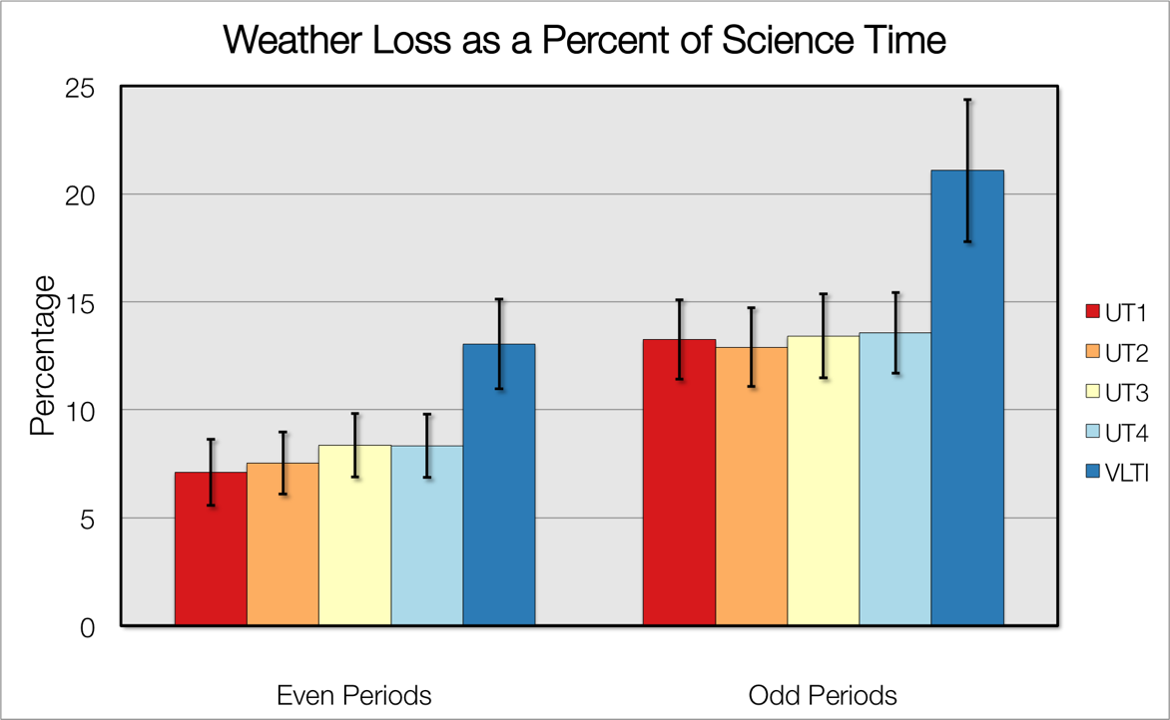
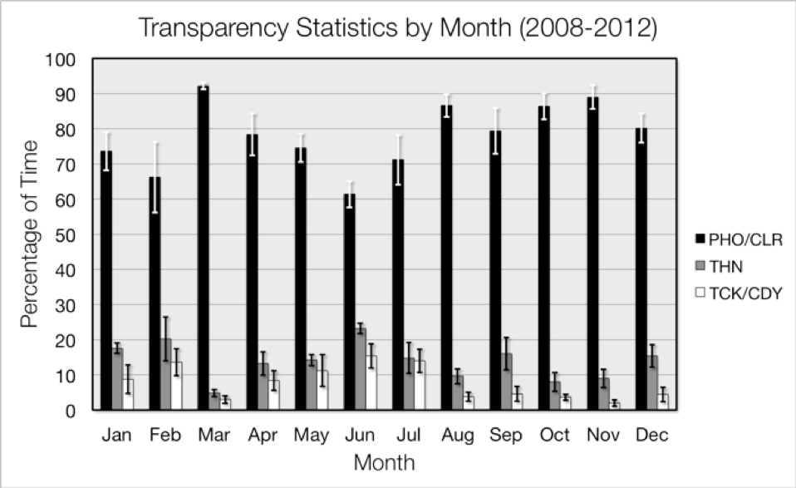
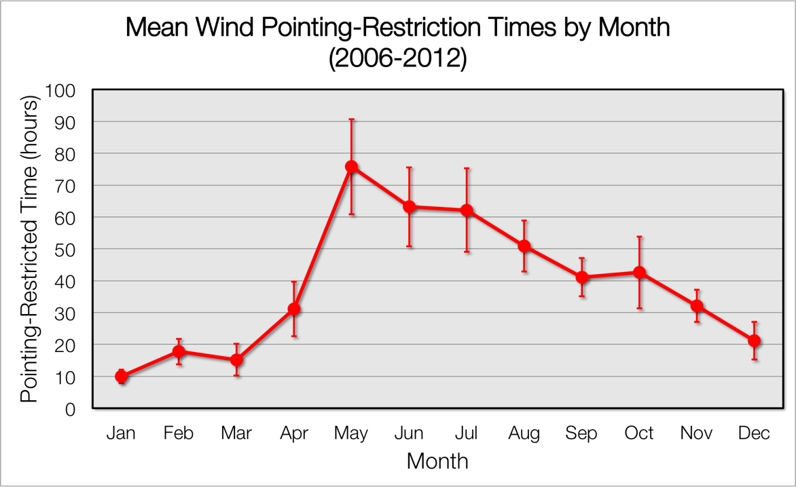
Metrics: input for scheduling

Slide 17
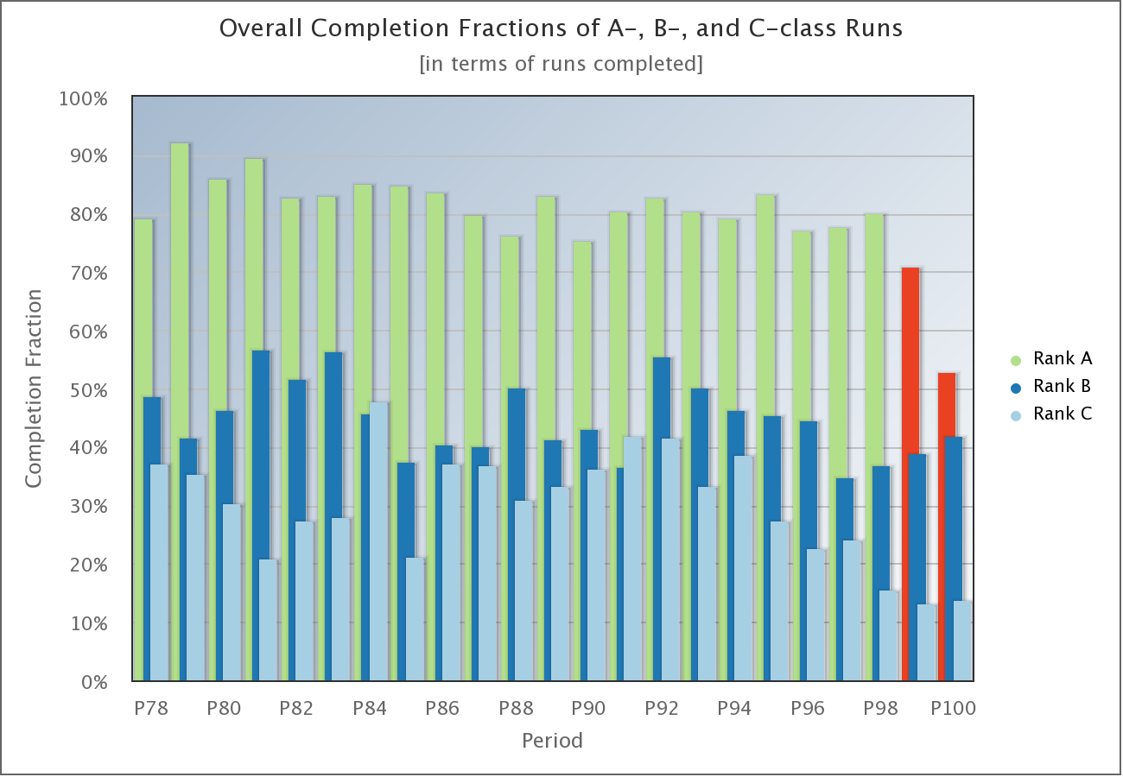
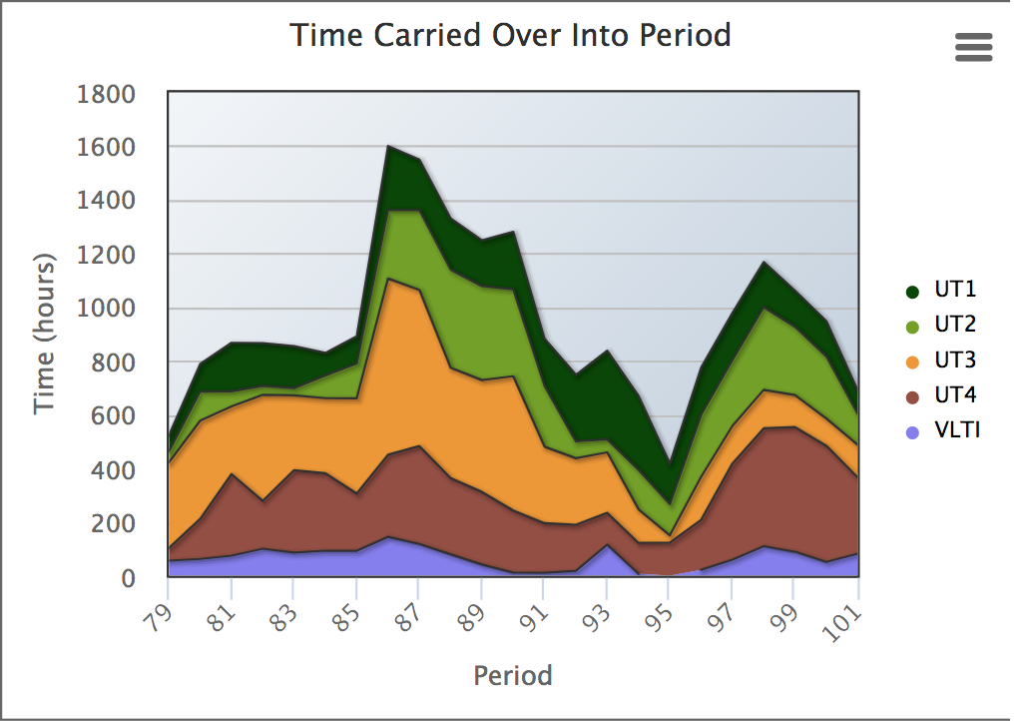
Metrics

Slide 18
Top Level Requirement
Maximise the scientific return within the operational specifications
Future:
TLR: Follow the ranking provided by the OPC as close as possible
TLR: Include the ongoing commitments
TLR: Include prioritised technical/programme needs within limit posed by the science policy

Slide 19
New Time Allocation Tool (TAtwo)
Top Level Requirement
maximize scientific return & minimize the differences between the OPC recommendations and the final outcome of an observing period within operational constraints

