Slide 1
Localised electron-induced X-ray fluorescence on the nightside surface of Mercury and its implications for magnetospheric structure
Simon Lindsay
Emma Bunce, Suzie Imber and Adrian Martindale
University of Leicester

Slide 2
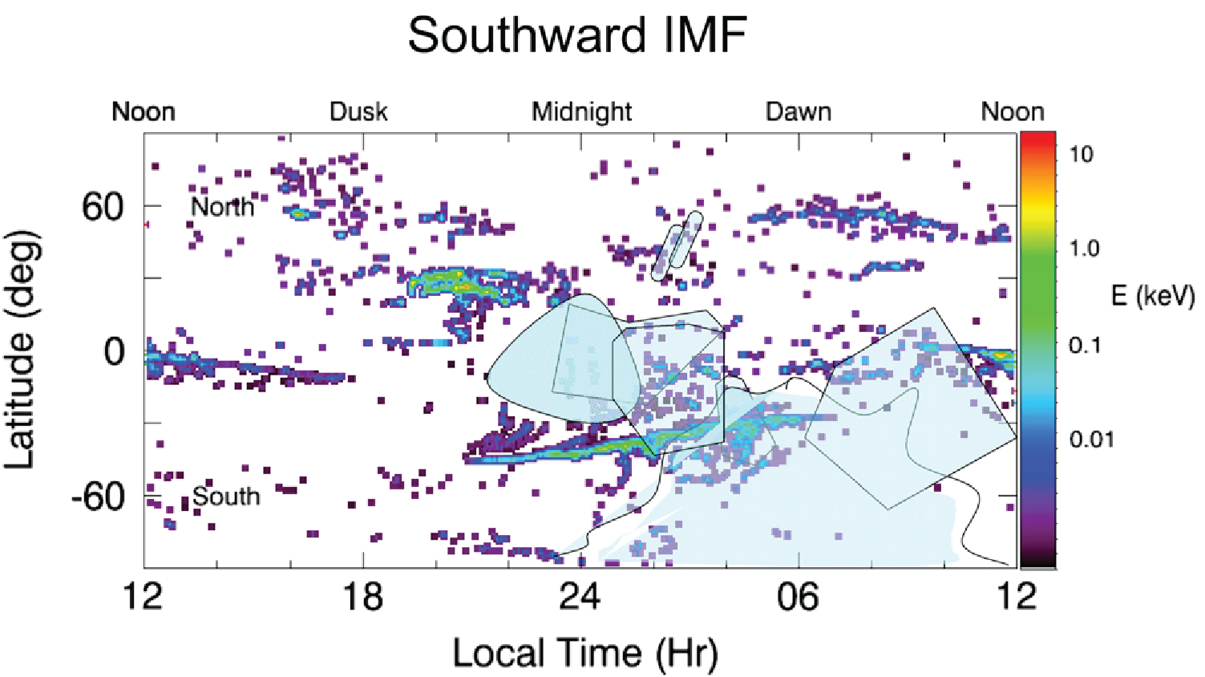
Electron fluorescence
Starr, R.D., et al., 2012. JGR 117, E00L02.

Slide 3
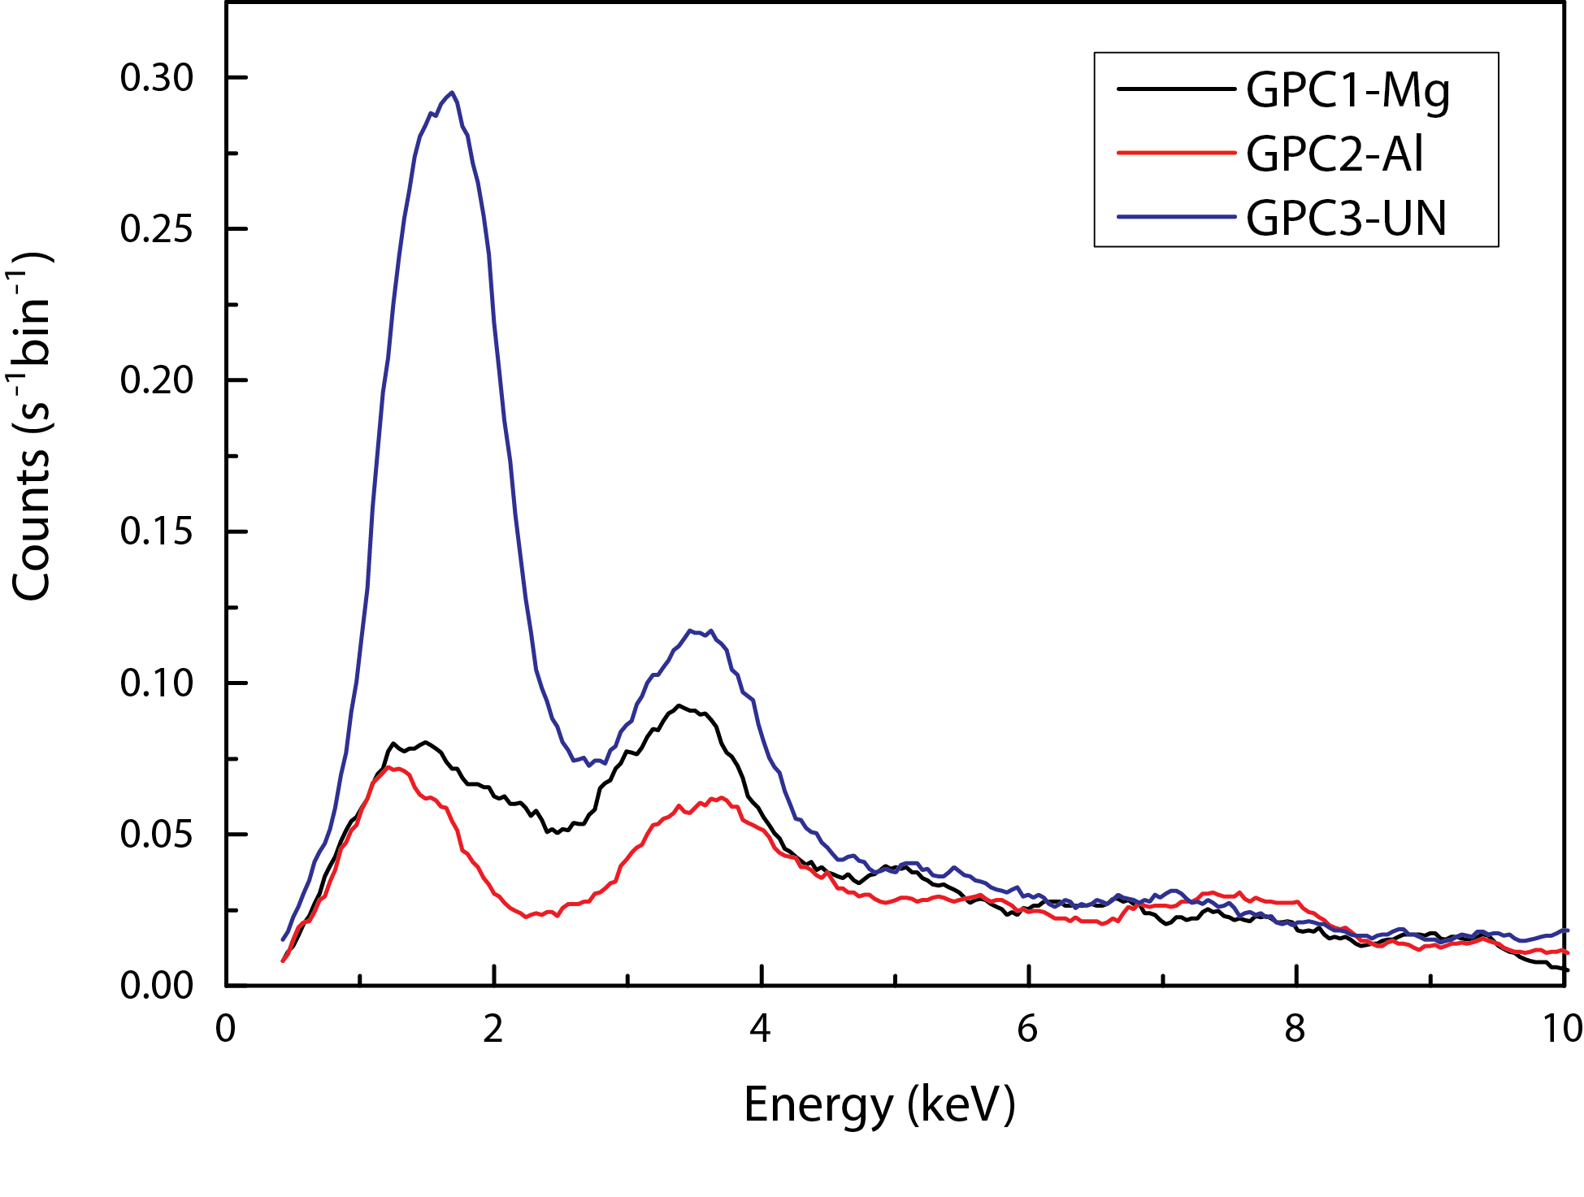
Identifying a new catalogue of events
Catalogue extended to March 2014
Events filtered by the presence of a significant Si-Kα (1.7keV) and/or Ca-Kα (3.7keV) peak while the surface is unlit
Instrumental self-fluorescent events are excluded
Catalogue contains 424 events over 177 (~6%) orbits

Slide 4
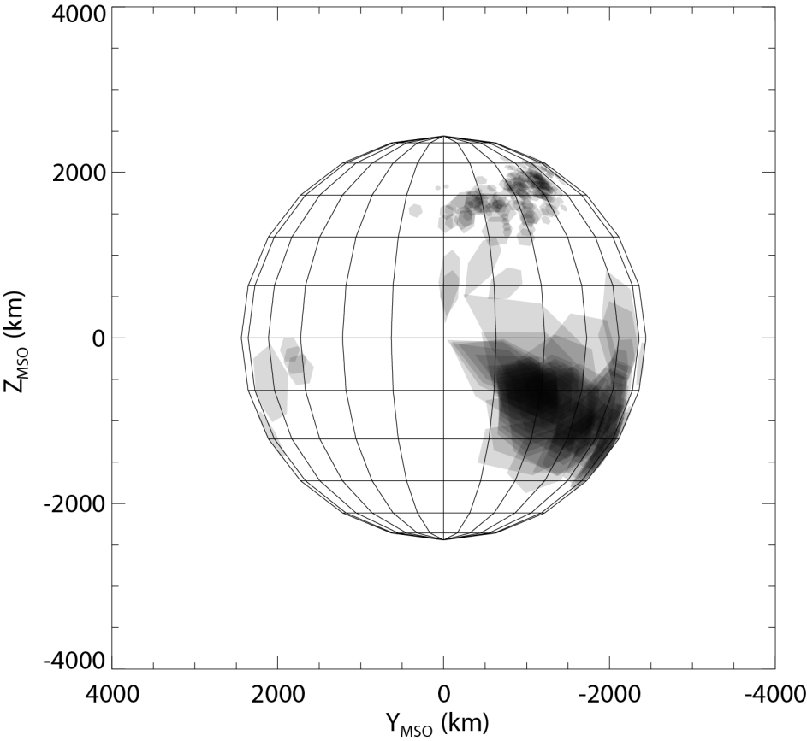
XRS footprints during events in catalogue
Sun

Slide 5
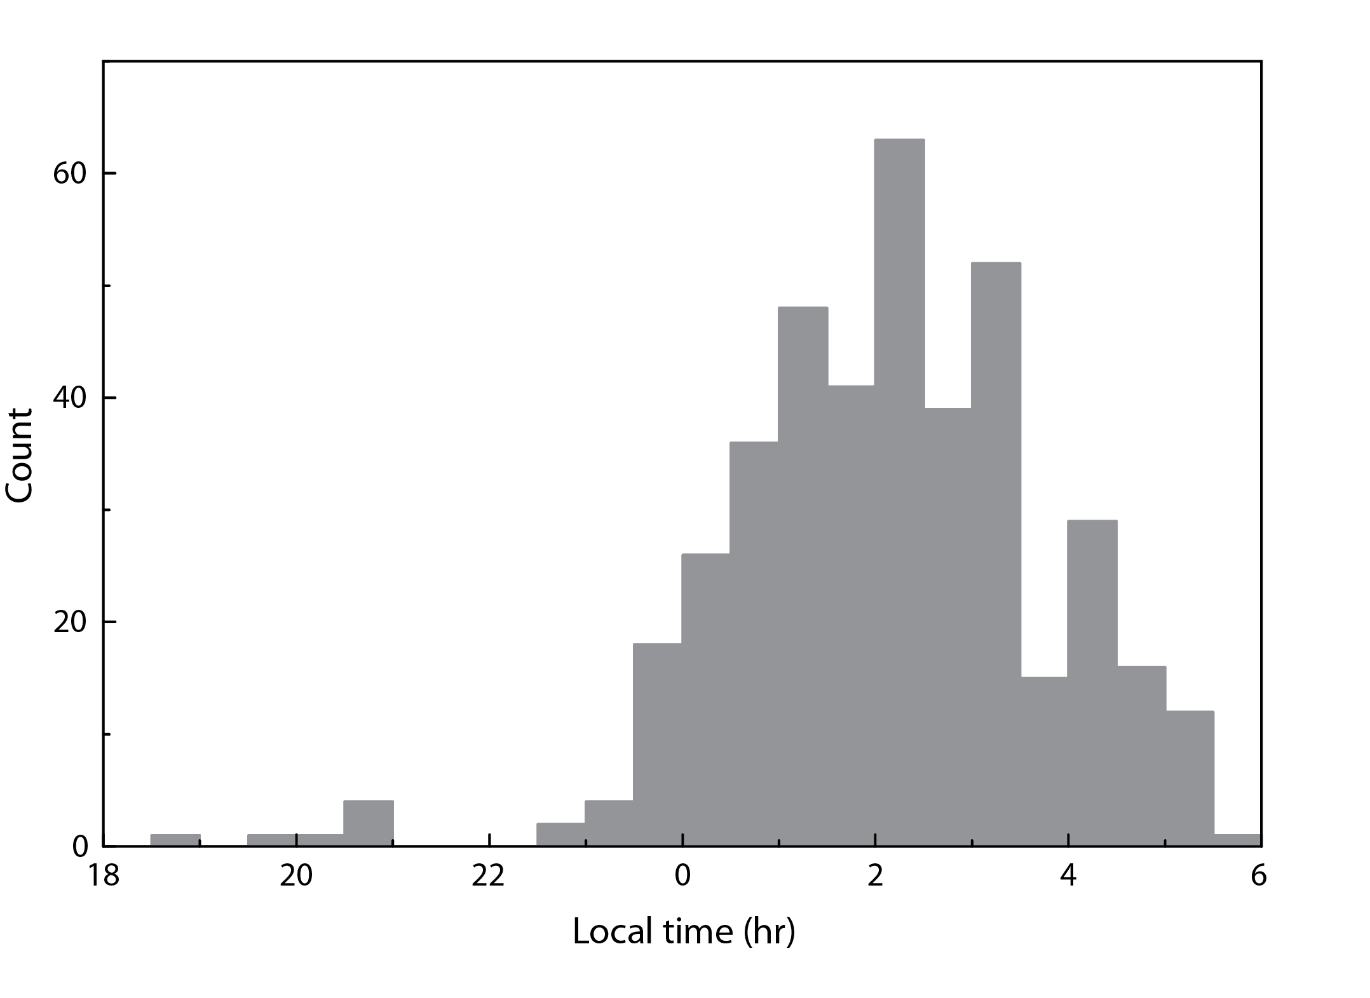
Footprint locations

Slide 6
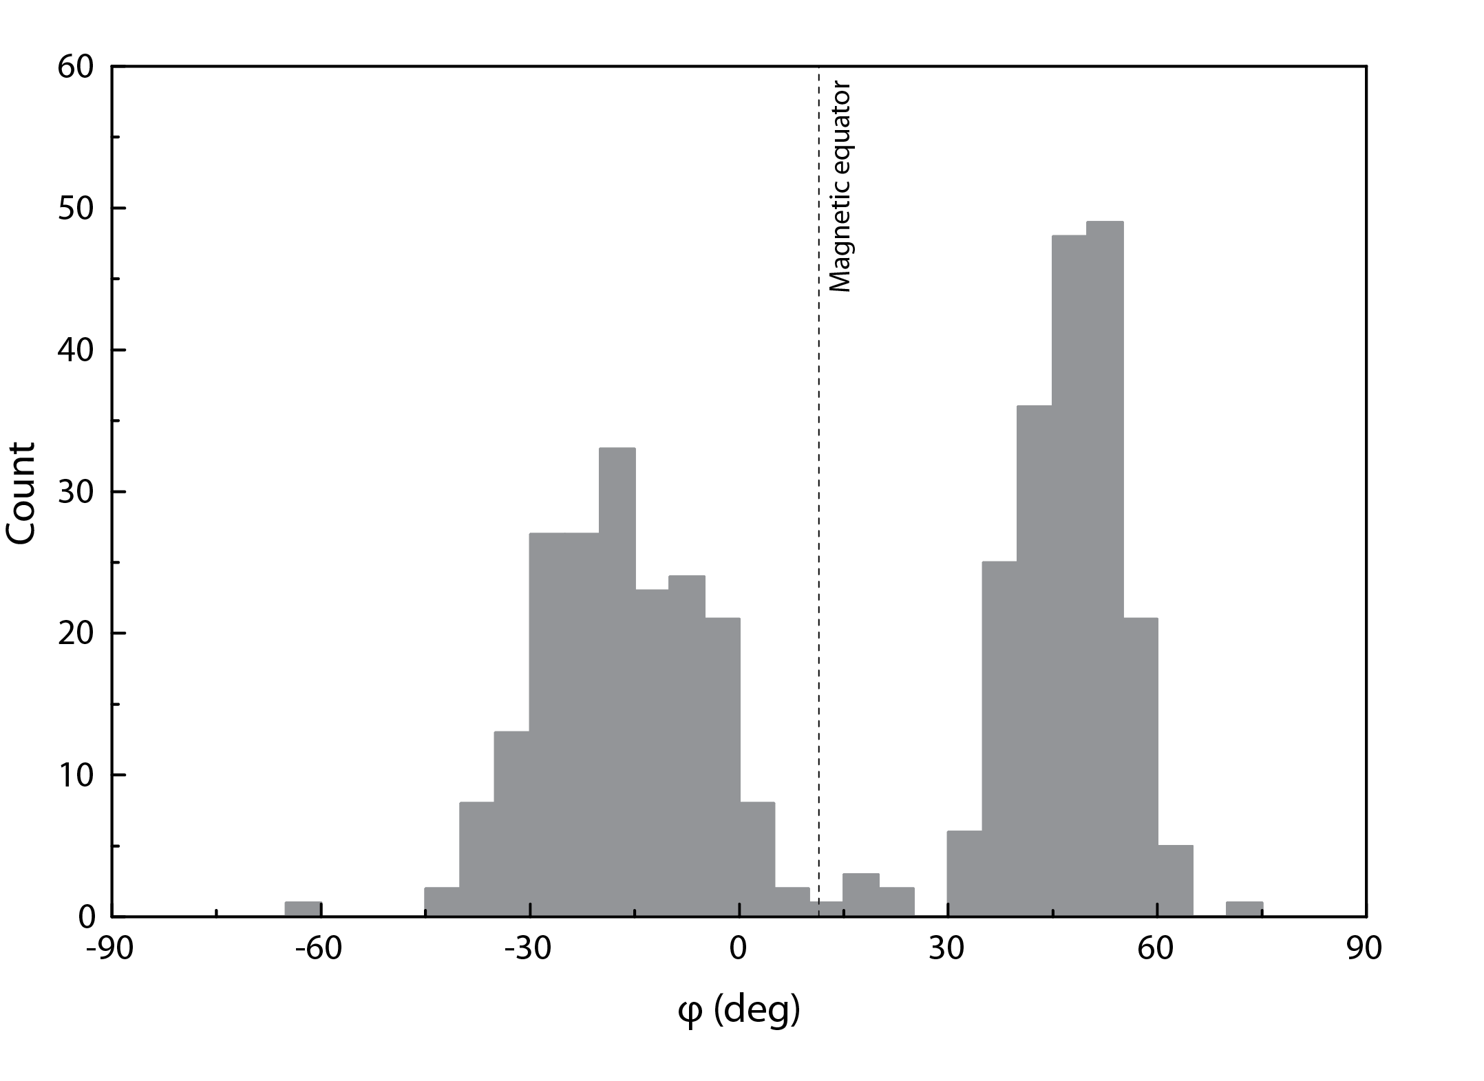
Footprint locations

Slide 7
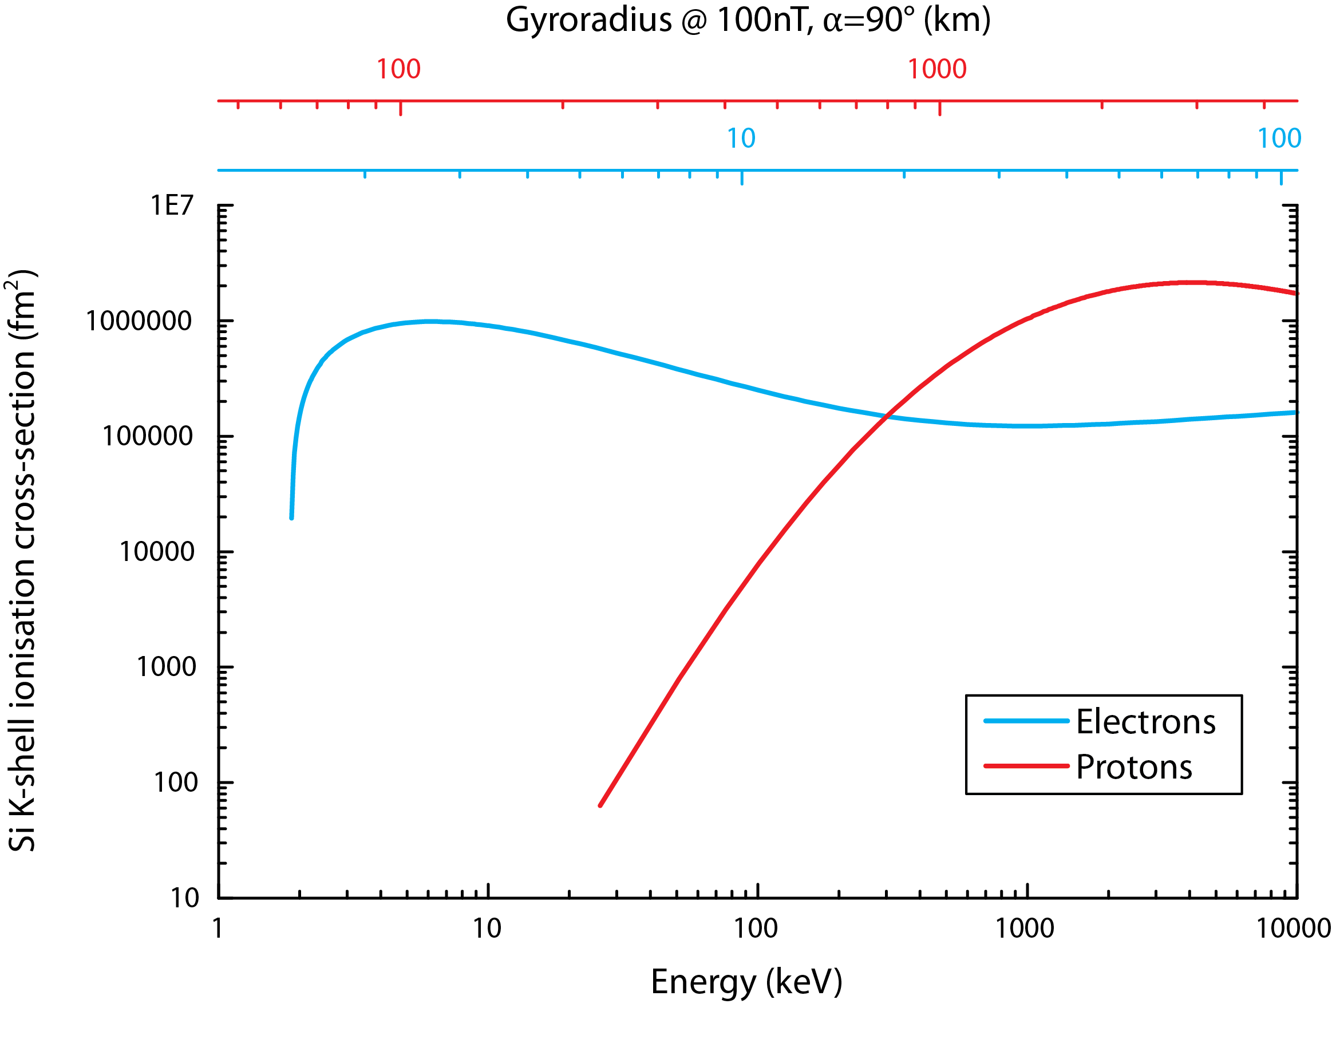
Source

Slide 8
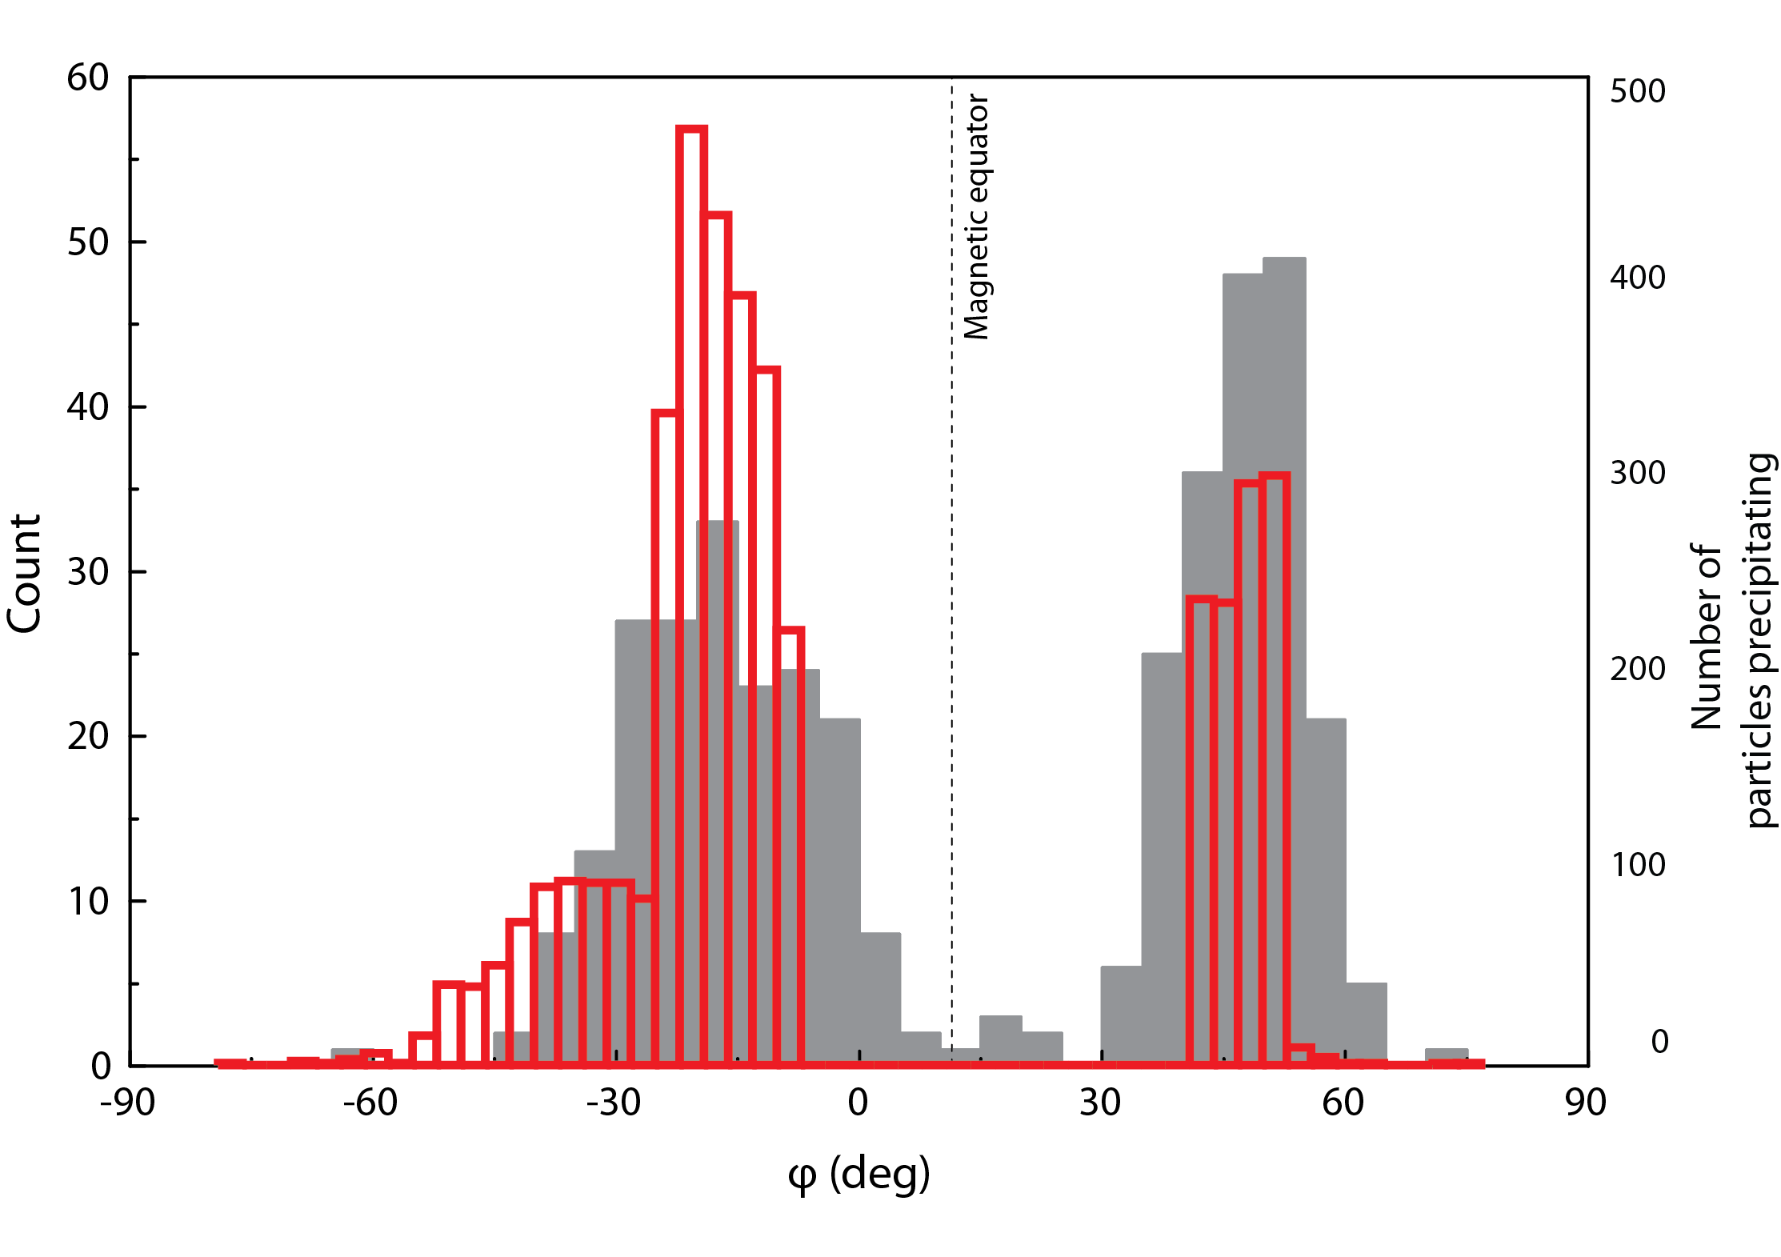
Footprint locations
Walsh, B.M., et al., 2013. JGR-SP 118, 1992-1999.

Slide 9
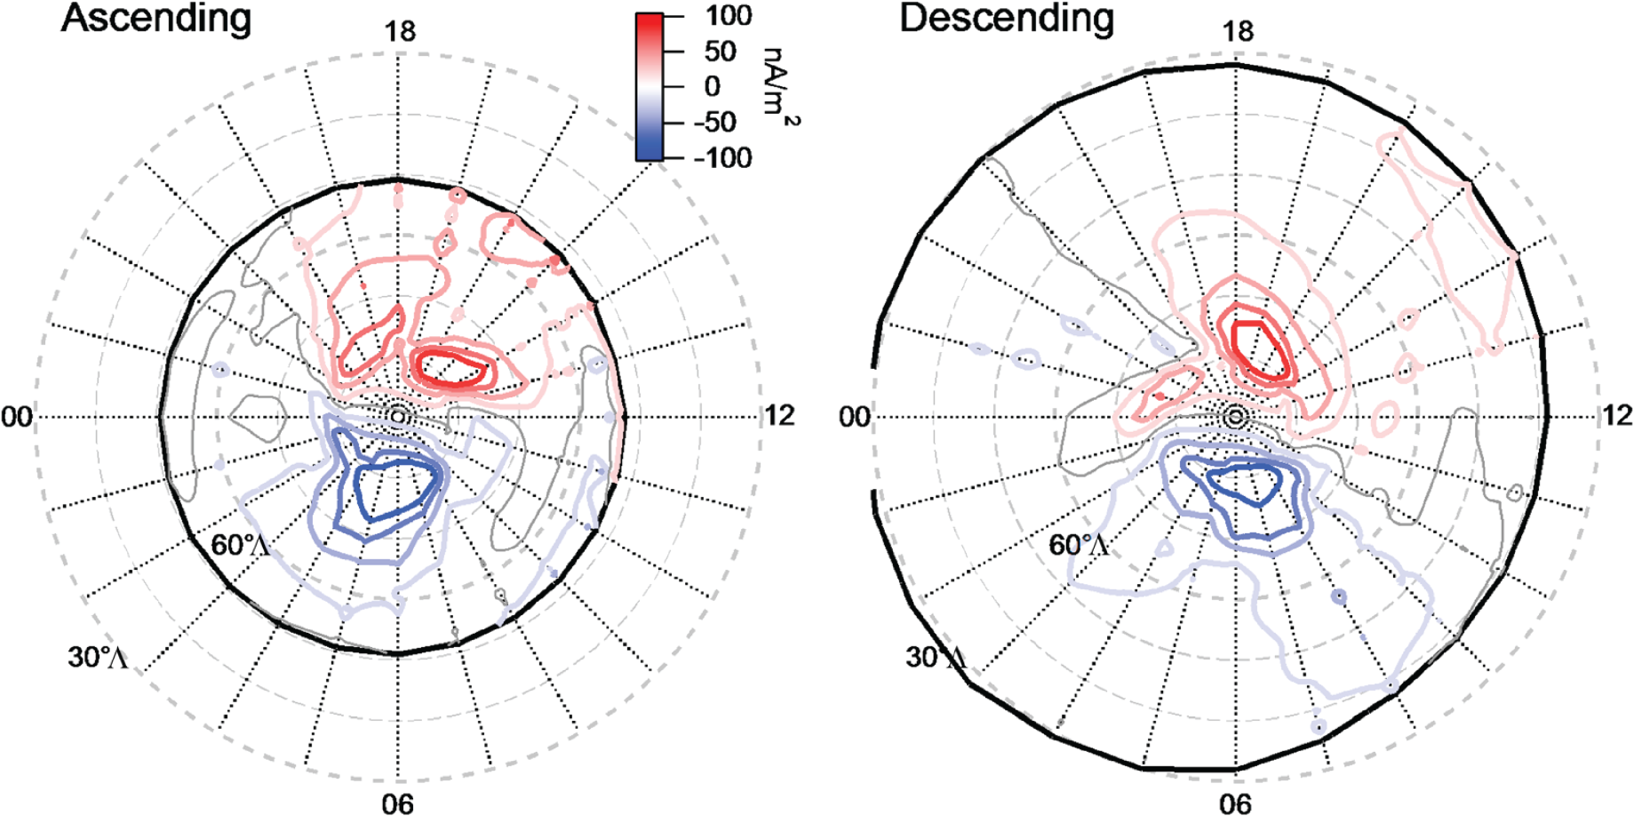
Current systems
Anderson, B.J., et al., 2014. GRL 41, 7444-7452.

Slide 10
Conclusions
We have identified a catalogue of nightside surface fluorescence events which appear to be the result of particle-induced X-ray emission
The footprints of XRS during these events are located almost exclusively on the dawn side of the planet and are arranged in two latitudinal bands, broadly symmetric about the magnetic equator
Simulations of electrons injected at the anti-sunward equator show similar patterns of precipitation
These regions are probably the footprints of magnetospheric features

Slide 11
Further work
Precisely which magnetospheric features are reflected in the footprint groupings?
Filtering can be improved and expanded – relax filter in proximity to identified events?
Synoptic analysis suggests many more fluorescence events occur; could filtering be improved to include these?
Why are events detected 8-12 hours apart when magnetospheric timescales are only a few minutes?
Are these events associated with other events in the magnetosphere as recorded by MESSENGER – for example by MAG, SAX or EPS?

Slide 12
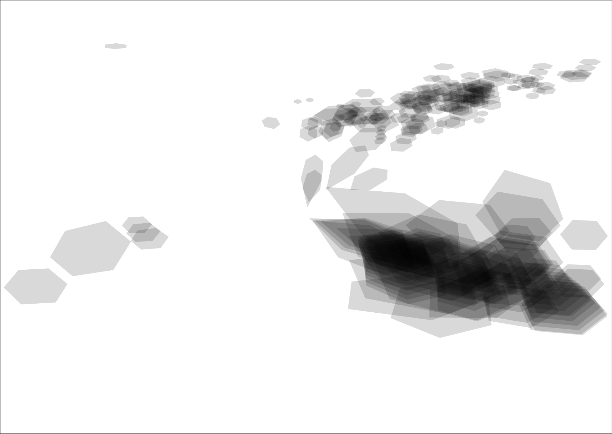
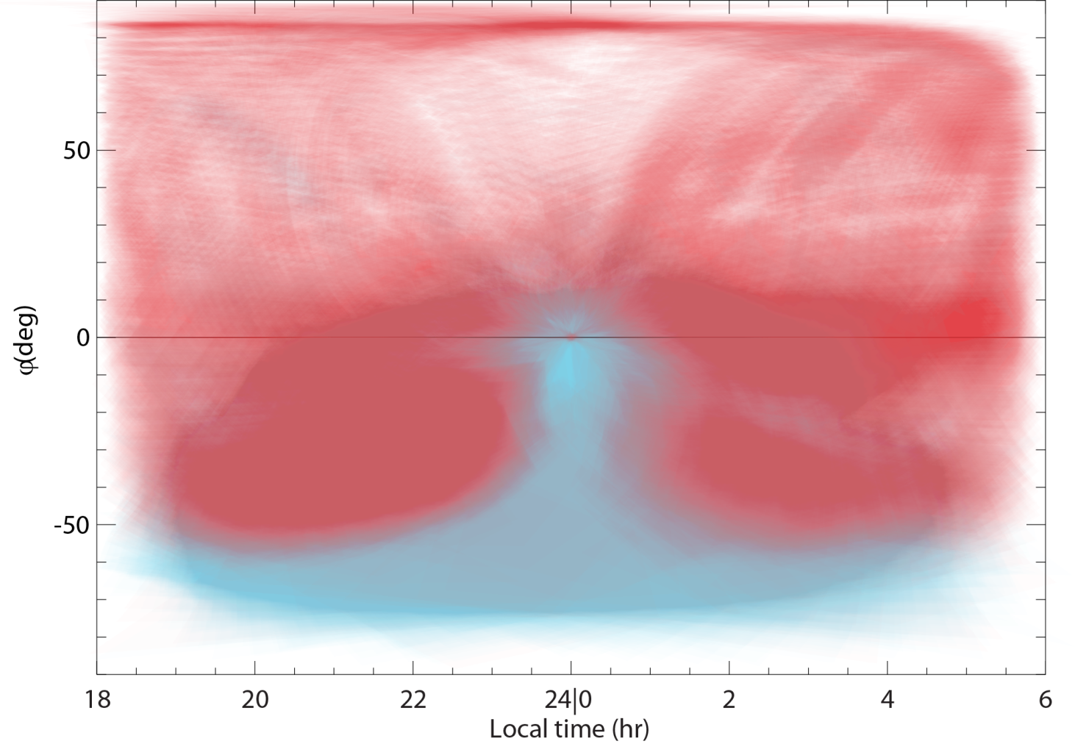
Coverage

