Slide 1
Studying the surface of Mercury with BepiColombo
Presented by Jörn Helbert
On behalf of the BepiColombo surface science working group and the operation team

Slide 2
The perception of joint surface science between MESSENGER and BepiColombo has seen many phases
We will do great surface science (and what is this MESSENGER mission??)
We will do great science with both missions observing the planet (almost) simultaneously
My instrument does much better surface science than all that other proposed instruments – and no way I will even mention MESSENGER
What can we do that MESSENGER hasn’t done already?
  (or the agency version – why do you need so much money for BepiColombo if MESSENGER has done it already)
MESSENGER raised so many questions that we didn’t even know about and with BepiColombo we might provide some answers
  And surely raise many new questions…

Slide 3
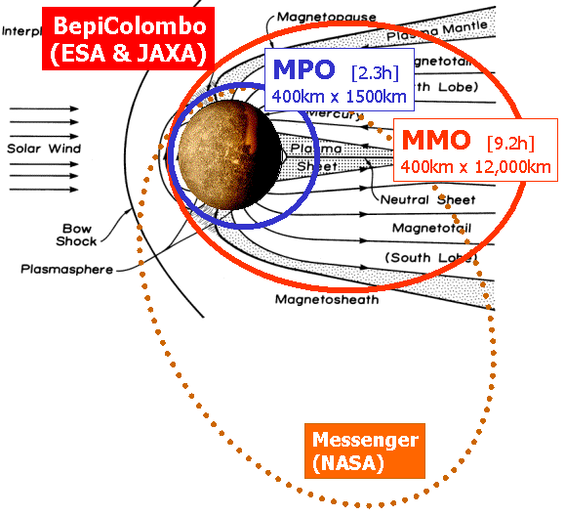
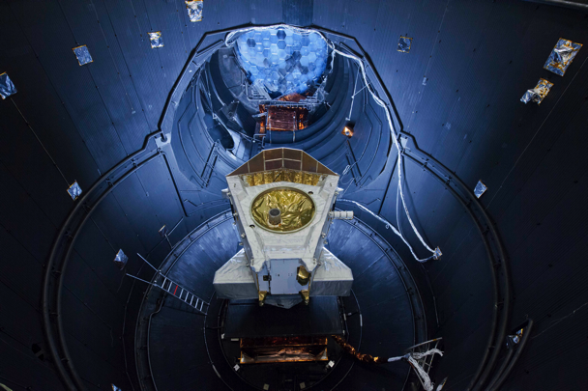
So what can BepiColombo bring to the table for surface science after MESSENGER?
MPO will be in an „almost“ circular orbit
Mainly nadir pointing without constraints from sunshade
5 instruments dedicated to surface science
580km

Slide 4
BepiColombo MPO Instruments
Instrument | Long Name | Scientific Objective | Avg power/ Orbit (W) | Mass, CBE w.o hn (kg)
BELA | BepiColombo Laser Altimeter | Mercury surface topographic mapping | 36.1 | 13.3
ISA | Italian Spring Accelerometer | Non-gravitational acceleration measurements of the spacecraft | 12.1 | 5.7
MERMAG | Mercury Magnetometer | Measurement of Mercury magnetic field, its source and interaction with solar wind | 4.6 | 1.8
MERTIS | Mercury Thermal & Infra-red spectrometer | Global mineralogical mapping, surface temperature and thermal inertia | 13.0 | 3.3
MGNS | Mercury Gamma-ray & Neutron Spectrometer | Elemental surface and sub-surface composition, volatile deposits on polar areas | 4.5 | 5.2
MIXS | Mercury Imaging X-ray Spectrometer | Elemental surface composition, global mapping and composition of surface areas | 16.0* | 7.3
MORE | Mercury Orbiter Radio-science Experiment | Core and mantle structure, Mercury orbit, fundamental science, gravity field | 37.0 | 3.5
PHEBUS | Probing of Hermean Exosphere by Ultraviolet Spectroscopy | UV spectral mapping of the exosphere | 3.8 | 7.5
SERENA | Search for Exospheric Refilling and Emitted Natural Abundances | In-Situ study of composition, vertical structure and source and sink process of the exosphere | 22.4* | 5.6
SIMBIO-SYS | Spectrometers & Imagers for MPO BepiColombo - System | Optical high-resolution and stereo imaging. Near-IR imaging spectroscopy for global mineralogical mapping | 32.5* | 11.1
SIXS | SIXS Solar Intensity X-ray and Particle Spectrometer | Monitor for solar X-ray intensity and solar particles in support of MIXS | 2.5 | 2.0
Total | - | - | 185.5 | 66.3
MMO | Mercury Magnetospheric Orbiter | Study of field, waves and particles in the Mercury exosphere. | 300 | 250

Slide 5
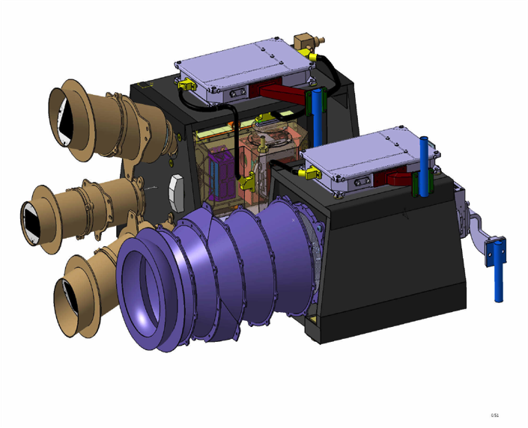
SIMBIO-SYS
The SIMBIO-SYS (Spectrometer and Imagers for MPO BepiColombo – Integrated Observatory SYStem) instrument architecture is based on 3 different optical channels sharing a common Main Electronics and PDU.
STC
HRIC
Local mapping at high resolution with colour capabilities, about 20% of the surface, at a spatial scale of 5-11 m/pixel
Filters: pan, 550, 750, 880 nm.
STC
Global stereo mapping at a spatial scale of 50-110 m/pixel.
Local color mapping at 50-110 m/pixel
Filters: pan, 420, 550, 750, 920 nm.
VIHI
Global mineralogical mapping at a spatial scale < 500 m/pixel
Local mineralogical mapping at 100 m/pixel
Spectral coverage 0.4-2.0 µm with 6.25 nm resolution
Flamini et al. PSS 58, 2010
VIHI
HRIC

Slide 6
SIMBIO-SYS compared to MDIS and MASCS
Imaging performance comparison
MDIS-NAC | SIMBIO-SYS HRIC | MDIS-WAC | SIMBIO-SYS STC
26 μrad/pxl | 12.5 μrad/pxl | 179 μrad/pxl | 111 μrad/pxl
1 bb filter | 1 pan + 3 bb | 11 nb + 1 nav | 2 pan + 4 bb
 | MASCS-VIRS | VIHI
Type | Pointer Spec. | Imaging Spec.
Spectral range | 0.3-1.45 µm | 0.4-2 µm
Spectral sampling | 4nm | 6.25nm
#channels | 768 | 256
FOV | 0. 023-0.023° | 3.7°x0.014°
IFOV | - | 250x250 µrad²
IFoV
filters

Slide 7
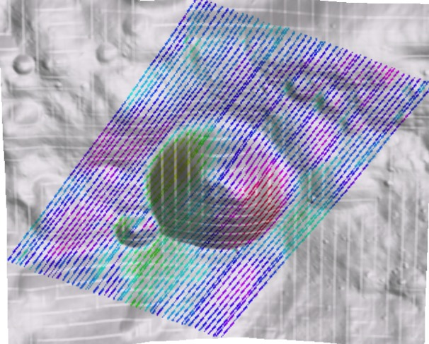
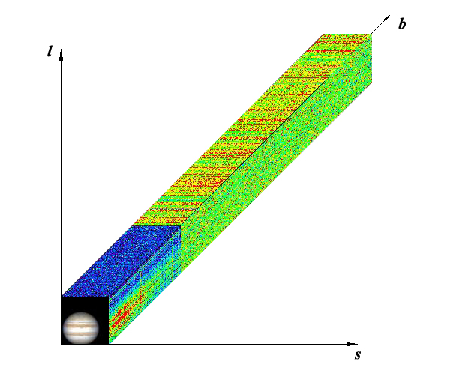
SIMBIO-SYS Visible and Near-Infrared hyperspectral imaging
VIHI will produce hyperspectral maps, with compositional information, that together with other compositional maps from other instrument onboard BepiColombo (MERTIS, MIXS) could integrate the morpho-tectonic and stratigraphic mapping to produce high detailed geological maps
Higher opportunity to identify spectral and compositional differences, and correlate it spatially with cameras
Example from VIR (Dawn)
VIHI spatial res: 100-375 mpp
(Capaccioni et al 2013)
Hyperspectral cube
180mpp
10km
Scan direction
Wavelength
Spectral information will be acquired by only one detector;
No data bridging
Scan direction
slit direction
VIHI data
Slit direction

Slide 8
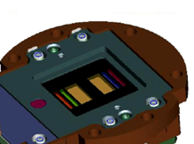
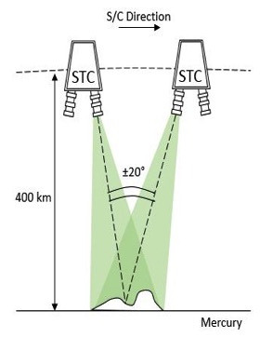
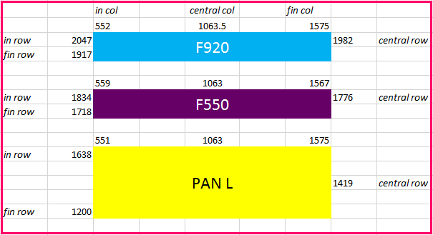
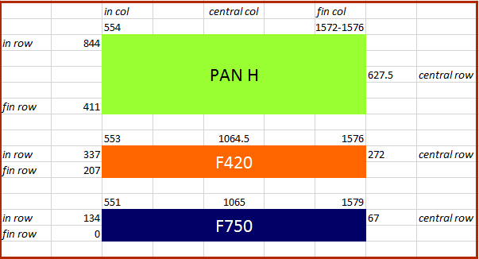
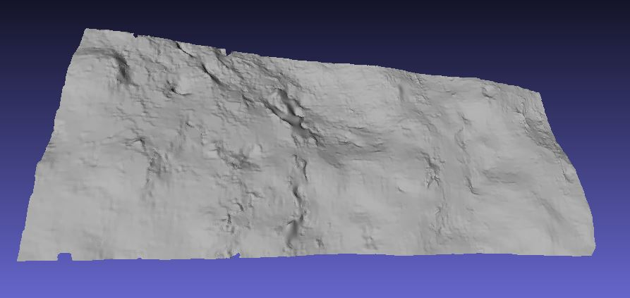
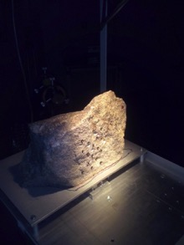
SIMBIO-SYS Stereo imaging
Stereo pairs will be acquired by using 2 panchromatic filters on the same detector.
Image acquisition is the push-frame, one image at the equator 2.5°x 5.3°
Global DTM with a vertical accuracy of 50-100 m
784 pixels 5°
Along track
784 pixels 5°
STC DTM of an anorthosite stone acquired in
laboratory during the STC stereo validation
835 pixels 5.3°
Cross track

Slide 9
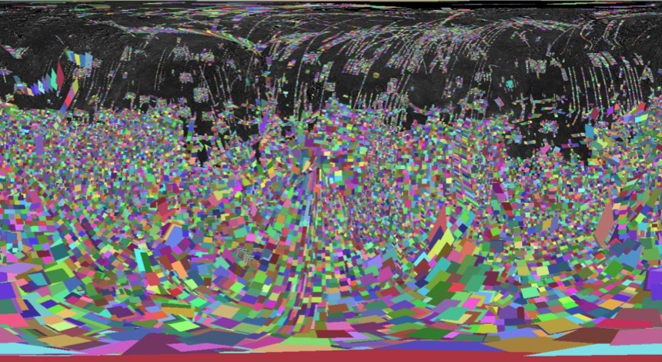
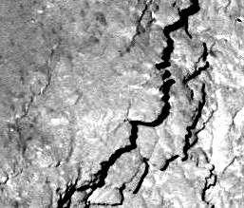
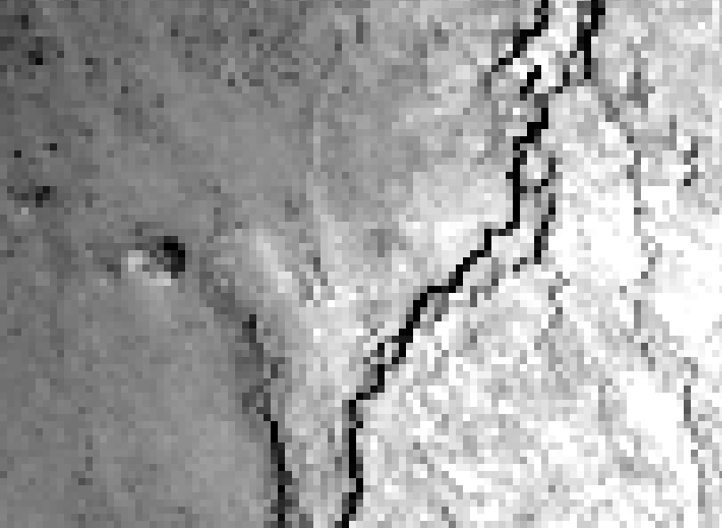
SIMBIO-SYS High Resolution imaging
SIMBIO-SYS HRIC IFoV is:
~1/2 wrt MDIS-NAC IFoV
~1/14 wrt MDIS-WAC IFoV
These instrument characteristics have to be coupled with the observation geometry and mission design
HRIC/NAC FoV comparison
1024 px
NAC
1024 px
90°
~8
÷
~280
30°
HRIC pan
~14
÷
~294
640 px
RESOLUTION RANGE (mpp)
0°
2048 px
~30
÷
~400
-30°
~60
÷
~400
MDIS-NAC orbital footprint coverage
-90°
HRIC resolution will not depends much on latitude
The estimated average HRIC spatial resolution will be ~10x better than MDIS-NAC (HRIC sampling range is [~6÷20 mpp] vs. NAC [~8÷400 mpp]*)
HRIC coverage on the surface will be up to 20%, depending on the average resolution – coverage trade-off
Image resolution improvement simulation (10x)

Slide 10
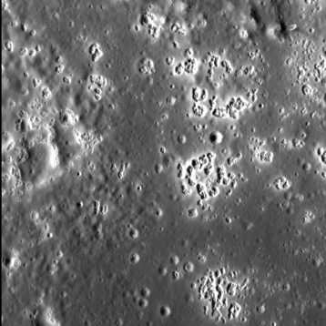
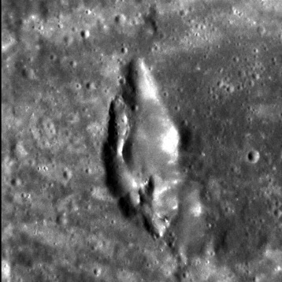
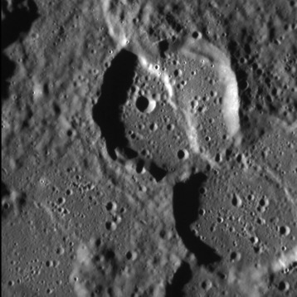
Surface science with SIMBIO-SYS
Some examples of scientific targets that need further investigation using higher resolution imaging, topography and spectroscopy
HOLLOWS
VENTS
From MDIS data:
Thomas et al., 2014a
Blewett et al., 2013
Blewett et al., 2011
From MDIS data:
Thomas et al., 2014a
Thomas et al., 2014b
Goudge et al., 2014
Kerber et al., 2011
Head et al., 2008
MDIS NAC ID: 8072780
MDIS NAC ID: 638531
FAULTS
There are still open questions on:
Formation
Timing
Interaction (e.g. faults vs. vents)
SIMBIO-SYS will further investigate the surface morphology, colors and composition of these features (and many others) with improved resolution
From MDIS data:
Watters et al., 2015
Klimczak et al., 2015
Galluzzi et al., 2015
Massironi et al., 2015
Byrne et al., 2014
Di Achille et al., 2012
Watters et al., 2009
MDIS NAC ID: 7847458

Slide 11

MERTIS - Mercury Radiometer and Thermal infrared Imaging Spectrometer
Principle Investigators
Dr. J. Helbert
DLR
Prof. H. Hiesinger
University of Münster
Monoblock
3.1 kg - 10W
Uncooled microbolometer
7-14μm @ 200nm
Global coverage @ up to 280m
Integrated μ-radiometer 7-40 μm
No comparable instrument on the NASA MESSENGER mission

Slide 12
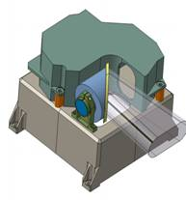
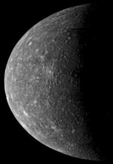

Scientific goals of MERTIS
MERTIS has four main scientific objectives, building on the general science objectives of the Bepi-Colombo mission.
Study of Mercury‘s surface composition in the TIR
Identification of rock-forming
minerals
  Spectral range 7-14μm
  Spectral resolution better
  than 200nm
Global mapping of the surface mineralogy
  Global mapping with spatial resolution better than 500m
  10% of the planet with better than 500m resolution
Study of surface temperature and thermal inertia
  NETD <1K for typical nightside temperature of 80K
Identification of rock-forming minerals
Mapping of the surface mineralogy
λ
Map the nightside temperatures
Study of
selected targets

Slide 13

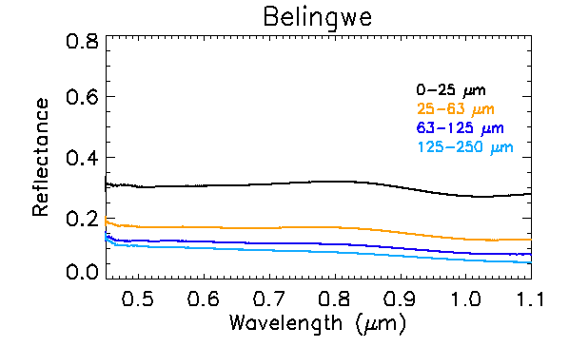
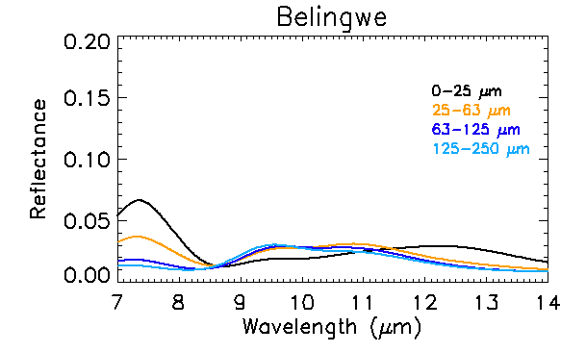
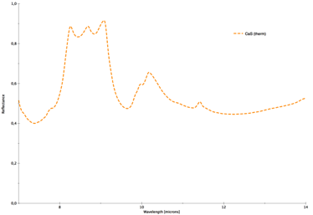
Two examples why it is important to study Mercury in the thermal infrared to identify the mineralogy
Komatiite as compositional analog
Maturilli et al. 2013
Sulfide as a potential hollow forming material
Helbert et al. 2013

Slide 14
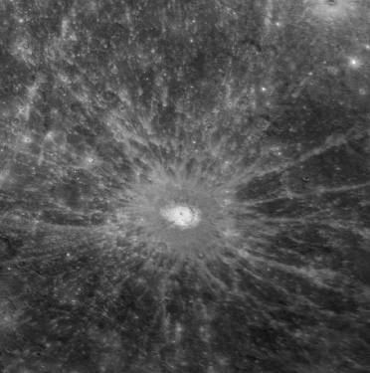
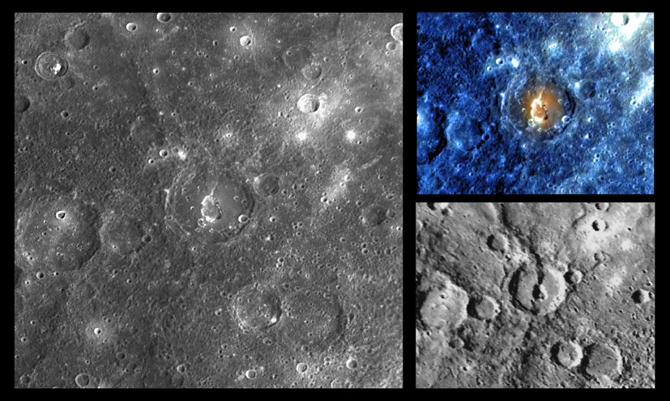
MERTIS will obtain a hyper-spectral global map at 500m (or better) resolution
This is equivalent to the resolution of the MESSENGER imaging system obtained during the flyby‘s
For volcanic vents we will not only see them, but resolve them and determine the composition of the deposits
We will resolve crater rays as well as the complex flooding relationships observed in several craters
Debussy crater
500m image resolution
Gedes crater
500m image resolution
© MESSENGER JHU/APL
© MESSENGER JHU/APL

Slide 15
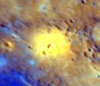
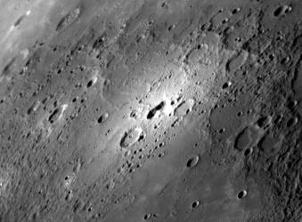
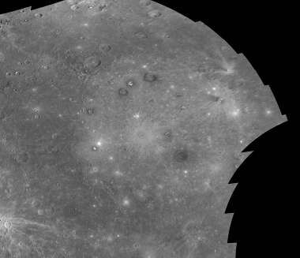
500m global coverage in the mid-infrared combined with 100m in the near infrared will provide amazing insights!
©MESSENGER JHU/APL
MERTIS/VIHI
Single pixel and swath width
20 km
Notes:
15

Slide 16
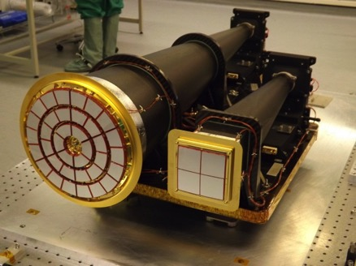
Mercury Imaging X-ray Spectrometer - MIXS
MIXS is an ideal follow-on instrument to the MESSENGER XRS:
  High spectral resolution of solid state focal plane allows direct measurement of composition ratios without the need for balanced filters
Science highlights:
  In periods of enhanced solar activity spatial resolution of a few km possible with MIXS-T
  In quiet sun a 10 degree resolution map of the surface (both hemispheres) will be generated by MIXS-C
  Compositional information from permanently shadowed craters may be possible if electrons precipitate at location
  High spatial resolution allows MIXS to resolve hollows/bright crater floor deposits and other surface geological features

Slide 17
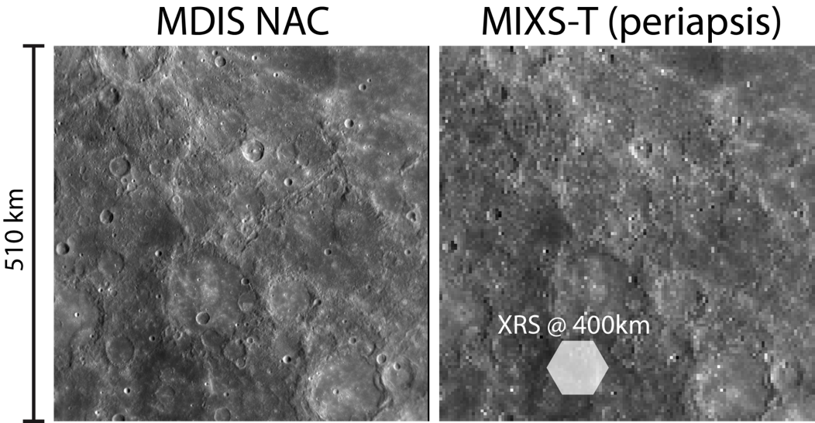
MIXS Performance
Spatial resolution
Flare state | X1 | M1
Element | Spatial resolution (km)
Na | 3 | 9
Mg | 1 | 4
Al | 2 | 6
Si | 5 | 15
P | 25
K | 15
Ca | 6 | 20
Ti | 10
Fe | 1 | 1
(left) MDIS NAC image; (right) rebinned to MIXS-T resolution (4km)
NB Lower flare state is associated with degraded resolutions as pixels are binned to improve image statistics
Image credit: NASA/Johns Hopkins University, Applied Physics Laboratory/Carnegie Institution of Washington.

Slide 18
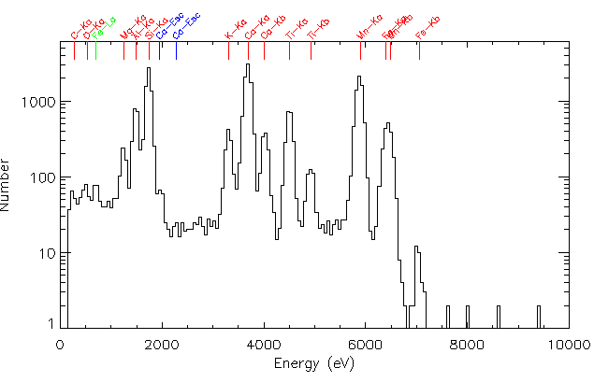
MIXS Performance
Energy resolution
Rock-forming elements Mg, Al and Si are directly resolved.
Fe-L is resolved, meaning Fe can be detected even during solar quiet.
Terrestrial basalt sample illuminated by W-anode X-ray tube during on-ground calibration of MIXS

Slide 19

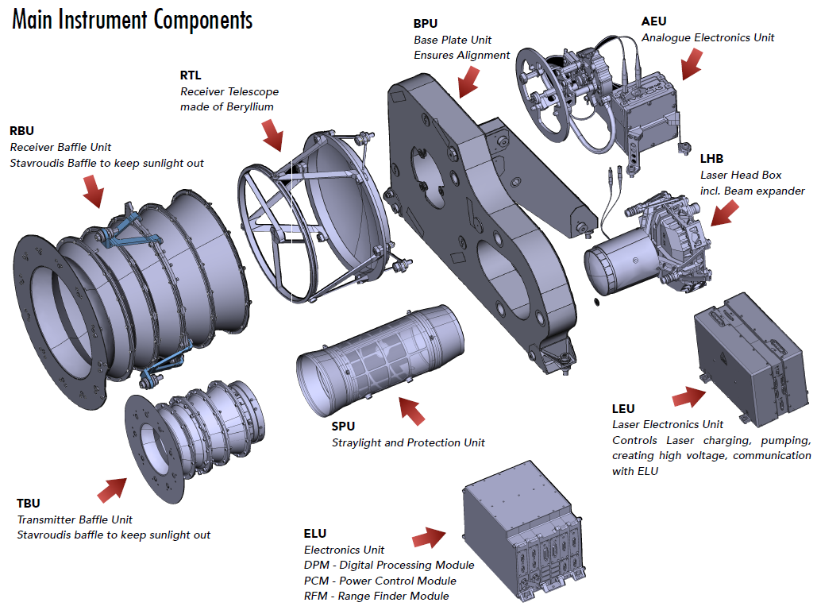
The BELA instrument: Overview

Slide 20
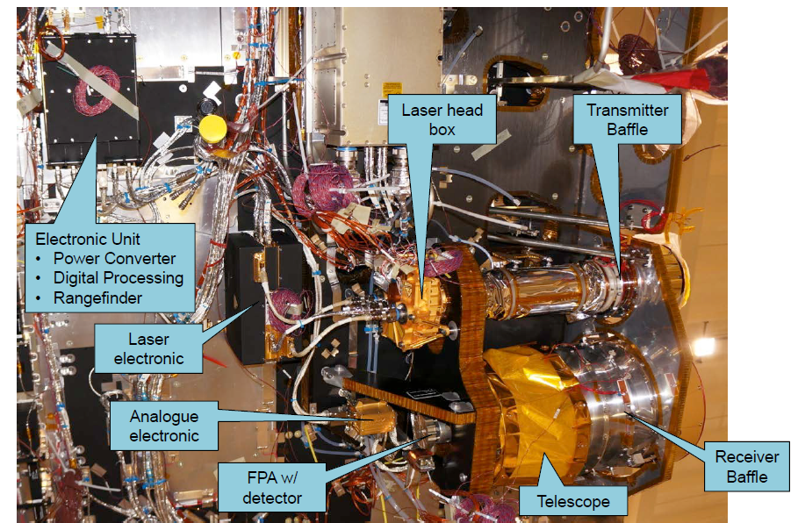
BELA on the BepiColombo S/C

Slide 21
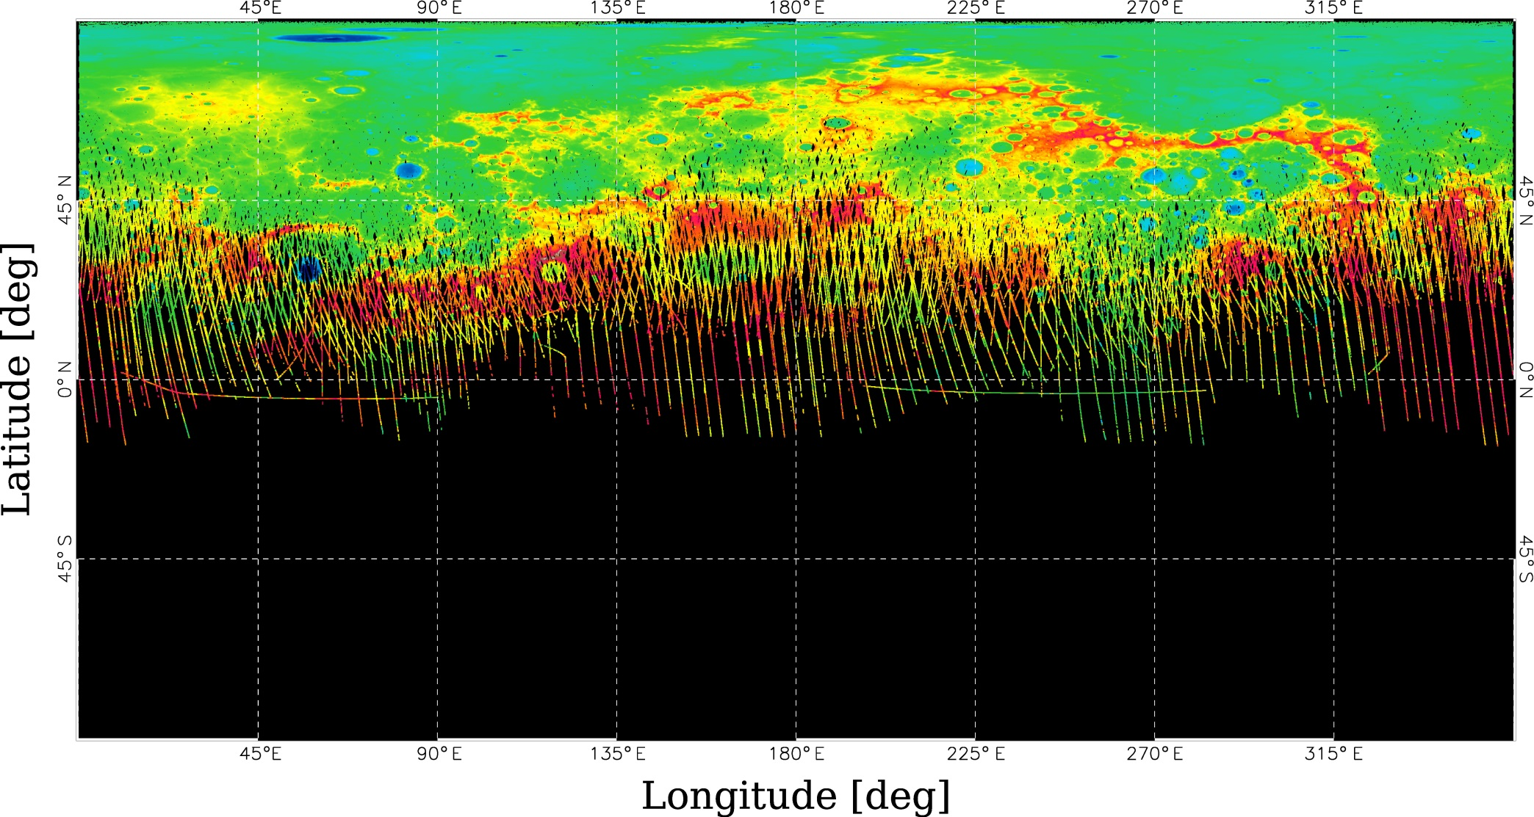
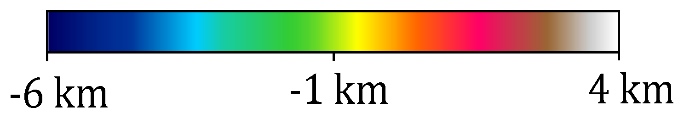
MLA coverage as of March 2014 (3 years of operation)
Reference sphere: 2440 km

Slide 22
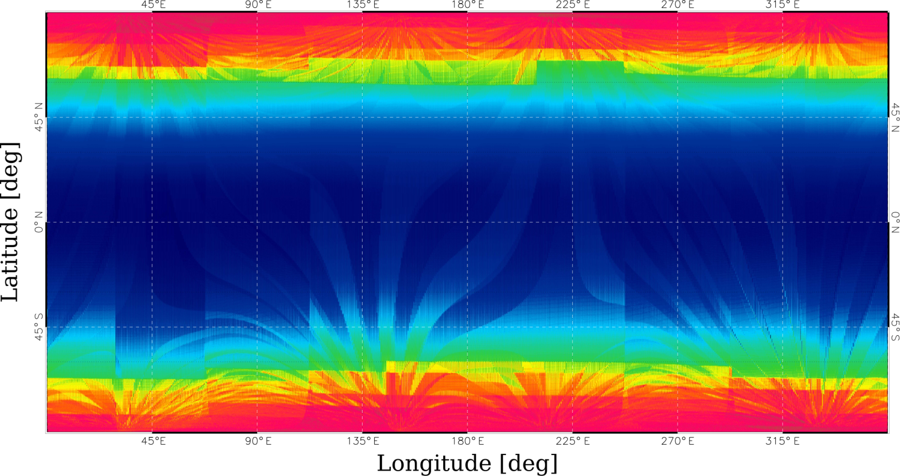
Expected BELA coverage for 1 year (nominal mission)
BELA can obtain full global coverage due to the MPO orbit and its natural shift of pericenter
Blue regions correspond to the best signal-to-noise ratio (lowest altitude ~400 km, red regions to ~1050 km altitude)

Slide 23
Improvements and Synergies
BELA will obtain global coverage due to the lower altitude and eccentricity of the MPO orbit => improvement of gravity/topography interpretation with respect to global, regional, and local processes for all latitudes
BELA is nadir-pointing, uses 10 Hz shot frequency and is not on highly elliptical orbit => Errors for height measurements and interpolation errors of cross-over points are expected to be smaller as compared to MLA
Tidal deformation could probably be measured by cross-over point analysis at the poles (see also poster by G. Steinbrügge)
By combining MLA and BELA data, long-period librations could be confirmed or further constrained due to temporal coverage of more than 10 years (see also poster by A. Stark)
BELA uses a pulse-fitting approach within its range-finder instead of thresholding => for calibration purposes full digitized signals of the pulse can be down-linked

Slide 24
What new datasets can BepiColombo provide?
Direct temperature measurements
  Removes ambiguities for spectral analysis
  Global thermal inertia map (texture, grain sizes,...)
Wider spectral coverage
  Thermal infrared range 7-14μm
  Near infrared up to 2μm
Higher spatial resolution for the spectral data
  Up to 100m for visual and near-infrared
  Up to 280m for the thermal infrared
  A few kilometer for X-ray spectroscopy
Homogenous global coverage
  Spatial resolution for all instruments largely independent from latitude
  Global topography

Slide 25
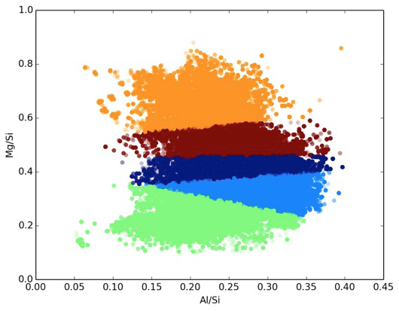
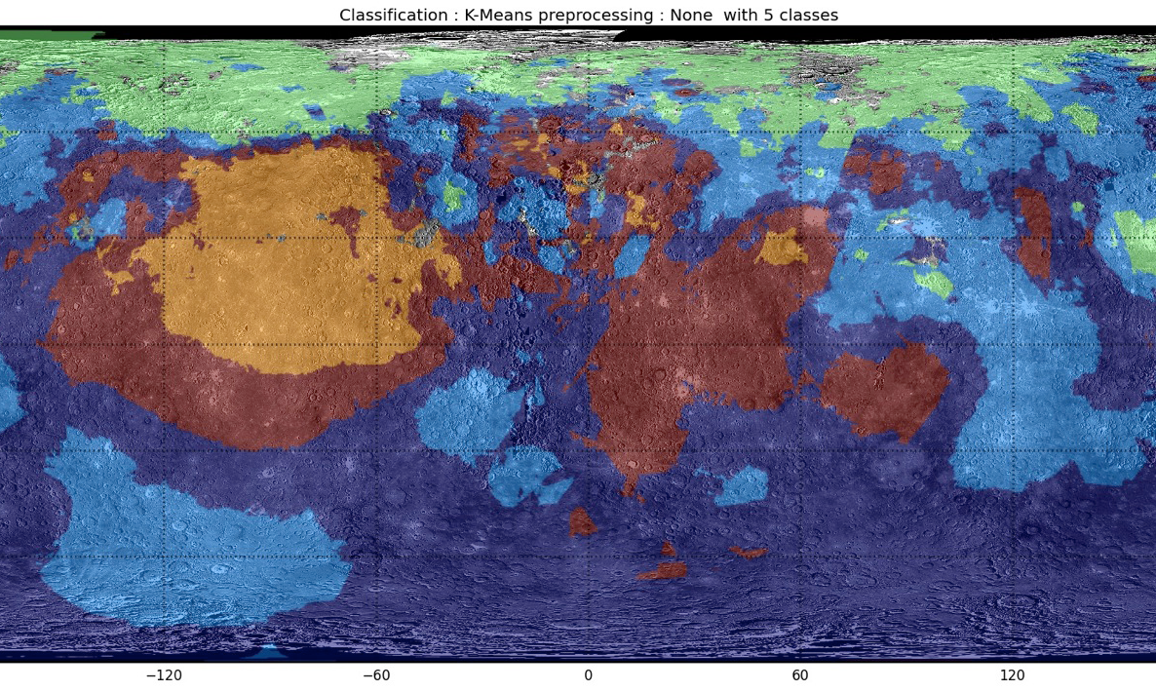
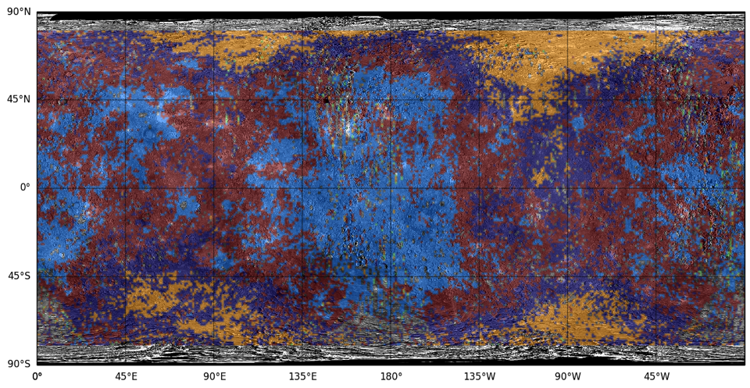
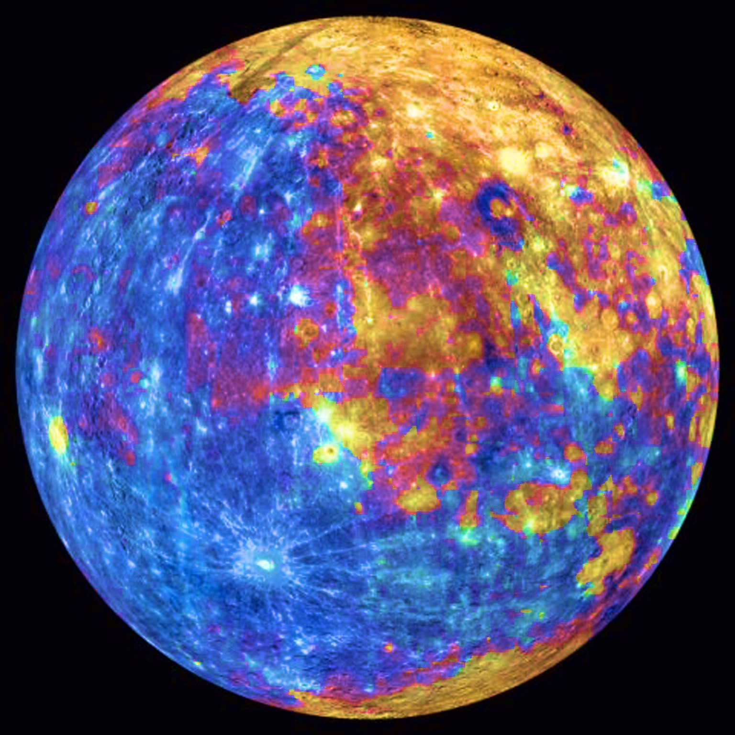
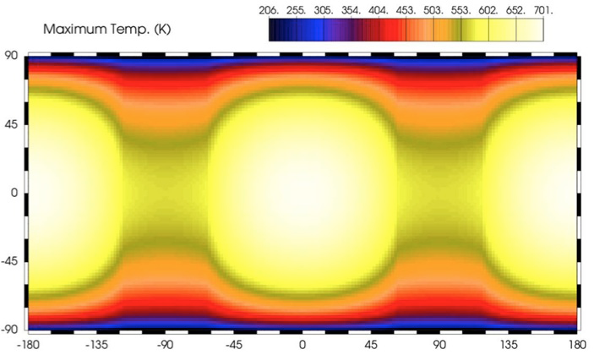
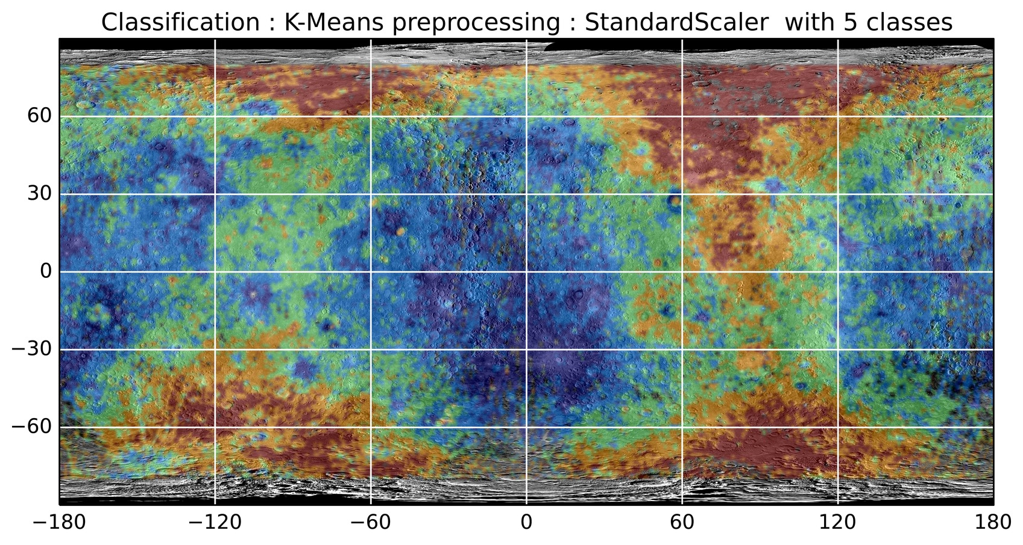
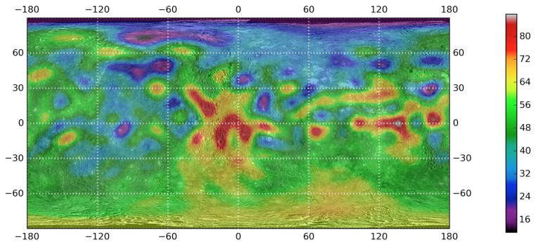
The true power comes from using the synergies between all the instruments
Compositional data from MIXS at few km resolution
TIR spectra at
500m resolution
globally from MERTIS
UV-VIS-NIR spectra
at 200m resolution
globally from VIHI
Temperature maps
at 2km resolution
from MERTIS
Global DTM at 50-100m vertical from SYMBIOSYS
Topography and gravity globally from BELA and MORE

Slide 26
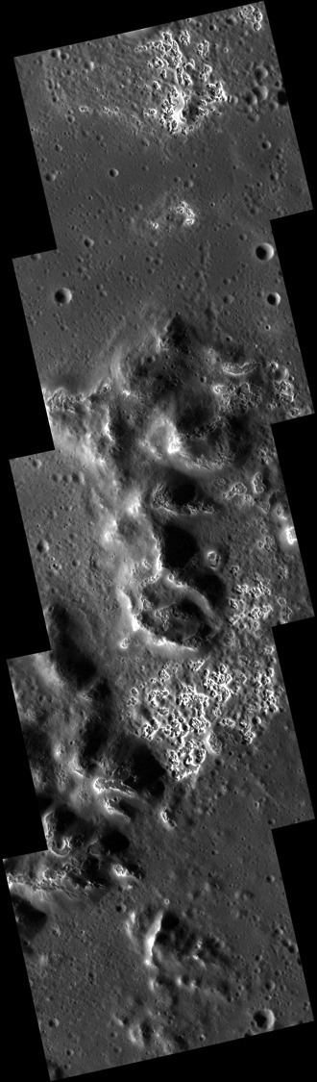
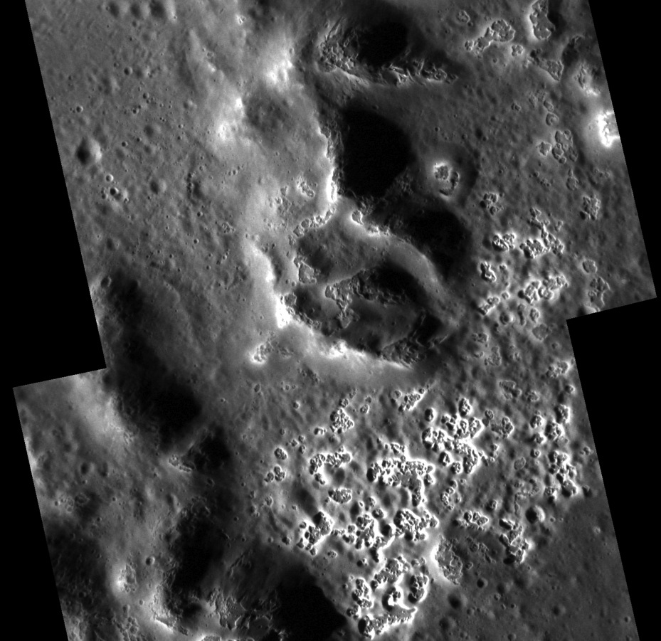
Just as an example: Seeing hollows with
SYMBIOSYS, MIXS and MERTIS
Targeted NAC, 17 m/pixel; ~26.7 N, 120.6 E.
SYMBIOSYS-VIHI/STC
MIXS-T
MERTIS
5 km
Raditladi peak ring (Blewett et al. 2011)

Slide 27
Science Operations Planning on MPO
Follows ESOC planning cycles: LTP (6 months), MTP (4 weeks), STP (1 week).
Single mission plan at SGS processed as needed.
Web-Based Centralised Object-Oriented Planning:
  PI Team definition/specification of observations via online Observation Catalogue
  Latest mission context-data available to PI Teams throughout planning
  Observation Definitions processed by central Science Planning System (observation instantiation, conflict identification and potential resolution) to produce Candidate Timelines
  Candidate Timelines resolved into Science Operations Timeline
  Link to instrument and mission Science Objectives maintained throughout planning, execution and data processing via Science Traceability Matrix

Slide 28
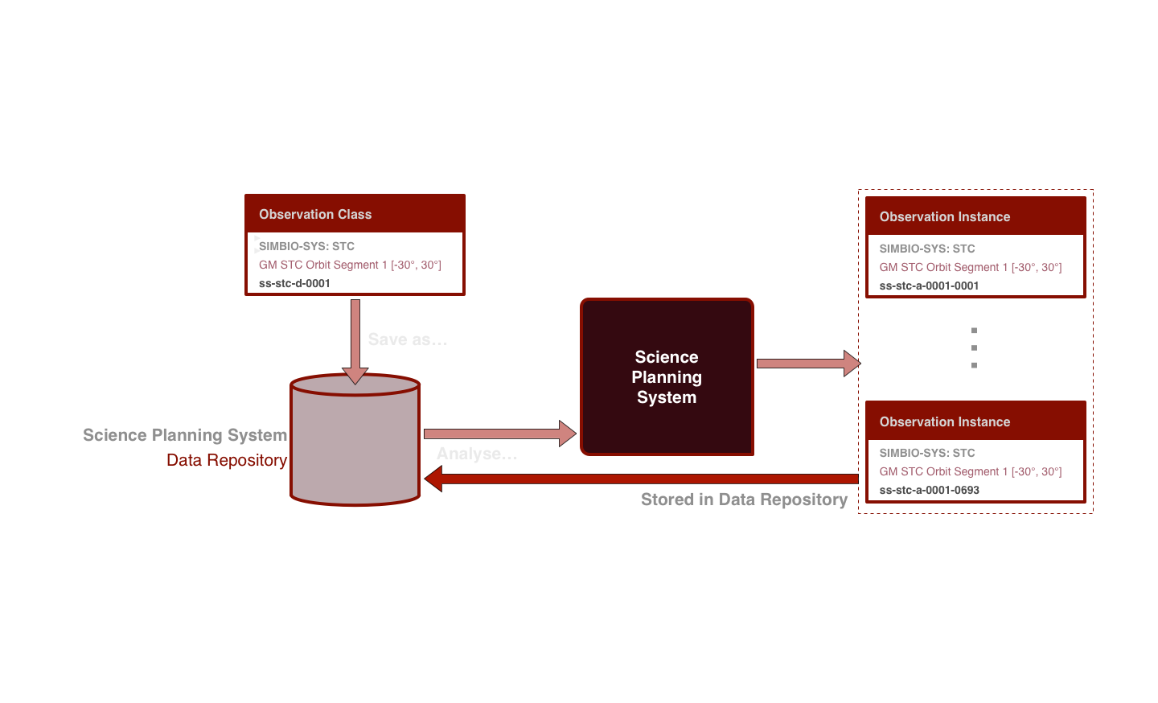
Science Operations Planning on MPO
Definition of observation definitions in Observation Catalogue and their processing by the Science Planning System.

Slide 29
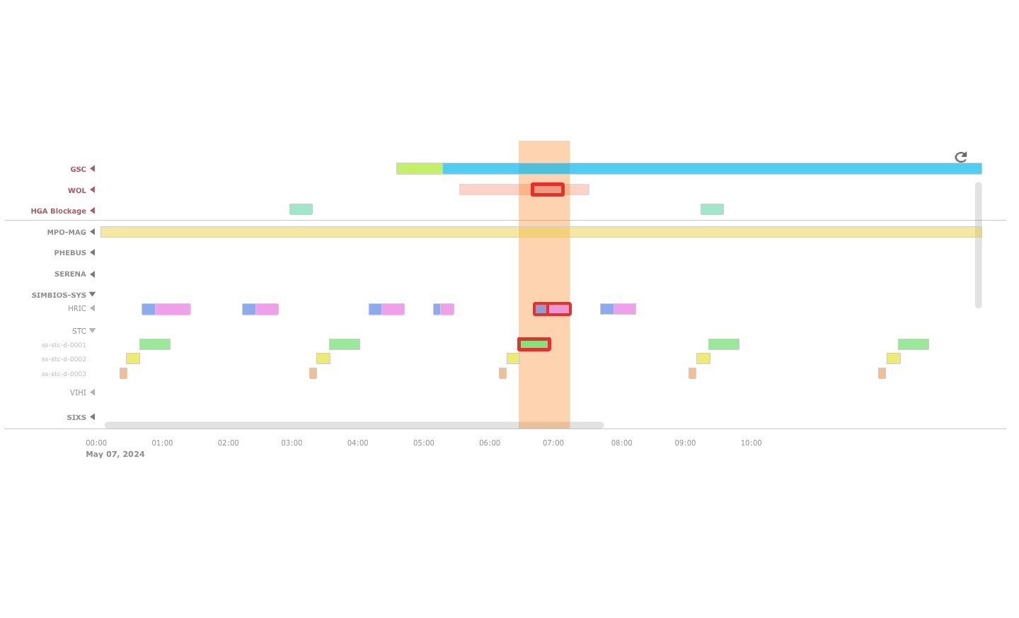
Science Operations Planning on MPO
Candidate Timelines, containing all context-data and conflicts, are compiled and presented to the PI Teams for approval.

Slide 30
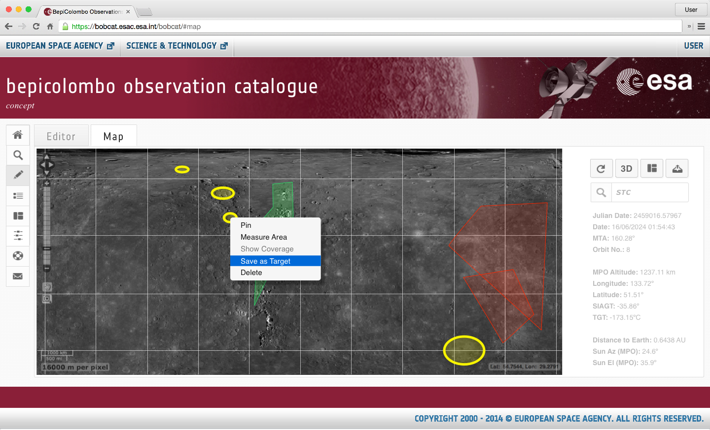
Map-based Interface for coverage analysis and targeted observations planning.

Slide 31
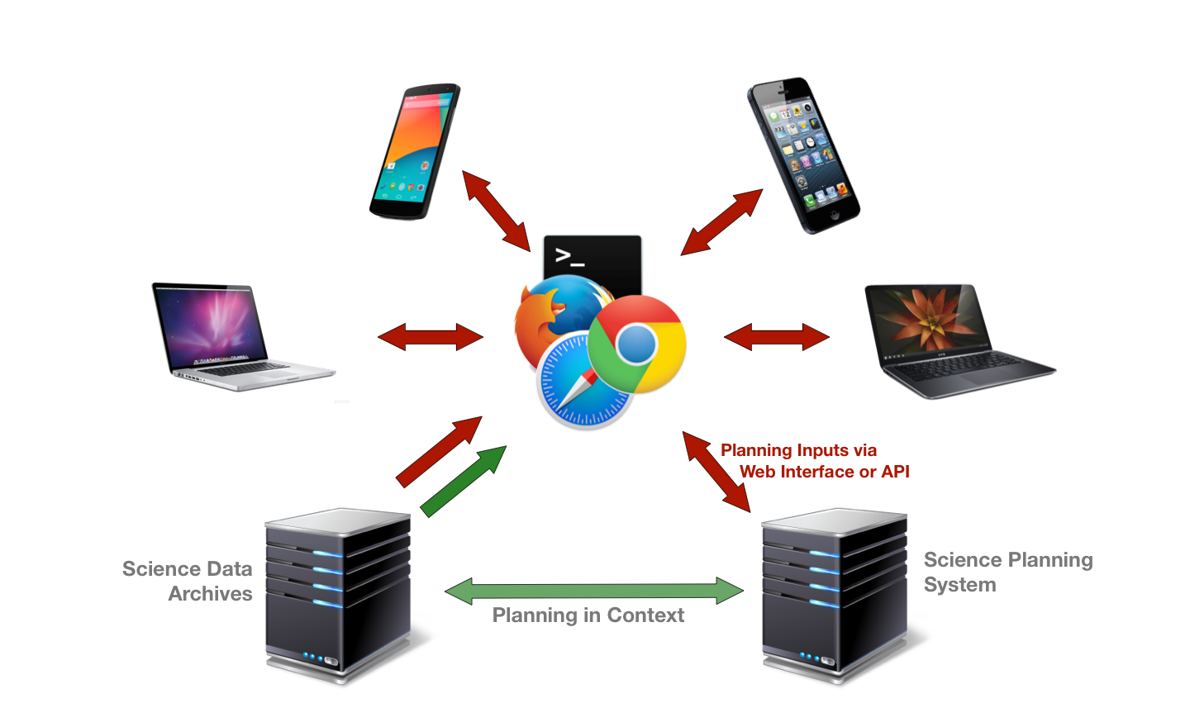
Centralised Object-Oriented Planning for MPO Science Operations Planning in context.

Slide 32
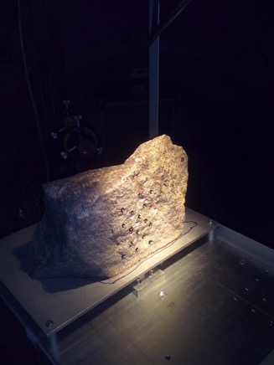
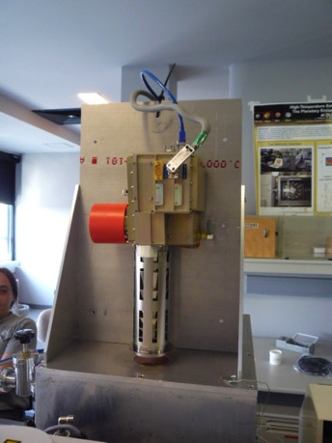


Luckily we have some (extra) time for preparation
(Cross-)calibration is very important
Samples are being exchanged between the different teams
Joint calibration strategies are discussed
New laboratories are set up
Cross-calibration in orbit is planned
New models are developed
MESSENGER data allows to test them
Procedures and concepts are defined
For example extensive mapping efforts are ongoing to select targets for SYMBIOSYS
Galluzzi et al.

Slide 33

BepiColombo will build on what we learn currently from MESSENGER
MESSENGER has changed our understanding of Mercury‘s evolution and formation
BepiColombo will add new chapters to the book on Mercury that MESSENGER is currently writing
Luckily we have 9 years more time to prepare
And with joint team efforts we can provide some answers to the questions MESSENGER raised
http://messenger.jhuapl.edu/
http://www.cosmos.esa.int/web/bepicolombo
Notes:
33

