Slide 1
Crustal thickness inside Mercury’s geochemical terranes
Peter James
LDEO

Slide 2
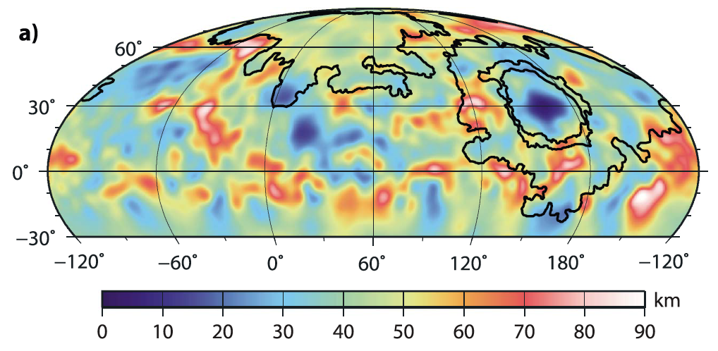
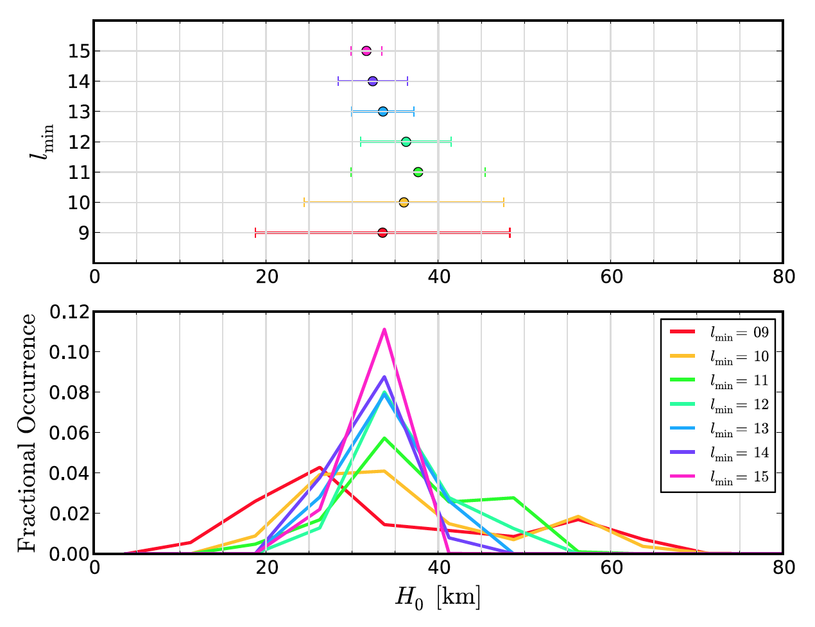
Crustal thickness constraints
High Magnesium Region (HMR)
Caloris Interior Plains (CIP)
Figure 9, James et al. 2014
Shape has been determined from MLA & radio occultation data, and gravity has been recovered from from the radio science experiment onboard MESSENGER. These may be used to infer a crustal thickness map via a two-layered inversion (above). A mean thickness of ≥38 km is required to avoid negative crustal thickness at Caloris Basin.
Mean crustal thickness of 35±18 km from geoid-topography ratios (right) implies that the thinnest crust on Mercury within CIP is not much larger than zero.
Figure 2, Padovan et al. 2015

Slide 3
Basin formation
iSALE Model of the Orientale basin formation impact on the Moon (300-350 km diameter).
(Courtesy of Brandon Johnson)

Slide 4
High Magnesium Region
Topography, crustal thickness, and elemental abundances (courtesy of Elizabeth Frank and Shoshana Weider) in the High Magnesium Region.
Topography DEM (USGS)
Crustal thickness (James et al. 2014)
A
B
A
B
B’
A’
B’
A’

Slide 5
High Magnesium Region
Topography, crustal thickness, and elemental abundances (courtesy of Elizabeth Frank) in the High Magnesium Region.
Topography DEM (USGS)
Mg/Si
A
B
A
B
B’
A’
B’
A’

Slide 6
High Magnesium Region
Topography, crustal thickness, and elemental abundances (courtesy of Elizabeth Frank) in the High Magnesium Region.
Topography DEM (USGS)
Al/Si
A
B
A
B
B’
A’
B’
A’

Slide 7
High Magnesium Region
Topography, crustal thickness, and elemental abundances (courtesy of Elizabeth Frank) in the High Magnesium Region.
Topography DEM (USGS)
S/Si
A
B
A
B
B’
A’
B’
A’

Slide 8
High Magnesium Region
Topography, crustal thickness, and elemental abundances (courtesy of Elizabeth Frank) in the High Magnesium Region.
Topography DEM (USGS)
Ca/Si
A
B
A
B
B’
A’
B’
A’

Slide 9
Caloris Basin
Topography and crustal thickness of the Caloris Basin.
Topography DEM (USGS)
Crustal thickness (James et al. 2014)
D
D
C
C
D’
C’
D’
C’

Slide 10
Crustal thickness profiles
Crustal thickness profiles from James et al. 2014.
High Magnesium Region
Caloris Basin
C
C’
A
A’
D
D’
B
30 km
B’
10x vertical exaggeration

Slide 11
Using an old shape solution (2013)
Crustal thickness profiles from James et al. 2014.
High Magnesium Region
Caloris Basin
C
C’
A
A’
D
D’
B
30 km
B’
10x vertical exaggeration

Slide 12
Using gravity clone fields
Crustal thickness profiles from James et al. 2014.
High Magnesium Region
Caloris Basin
C
C’
A
A’
D
D’
B
30 km
B’
10x vertical exaggeration

Slide 13
No compensation constraints
Crustal thickness profiles from James et al. 2014.
High Magnesium Region
Caloris Basin
C
C’
A
A’
D
D’
B
30 km
B’
10x vertical exaggeration

Slide 14
Including degree-2 terms
Crustal thickness profiles from James et al. 2014.
High Magnesium Region
Caloris Basin
C
C’
A
A’
D
D’
B
30 km
B’
10x vertical exaggeration

Slide 15
The Effects of Density Variations
Crustal thickness models assume uniform crust & mantle densities
However, high density crust is nearly indistinguishable from an elevated crust-mantle boundary (thin crust), and low density is indistinguishable from thick crust.
Highly evolved crustal melts may have lower density, while high-T ultramafic melts may have higher density.
=
=
Low ρ
High ρ

Slide 16
Summary
The center of Caloris Basin likely has thin crust (<10 km). This indicates near-complete removal of the crust and excavation of the mantle during the impact event. The CIP do not represent exposed mantle mineralogies, but rather a derived melt.
Mantle was almost certainly excavated during the Caloris basin-forming impact event.
The nominal crustal model at the HMR (~25±10 km) does not approach zero thickness for any parameters or data. However, a density reduction of 40 kg m^-3 across 100 km of crust & upper mantle may allow a thin (<10 km) crust in the HMR.

