Slide 2
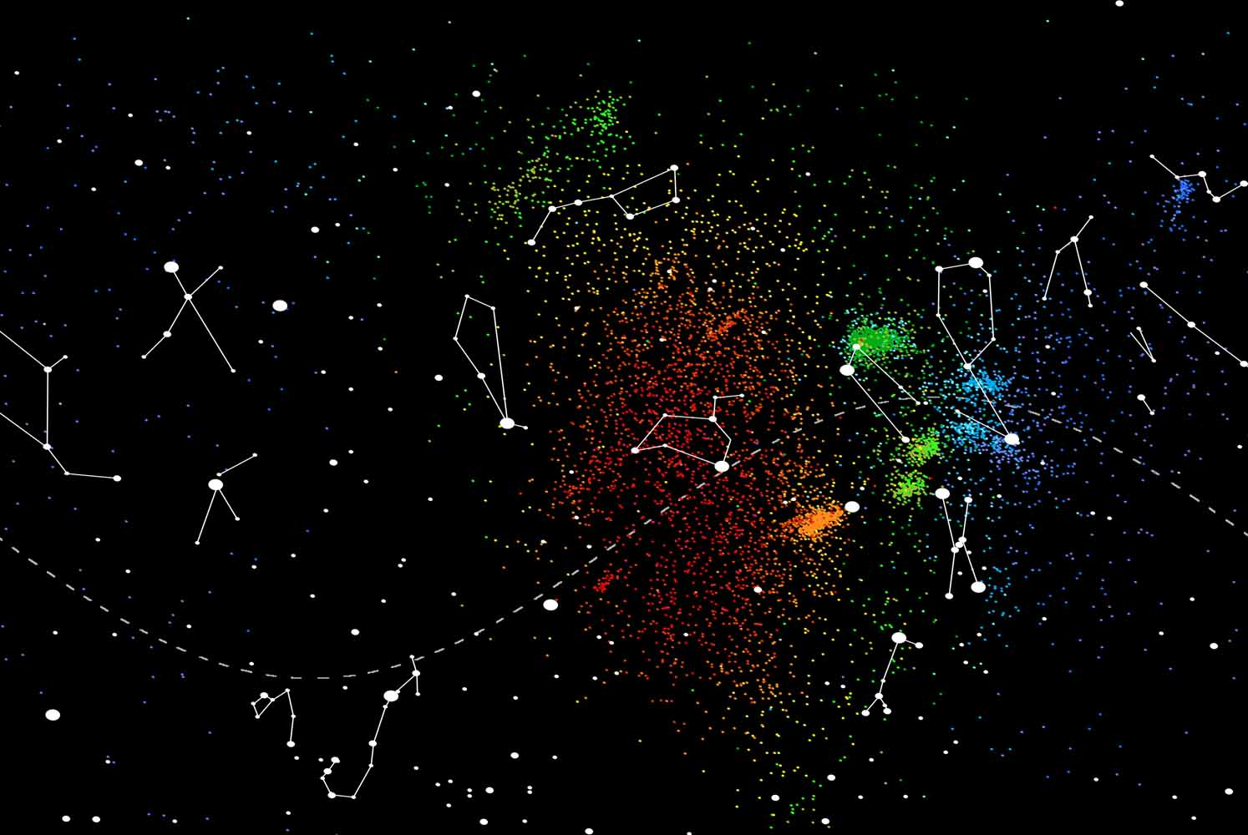
Meteor showers in review
Peter Jenniskens
SETI Institute

Slide 3
open questions
What is collisional lifetime as function of particle size?
What effect do comet disruptions have on stream properties?
When did these streams form?
Wanted: Dynamical models that explain all shower features
What caused meteor outbursts?
Do we understand the zodiacal cloud dynamics ?

Slide 4
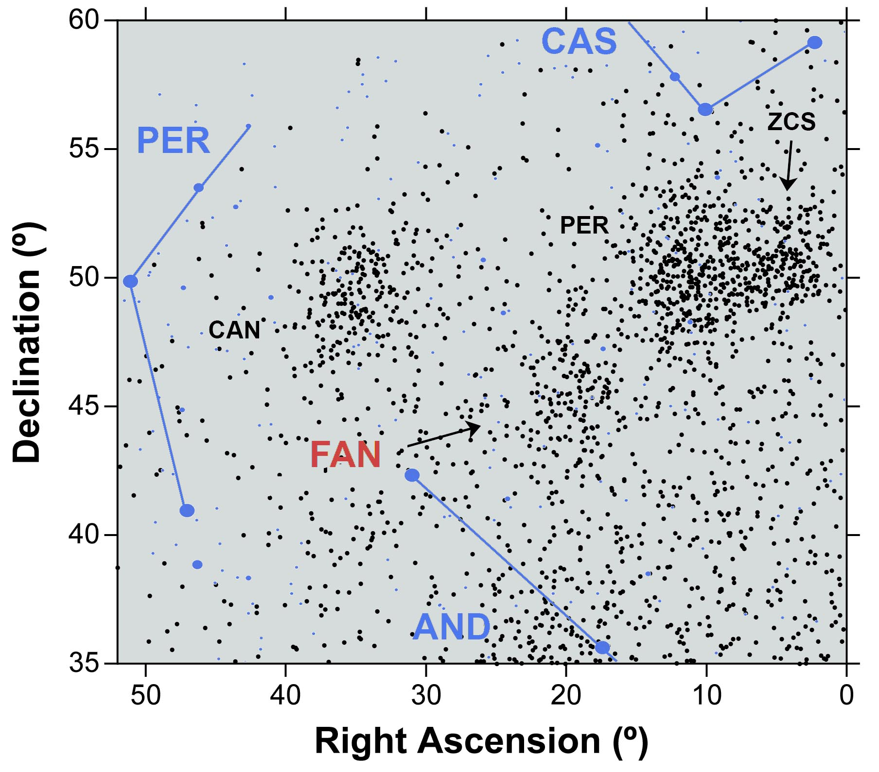
#showers in IAU list
Increase dramatically – now up to IAU#795
700 showers
112 established
New surveys reporting results:
CMN (#509-622)
CAMS (#623-750)
SAAMER (#756-792)
CMOR (#793-795)
Near future:
CILBO (Canary Islands)
CAMS Southern Hemisphere
Single station radars (Younger)
EDMOND
Polish Video Meteor Network
Mu radar
49 Andromedids “FAN”

Slide 5
CMOR outburst 2015 Brown et al., 2016
Kappa Cancrids (793) – January 10, 2015
Few hours
Halley-type
Gamma Lyrids (794) – February 5, 2015
Part of northern toroidal complex
Halley-type or long period comet (NIC)

Slide 6
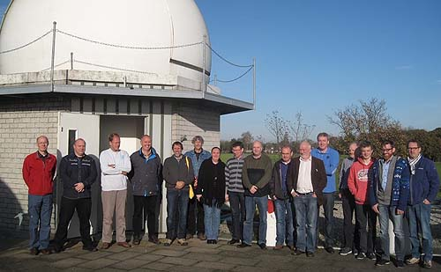
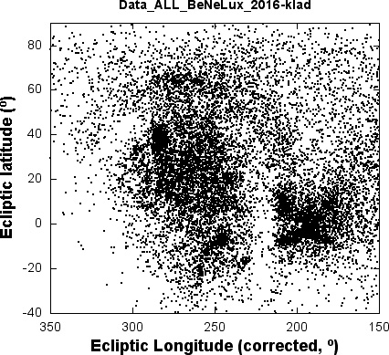
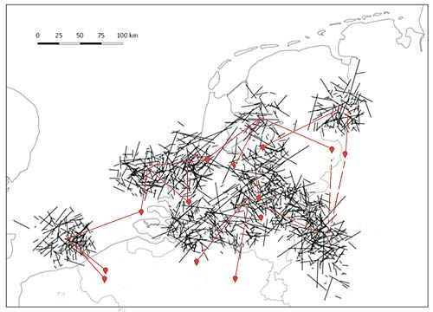
Carl Johannink
Martin Breukers
CAMS BeNeLux

Slide 7
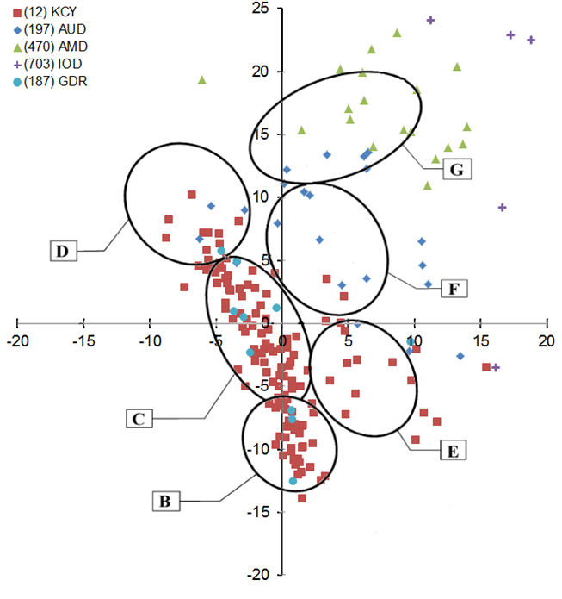
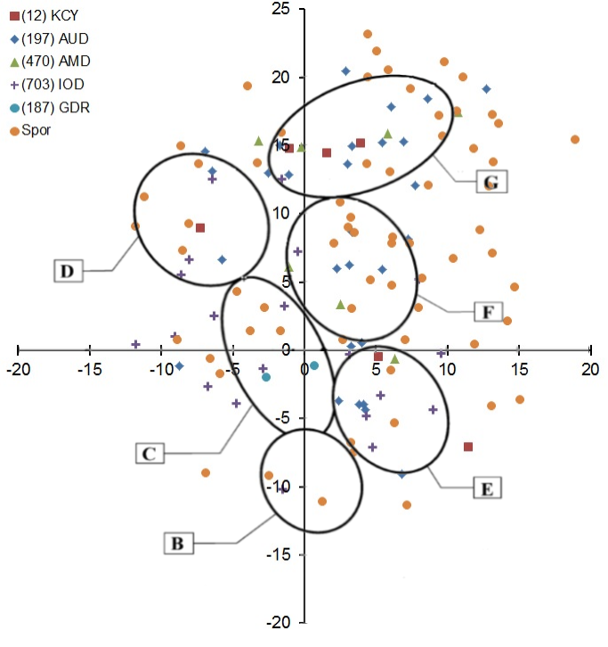
Status of the CAMS-BeNeLux network
2014
2015
IMC, 2-5 juni 2016, Egmond – the Netherlands

Slide 8
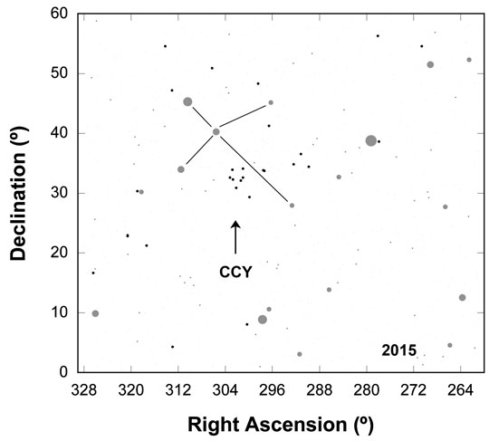
Chi-Cygnids (Sept. 2015)

Slide 9
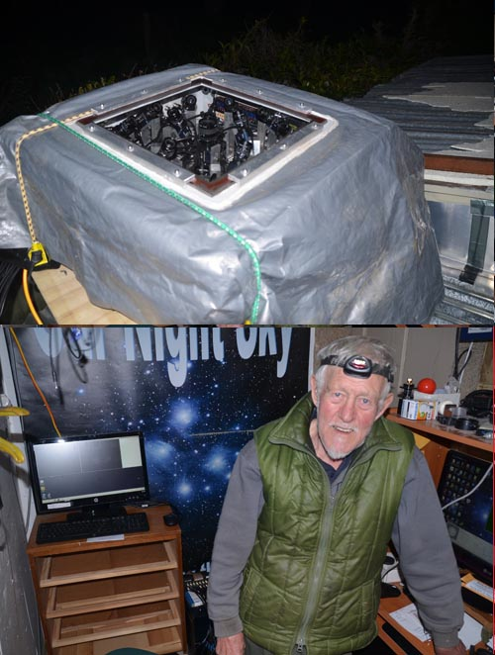
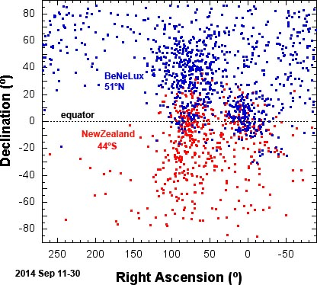
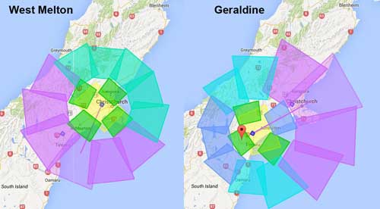
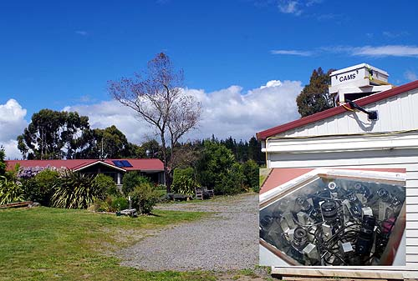
CAMS New Zealand
Peter Aldous (Geraldine)
Ian Crumpton (West Melton)

Slide 10
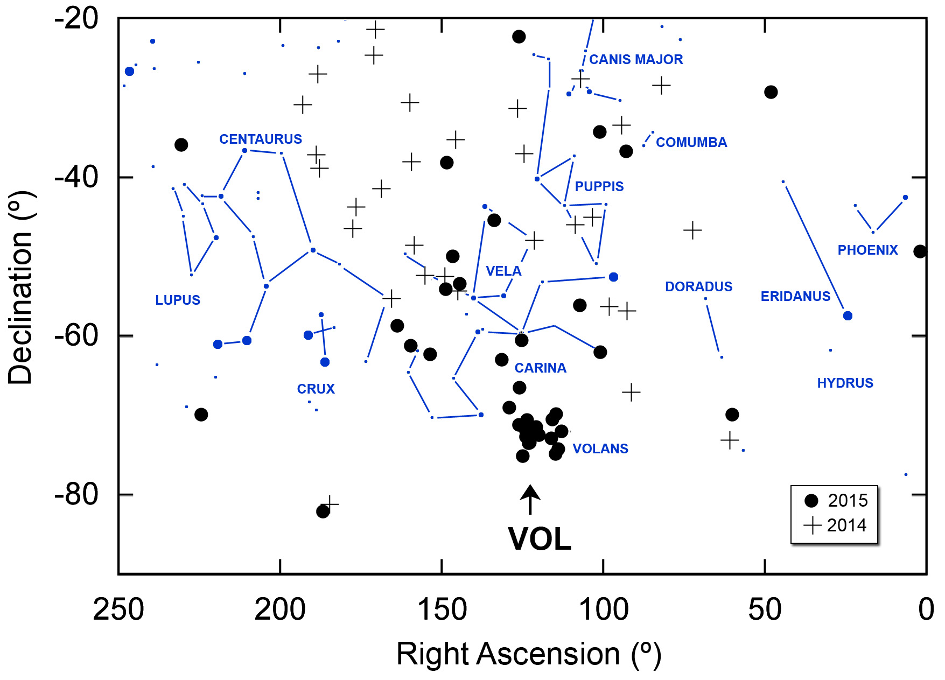
2016 New Year’s Eve shower: Volantids

Slide 11
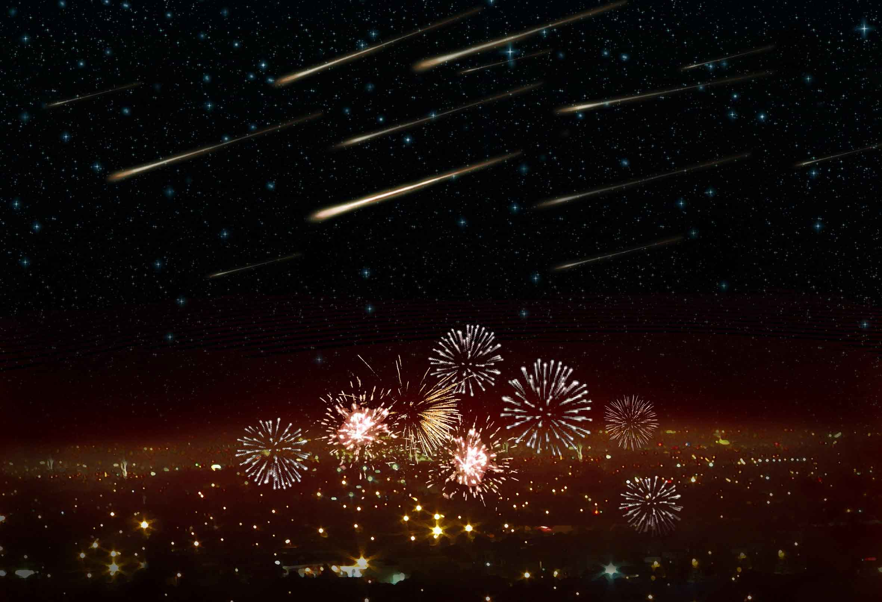

Slide 13
Alpha Capricornids
Jenniskens et al., 2016. Icarus 266, 331-354.

Slide 14
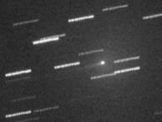
Alpha Capricornids
169P/NEAT
169P/NEAT
Jenniskens et al., 2016. Icarus 266, 331-354.
Jenniskens, P., Vaubaillon, J., 2010. Astron. J. 139, 1822–1830.

Slide 15
Alpha Capricornids
169P/NEAT
2003 T12 (SOHO)
169P/NEAT
Jenniskens et al., 2016. Icarus 266, 331-354.
Jenniskens, P., Vaubaillon, J., 2010. Astron. J. 139, 1822–1830.

Slide 16
Taurid Complex Multiple showers

Slide 17
Taurids
19 components
7 parents with:
a = 2.20-2.27 AU
Main: 2P/Encke 3.0 km ø
Others add 20%;0.3-1.7 km ø (so far 64% discovered)

Slide 18
Taurid rates
sequence of typical activity curves
STA/NTA not symmetric

Slide 19
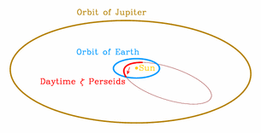
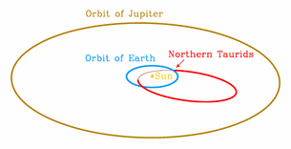
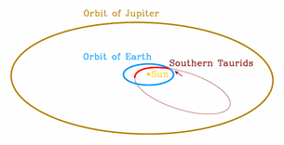
Rotation of the nodal line
Courtesy of: Armagh Observatory

Slide 20
Camelopardalids - 209P/Linear
Vaubaillon

Slide 21
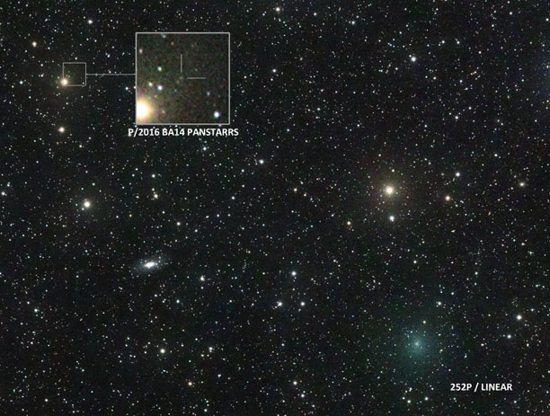
Jose Chambo (2 March 2016) / Sky&Tel.

Slide 22
Fading Showers: Meteoroids fragment by other than collisional processes on 1/e timescale of:
Camelopardalids ~ 50 y
Leonids ~ 150 y
Taurids ~ 4,000 y
Sporadic meteors ~ 4,000 y

Slide 24
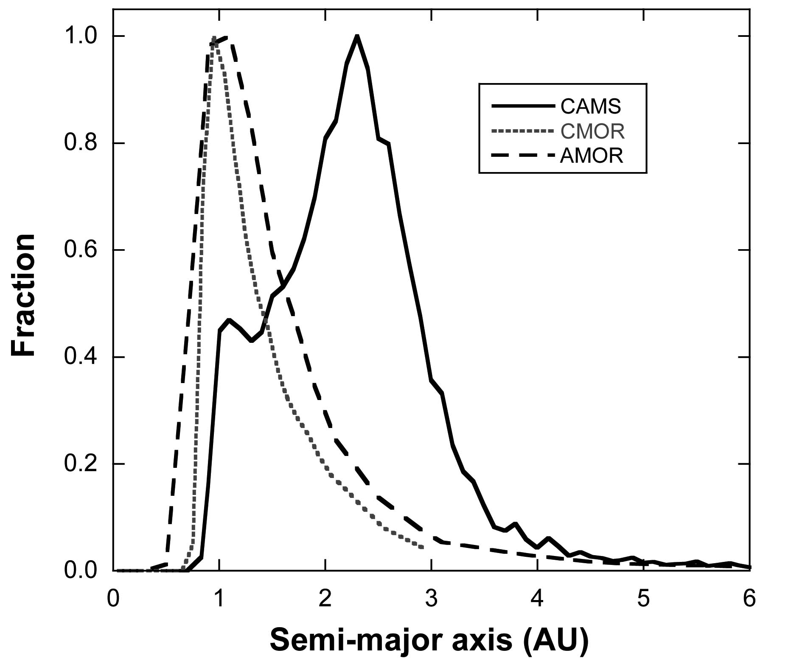
Distribution of semi-major axis

Slide 25
The sky at different particle sizes
CAMS CMOR AMOR
Wikipedia
Nick Spiker

Slide 26
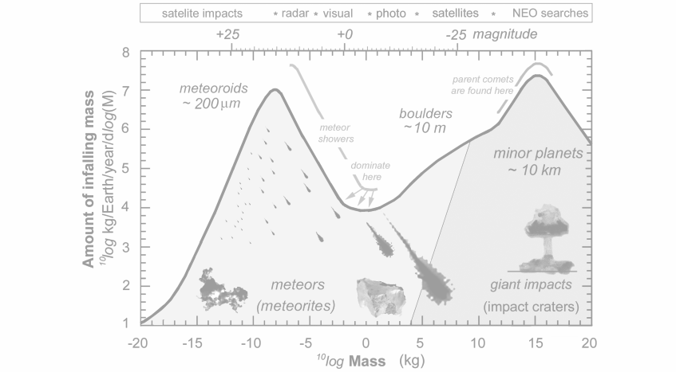
~ 10-5000 My
~ 300,000 y
~2-100 My
Mostly
Asteroids
~ 1000 y
(some ~1,600,000 y)
Mostly
JFC comets
e ~ 0.3
~ 10% comets
Mostly
Asteroids
Some
Oort cloud
Comets?
e << 1
Mostly
JFC comets
e ~ 0.7
~ 5% comets ?
~ 1 y
Ø 200 m
|
Ø 10 cm - 1 m
|------|
Ø 1 mm
|--|

Slide 28
~ 100,000 y
~ 1000 y
~ 1 y

Slide 29
CURRENT VIEW (GRÜN et al., 1985)
Collisions destroy
large grains
Small grains
Lost by
Poynting-
Robertson
Drag

Slide 30
Distribution of semi-major axis

Slide 31
ALTERNATIVE VIEW (Jenniskens, 2016)
Large grains fall
apart by processes
other than
collsions
Small grains
lost in
collisions

