Slide 1
Spacecraft risk posed by the 2016 Perseid outburst
Bill Cooke/Danielle Moser/Althea Moorhead
NASA Meteoroid Environment Office
william.j.cooke@nasa.gov

Slide 2
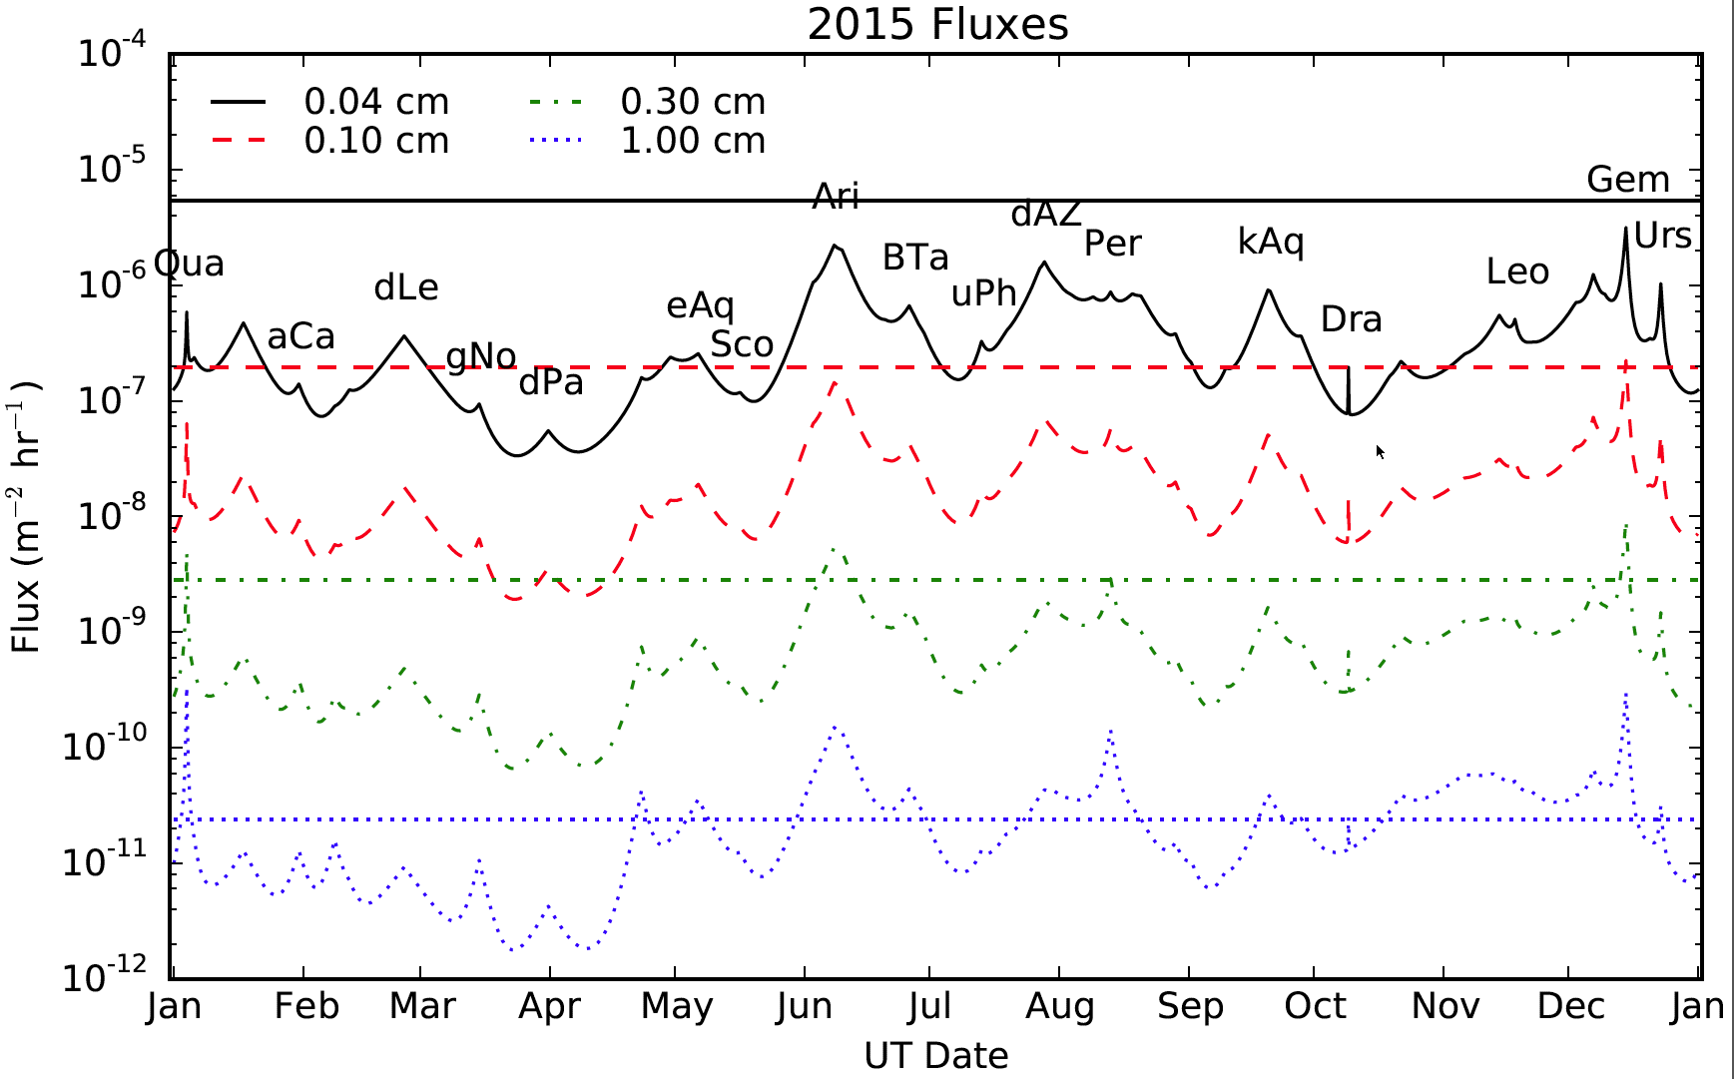
Showers vs. Sporadics
McBride & McDonnell, 1999
McBride & McDonnell, 1999
At sub-mm & mm sizes, the average flux of meteor showers is an order of magnitude below the sporadic (background) flux

Slide 3
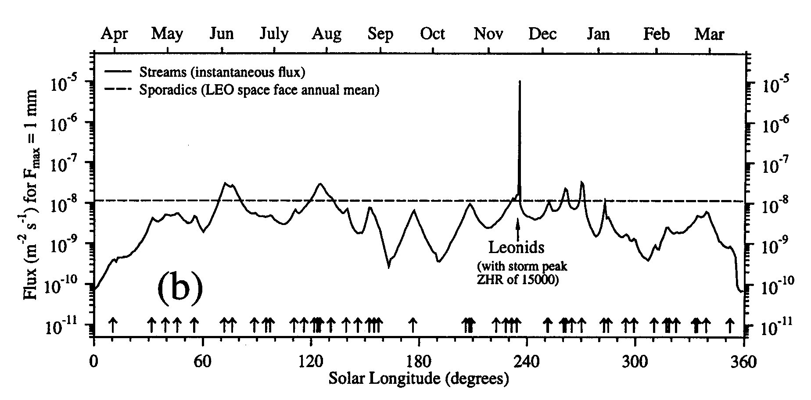
Storms vs. Sporadics
McBride & McDonnell, 1999
Instantaneous storm flux required to penetrate a surface can exceed the background by several orders of magnitude
Penetrating fluence can range anywhere from a few days to a year’s equivalent exposure to background meteors

Slide 4
Notes on meteoroid risk
Sporadic meteoroid background is directional (not isotropic) and accounts for 90% of the meteoroid risk to a typical spacecraft
Meteor showers get all the press, but account for only ~10% of spacecraft risk
Bias towards assigning meteoroid cause to anomalies during meteor showers
Design to sporadic background, mitigate outbursts/storms by operational means
Gun tests/damage equations focus on physical damage – hard to assess other anomaly causes, such as meteoroid generated plasma

Slide 5
Could it be a meteoroid hit?
Are the anomaly characteristics consistent with a particle impact?
Sudden change in attitude most common
Was there a meteor outburst or storm at the time of the anomaly?
If yes, was the shower radiant visible from the spacecraft?
If yes, did the affected surface “see” the shower radiant?
If yes, shower impact possible
Compare meteoroid (sporadic + shower) flux to orbital debris flux at spacecraft location to establish likelihood.
If affected surface is sun-fixed, must use a directional meteoroid model to compute flux

Slide 7
 |  |  | Possible | Possible
Launch Time | MET | GMT | Perseid? | SDA?
8/8/07 22:36 | 02 08:49:14 | 8/11/07 7:25 | Y | Y
 | 02 06:17:53 | 8/11/07 4:54 | N | N
 | 02 03:19:10 | 8/11/07 1:55 | N | N
 | 02 21:46:13 | 8/11/07 20:22 | Y | N
 | 02 22:51:46 | 8/11/07 21:28 | N | Y
 | 00 21:51:50 | 8/9/07 20:28 | Y | Y
 | 00 20:46:20 | 8/9/07 19:22 | N | Y
 | 00 20:32:48 | 8/9/07 19:09 | Y | Y
 | 00 21:09:00 | 8/9/07 19:45 | Y | N
 | 00 22:25:31 | 8/9/07 21:02 | N | N
 | 01 16:37:58 | 8/10/07 15:14 | N | N
 | 01 12:03:15 | 8/10/07 10:39 | N | N
 | 01 10:27:42 | 8/10/07 9:04 | N | N
 | 01 15:53:58 | 8/10/07 14:30 | Y | Y
 | 01 16:45:12 | 8/10/07 15:21 | N | N

Slide 8
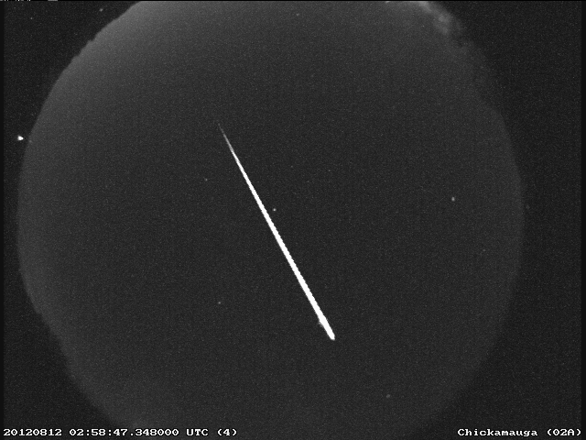
Perseid Summary
Parent comet: 109P/Swift-Tuttle
Peak: Max. around Aug 11-13
Activity range: Jul 17 – Aug 24
Speed: 59 km/s (2.5-3x average sporadic speed)
Radiant:  = 48,  = +58 at peak
Typical ZHR: 100/hr
Recent major displays: 1991-1995, 2004, 2009
Perseid fireball recorded Aug 12, 2012

Slide 9
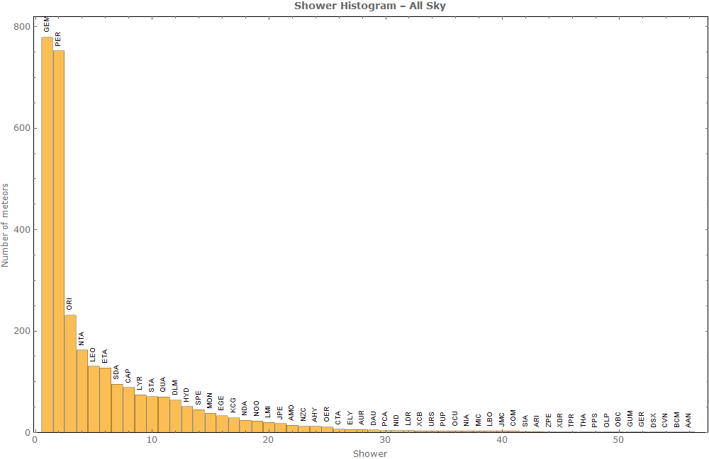
Rich in bright meteors
Perseid seen from STS-105

Slide 10
The 1993 Perseids
The Perseid parent, Comet Swift-Tuttle, reached perihelion in late 1992. High Perseid rates were also seen near the last perihelion passage of the comet, in the 1860’s
Many astronomers postulated a dense concentration of dust near the comet’s orbit
Perseids had never been observed to reach storm levels, but historical record showed outbursts of a few hundred per hour

Slide 11
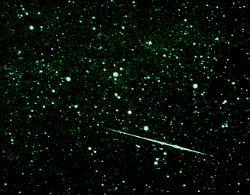
STS-51 launch, slated for late July delayed until after Perseid peak (August 12)
NASA unable to predict shower intensity
Head of astronaut office decided to delay launch
Perseid outburst with ZHR of ~360 occurred, peaking at 03:30 UT on August 12.
Cosmonauts aboard Mir space station reported hearing “pings” on outside of craft, and retreated to Soyuz (Science News, 1993)

Slide 12
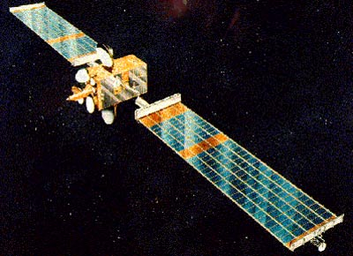
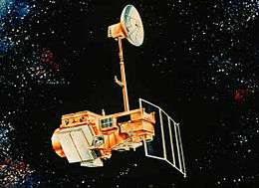
Spacecraft struck by Perseids
Olympus
ESA communication satellite
Struck by a Perseid near the time of the shower peak in August 1993
Sent tumbling, fuel exhausted, end of mission
Landsat-5
NASA/USGS imaging satellite
Struck by a Perseid near the time of the shower peak in August 2009
Sent tumbling, stabilized, returned to normal operations

Slide 13
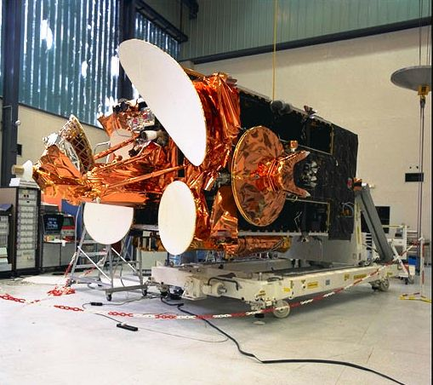
Olympus

Slide 14
Technology demonstration satellite - launched 12 July 1989; largest civilian comm satellite built up to that time
South solar panel stopped tracking the Sun in January 1991 (particle impact?)
19 June 1991– attitude control issue; incorrect commands uplinked from ground resulted in tumbling and drift off station. Vehicle recovered and put back into service at 19W on 7 August 1992
Olympus roll gyro stops at 23:32 UTC August 11 during 1993 Perseid outburst. Spacecraft enters Emergency Sun Acquisition (ESA) mode and fails to acquire the Sun

Slide 15
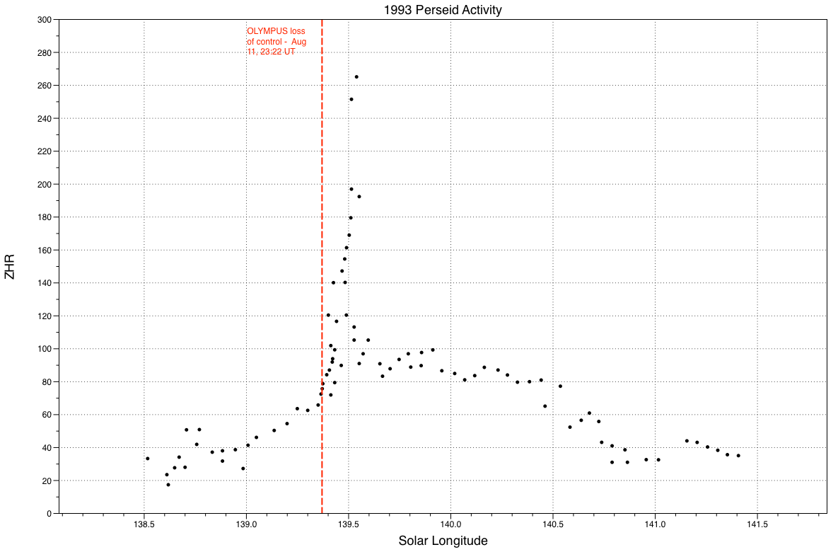

Slide 16
Attempts to recover spacecraft exhausted most of remaining fuel, making it impossible to return the vehicle to service. Mission was terminated August 12, and the spacecraft was moved into a disposal orbit 200 km below GEO
ESA anomaly investigation attributed the failure to a Perseid strike on the south solar array
South array had 8.5 m⁻² of area exposed to the stream.
There was a possible conducting path to the gyro though the spacecraft umbilical
Ground hypervelocity tests showed plasma generated by a meteoroid strike to be proportional to v^{3.5}

Slide 18
Olympus conclusion and recommendations
Conclusion of investigation: “The impact by a small meteoroid may have generated a plasma triggering a discharge of charged surfaces entering the grounded spacecraft via the umbilical and an external sensor. Such a scenario is particularly interesting for other spacecraft since the Perseid shower is likely to be worse for the next few years.”
Recommendations:
Minimize the area cross-section as much as possible during the peak period of the shower.
Prepare operational contingency plans for recovery from and for observation of impacts/plasmas.
Provide total protection from plasmas through external electrical windows such as sun sensors.
Ground and cover all interface points such as spacecraft umbilical connections.

Slide 19
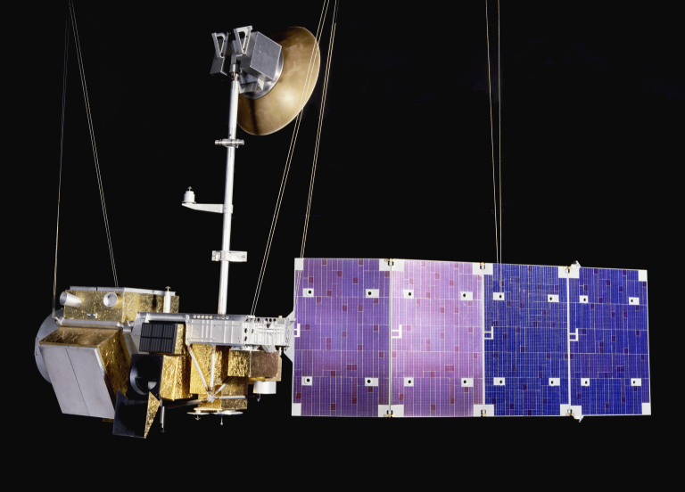
Landsat-5
USGS remote sensing satellite launched into sun-synchronous LEO orbit March, 1984
Decommissioned June, 2013
Began tumbling at 5:23 UTC on August 13 2009, just before 3rd and strongest peak of the Perseid shower
Perseid radiant was 37° above Earth limb at time of anomaly
Operations restored a week later (August 17)

Slide 22
Thoughts
Plasma production (v^{3.5}) is >40x mass limited and 5x kinetic energy
Drives affecting particle mass down the mass scale (e.g. 1 mg to 2.3x10⁻⁵ g), with corresponding increase in flux
Both satellites aging at time of anomalies
Neither OLYMPUS or Landsat showed momentum disturbances at the times of the anomalies
Chandra

Slide 23
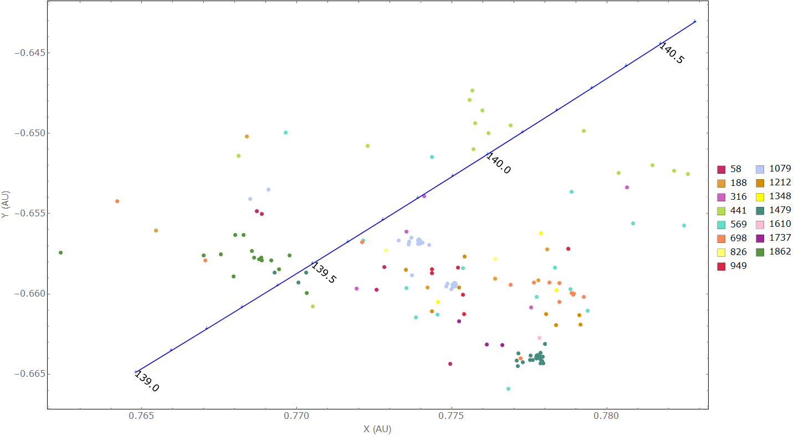
2016 Perseid model results: MSFC preliminary
Particles (β=10⁻² -10⁻⁵) ejected hourly proportional to r⁻⁶ while Swift-Tuttle is inside 2.5 AU.
157 / 13.5 M
23
Notes:
-- Particles are ejected along Swift-Tuttle’s orbit at 1 hour time steps when the comet is within 2.5 AU of the Sun. We simulate particles between 1 ug – 1 kg (microns to cm sizes)
-- Plotted here are the nodal crossings within 0.01 AU of Earth
-- Particles ejected in 1862, 1479, 1079, and 441 are found to be the main contributors

Slide 25
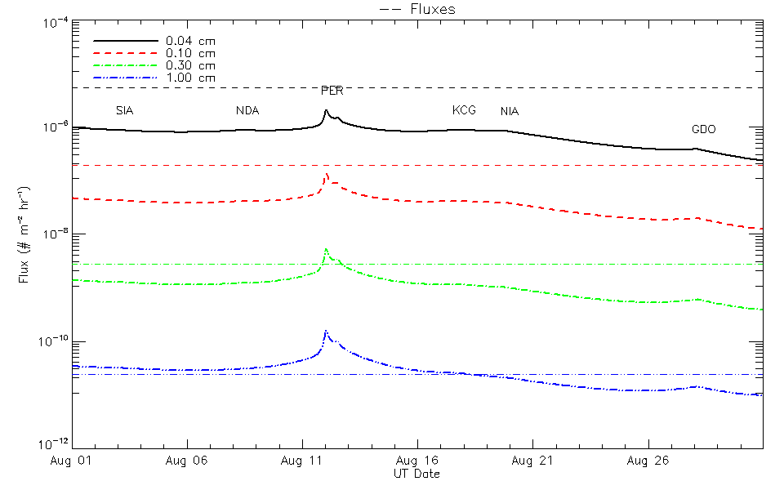
Kinetic energy flux
25

Slide 26
2016 Perseid model results - Summary -
Modeler | Rev | Date | Time (UT) | λ_{s} (°) | ZHR | r_{d}-r_{E} (AU)
Maslov (web, undated) | 1862 | Aug 11 | 22:34 | 139.436 | ? | -0.00134
Vaubaillon (Jenniskens, 2006) | 1862 | Aug 11 | 22:36 | 139.438 | 1 | -0.00327
MSFC single rev (June 2015) | 1862 | Aug 11 | 22:47 | 139.445 | - | -0.00170
Maslov (Rao, 2012) | - | Aug 11 | 23:23 | - | 160-180 | -
Maslov (web, undated) | 1479 | Aug 11 | 23:23 | 139.468 | ? | 0.00008
Vaubaillon (Rao, 2012) | - | Aug 12 | ~00:00 | - | “Unusually high activity” | -
Main MSFC (June 2015) | Combined 15 revs | Aug 12 | 00:32 | 139.515 | 210 ± 50 | -
MSFC single rev (June 2015) | 1079 | Aug 12 | 04:36 | 139.678 | - | 0.00194
Vaubaillon (Jenniskens, 2006) | 1079 | Aug 12 | 04:43 | 139.683 | 580 | 0.00023
MSFC single rev (June 2015) | 441 | Aug 12 | 13:03 | 140.016 | Comprises secondary peak? | -0.00046
Increased activity lasts about half a day, from late-Aug 11 to mid-Aug 12.
26
Notes:
-- particles ejected in 441 may contribute to a secondary peak, but this will probably be swallowed up in the nodal peak activity
-- r (D-E) is positive if dust trail is outside Earth’s orbit

Slide 27
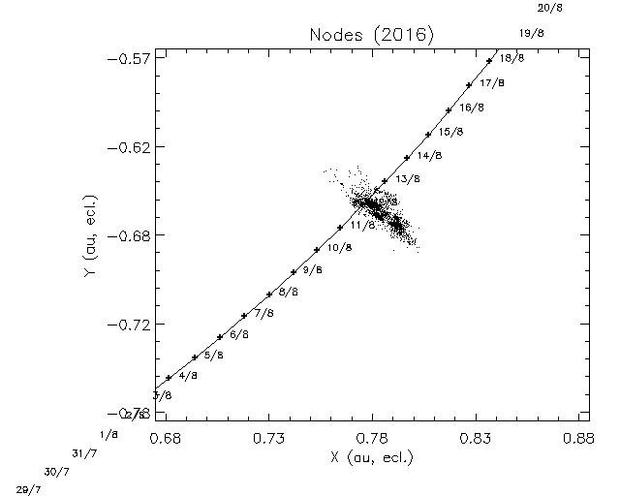
2016 Perseid model results: Vaubaillon
Approx. region covered by MSFC model
Vaubaillon
http://www.imcce.fr/langues/en/ephemerides/phenomenes/meteor/DATABASE/Perseids/BIN-tout/Noeuds-Earth2016.jpg
27

Slide 28
Conclusion
A Perseid outburst in 2016 is predicted by numerous forecasters, similar in intensity to 2009
Increased activity predicted late Aug 11 – Aug 12, lasting ~half a day
Peak rates predicted between 160 – 580 per hour
Kinetic energy (physical damage) flux is elevated by a few 10’s of % above sporadic background
The outburst represents a time of increased potential for meteoroid-induced plasmas capable of causing spacecraft anomalies

Slide 29
References
Caswell, D. R. et al. (1995) “Olympus end of life anomaly – A Perseid meteoroid impact event?” Int. J. of Impact Engineering 17, 139-150.
Cooke, W. J. (2009) “The 2009 Perseid meteoroid environment and Landsat 5.” NASA MSFC: NASA MEO Internal Report, 5pp.
Jenniskens, J. (2006) “Meteor showers and their parent comets.” Cambridge: Cambridge University Press, p.657.
Kronk, G. (n.d.) “Meteor showers online: Perseids.” http://meteorshowersonline.com/perseids.html.
Kronk, G. W. (2014) “Meteor showers: An annotated catalog.” New York: Springer-Verlag, 362pp.
Maslov, M. “Perseids 1901-2100: predictions of activity.” http://feraj.narod.ru/Radiants/Predictions/1901-2100eng/Perseids1901-2100predeng.html.
McBride, N., & McDonnell, J. A. (1999). Meteoroid impacts on spacecraft:sporadics, streams, and the 1999 Leonids. Planetary and Space Science, 47, 1005.
Peterson, G. E. (1999) “Dynamics of meteor outbursts and satellite mitigation strategies.” El Segundo, Calif. : Aerospace Press ; Reston, Va. : American Institute of Aeronautics and Astronautics
Rao, J. (2012) “August Perseid meteor shower has long legacy, bright future.” Space.com, 3 August 2012, http://www.space.com/16915-perseid-meteor-shower-2012-history.html.
Vaubaillon, J. “Nodes (2016)” http://www.imcce.fr/langues/en/ephemerides/phenomenes/meteor/DATABASE/Perseids/BIN-tout/Noeuds-Earth2016.jpg

