Slide 1
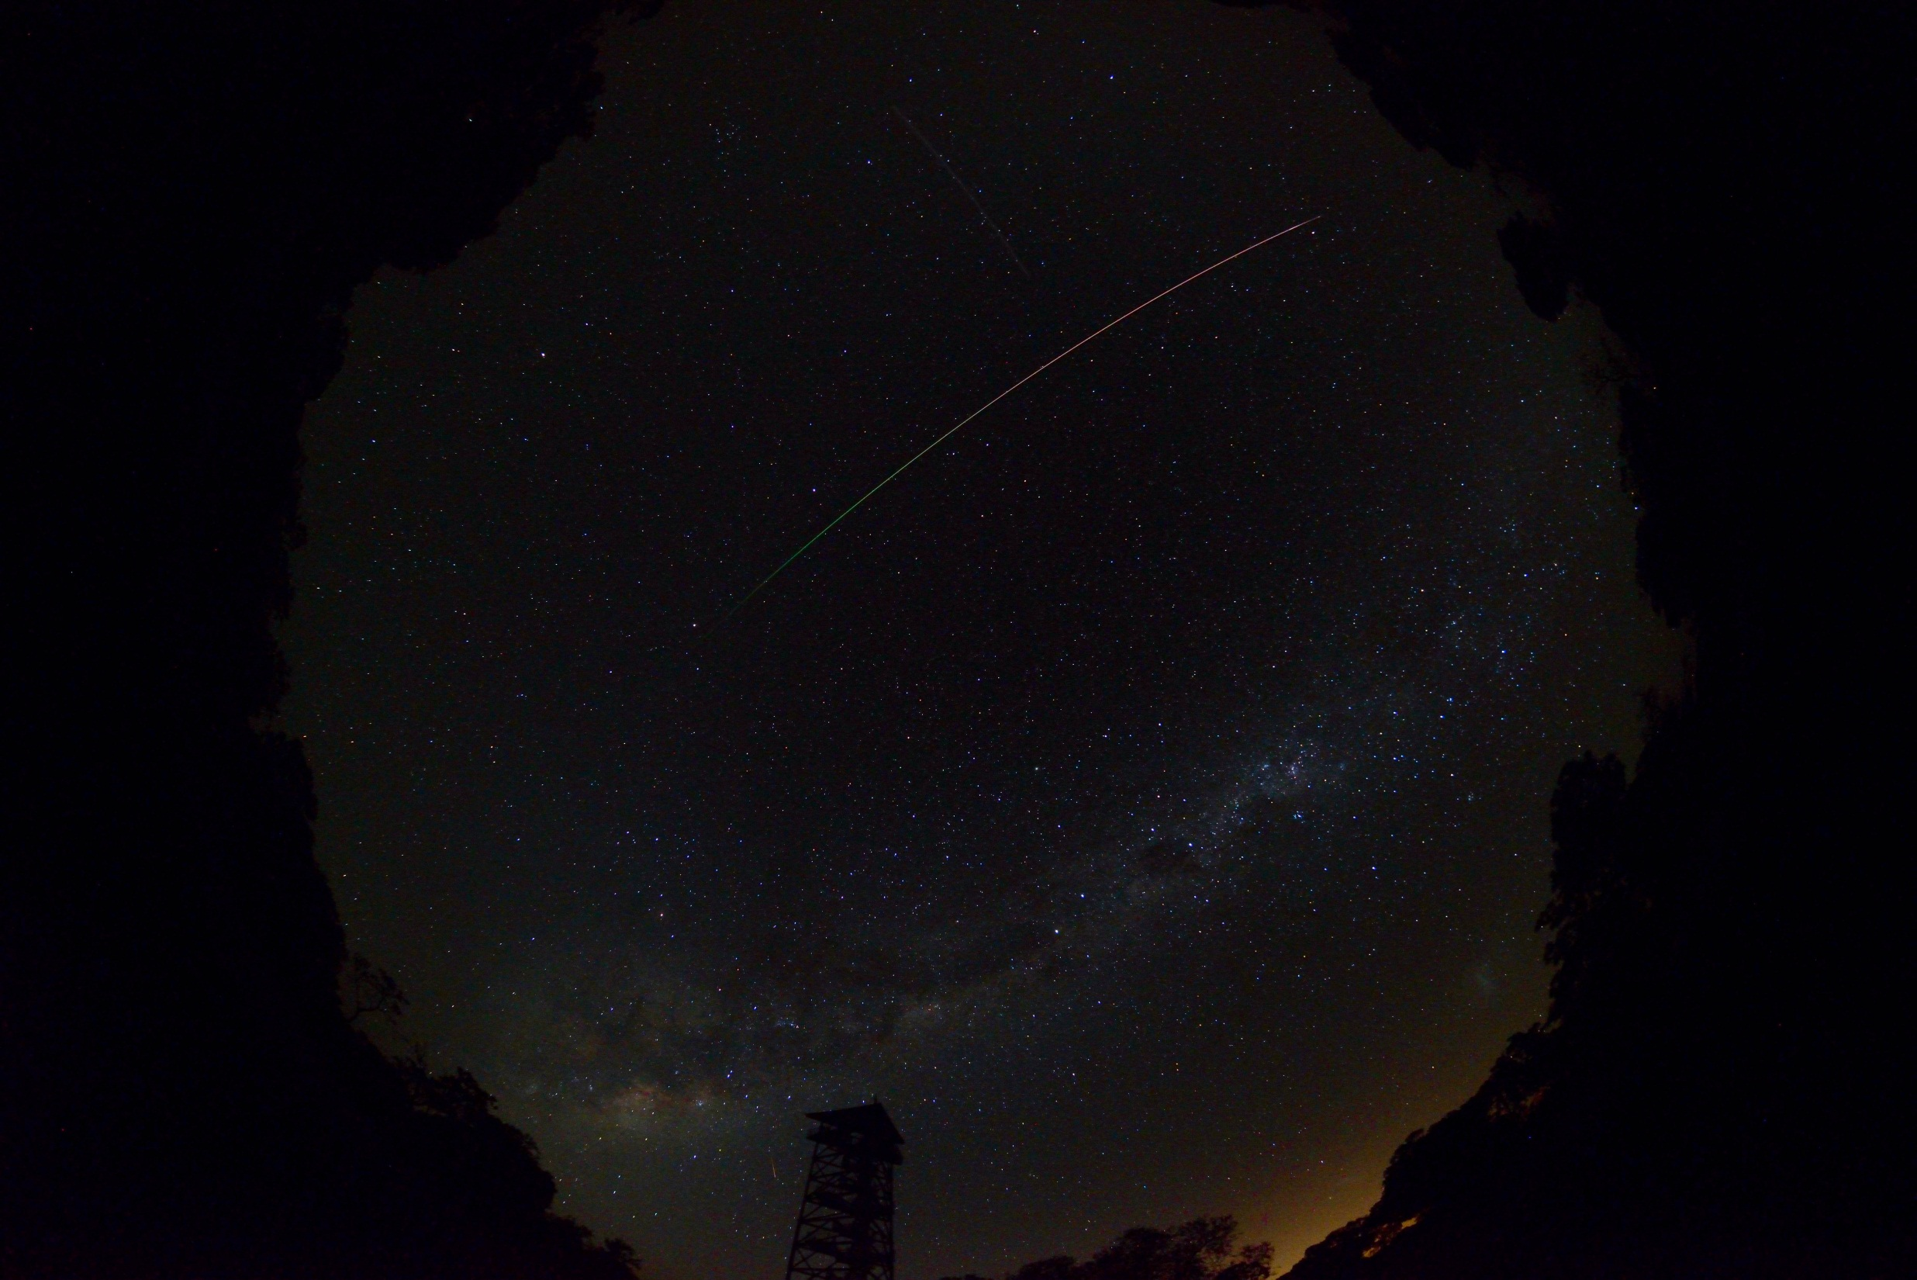
EXPLORING ADVANCED ESTIMATORS FROM GUIDANCE, NAVIGATION AND CONTROL IN FIREBALL MODELLING
*Ellie Sansom, Phil Bland and Mark Rutten

Slide 2
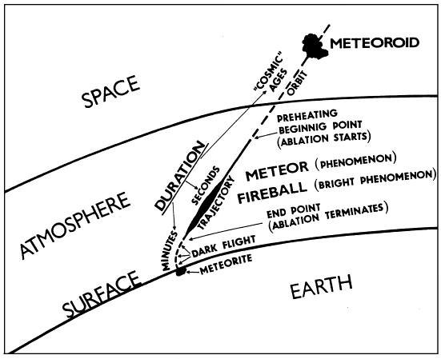
Ceplecha et al., 1998

Slide 3
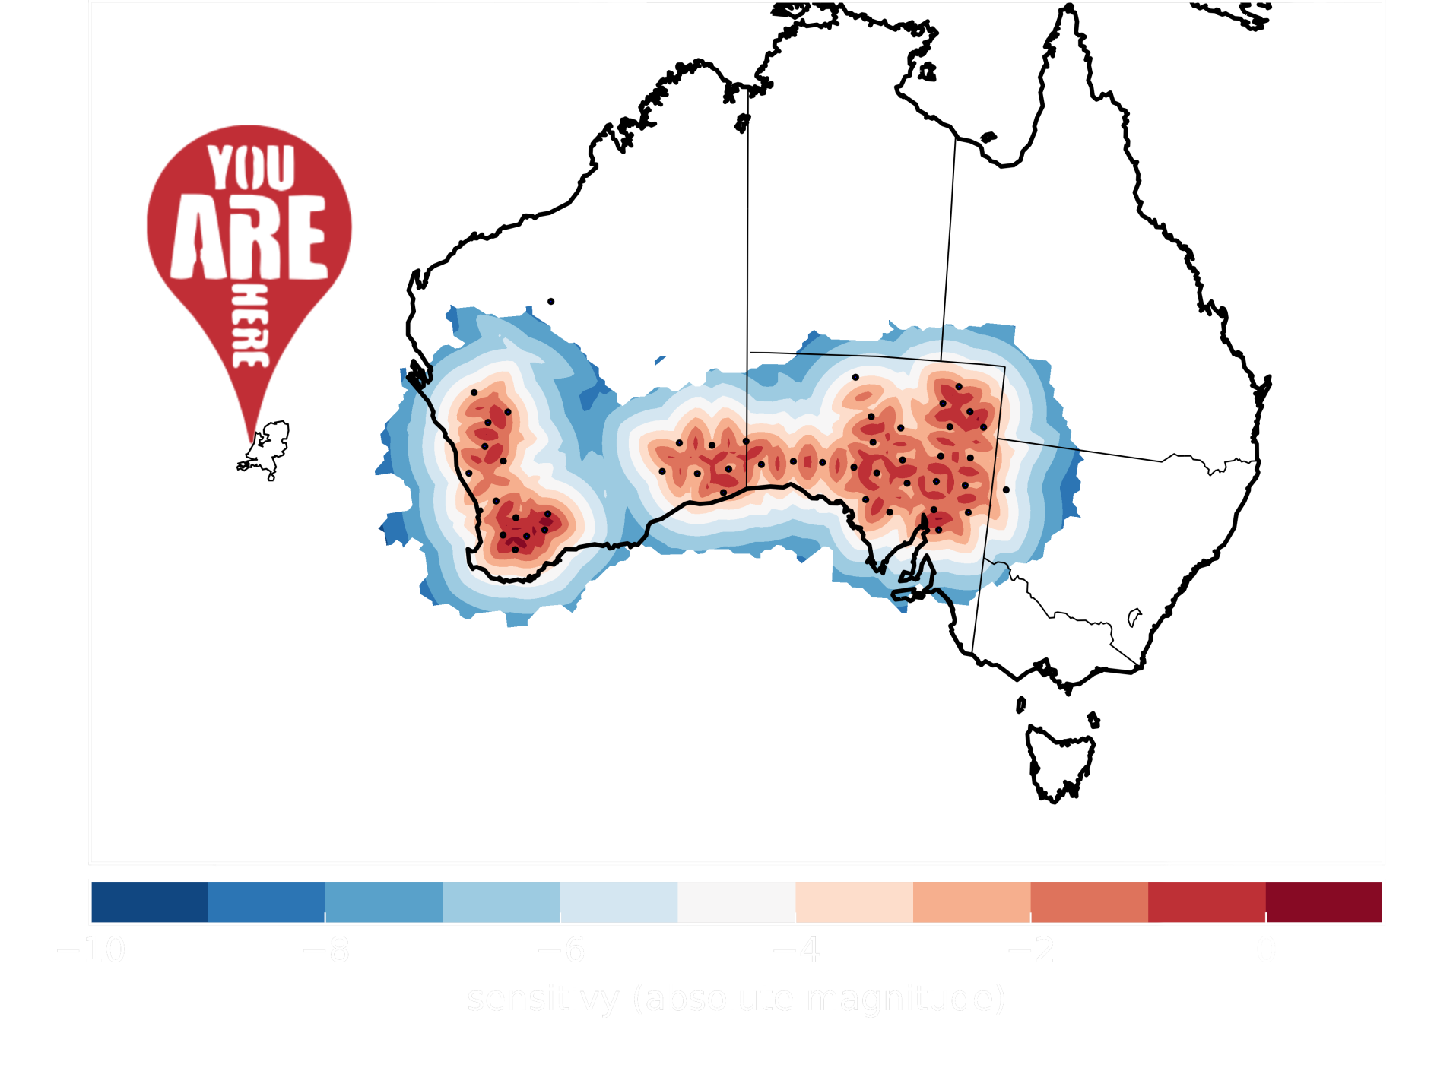
Notes:
Need automation

Slide 4
Mass Determination
$\frac{\text{dv}}{\text{dt}} ∝ − K \frac{v^{2}}{m^{1/3}}$ $+$ gravity
$$\frac{\text{d}m}{\text{dt}} ∝ −K σ v^{3} m^{2/3}$$
(modified from Bronshten, 1963)

Slide 5
Mass Determination
$\frac{\text{dv}}{\text{dt}} ∝ − K \frac{v^{2}}{m^{1/3}}$ $+$ gravity
$$\frac{\text{d}m}{\text{dt}} ∝ −K σ v^{3} m^{2/3}$$
(modified from Bronshten, 1963)

Slide 6
Mass Determination
$\frac{\text{dv}}{\text{dt}} ∝ − K \frac{v^{2}}{m^{1/3}}$ $+$ gravity
$$\frac{\text{d}m}{\text{dt}} ∝ −K σ v^{3} m^{2/3}$$
(modified from Bronshten, 1963)

Slide 7
Mass Determination
$\frac{\text{dv}}{\text{dt}} ∝ − K \frac{v^{2}}{m^{1/3}}$ $+$ gravity
$$\frac{\text{d}m}{\text{dt}} ∝ −K σ v^{3} m^{2/3}$$
Tracking Algorithms:
Uses equations and observations
to determine estimate of state :
With comprehensive errors
$${\hat{x}}_{k}=\left(\begin{aligned}\begin{matrix}l_{k} \\ v_{k} \\ m_{k}\end{matrix} \\ \end{aligned}\right)$$

Slide 8
Initiation of State
Estimators –
$$x_{0}=\left(\begin{aligned}\begin{matrix}l_{0} \\ v_{0} \\ m_{0}\end{matrix} \\ \end{aligned}\right)$$

Slide 9
Initiation of Covariance
Estimators –
$$l_{0},v_{0}, m_{0}$$
$$P_{0}$$
$$P_{k}=\left[\begin{matrix}{σ_{l}}^{2} & & \\ & {σ_{v}}^{2} & \\ & & {σ_{m}}^{2}\end{matrix}\right]$$

Slide 10
Prediction
Estimators –
$$l_{0},v_{0}, m_{0}$$
$${\hat{x}}_{t_{1}|t_{0}}→l_{t_{1}|t_{0}},v_{t_{1}|t_{0}}, m_{t_{1}|t_{0}}$$
$$P_{0}$$
$$P_{t_{1}|t_{0}}$$

Slide 11
Update
Estimators –
$$l_{0},v_{0}, m_{0}$$
$${\hat{x}}_{t_{1}}→l_{t_{1}},v_{t_{1}}, m_{t_{1}}$$
$$P_{0}$$
$$P_{t_{1}}$$

Slide 12
Prediction
Estimators –
$$l_{0},v_{0}, m_{0}$$
$${\hat{x}}_{t_{1}}→l_{t_{1}},v_{t_{1}}, m_{t_{1}}$$
$$P_{0}$$
$${\hat{x}}_{t_{2}|t_{1}}→l_{t_{2}|t_{1}},v_{t_{2}|t_{1}}, m_{t_{2}|t_{1}}$$
$$P_{t_{1}}$$
$$P_{t_{2}|t_{1}}$$

Slide 13
Update
Estimators –
$$l_{0},v_{0}, m_{0}$$
$${\hat{x}}_{t_{1}}→l_{t_{1}},v_{t_{1}}, m_{t_{1}}$$
$$P_{0}$$
$${\hat{x}}_{t_{2}}→l_{t_{2}},v_{t_{2}}, m_{t_{2}}$$
$$P_{t_{1}}$$
$$P_{t_{2}}$$

Slide 14
Estimators –
Prediction
$$l_{0},v_{0}, m_{0}$$
$${\hat{x}}_{t_{1}}→l_{t_{1}},v_{t_{1}}, m_{t_{1}}$$
$$P_{0}$$
$${\hat{x}}_{t_{2}}→l_{t_{2}},v_{t_{2}}, m_{t_{2}}$$
$$P_{t_{1}}$$
$${\hat{x}}_{t_{3}|t_{2}}→l_{t_{3}|t_{2}},v_{t_{3}|t_{2}}, m_{t_{3}|t_{2}}$$
$$P_{t_{2}}$$
$$P_{t_{3}|t_{2}}$$

Slide 15
Update
Estimators –
$$l_{0},v_{0}, m_{0}$$
$${\hat{x}}_{t_{1}}→l_{t_{1}},v_{t_{1}}, m_{t_{1}}$$
$$P_{0}$$
$${\hat{x}}_{t_{2}}→l_{t_{2}},v_{t_{2}}, m_{t_{2}}$$
$$P_{t_{1}}$$
$${\hat{x}}_{t_{3}}→l_{t_{3}},v_{t_{3}}, m_{t_{3}}$$
$$P_{t_{2}}$$
$$P_{t_{3}}$$

Slide 16
Final Estimates
Estimators –
$$l_{0},v_{0}, m_{0}$$
$${\hat{x}}_{t_{1}}→l_{t_{1}},v_{t_{1}}, m_{t_{1}}$$
$$P_{0}$$
$${\hat{x}}_{t_{2}}→l_{t_{2}},v_{t_{2}}, m_{t_{2}}$$
$$P_{t_{1}}$$
$${\hat{x}}_{t_{3}}→l_{t_{3}},v_{t_{3}}, m_{t_{3}}$$
$${\hat{x}}_{f}=\left(\begin{aligned}\begin{matrix}l_{f} \\ v_{f} \\ m_{f}\end{matrix} \\ \end{aligned}\right)$$
$$P_{t_{2}}$$
$$P_{f}=\left[\begin{matrix}{σ_{l_{f}}}^{2} & & \\ & {σ_{v_{f}}}^{2} & \\ & & {σ_{m_{f}}}^{2}\end{matrix}\right]$$
$$P_{t_{3}}$$

Slide 17
Final Covariance
Estimators –
$$l_{0},v_{0}, m_{0}$$
$${\hat{x}}_{t_{1}}→l_{t_{1}},v_{t_{1}}, m_{t_{1}}$$
$$P_{0}$$
$${\hat{x}}_{t_{2}}→l_{t_{2}},v_{t_{2}}, m_{t_{2}}$$
$$P_{t_{1}}$$
$${\hat{x}}_{t_{3}}→l_{t_{3}},v_{t_{3}}, m_{t_{3}}$$
$${\hat{x}}_{f}=\left(\begin{aligned}\begin{matrix}l_{f} \\ v_{f} \\ m_{f}\end{matrix} \\ \end{aligned}\right)$$
$$P_{t_{2}}$$
$$P_{f}=\left[\begin{matrix}{σ_{l_{f}}}^{2} & & \\ & {σ_{v_{f}}}^{2} & \\ & & {σ_{m_{f}}}^{2}\end{matrix}\right]$$
$$P_{t_{3}}$$
Notes:
Final covariance provides comprehensive error analysis…. Propagation of errors from start to finish including errors of both observation and position

Slide 18
New Approach Using Estimators -testing the Bunburra Rockhole dataset
Extended Kalman filter (EKF)
Unscented Kalman filter (UKF)
Interactive Multiple Models (IMM)
Sequence Interval Sampling Particle Filter (SIS PF)

Slide 19
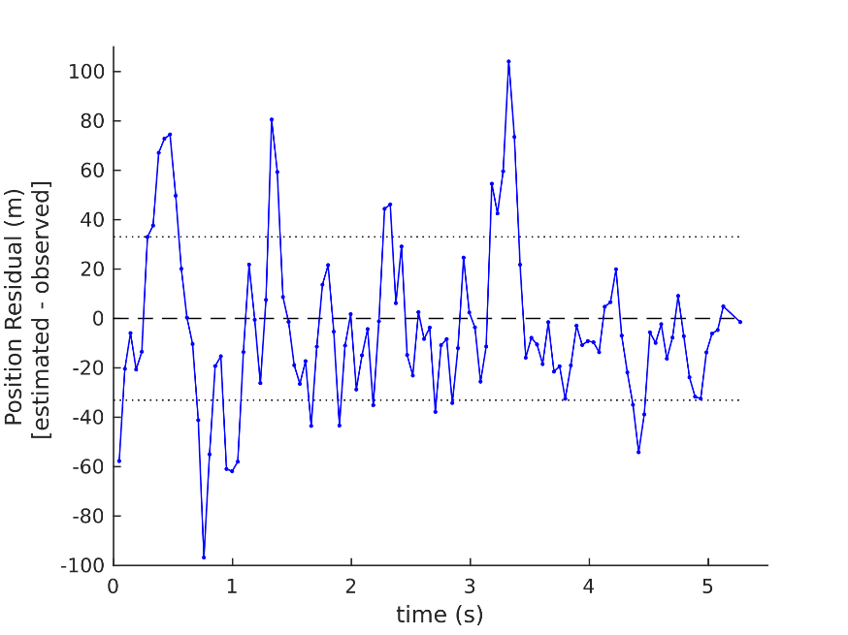
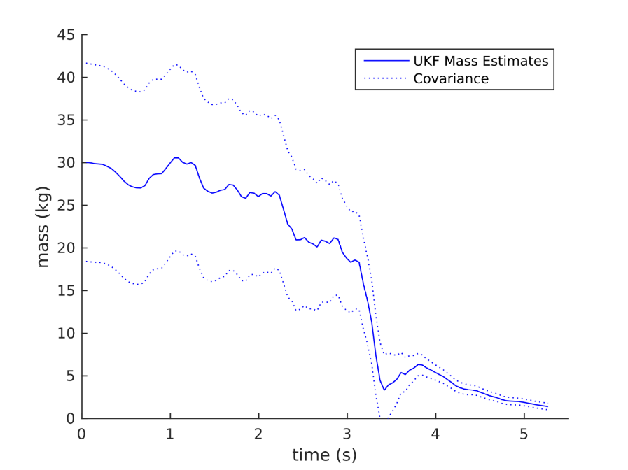
Unscented Kalman Filter (UKF)
Forward Calculated Masses
Velocities
MASS - kg
Position Residual
(Sansom et al., in review)

Slide 20
Final Covariance
 | Position | Velocity | Mass
EKF (Sansom et al., 2015) | ± 62m | ± 241 m/s | ± 1.63 kg
UKF (Sansom et al., in review) | ± $58 m$ | ± 203 m/s | ± 1.04 kg
IMM + UKF

Slide 21
New Approach Using Estimators -testing the Bunburra Rockhole dataset
Extended Kalman filter (EKF)
Unscented Kalman filter (UKF)
Interactive Multiple Models (IMM)
Sequence Interval Sampling Particle Filter (SIS PF)

Slide 22
Interactive Multiple Models (IMM)
(Sansom et al., in review)

Slide 23
IMMs as Fragmentation Indicators
(Sansom et al., in review)
Light Curve modified from Spurný et al., 2012

Slide 24
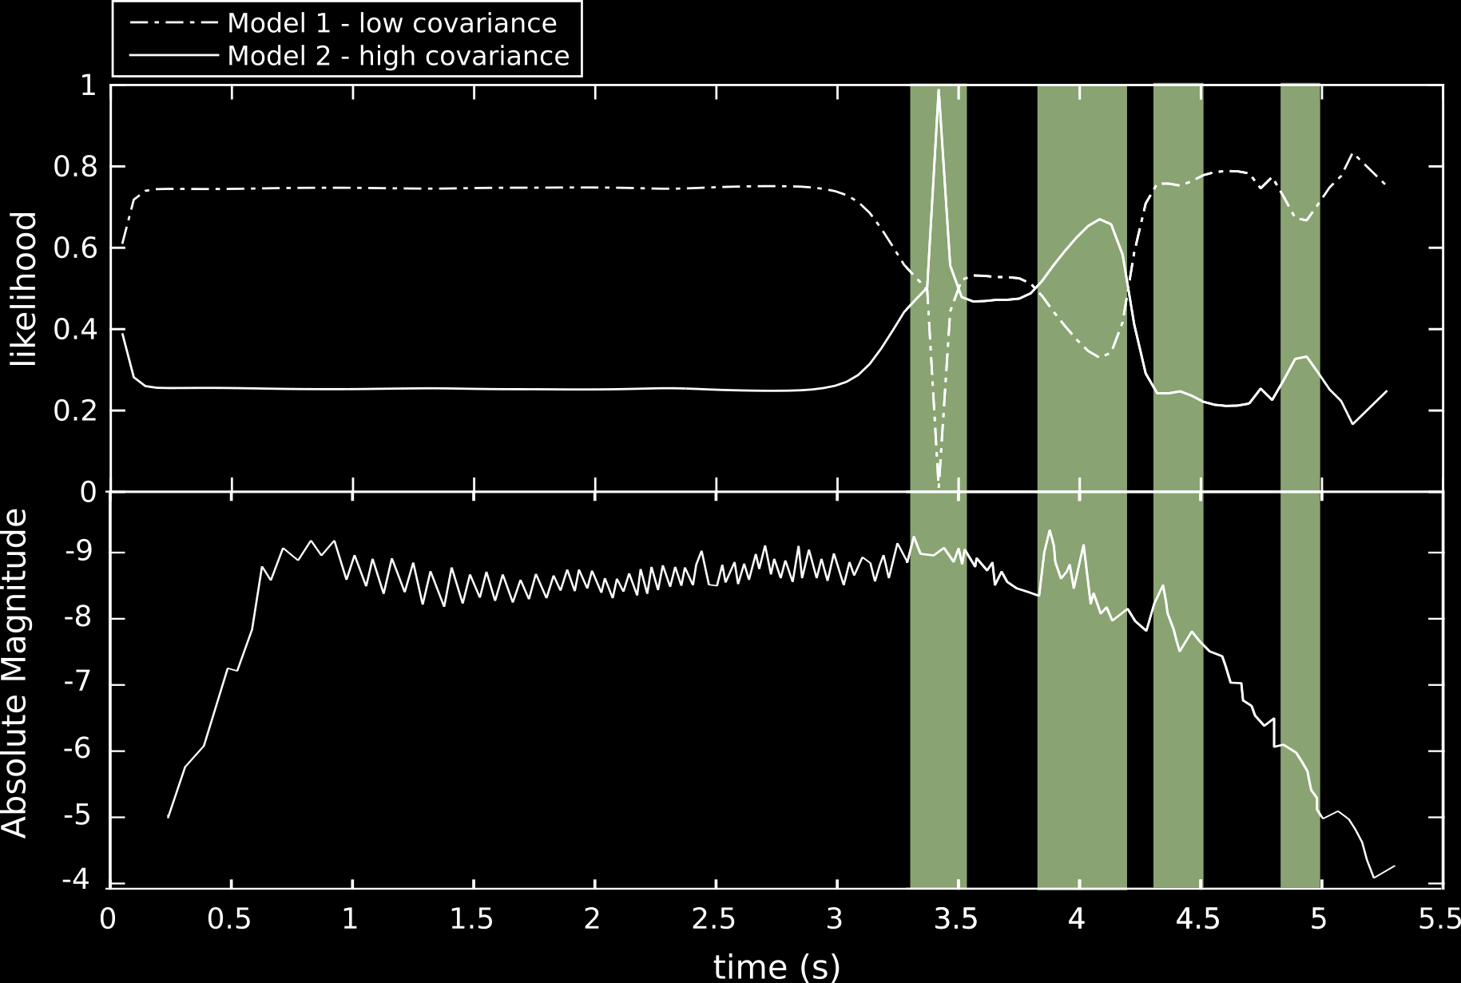
IMMs as Fragmentation Indicators
Light Curve modified from Spurný et al., 2012

Slide 25
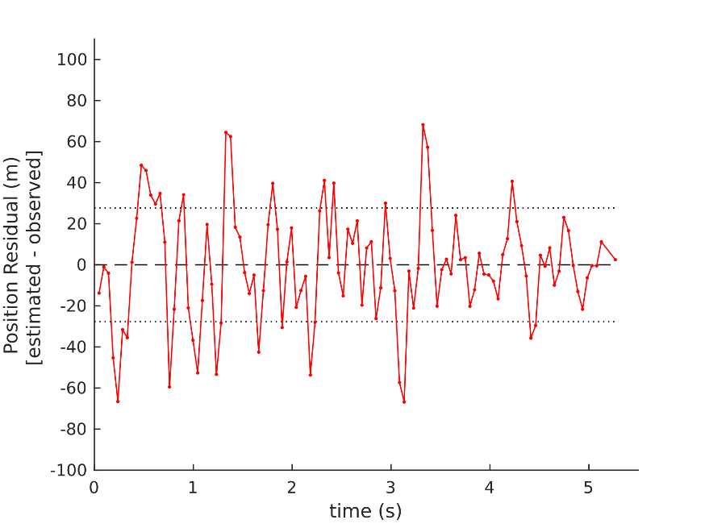
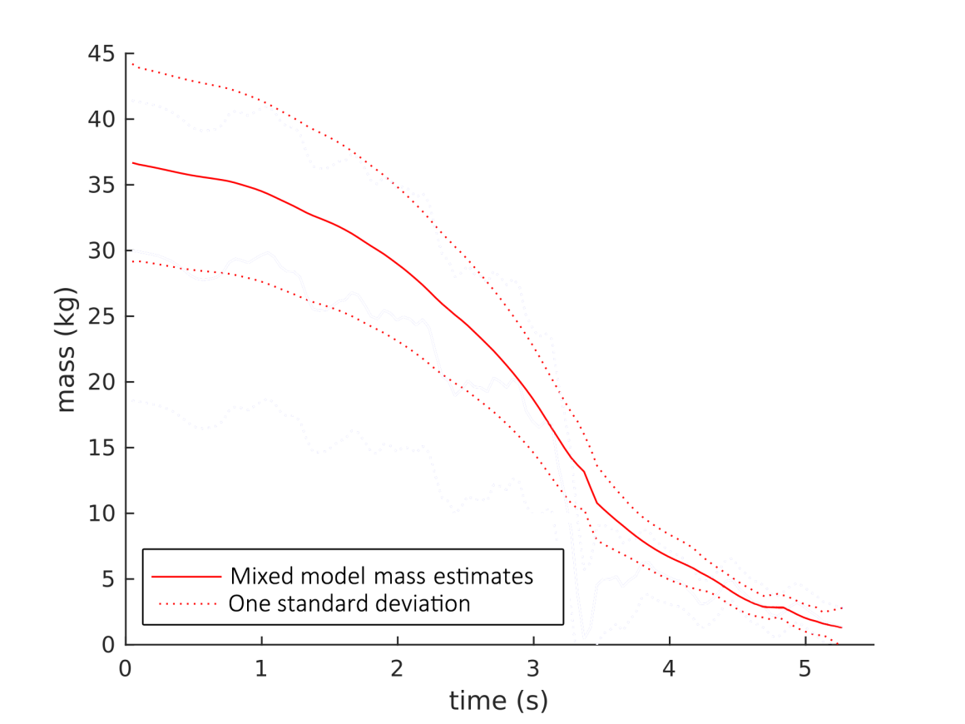
IMM + UKF
Smoothed Calculated Masses
Velocities
Position Residual
(Sansom et al., in review)

Slide 26
Final Covariance
 | Position | Velocity | Mass
EKF (Sansom et al., 2015) | ± 62m | ± 241 m/s | ± 1.63 kg
UKF (Sansom et al., in review) | ± $58 m$ | ± 203 m/s | ± 1.04 kg
IMM + UKF | $$\text{±} 7 m$$ | ± 59 m/s | ± 0.49 kg

Slide 27
New Approach Using Estimators -testing the Bunburra Rockhole dataset
Extended Kalman filter (EKF)
Unscented Kalman filter (UKF)
Interactive Multiple Models (IMM)
Sequence Interval Sampling Particle Filter (SIS PF)

Slide 28
Sequence Importance Sampling Particle Filter
Figures soon to be published

Slide 29
Summary
Tracking algorithms iterate and progress a model based on an observational dataset.
Interactive Multiple Models switch between different systems of equations given their likelihood based on observations.
Particle Filters allow us to estimate unknown parameters that are not linked to observational data.

Slide 30
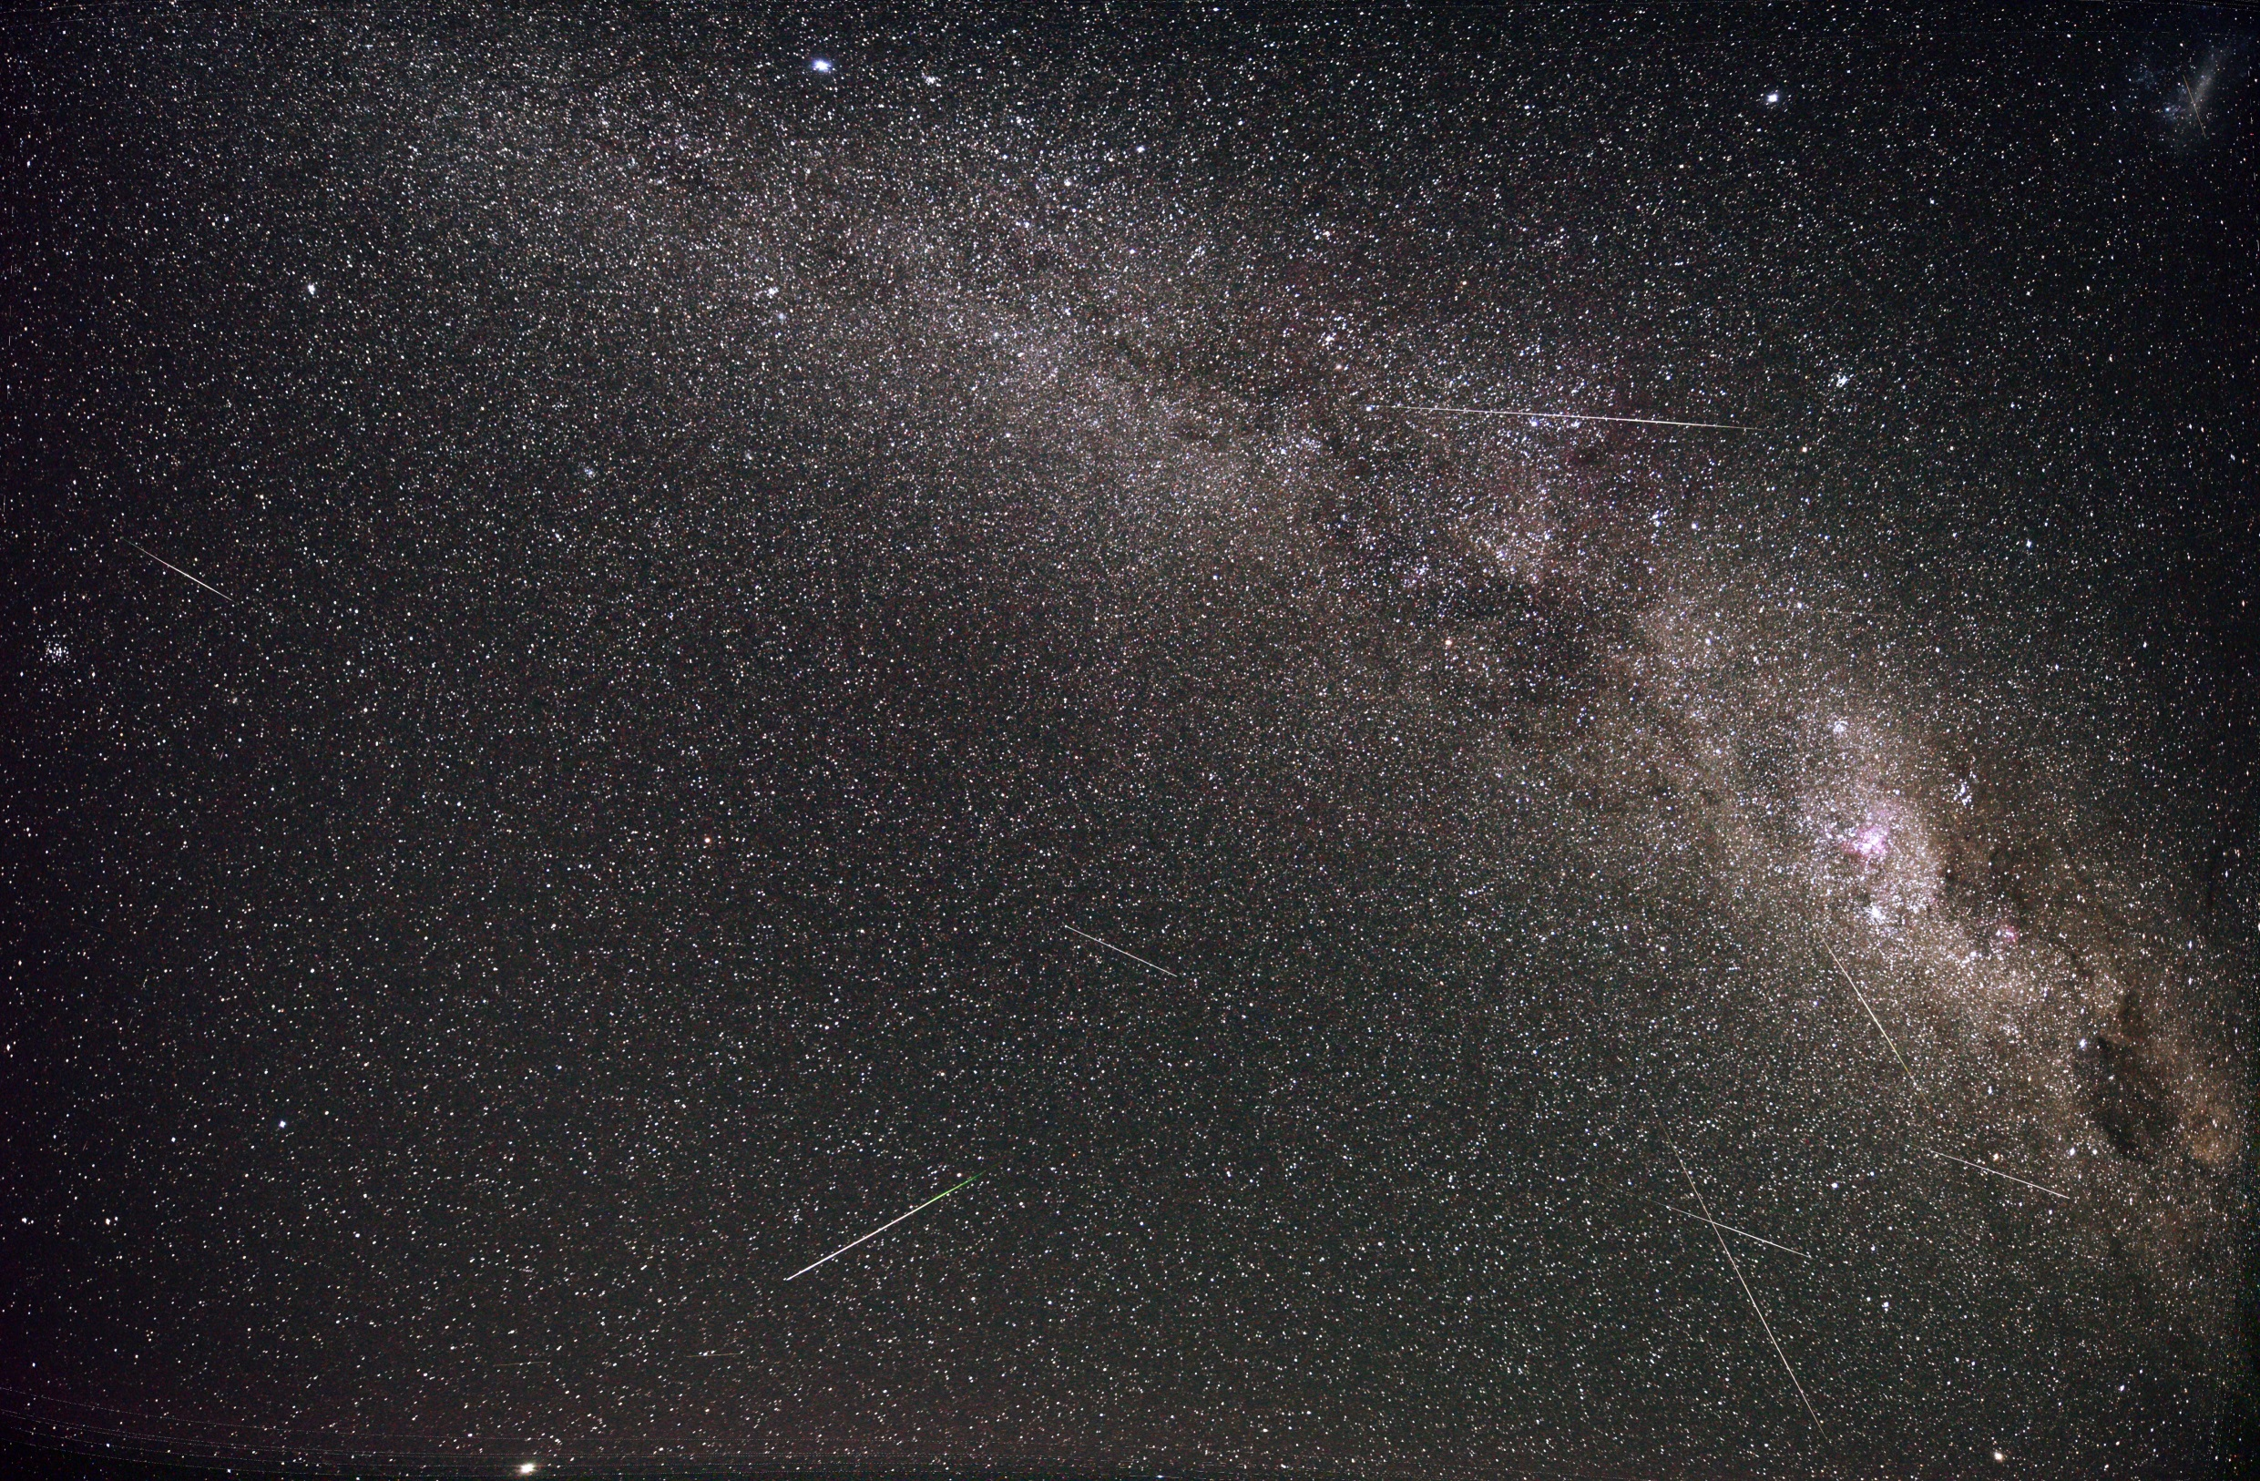
Thank You Any Questions? fireballs@curtin.edu.au fireballsinthesky.com.au

