Slide 1
A Spectral Analysis of Ablating Meteors
Kevin Bloxam
Supervisor: Dr. Margaret Campbell-Brown

Slide 2
Background
Building on Jiří Borovička’s research:
Physical and chemical properties of meteoroids as deduced from observations (2006)
Spectral properties of ablating meteors observed using diffraction grating
Na, Mg, Ca, and Fe spectral lines consistently exhibited by meteors among other less vivid elements
Properties of meteoroids from different classes of parent bodies (2007)
Physical properties will be different depending on body of origin
Notes:
Physical – a review of current knowledge of physical properties and chemical composition of meteoroids entering the Earth’s atmosphere
discusses observations of ablation.
Use light to gain information about meteoroid properties
Fainter meteors produced have been classified according to height
Faint meteor observations have shown that meteor beginning heights depend on mass
Blue spectrum – mostly meteoric material
Red/IR – mostly heated air
Larger bodies do not get as disrupted as smaller bodies
Ablation of regular chondritic (stony) material may not be uniform – thermodynamic equilibrium calculations show that fractionation occurs during melting and vaporization
Degree of volatility leads to differential ablation
Suggests bright spectral lines of Na and Mg to be present while also fainter lines of Ca and Fe – this is starting point of my project
Early release of Na is indication of meteoroid disruption well before heating
There are different disruption heights
Derivation of elemental abundances can in principle be done from meteor spectroscopy
Properties – provides an understanding of the properties of meteoroids as deduced from their parent body. Physical makeup will be different depending
on the body from which they originate
Meteoroids observed to disintegrate in terrestrial atmosphere can be directly linked to parent bodies that they belong to certain meteor showers
Strength of cometary material is enhanced be long term exposure to cosmic rays and solar heating – loss of volatile Na
Physical properties can be derived from meteor observations
Would like to know how do meteoroids look before and after encountering atmosphere – meteor observations provide some clues
End height increases with increasing fragility
Approximate chemical composition can be inferred from meteor spectra
Low abundance of Ca caused by incomplete evaporation of meteoric matter
Southern delta Aquarids are old enough to have lost all Na due to low perihelion distance (0.07 AU)
Analysis of meteor data can reveal differences in physical and chemical composition of various small bodies in the solar system
This project will attempt to provide more statistical evidence of the properties of known parent bodies in the solar system

Slide 3
Expectations
Differential ablation
Tied to the notion of volatility
Fractionation occurs during melting and vaporization
Detect bright lines of Na and Mg and fainter lines of Ca and Fe (Borovička 2006)
Na should vaporize sooner than Mg and Fe due to volatility
Refractory Ca should ablate later and not fully(Borovička 2006)
Beginning altitude higher for fragile bodies(Borovička 2007)
Notes:
Sodium may be released preferentially at the beginning of the luminous trajectory

Slide 4
Expectations
Light curve to show skewness to beginning for volatile components (Borovička 2007)
Example of early Na release and a similar release time of Na and Mg of two Leonid meteors (Borovička 2006)
Notes:
Main component of radiation is oxygen triplet at 777nm

Slide 5
Design and Methodology
Capture spectral line emissions of ablating meteor as electrons de-excite
Development of a multi-camera system (5 total)
Four cameras with narrow-band filters:
Na – 589 nm on intensified COHU
Mg – 520 nm on intensified COHU
Ca – 426 nm on intensified COHU
Fe – 394 nm on gated camera
One Watec (white light) unfiltered camera
Notes:
3 COHU: 4910 Series – High Performance CCD Cameras, 1 Watec – white light camera, 1 gated camera – Intensified Retiga Fast 1394 Monochrome super high sensitivity – extended blue range
Filters are 25 mm diameter, Hard coated, 10 nm bandpass
Intensifiers – IR – just shy of blue spectral range
Unfortunately Ca proved to be a little too dark to see with the intensified COHU. Though some stars were faintly visible and some brighter meteors were seen there was no way this data could be reduced.
COHUs are digitized at 8 bit rate – can lead to some oversaturation due to limitations
Gamma = 1
Gain turned up as far as possible
Fe proved to filter out too much light and no stars were visible. As a result the second summer working on this project we swapped the COHU and replaced it with a gated camera to increase the spectral range.
Watec is 8 bit
CAMO widefield – 80 fps
Watec, Na, Mg – 60 fps
Gated – 10 fps

Slide 6
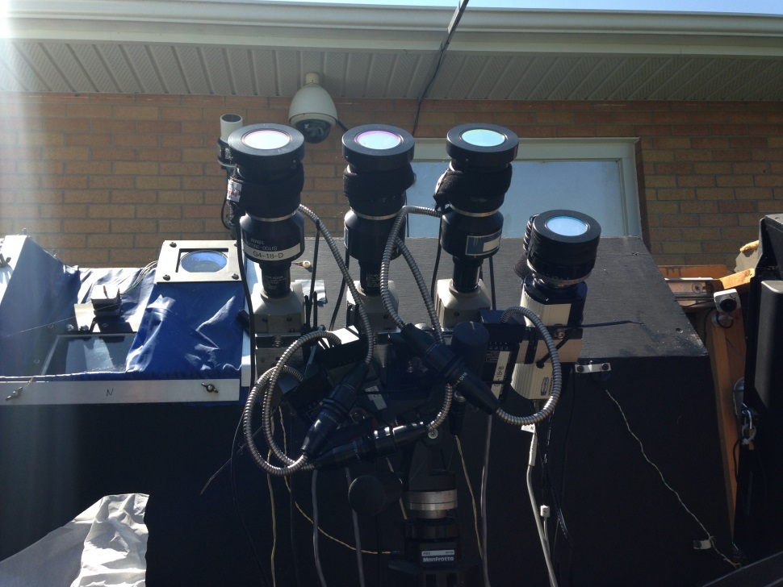
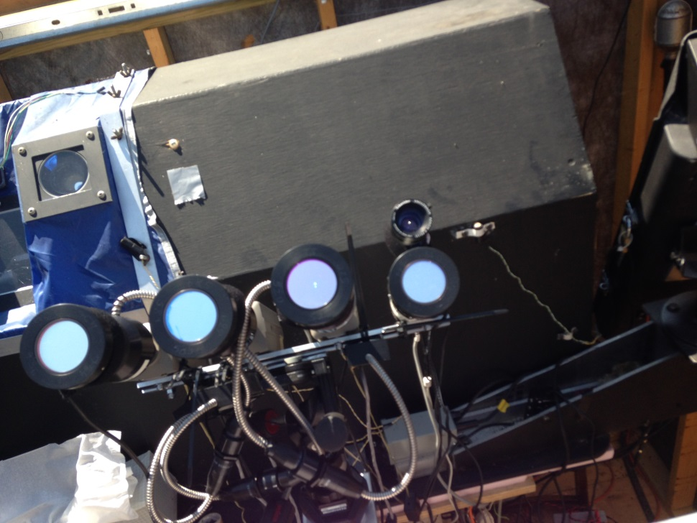
Multi-camera system at the Elginfield Observatory. Sodium, magnesium, and calcium filters were fitted on COHU cameras. Iron filter was placed on a gated camera with a Watec camera mounted on top.
Notes:
Na, Mg, Ca, Fe, and WATEC

Slide 7
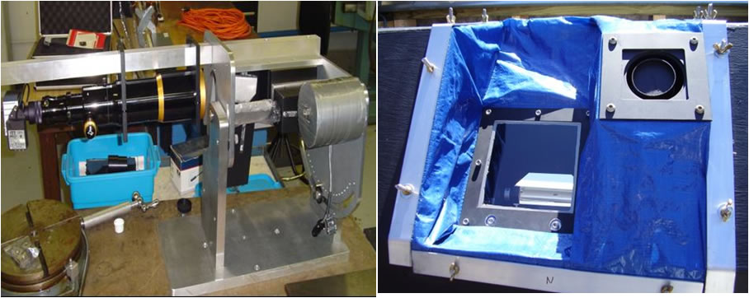
Design and Methodology
Utilized Canadian Automated Meteor Observatory (CAMO) System
High resolution wide-field cameras
Detect meteors and chop video footage around events
High resolution wide-field camera at Tavistock and Elginfield Observatories
Notes:
Elginfield and Tavistock are separated by a baseline of 50km
The CAMO system provides a universal timestamp to each of the camera’s video footage so that we can properly compare events.
The same timestamp is given to the filtered cameras.
Each night’s worth of data is cut around the time the system detects a meteor and a list of potential meteor events are compiled each night. Using the time of the events the 4-filter data is cut and each event as seen on each of the cameras can be compared to one another and reduced using a specially designed software called METAL which allows for the development of light curves.

Slide 8
Results
Notes:
The following is a sample of sporadic meteors detected during September and October 2015.

Slide 9
Multi-camera event captured September 13, 2015 at 07:09:53 UTC
Tavistock - CAMO - Wide Field
Elginfield - CAMO - Wide Field
Elginfield – Mg Filter
Elginfield – Na Filter
Elginfield – Watec

Slide 10
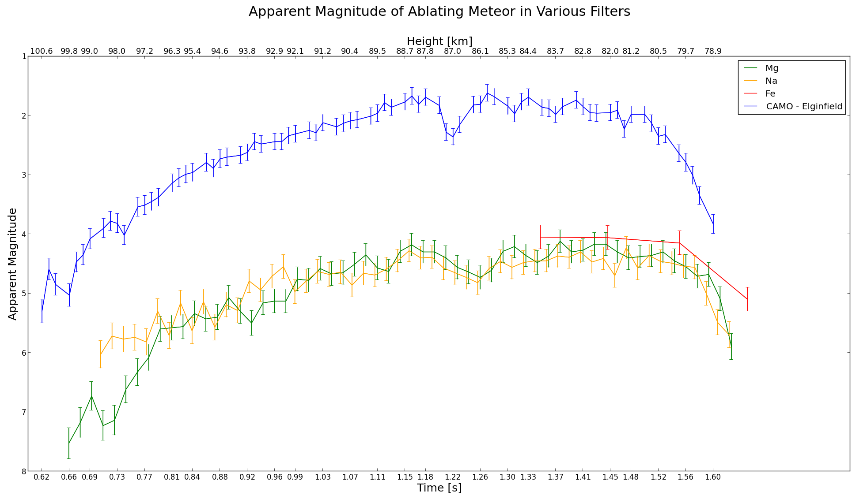
Multi-camera event captured September 13, 2015 at 07:09:53 UTC
Notes:
This event is the one from my abstract. This event occurred September 13, 2015 at 07:09:53 UTC.
Please note that time after the beginning of the event (i.e. the length of the video clip associated with the event) is along the bottom, the associated height is along the top, and the y-axis is represented by the apparent magnitude.
We see that expect for the very beginning this event produces a light curve that exhibits characteristics of a uniformly ablating meteor.
Based on the magnitudes of the Mg, Na, and Fe compared to the total magnitude of the CAMO system we can conclude that at the peak of the curve approximately 15% of the light is produced by Mg, Na, and Fe each.
Lower beginning height – more uniform ablation
Meteor likely wasn’t disrupted before entry

Slide 11
Multi-camera event captured September 20, 2015 at 06:53:04 UTC
Notes:
Multi-camera event captured September 20, 2015 at 06:53:04 UTC.
Strong evidence for differential ablation exhibited by this curve.
Notice the clear skewness of the Na curve compared to the Mg
Na begins to ablate much sooner than Mg – which implied ablation is beginning at higher altitude
Notice how the curve for Mg follows the peak of total magnitude as captured by the CAMO system
Na ends much sooner than Mg
Also notice how at the beginning the fraction of total light that is emitted is strongly exhibited by 589 nm (sodium) de-excitation

Slide 12
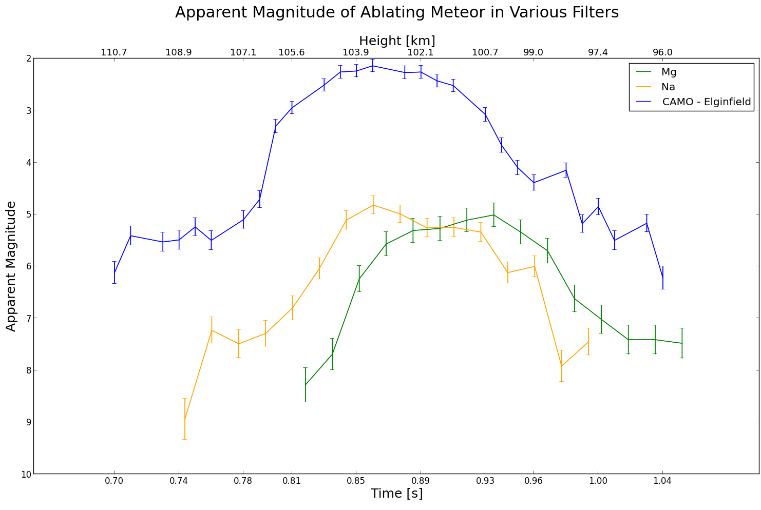
Multi-camera event captured September 22, 2015 at 06:31:03 UTC
Notes:
Multi-camera event captured September 22, 2015 at 06:31:03 UTC
Another case for differential ablation based on the skewness of the Na and Mg curves
We note the earlier and higher release of volatile Na
At peak of Na and Mg curves we note that they contribute to approximately 10% of the total light output each
Also note the earlier end time of Na compared to Mg

Slide 13
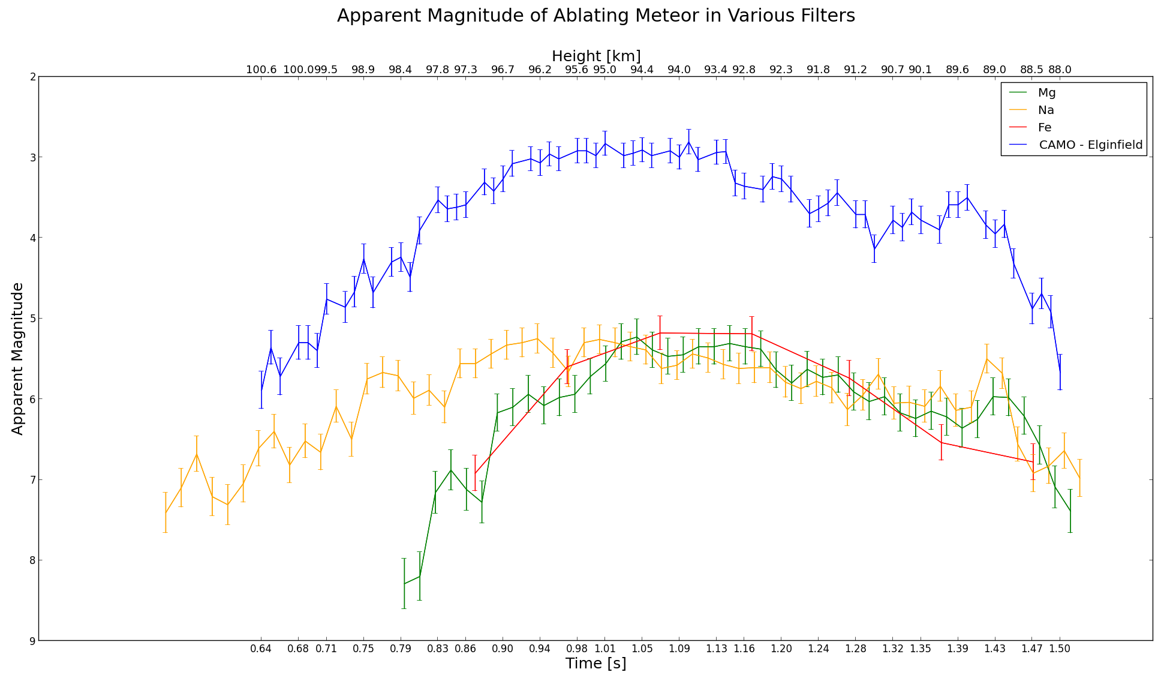
Multi-camera event captured October 8 , 2015 at 05:03:08 UTC
Notes:
Multi-camera event capture October 8, 2015 at 05:03:08 UTC
This event was able to capture a move complete light curve from the Fe filtered camera.
Note again the early release of Na indicating some disruption to the meteor prior to entry or there may have been an outer crust of Na that would have caused Na to ablate first
However after Mg begins to ablate we notice Na and Mg ablating uniformly until the end of the event
At peak intensity it appears that Fe, Mg, and Na all contribute approximately the same degree of light – 45% of the light total

Slide 14
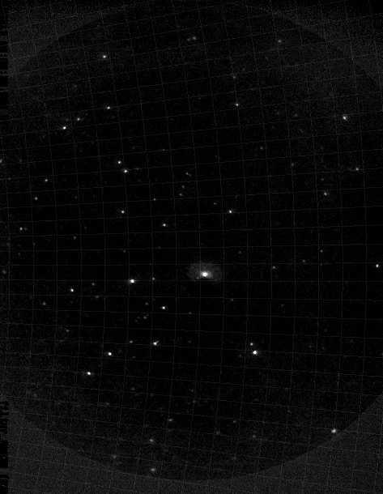
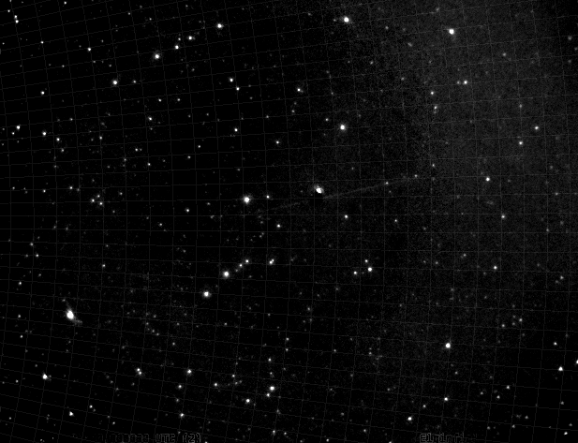
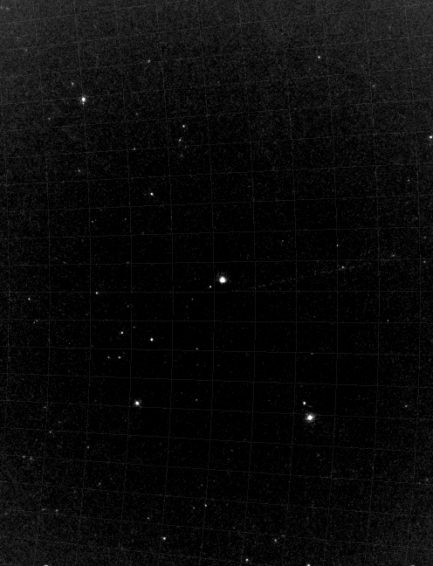
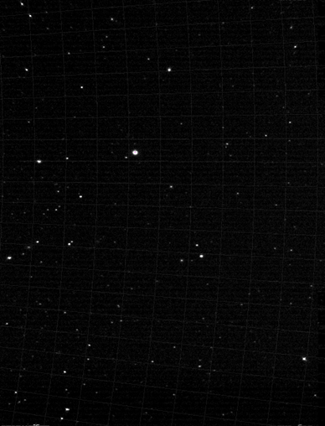
Considerations and Next Steps
Increase field of view for Watec and gated cameras
Notes:
Camo – wide field – 25 x 20 deg., Mg/Na – 22 x 16.5 deg., Watec – 14.2 x 10.6 deg., Fe – 14 x 11 deg.

Slide 15
Considerations and Next Steps
Normalization – effects of airglow
Specifically by Na due to deposition in Thermosphere by meteors (McNeil et. al 1998)
Luminous efficiency: $I= −τ\left(\frac{v^{2}}{2}\frac{dm}{dt}+mv\frac{dv}{dt}\right)$
Determine fraction of light produced at specific wavelengths
Update $τ$ parameter for meteors with various densities and chemical makeup
Improve predictions and understanding of light emitted
Notes:
Would like to know more about the effects of airglow on results. Specifically on Na light curves. Though it seems airglow effects are mostly just after sundown and most meteors are observed in the early morning. However I have a concern Na in atmosphere may be excited and add to the observed magnitude of the meteor.
Luminous efficiency – which is essentially the conversion of kinetic energy to light and is determine through observations based on the intensity of light that is produced. Current observations use intensified video which extends from IR to just shy of blue and doesn’t see quite the entire spectrum. Hopefully using specific spectral lines, specifically Ca and Fe which has their peak emission at 420 and 394 nm, one can later be applied to improving the determination of luminous efficiency .
In addition using four filter data we will gain insight into where the light is coming from (i.e. elemental emission) that is emitted by the meteor and we can estimate the fraction of white light emitted at various wavelengths. With a understanding of the light that is emitted (wavelength, magnitude and fraction of light) we can refine the luminous efficiency models by updated the tau parameter as it is applied to meteors with various densities and chemical structure.
Essentially we hope to gain a more complete understanding of our observations but also apply this to models to build our expectations of what we expect to see and also better predict ablation characteristics of meteors.
In turn if we understand the expected light output of meteors we gain a understanding of the mass

Slide 16
Considerations and Next Steps
Comparison of Watec vs. intensified light curves
Replace Fe for Ca filter on the gated camera
Gain insight into fraction of light produced at this wavelength
How and when calcium ablates
Reduce meteors associated with known showers using filtered data
Develop and refine statistics of parent body characteristics
Notes:
We would also like to look into a comparison between the Watec (white light) camera and the intensified system. The intensified system looks more into the IR with a range to just shy of blue. We would like to know how the light curves that are produced will vary between the cameras and we can apply this to luminous efficiency and see if there is a correction factor that we can apply.
Want to swap the Fe for the Ca filter on the gated camera. Since bright stars and meteors were faintly visible with the Ca filtered intensified COHU if we use the gated instead we will be able to see a tremendous amount of stars and meteors clearly (considering when we first started the Fe was on an intensified COHU and we couldn’t observe anything)
Again by looking at Ca light output we can see the fraction of total light that Ca contributes to which helps with luminous efficiency. Also it would be interesting to observe how Ca ablates – does it ablate later on due to its refractory nature as Borovicka suggests?
Try to increase the fps of the gated camera – if possible – also try to improve timing of gated events so they match other cameras perfectly - as to increase accuracy
Finally we would also like to continue going through the data collect and reduce any events that are associated with known showers and parent bodies. By examine the light produced by these meteors we can help build and refine the statistics of parent body characteristics

Slide 17
Preliminary Conclusions
Evidence for both differential ablation and uniform ablation
Differential ablation
Na released higher in the atmosphere
Skewness of Na light curve toward beginning of event
At peak magnitude Na and Mg wavelengths contribute approximately the same amount of light
Meteoroid structure plays an important role in differential ablation
Notes:
Our preliminary results indicate we have evidence for both uniform and differential ablation.
In the cases of differential ablation we see that Na is being released earlier/higher in the atmosphere due to its higher volatility
As a result of earlier release we see a skewness in the light curve that Na produces compared to Mg
At the peak magnitudes Na and Mg we see that they emit approximately the same output of light
We definitely see that meteoroid structure plays an important role in differential ablation. If the meteor is disrupted before entry the chances of differential ablation occurring are increased and skewed light curves are the result.

Slide 18
Thank you – Dank je

Slide 19
Appendix

Slide 20
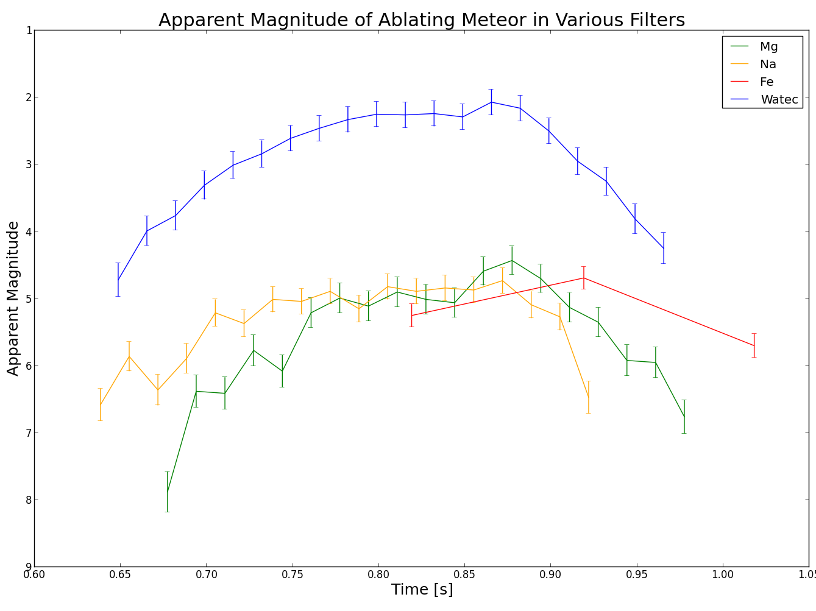
Multi-camera event captured September 24, 2015 at 08:53:16 UTC
Notes:
This event was not captured by the CAMO system, however it was captured on all other cameras except for Ca. By comparing the data with WATEC we will hope to discover more insight into luminous efficiency since WATEC is a white light camera and captures more of the smaller wavelengths compared to the intensified CAMO wide-field cameras. We can also follow the shape light curves of the various filters as they compare to the WATEC curve.

Slide 21
Elginfield – Fe Filter September 13, 2015 at 07:09:53 UTC
Notes:
Footage captured with the gated camera. It is digitized at a higher bit rate (12 bits) and is why the footage appears white. However once we load the event into METAL we can adjust the light so that it resembles the output of the COHU and Watec, which are both 8 bit.

Slide 22
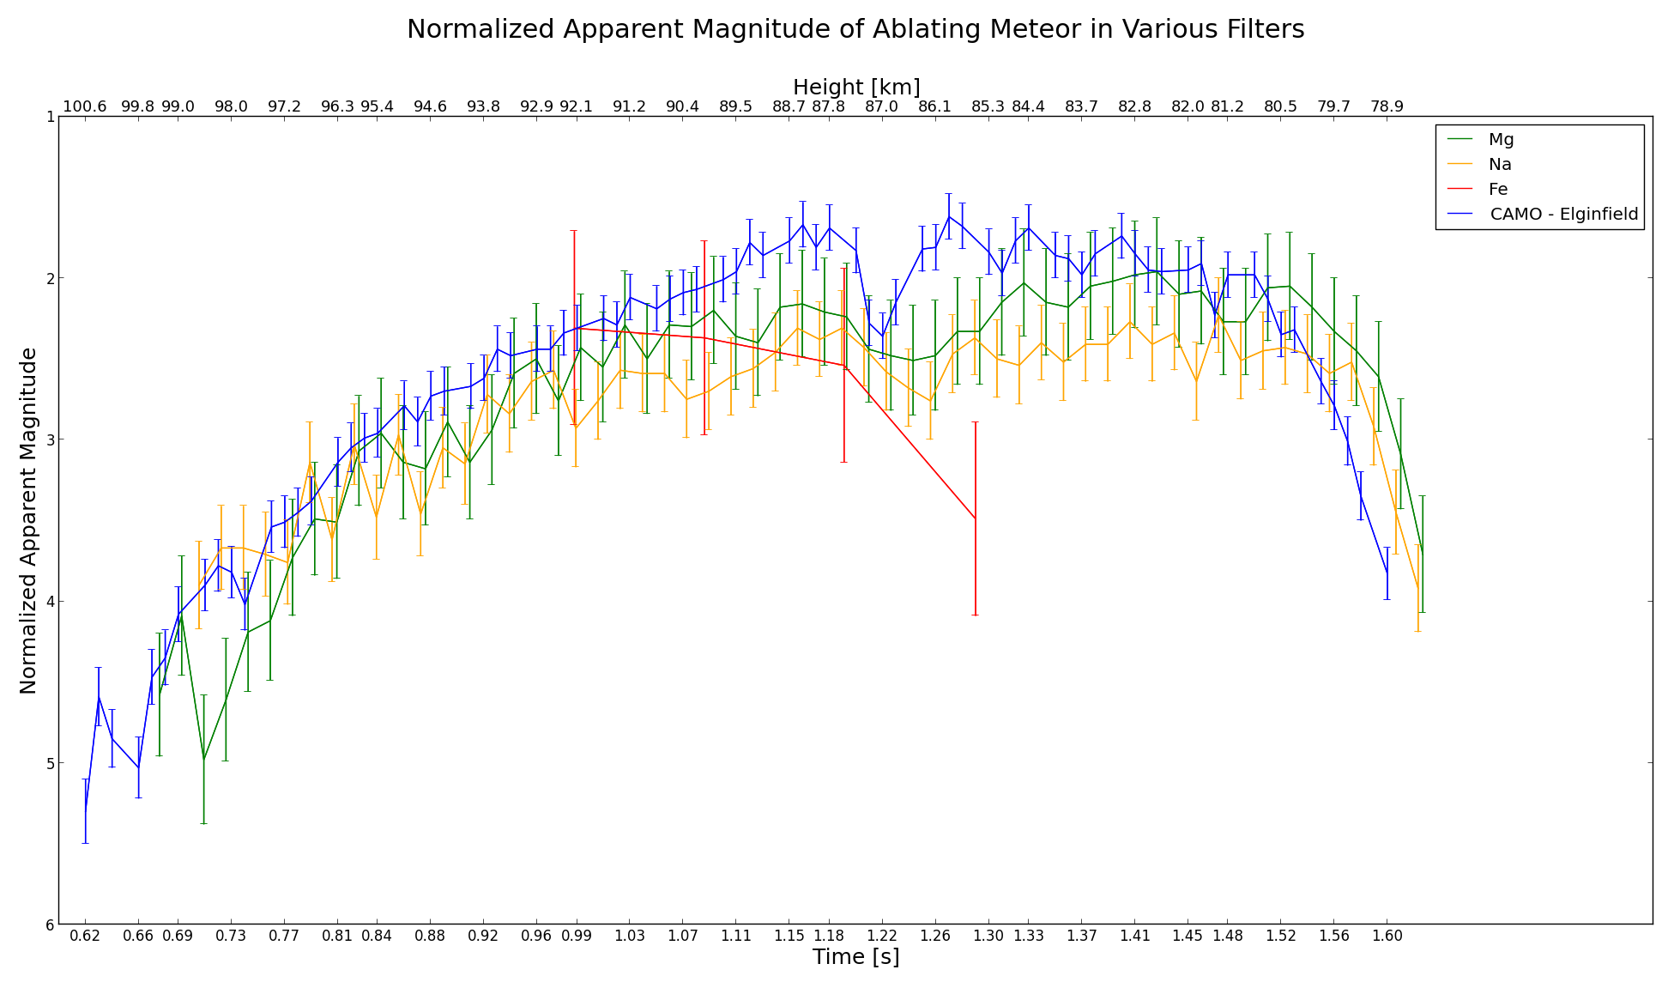
Multi-camera event captured on September 13, 2015 at 07:09:53 UTC
Notes:
Abstract curve before star catalogue was adjusted. This was normalized by taking searching for the max magnitude for each filter and taking the offset at that point and applying this offset to the entire curve to ensure that the magnitude didn’t surpass the CAMO light curve.

Slide 23
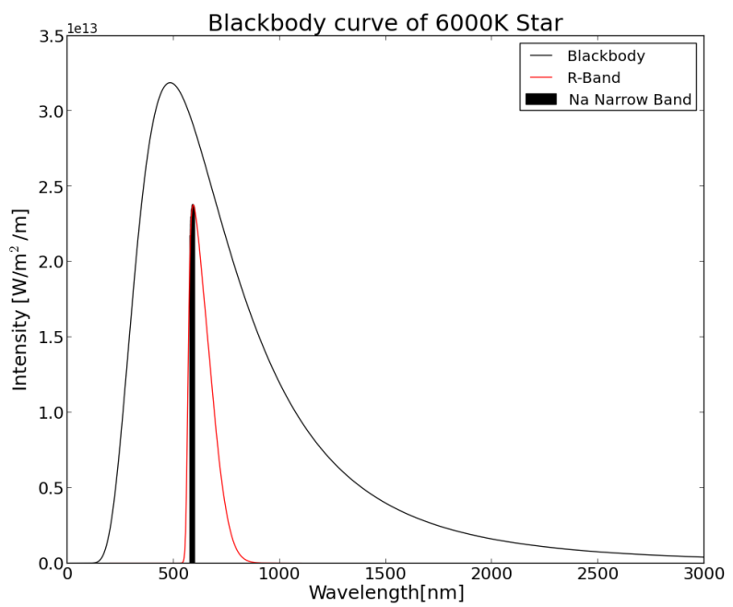
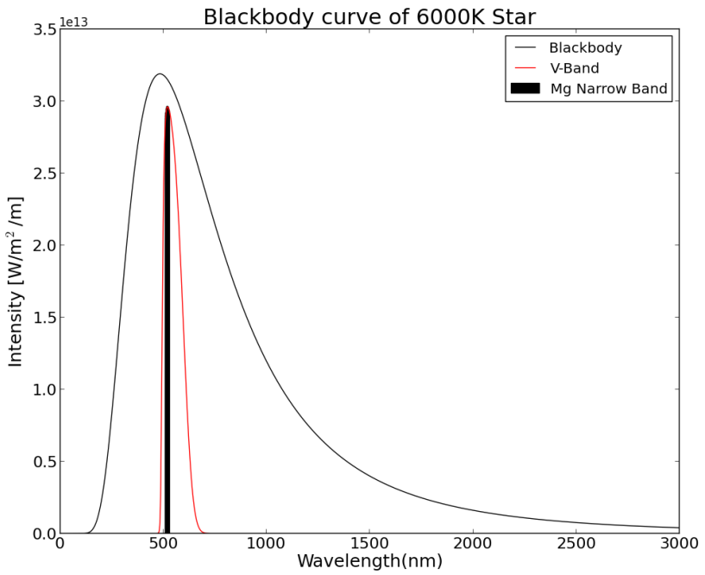
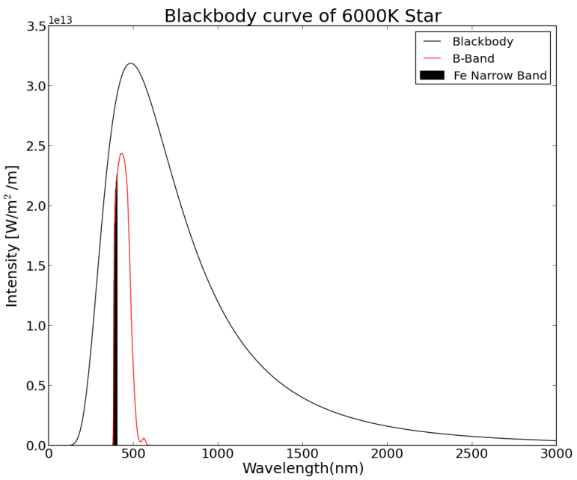
Blackbody curve of 6000K star with R-band transmission and Na narrow-band transmission juxtaposed.
Blackbody curve of 6000K star with V-band transmission and Mg narrow-band transmission juxtaposed.
Blackbody curve of 6000K star with B-band transmission and Fe narrow-band transmission juxtaposed.
Notes:
Example of a blackbody curve fitted using the Planck function for a 6000K star. The R, V, and B bandwidths were juxtaposed on top of the curve and the respective transmission of Na, Mg, and Fe were also incorporated. Na – uses R band. Mg – V band. Fe – B band.

Slide 24
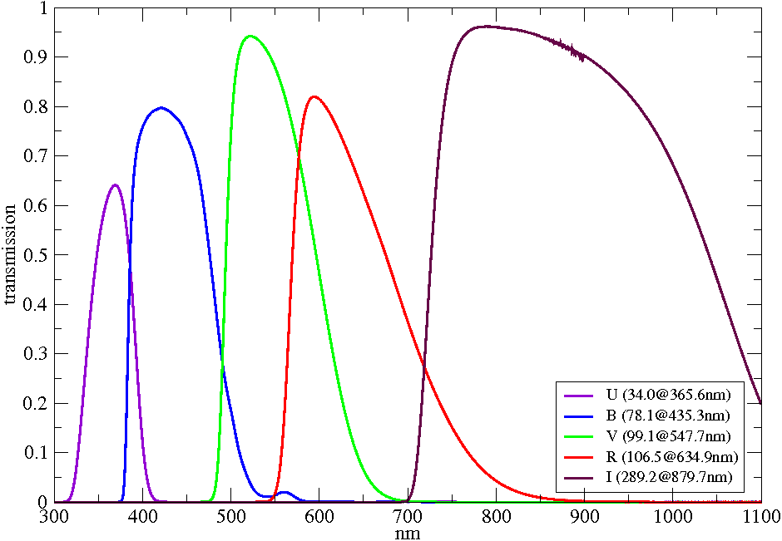
Fe
Ca
Mg
Na
Johnson-Cousins UBVRI filter curves – taken from: http://www.aip.de/en/research/facilities/stella/instruments/data/johnson-ubvri-filter-curves/
Notes:
Johnson-Cousins UBVRI filter curves – representation of the transmission of light in these various bands. The website provides data of the transmissions at 0.5 nm intervals. This data was incorporated into the determination of the magnitudes of the star catalogue used in Metal as seen in the respective wavelengths (i.e. Na, Mg, Fe). The peak wavelengths of Fe, Ca, Mg, and Na have are displayed.

Slide 25
Planck’s Law : $B_{λ}=\frac{2hc^{5}}{λ^{5}} \frac{1}{e^{({hc}/{λkT})}−1}$
Apparent Magnitude: $m_{B}−m_{A}=2.5\log_{10}{(\frac{I_{A}}{I_{B}})}$
Notes:
We use Planck’s law to determine the intensity over a range of wavelengths from 10 to 3000 nm at 0.5nm intervals and build the blackbody curve.
We then apply the Johnson-Cousins UBVRI filter curve transmissions to determine the perceived intensity in R,V, and B band widths.
We also look at the peak wavelengths of each filter +- 10nm and sum the intensities.
Since we have a star catalogue with known R and V magnitudes we could sum the intensities over these ranges, sum the intensities over filters and determine the apparent magnitude for each of the filters.
We then updated the star catalogues with the new magnitudes and reduced the events which gave more reasonable magnitudes compared to before when a simple normalization was applied.

Slide 26
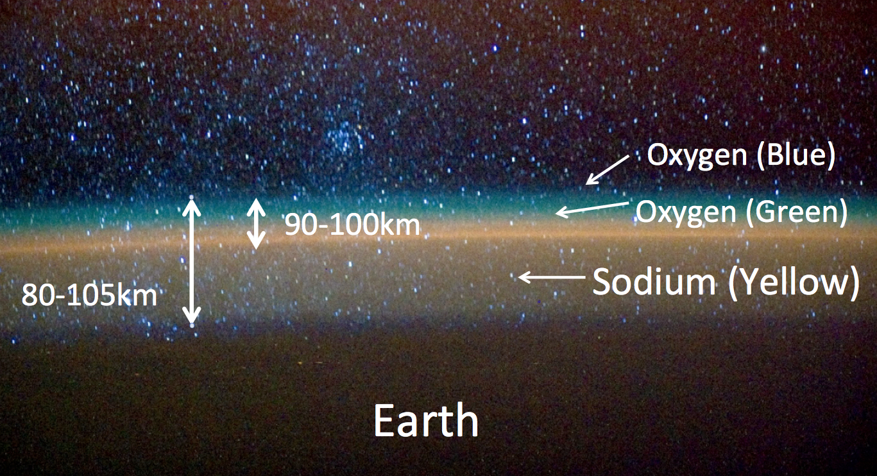
Airglow
Airglow emissions of Na in Mesopause and Thermosphere
Source: http://auroranightglow.blogspot.ca/2012/05/night-glow.html
Notes:
Though this seems to occur early evening after sunset and considering most events occur early morning this shouldn’t be too much of an issue
Due to early release of volatile Na
Na gets deposited in atmosphere
Though one may need to consider the notion of the meteor’s energy transfer to the sodium in the atmosphere and causing more sodium to appear than there really is

