Slide 1








JWST is an international partnership between NASA, ESA and the CSA.
JWST status, timeline and GO policies
Pierre Ferruit (ESA JWST project scientist)
INAF JWST info day – 17 March 2017

Slide 2

Contents of the JWST presentation
Mission overview in 6 slides
Mission status
Status – Hardware.
Status – Schedule to launch.
JWST capabilities
Quick overview – imaging, spectroscopy and coronagraphy.
Miscellaneous (moving targets, parallel observations).
Scientific timeline
Timeline for JWST cycle 1.
The Early Release Science (ERS) call.
The timeline for the call for JWST Guaranteed Time Observers (GTOs).
Full timeline including the call for JWST General Observers (GOs).
Conclusion

Slide 3
Acknowledgements
All along this presentation you will see results from work conducted by a large number of teams in Europe, USA and Canada.
Many elements of this presentation are based on existing presentations prepared by other members of the JWST project, the instrument teams and STScI.
A lot of material used in this presentation is coming from from STScI’s JWST web sites (main resources for getting information):
https://jwst.stsci.edu/ (main site)
https://jwst-docs.stsci.edu/ (documentation site, work in progress)

Slide 4
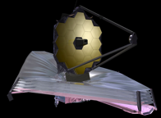
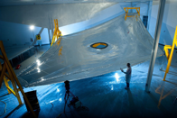
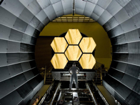




JWST mission overview in 6 slides
JWST will be one of the “great observatories” of the next decade.
Often presented as the next step after the Hubble Space Telescope (HST).
Joint mission between NASA, ESA and CSA.
High-priority endeavor for the associated astrophysical communities.
Setup similar to the HST one.
Over the duration of the mission, at least 15% of the total JWST observing time goes to ESA member states applicants.
To be launched in October 2018 for a minimum mission duration of 5 years (10-year goal).

Slide 5
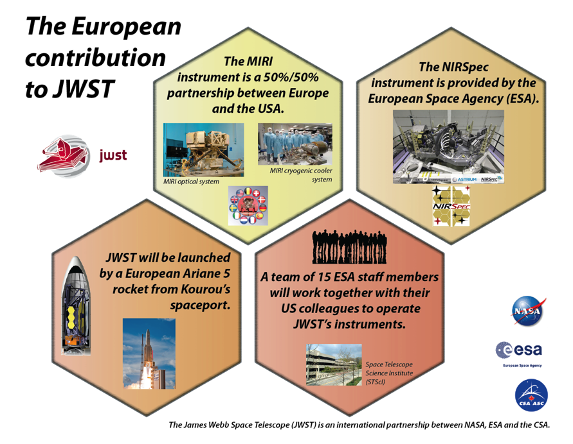
JWST mission overview in 6 slides

Slide 6
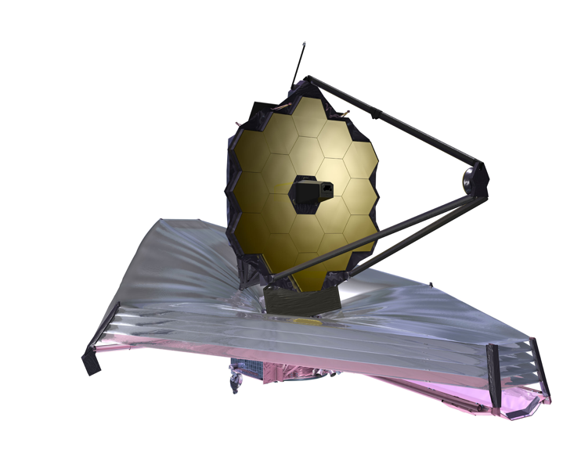
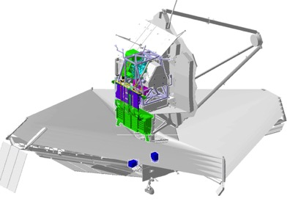
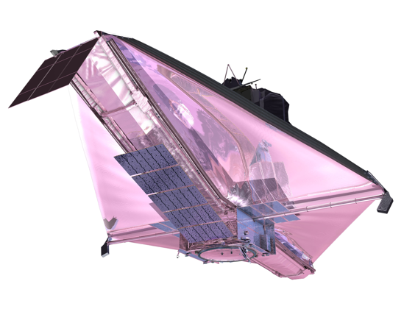

JWST mission overview in 6 slides
payload module
segmented primary mirror
(18 hexagonal mirrors of 1.32m flat-to-flat; collecting surface > 25m²)
the 4 instruments and their electronic boxes
the telescope
(4 optical elements, only 2 visible here)
secondary mirror
(0.74m diameter)
the sunshield
Allows passive cooling of the telescope and the instruments down to ~40K, the size of a tennis court
the spacecraft
Note that a cryogenic cooler is used to cool JWST’s mid-infrared instrument (MIRI) down to 6-7K.
the spacecraft bus and solar panels
The past and future of astroPAH research - Noordwijk - 31 October 2016

Slide 7
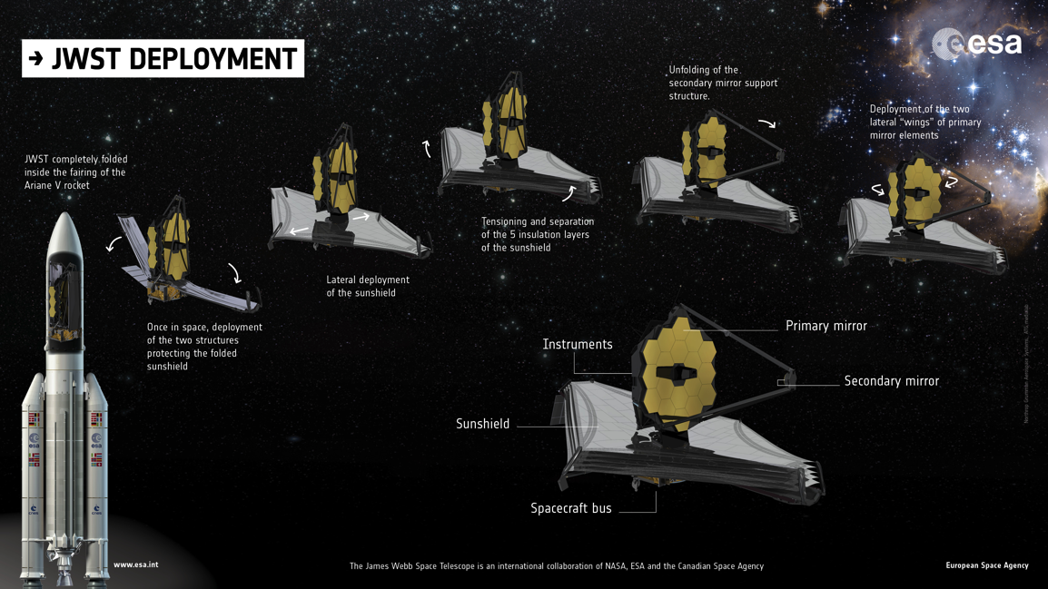
JWST mission overview in 6 slides
Note that a cryogenic cooler is used to cool JWST’s mid-infrared instrument (MIRI) down to 6-7K.
the spacecraft bus and solar panels
The past and future of astroPAH research - Noordwijk - 31 October 2016

Slide 8
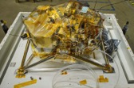

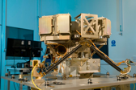


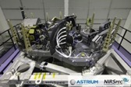

JWST mission overview in 6 slides
NIRCam = Near-InfraRed Camera - PI: M. Rieke
Developed under the responsibility of the University of Arizona.
MIRI = Mid-InfraRed Instrument - PIs: G. Wright and G. Rieke
50/50 partnership between a nationally funded consortium of European institutes (MIRI EC) + ESA and NASA/JPL.
NIRISS = Near-infrared Imager and Slit-less Spectrograph
FGS = Fine Guidance Sensor - PIs: R. Doyon & C. Willott
Provided by the Canadian Space Agency.
NIRSpec = Near-infrared Spectrograph
Provided by the European Space Agency. Built for ESA by an industrial consortium led by Airbus Defence and Space.

Slide 9
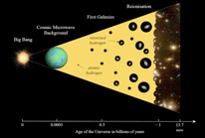
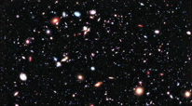
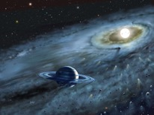
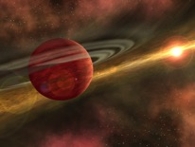

JWST mission overview in 6 slides
The end of the dark ages: first light and re-ionization.
Sketch - P. Geil
The assembly of galaxies: the formation and evolution of galaxies.
Hubble Ultra-deep Field
The birth of stars and proto-planetary systems.
Artist view – D. Hardy
Planetary systems (including our solar system and exoplanets) and the origin of life.
See Gardner et al., 2006, Space Science Reviews,123, 485
Artist view – R. Hurt

Slide 10
Status – Hardware - OTIS
OTIS = telescope + instruments
  OTIS = Optical Telescope and Integrated Science instruments module.
2015 and 2016 were very busy years with a lot of very visible progress.
Completion of the integration of OTIS
Start of the environmental test campaign of OTIS.
Extensive and very successful preparation for the cryogenic testing of OTIS at the Johnson space center.
  Make sure the facilities, the test setup, the procedure and the personnel are ready for the actual test.

Slide 11
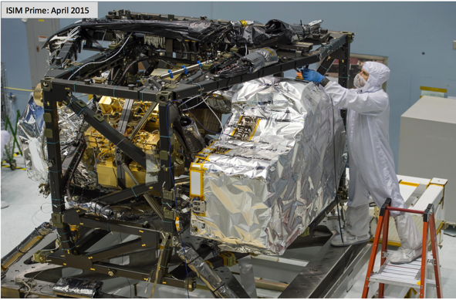
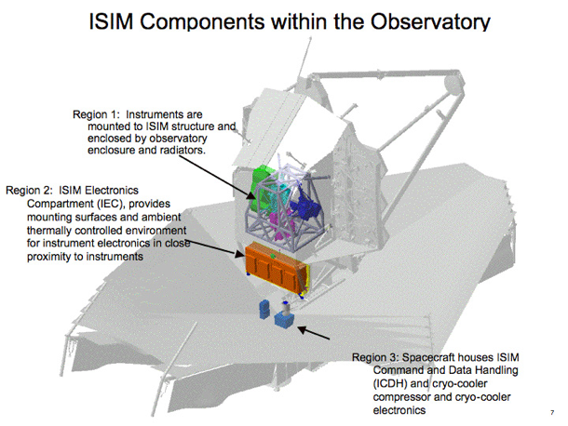
Status – Hardware - OTIS
At the beginning of 2016 the payload module of JWST (ISIM = Integrated Science Instrument Module) was ready, fully integrated and tested.

Slide 12
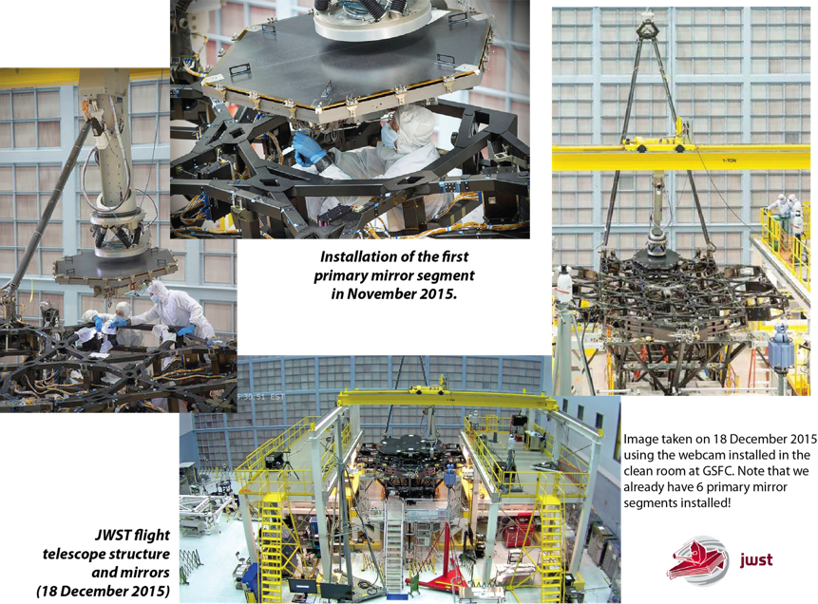
Status – Hardware - OTIS
Around the same time, the telescope itself (OTE = Optical Telescope Element) was integrated and ready to receive ISIM on its back.

Slide 13
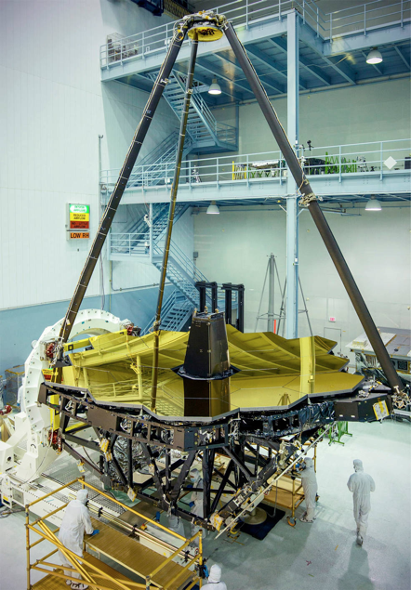
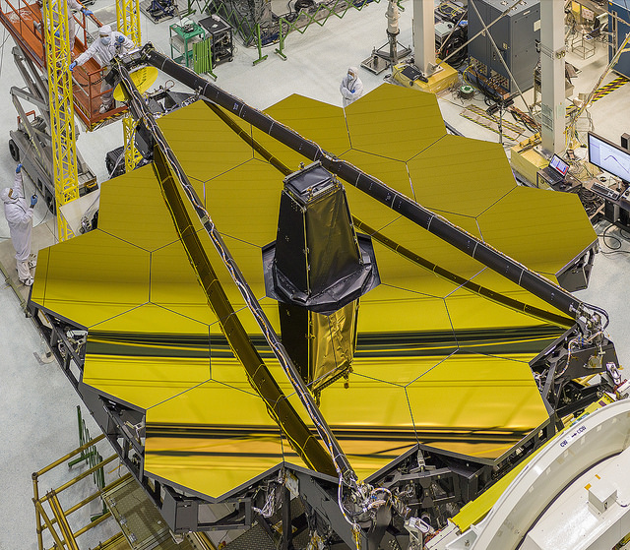
Status – Hardware - OTIS
JWST OTE
Credit: NASA/Chris Gunn

Slide 14
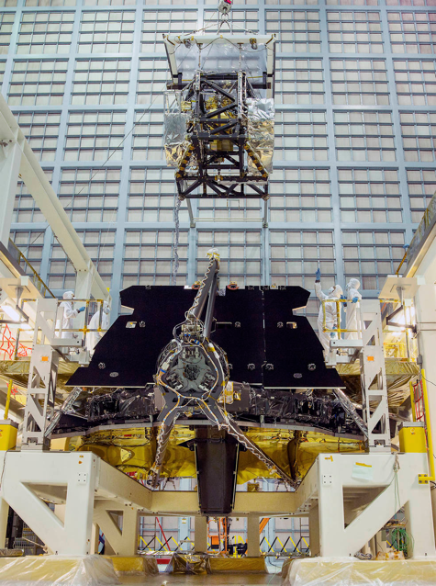


Status – Hardware - OTIS
In May 2016, the payload module was installed on the back of the OTE.
Credit: NASA/Chris Gunn

Slide 15
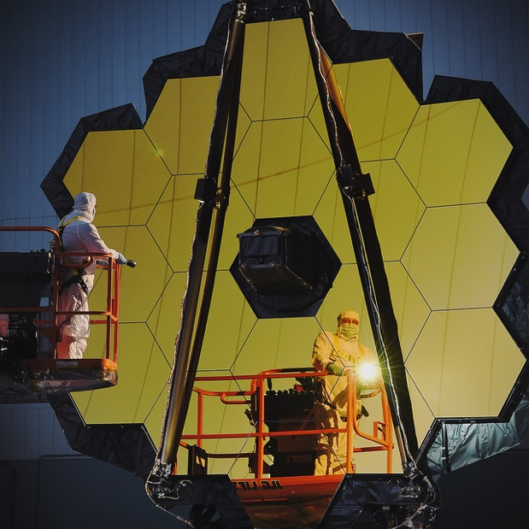
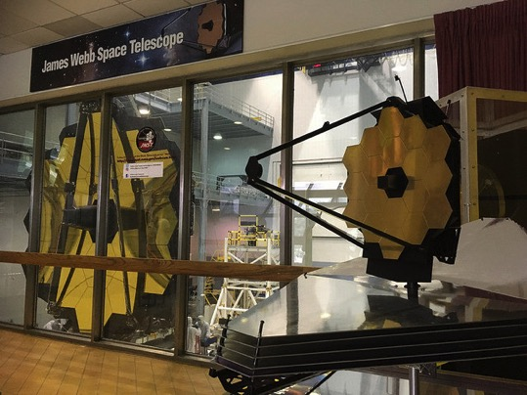
Status – Hardware - OTIS
In Fall 2016, OTIS integration was successfully completed and ready for environmental testing.
Credit: NASA/Chris Gunn

Slide 16
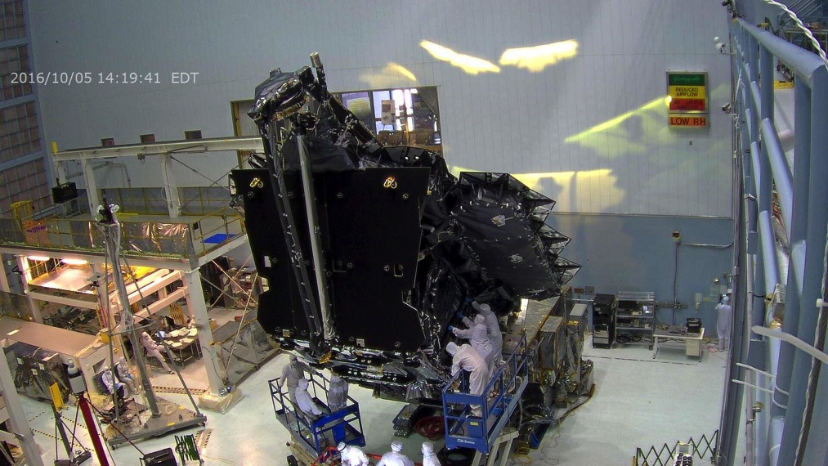
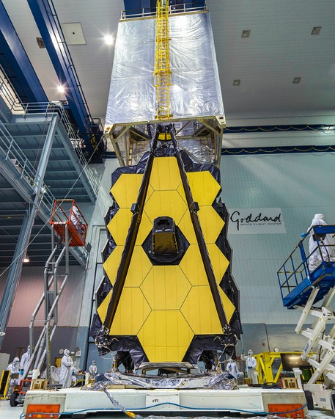
Status – Hardware - OTIS
Credit: NASA/Chris Gunn

Slide 17
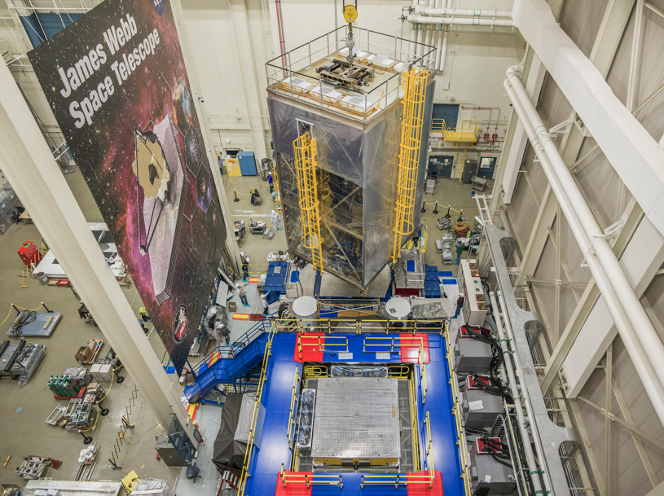
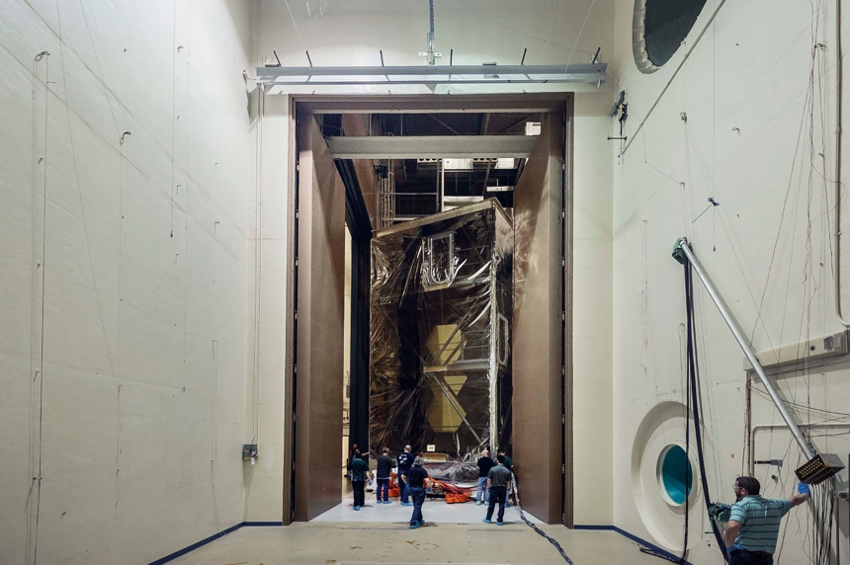
Status – Hardware - OTIS
Vibration testing
Acoustic
testing
Credit: NASA/Chris Gunn

Slide 18
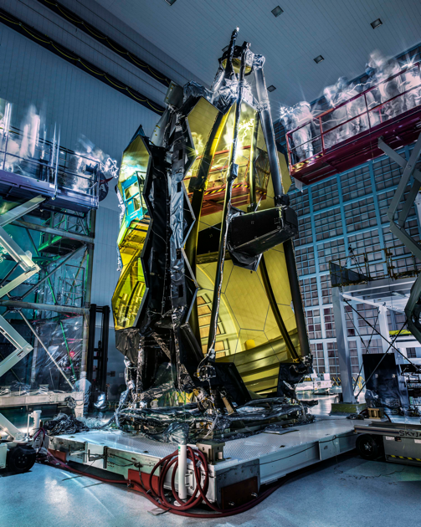
Status – Hardware - OTIS
Vibration and acoustic testing of OTIS have just been completed.
OTIS is back in the clean room for post-test checks before being shipped to Houston for the cryogenic testing.
Credit: NASA/Chris Gunn

Slide 19
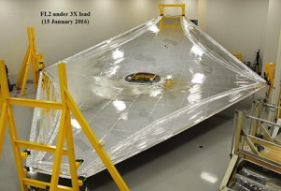
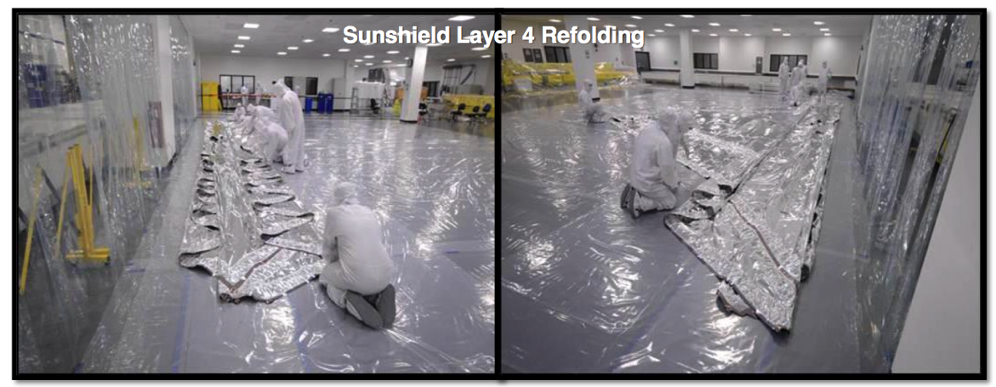
Status – Hardware - sunshield
In parallel to the work on OTIS, the manufacturing of the sunshield hardware continued and we are now mainly in the integration phase.
Last flight sunshield layer delivered in Sep. 2016.
Credit: Northrop - Grumman

Slide 20
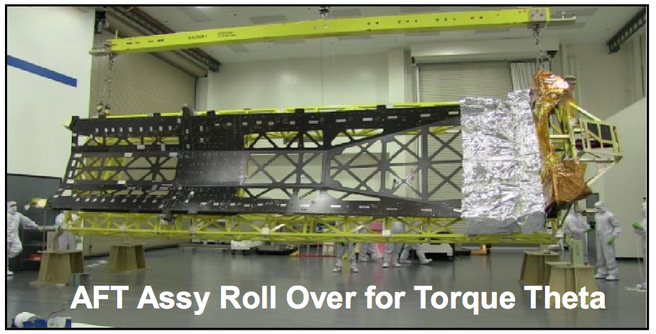
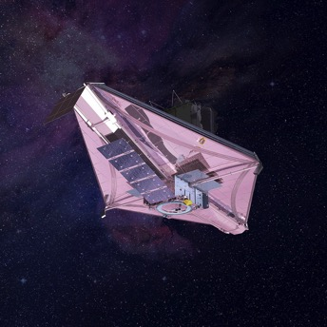
Status – Hardware - sunshield
Structure supporting and protecting the folded sunshield during launch.
Credit: Northrop - Grumman

Slide 21
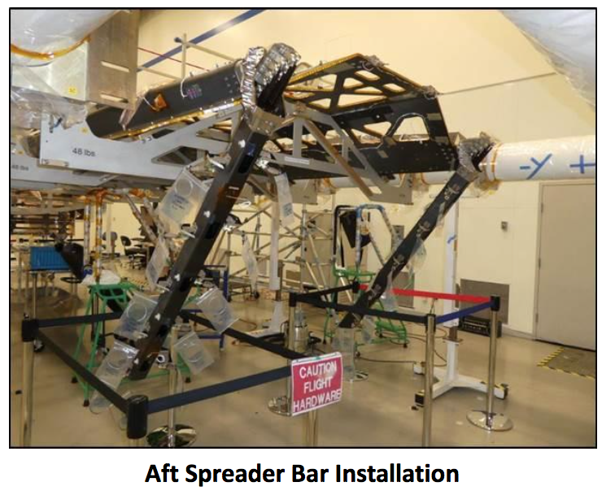
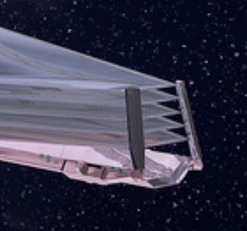
Status – Hardware - sunshield
Credit: Northrop - Grumman

Slide 22
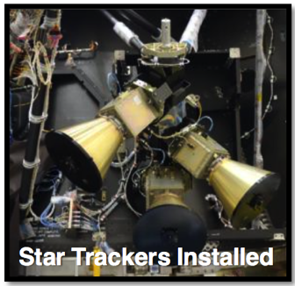
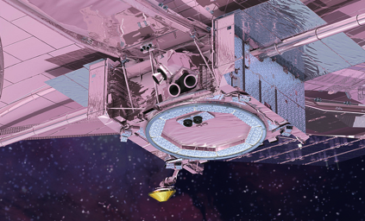
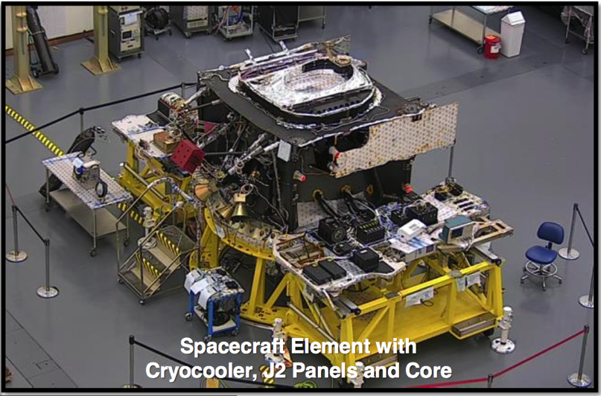
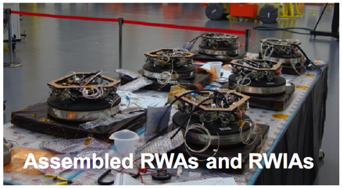
Status – Hardware - spacecraft
The spacecraft is also progressing well and is in its integration phase.
RWA = reaction wheel assemblies
Credit: Northrop - Grumman

Slide 23
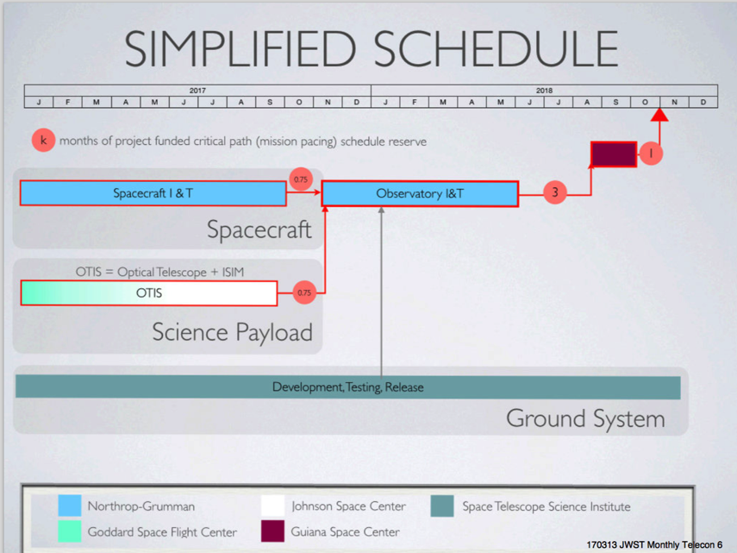
Status – Schedule and contingency
JWST is on track for a launch in October 2018 with almost 5 months of contingency.
Does this mean that we do not encounter any problem?
Of course not. But we have the necessary schedule and funding contingencies to tackle them.

Slide 24
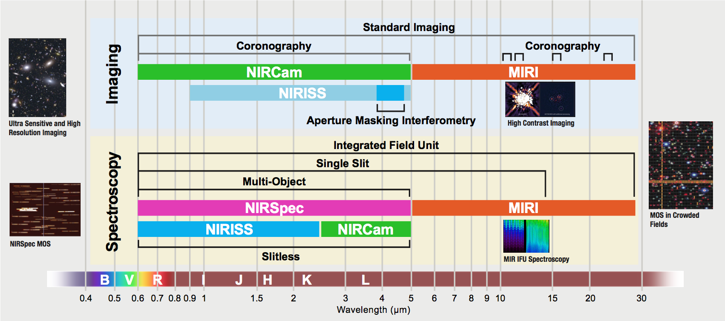
JWST capabilities

Slide 25
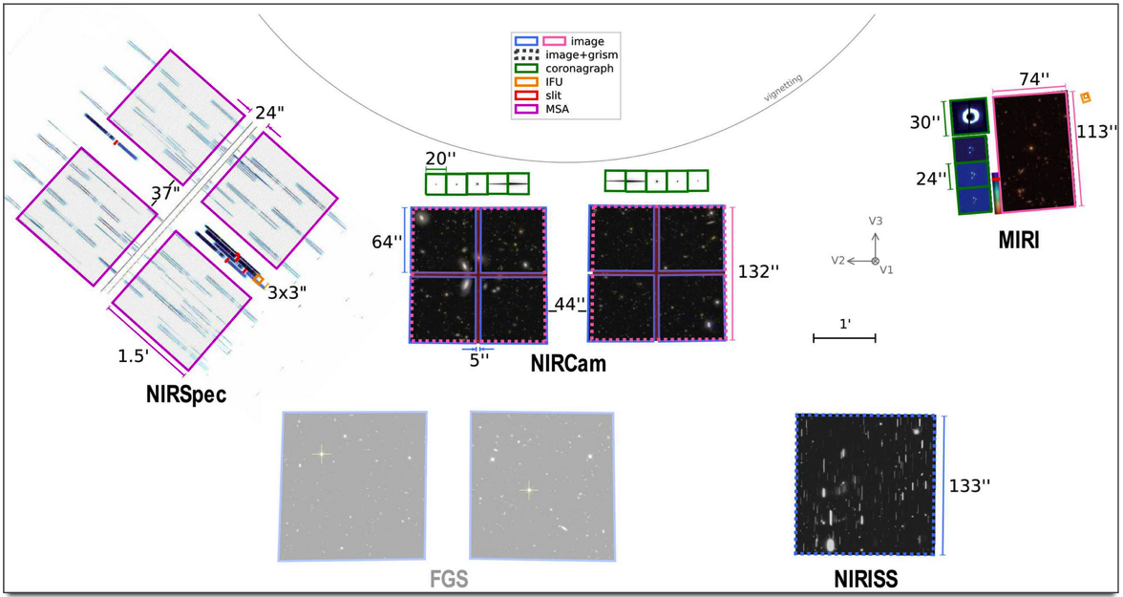
JWST capabilities

Slide 26
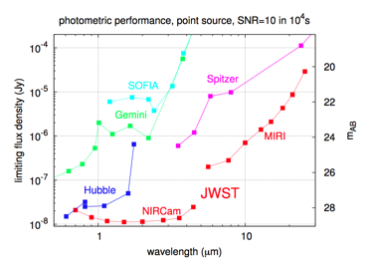
JWST capabilities (imaging)
Instrument | Wavelength (in microns) | Pixel scale (in mas/pixel) | Field of view (arcmin x arcmin)
NIRCam | 0.6-2.3 | 32 | 2.2’ x 4.4’
NIRCam | 2.4-5.0 | 65 | 2.2’ x 4.4’
NIRISS | 0.9-5.0 | 65 | 2.2’ x 2.2’
MIRI | 5.0-28 | 110 | 1.3’ x 1.7’
NIRCam: Simultaneous imaging of the same field of view in the ‘blue’ and ‘red’ channels.
More than one order of magnitude sensitivity improvement in some bands.
Extremely powerful observatory, a lot of discovery space.

Slide 27
JWST capabilities (spectroscopy)
Instrument | Type | Wavelength (microns) | Spectral resolution | Field of view
NIRISS | slitless | 1.0-2.5 | ~150 | 2.2’ x 2.2’
NIRCam | slitless | 2.4-5.0 | ~2000 | 2.2’ x 2.2’
NIRSpec | MOS | 0.6-5.3 | 100/1000/[2700] | 9 square arcmin.
NIRSpec | IFU | 0.6-5.3 | 100/1000/2700 | 3” x 3”
MIRI | IFU | 5.0-28.8 | 2000-3500 | >3” x >3.9”
NIRSpec | SLIT | 0.6-5.0 | 100/1000/2700 | Single object
MIRI | SLIT | 5.0-10.0 | 60-140 | Single object
NIRSpec | Aperture | 0.6-5.3 | 100/1000/2700 | Single object
NIRISS | Aperture | 0.6-2.5 | 700 | Single object
NIRCam: Simultaneous imaging of the same field of view in the ‘blue’ and ‘red’ channels.
Take-home message: in JWST, spectroscopy comes in many different flavors…

Slide 28
JWST capabilities (coronagraphy)
Instrument | Wavelength (in microns) | Pixel scale (in mas/pixel) | Field of view | Type
NIRCam | 0.6-2.3 | 32 | 20” x 20” | Lyot
NIRCam | 2.4-5.0 | 65 | 20” x 20” | Lyot
NIRISS | 3.8-4.8 | 65 | 0.1-0.5” | Aperture masking interferometry
MIRI | 10.65 | 110 | 24” x 24” | 4QPM
MIRI | 11.4 | 110 | 24” x 24” | 4QPM
MIRI | 15.5 | 110 | 24” x 24” | 4QPM
MIRI | 23 | 110 | 30” x 30” | Lyot
Variety of modes covering the complete wavelength range of JWST.

Slide 29
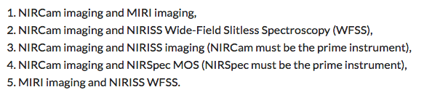
JWST capabilities - Miscellaneous
JWST can observe moving targets.
Up to 30 mas/s. Covers a lot of the potential Solar System targets.
The cycle-1 calls for proposals will al include the possibility to request for coordinated parallel observations. → great news!

Slide 30
Scientific timeline – cycle 1
JWST will launch in October 2018
After launch, JWST will deploy (duration ~2-3 weeks) as it cruises toward the Lagrange 2 point.
It will take it ~1 months to reach the vicinity of the Lagrange 2 point around which it will orbit (halo orbit).
  The commissioning should be completed 6 months after launch, i.e. in April 2019.
  Cycle 1 is scheduled to start in April-May 2019.
  Scientific observations will start as soon as possible, mode per mode.
  Full calibration will be achieved progressively during cycle 1.

Slide 31
Scientific timeline – cycle 1 calls
The first JWST cycle-1 calls have been issued!!!
  JWST guaranteed time observer (GTO) call for proposals.
    https://jwst-docs.stsci.edu/display/JSP/JWST+Cycle+1+Guaranteed+Time+Observations+Call+for+Proposals
  Call for (mandatory) notice of intents for the Early Release Science (ERS) programs.
    https://jwst-docs.stsci.edu/display/JSP/JWST+Director%27s+Discretionary+Early+Release+Science+Call+for+Proposals
The call for general observers (GOs) is planned for November 2017.
  After the GTO proposals are known and the ERS proposals selected.

Slide 32
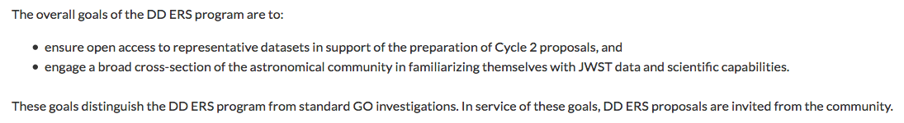
Scientific timeline – ERS
The ERS program is based on director’s discretionary (DD) time.
It will have its own selection committee set up by the STScI director.
Specific goals.
  https://jwst.stsci.edu/science-planning/early-release-science-program

Slide 33
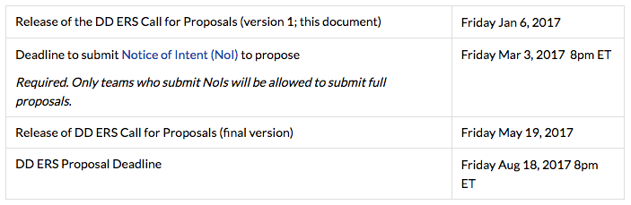
Scientific timeline – ERS
The ERS proposal submission is a two-step process
Mandatory notices of intent & proposals.
We are here

Slide 34
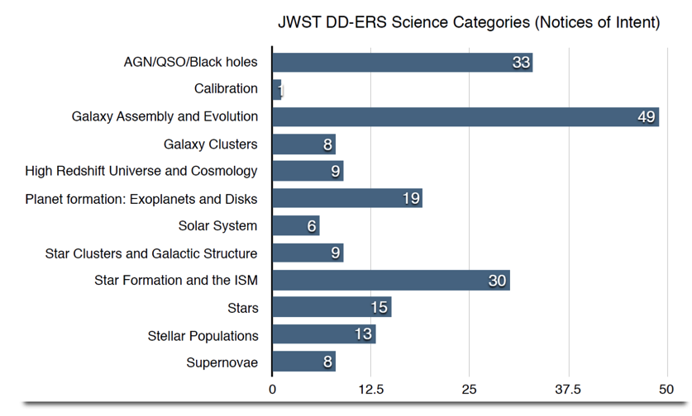
Scientific timeline – ERS
The mandatory notices of intent to propose (> 200) have been received.
Good presence of European scientists and of Italian ones.

Slide 35
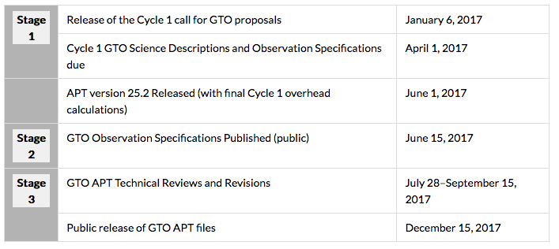
Status – Scientific timeline – GTO
The GTO proposal submission is a staggered process extending over most of 2017.
We are almost here

Slide 36
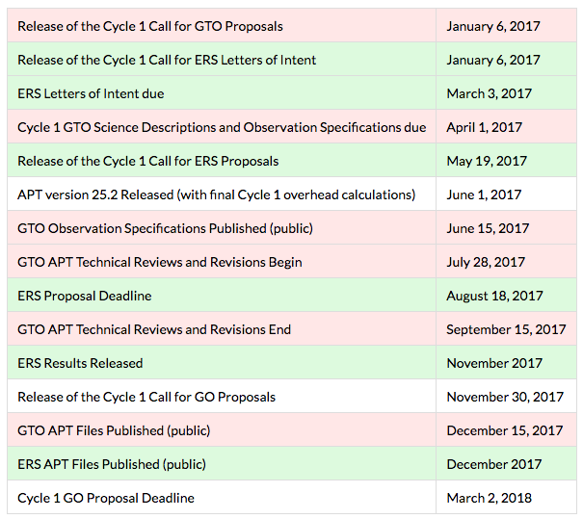
Scientific timeline - full
In the background, a lot of work to get the tools and the documentation ready.
The GTOs and the ERS proposers will try the system.
A lot of additional material will be available for the cycle-1 GO call.

Slide 37
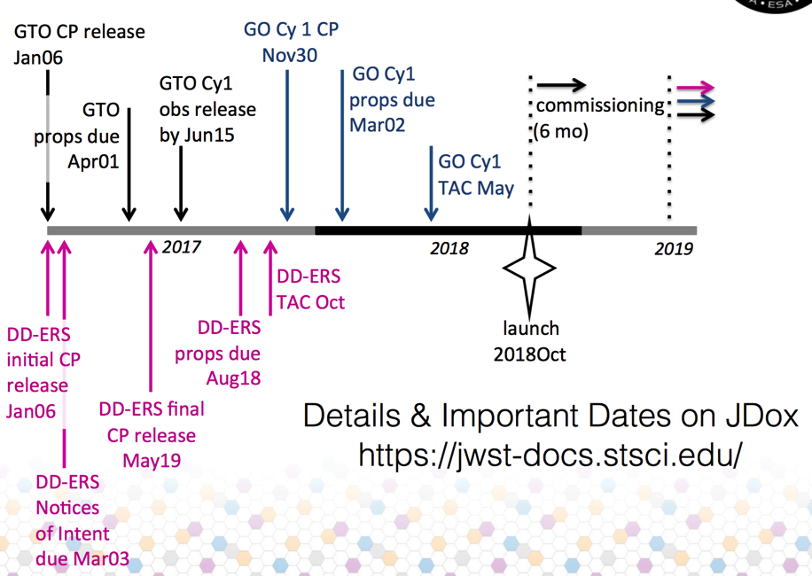
Scientific timeline - full

Slide 38
More opportunities to prepare…
“Science with the Hubble & James Webb space telescopes V” in Venice (20-24 march 2017).
  A 1-day workshop at the end.
Special session “Preparing the JWST era” at the EWASS 2017.
  Focusing on learning from the GTO proposals (transferring experience). Work in progress.
Second JWST ESAC workshop “Mastering the science instruments and of the observing modes of JWST [get set]” at ESAC (4-6 October 2017).
  Following the successful [on your mark] 2016 edition.
Workshop “Planning Solar System Observations with JWST” in ESTEC (13-15 December 2017).
  Mirroring a similar US workshop planned for November.

Slide 39
Conclusion
Launch in October 2018 (stable) and we can now say we launch next year!
Some cycle-1 calls for proposals have been issued and the call for GOs will be issued this year also!
Thanks for your attention

