Slide 1
JWST ETC MIRI Demo
Macarena Garcia Marin
European Space Agency

Slide 2
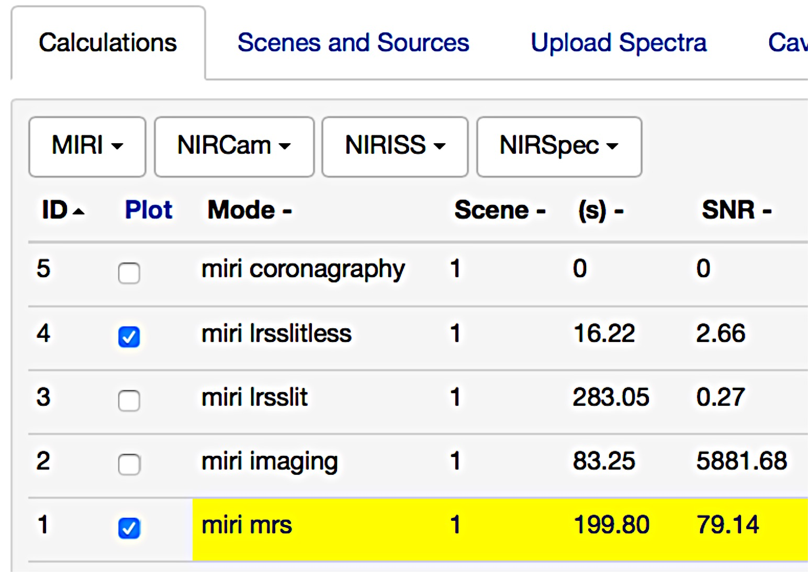
MIRI modes in the ETC
All MIRI modes available for cycle 1 are available in the ETC:
Image credit: STScI

Slide 3
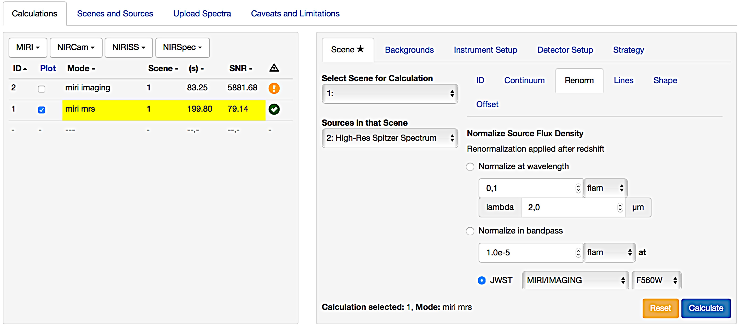
ETC: MIRI Medium Resolution Spectrograph (IFU)

Slide 4
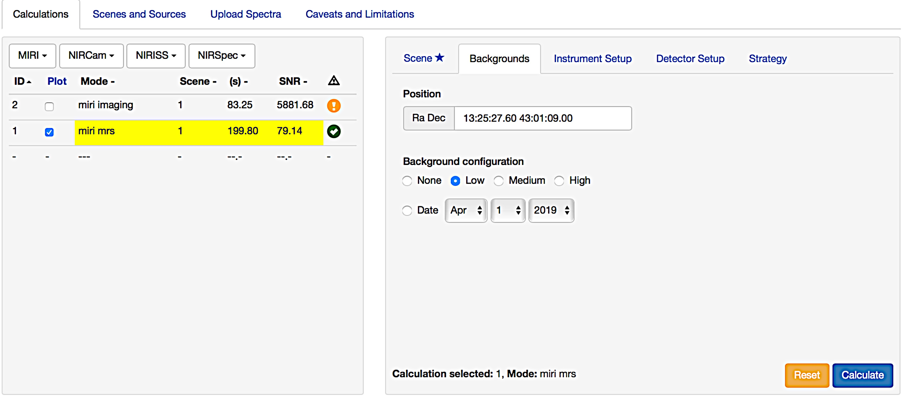
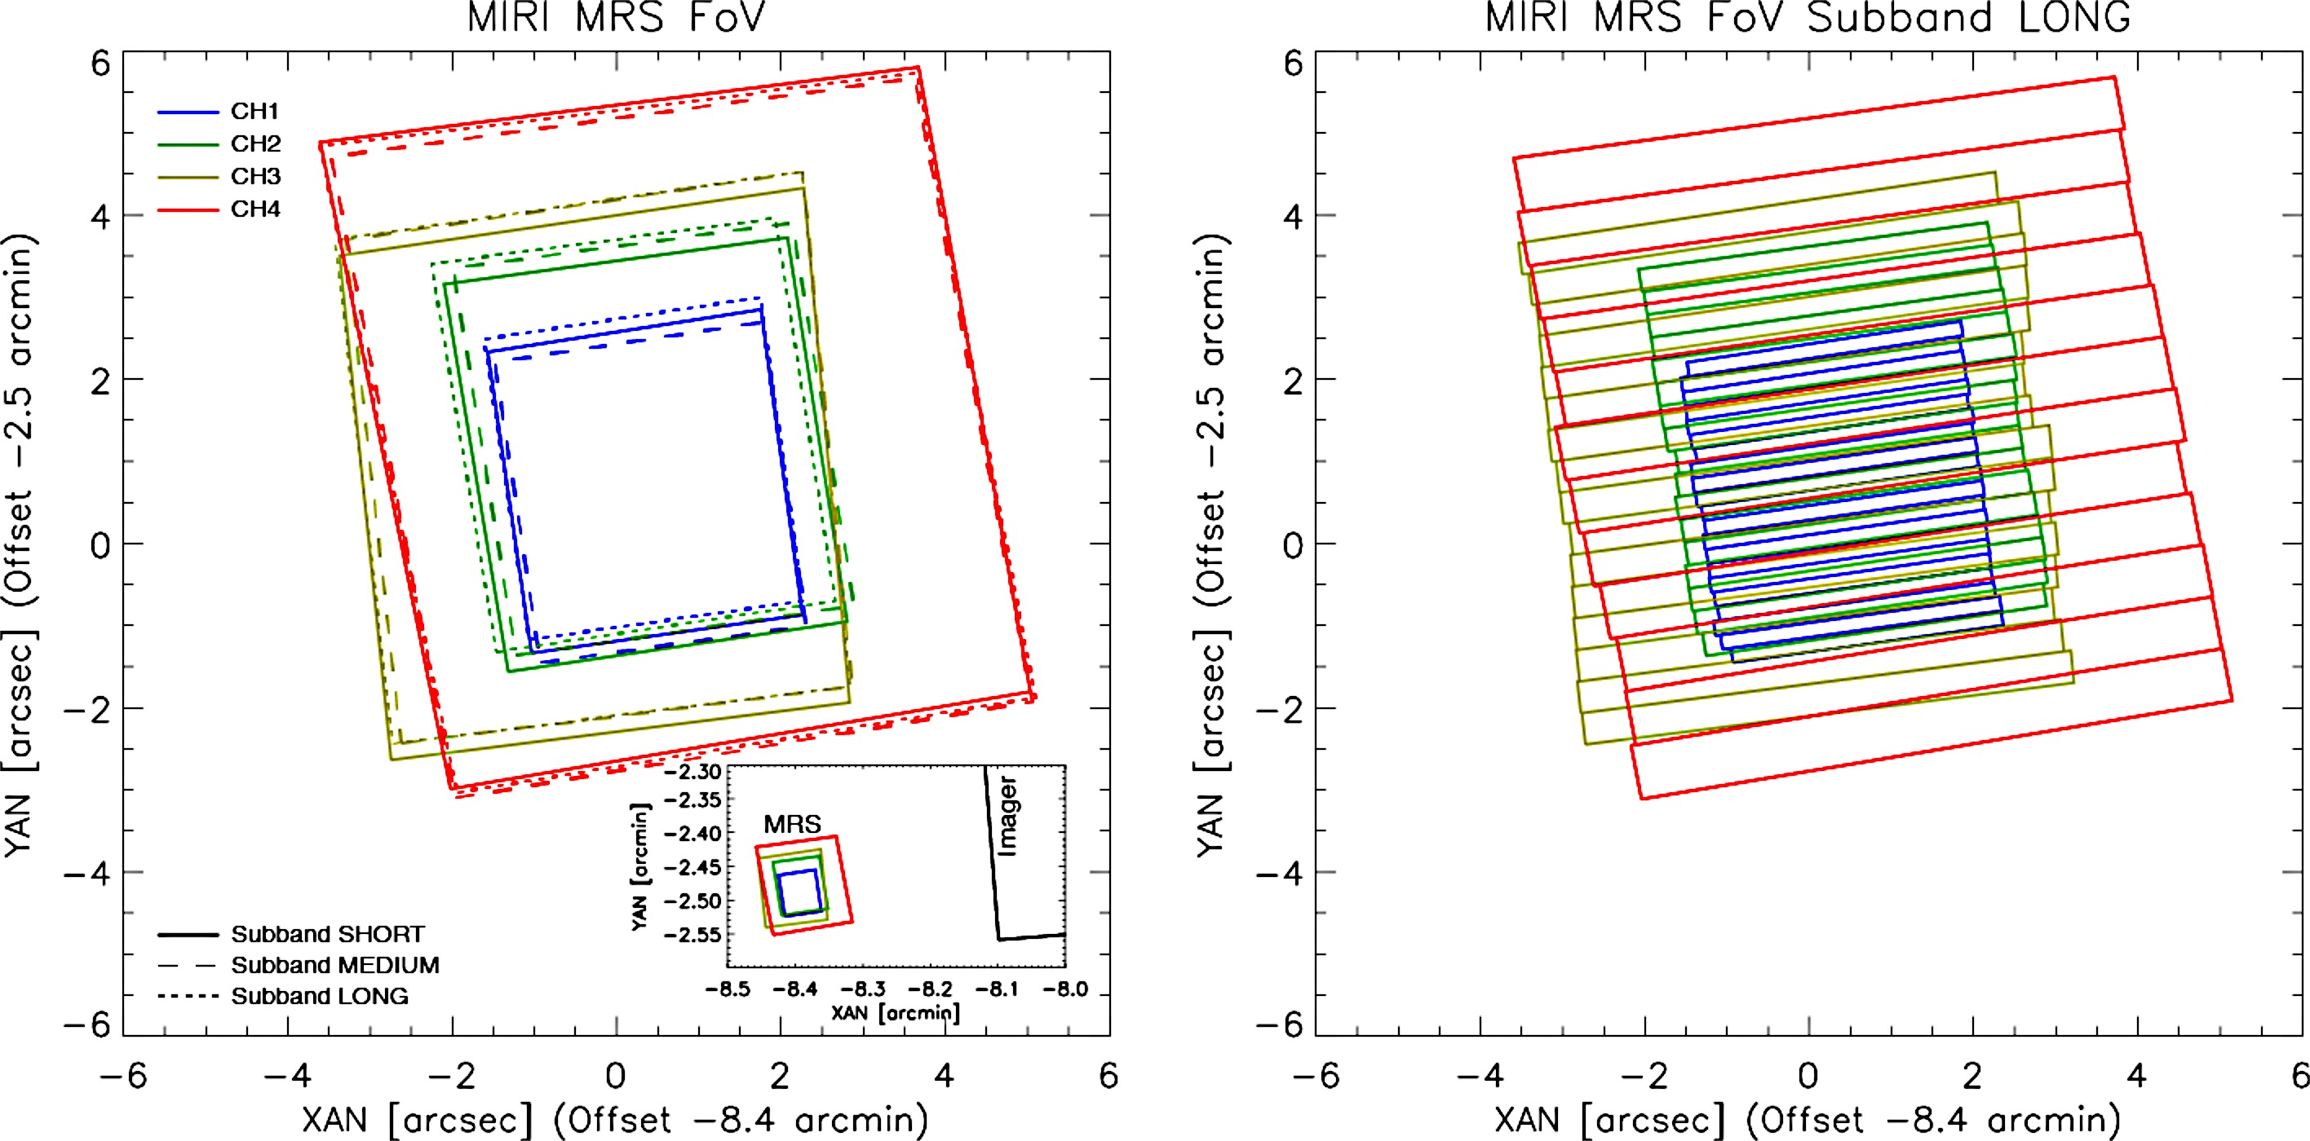
ETC: MIRI Medium Resolution Spectrograph (IFU)
After creating a suitable scene: Choose background, instrument/detector setup and strategy
The ETC background model includes the zodiacal+ galactic background, the stray light and the telescope thermal emission (that mostly affects MIRI)

Slide 5
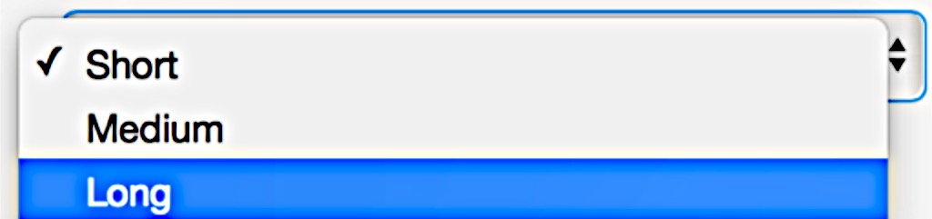
ETC: MIRI Medium Resolution Spectrograph (IFU)
After creating a suitable scene: Choose background, instrument/detector setup and strategy

Slide 6
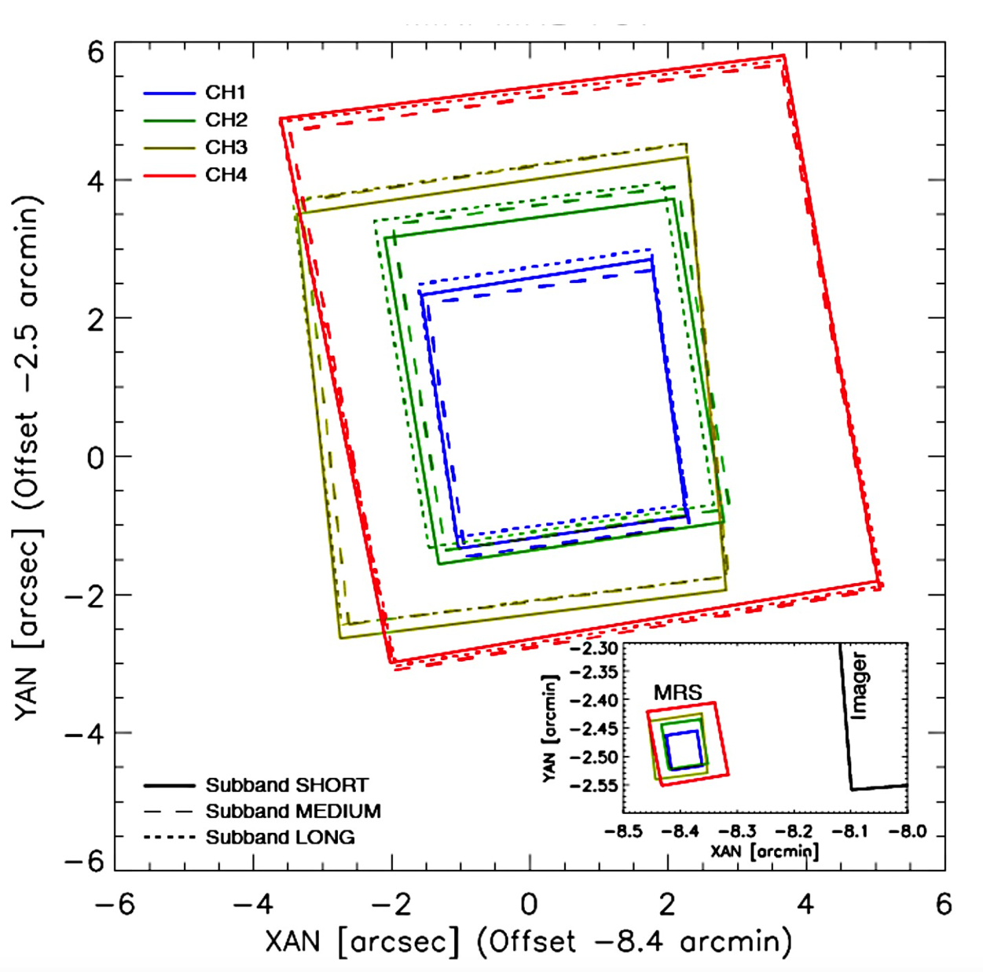
ETC: MIRI Medium Resolution Spectrograph (IFU)
After creating a suitable scene: Choose background, instrument/detector setup and strategy
Image credit: Wells et al 2015

Slide 7
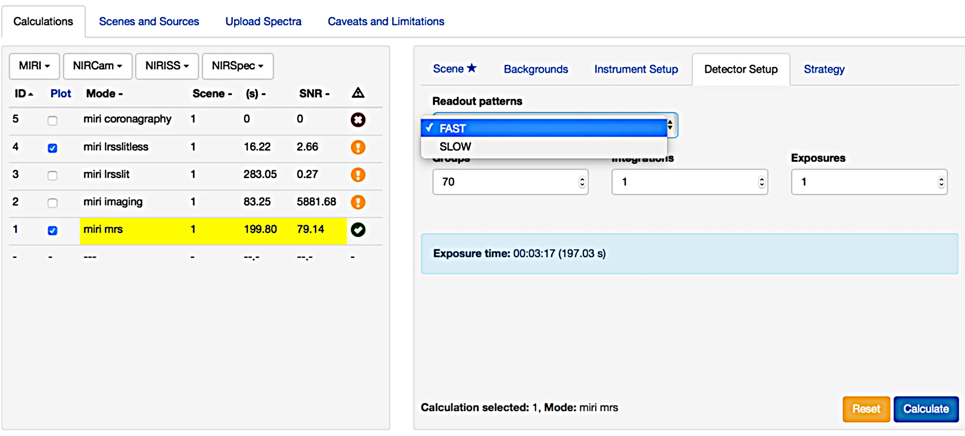
ETC: MIRI Medium Resolution Spectrograph (IFU)
After creating a suitable scene: Choose background, instrument/detector setup and strategy
Recommendation: longer ramps are better.
ETC default Ngroups = 100
However, one should not use ramps (integrations) of 1000 seconds or more too many cosmic rays expected.
SLOW: 23.89 s (default for the MRS)
FAST: 2.775 s (default for Imager)
See later notes on ETC detector timing

Slide 8
ETC: MIRI Medium Resolution Spectrograph (IFU)
After creating a suitable scene: Choose background, instrument/detector setup and strategy

Slide 9
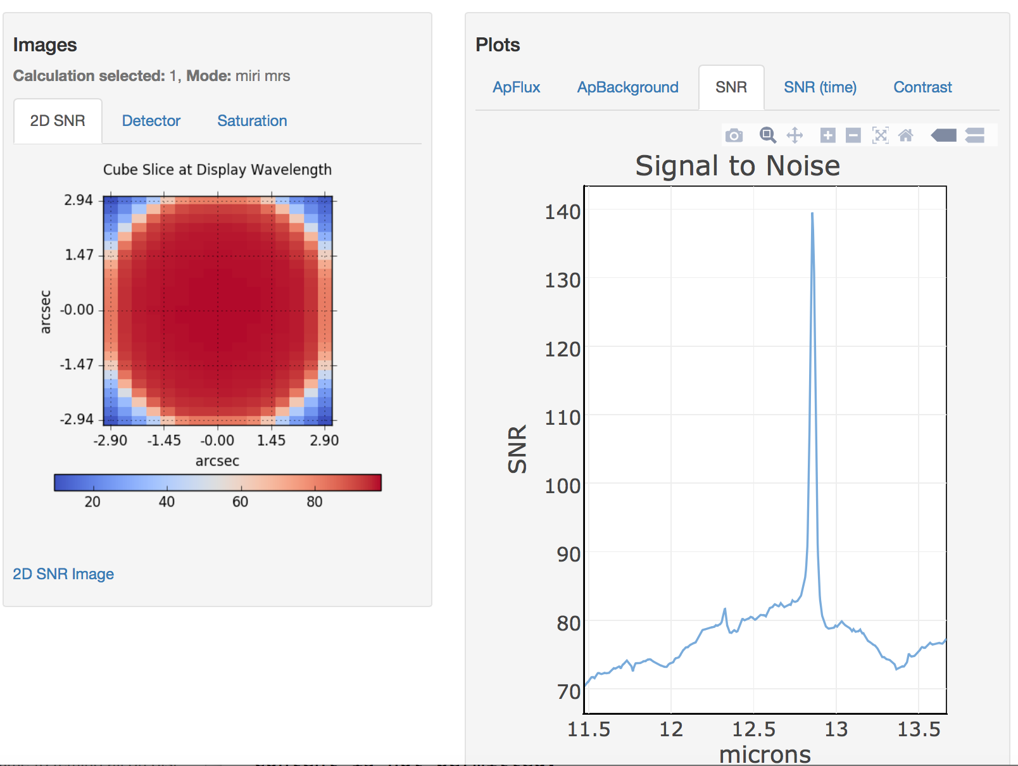
ETC Results: MIRI MRS (IFU)
Note that:
The SNR ratio is given for the specified
Ngroups, Nints and Nexp.
The Nexp can be assumed to be
individual dithers.
Note of Caution: depending on the chosen pattern 100 redundancy will not apply to all regions and thus the ETC results will not be valid there.
Background, Source Flux, SNR, contrast plots
“Focal Plane”: 2D SNR (per pixel not per dλ in spectr.) map, Detector view, Saturation map
It also gives a report panel with information, warning, errors etc.

Slide 10
ETC Results: MIRI MRS (IFU)
Note on the MIRI detectors:
The SNR reached will vary depending on the Ngroups and Nints.
One example: Using the MULTIACCUM noise model equations from Rauscher with MIRI detector read noise (SLOW mode) and dark current values from Ressler et al 2015
Ngroups=10, Nint=1: SNR=15.4
Ngroups=20, Nint=1: SNR=29.9
Ngroups=10, Nint=2: SNR=21.8

Slide 11
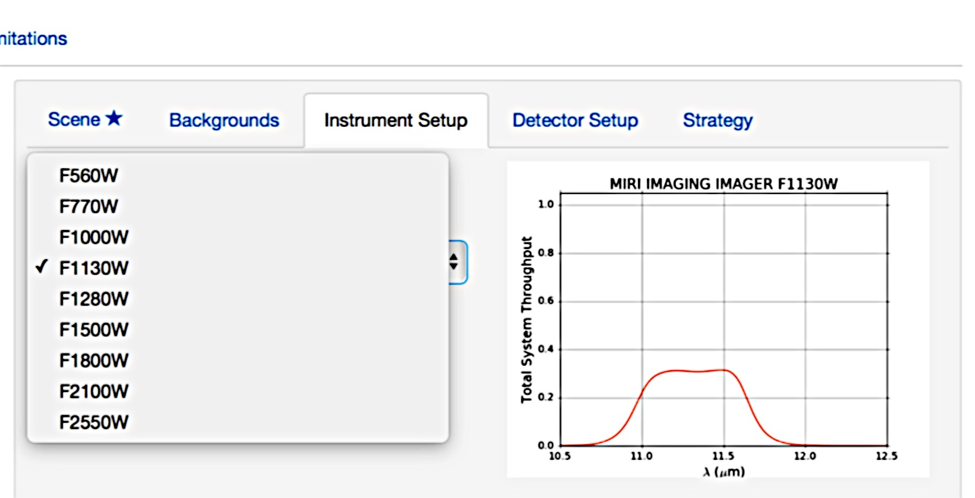
ETC: MIRI Imaging

Slide 12
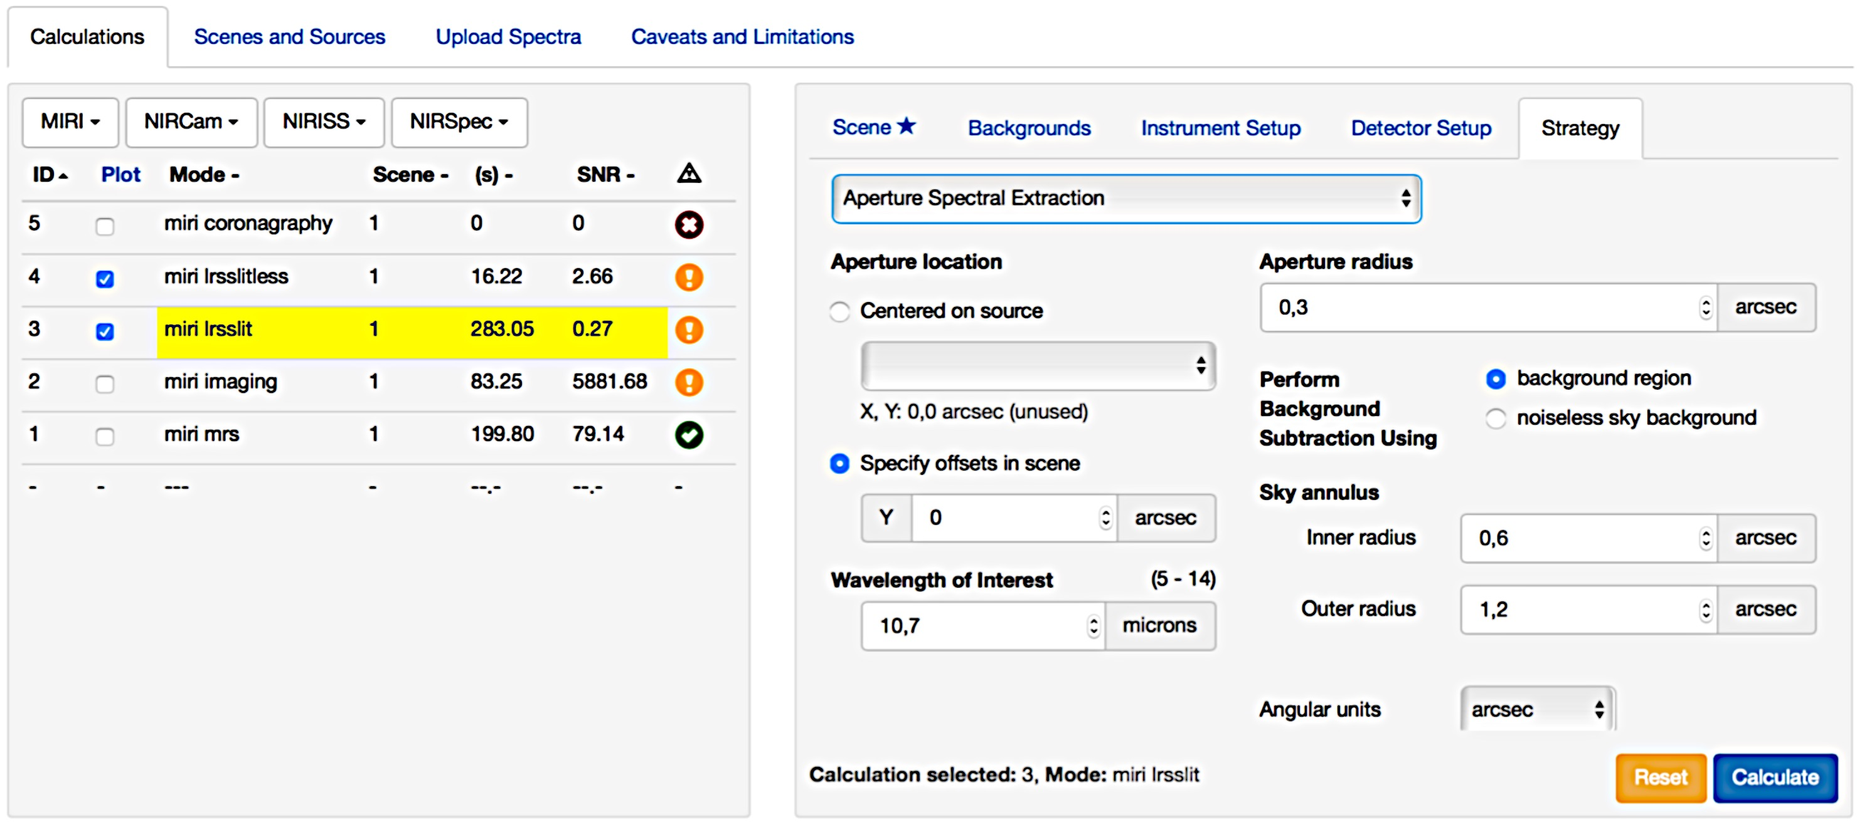
ETC: MIRI Low Resolution Spectrograph

Slide 13
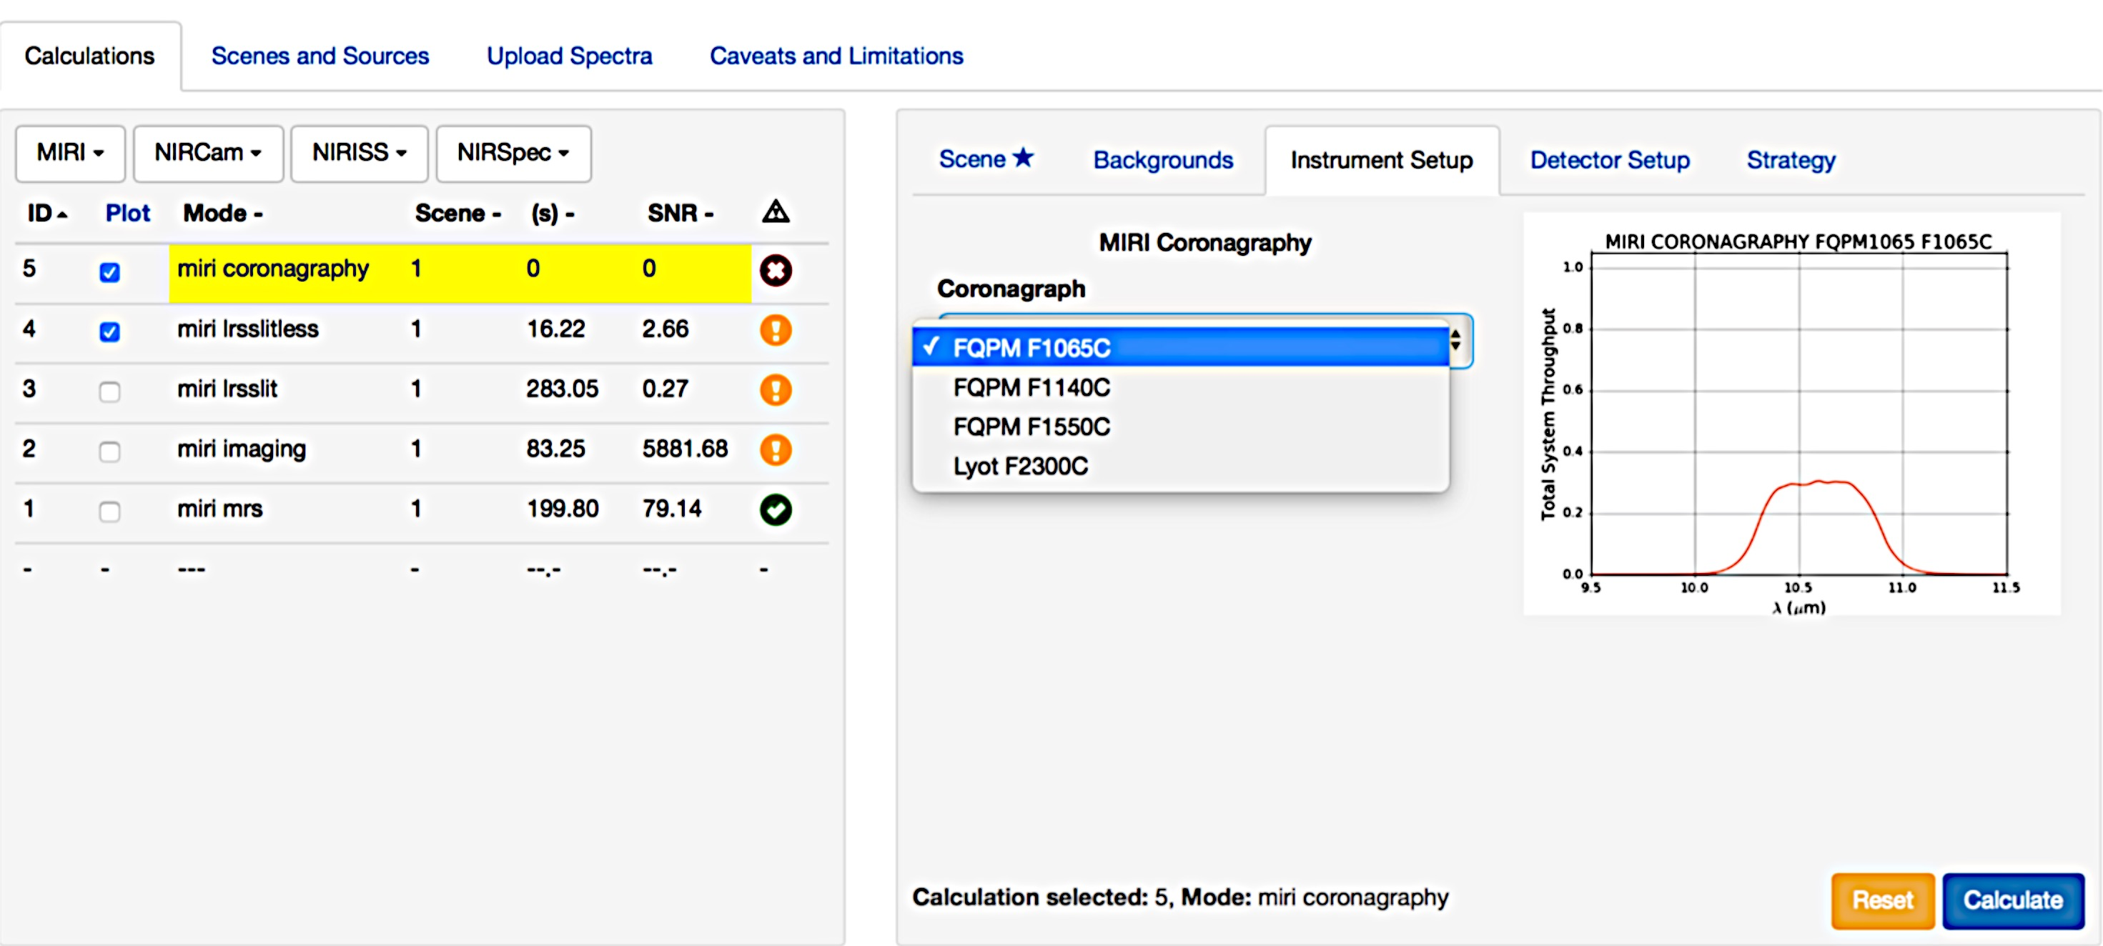
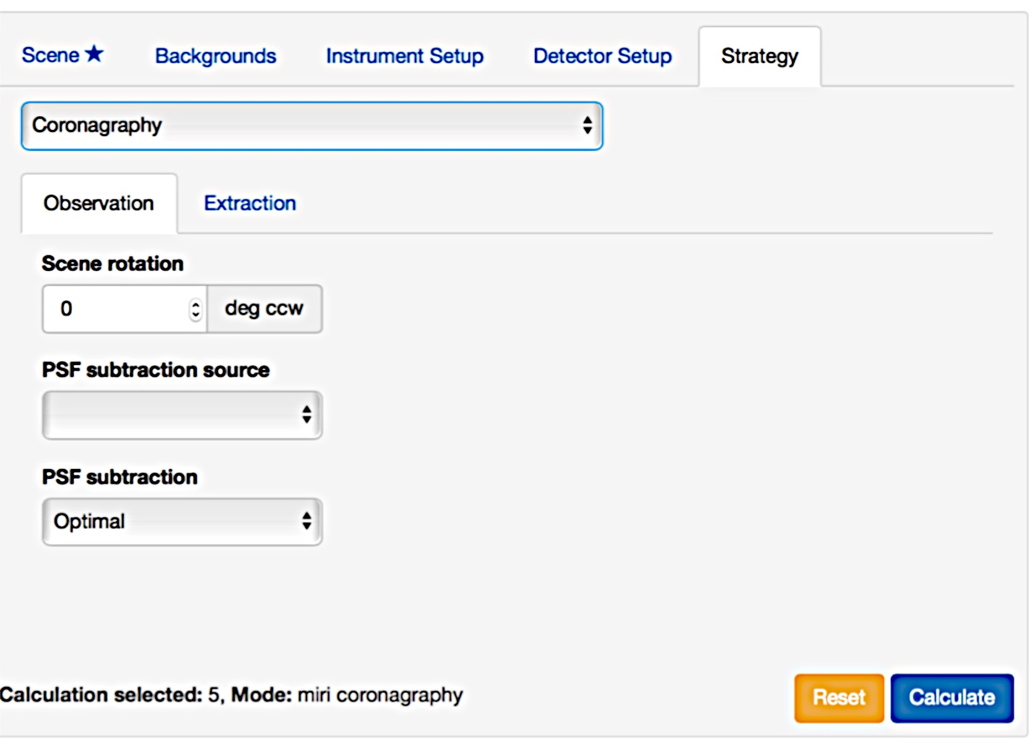
ETC: MIRI Coronagraphy

Slide 14
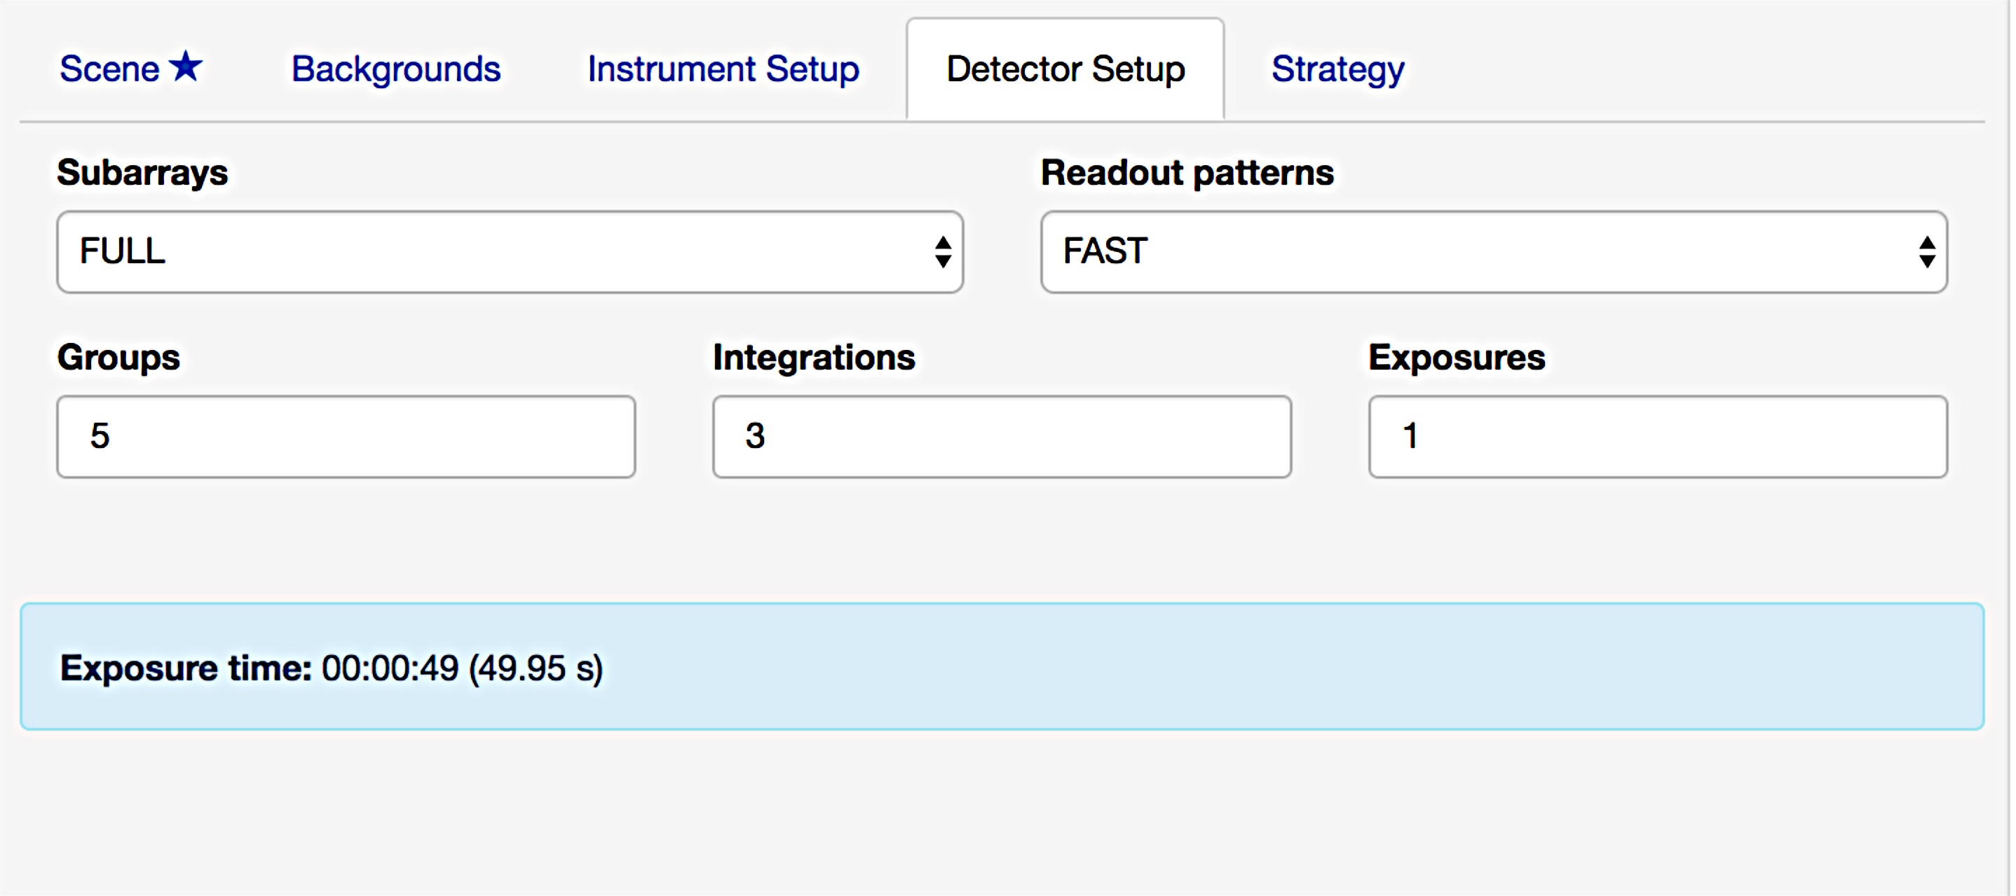
Open Issues
Timing issues
SLOW mode frame time: time is 23.89 s but ETC uses 28.9 s.
Reported exposure time: Time reported assumes 2 additional groups
Based on original slide from S. Kendrew

Slide 15
Open Issues
Saturation limits:
Updated detector information.
PCE/Quantum yield: New reference files have been produced.
Neutral density filter missing.
The STScI ETC team is currently working on fixing these issues for the next release. Good communication with instrument team (two representatives, S. Kendrew from ESA and B. Nixon from STScI attending regular meetings).

