Slide 1
Where to Find Informations and Future events
Marco Sirianni
European Space Agency
JWST Info Day – INAF 17 March 2017

Slide 2
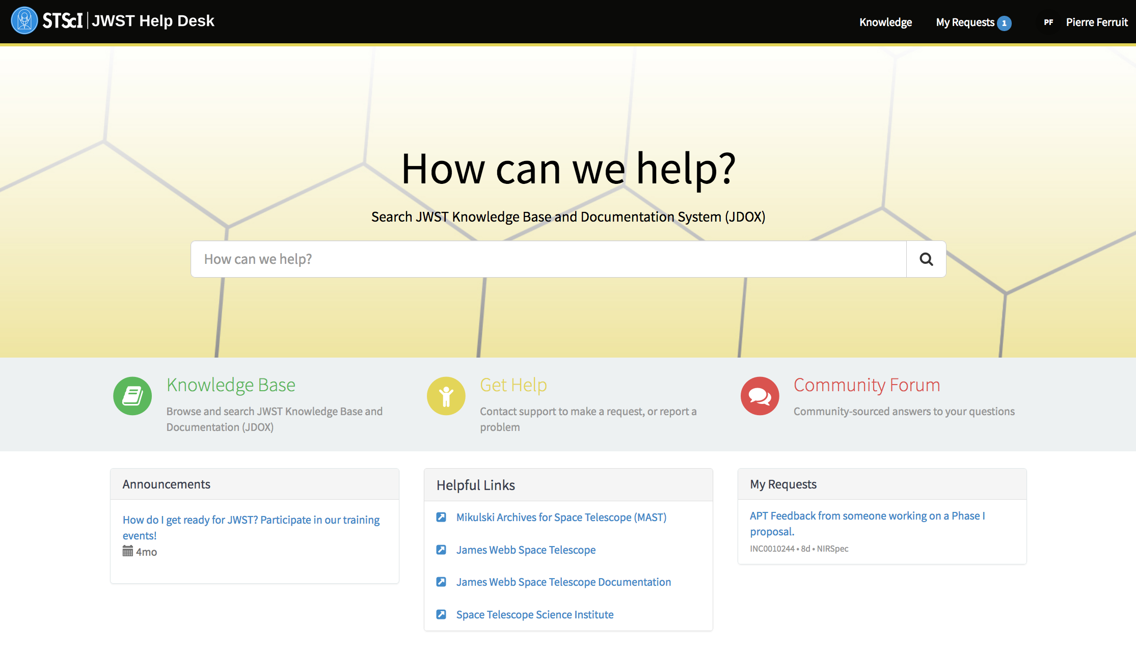
Help desk
stsci.service-now.com/jwst

Slide 3
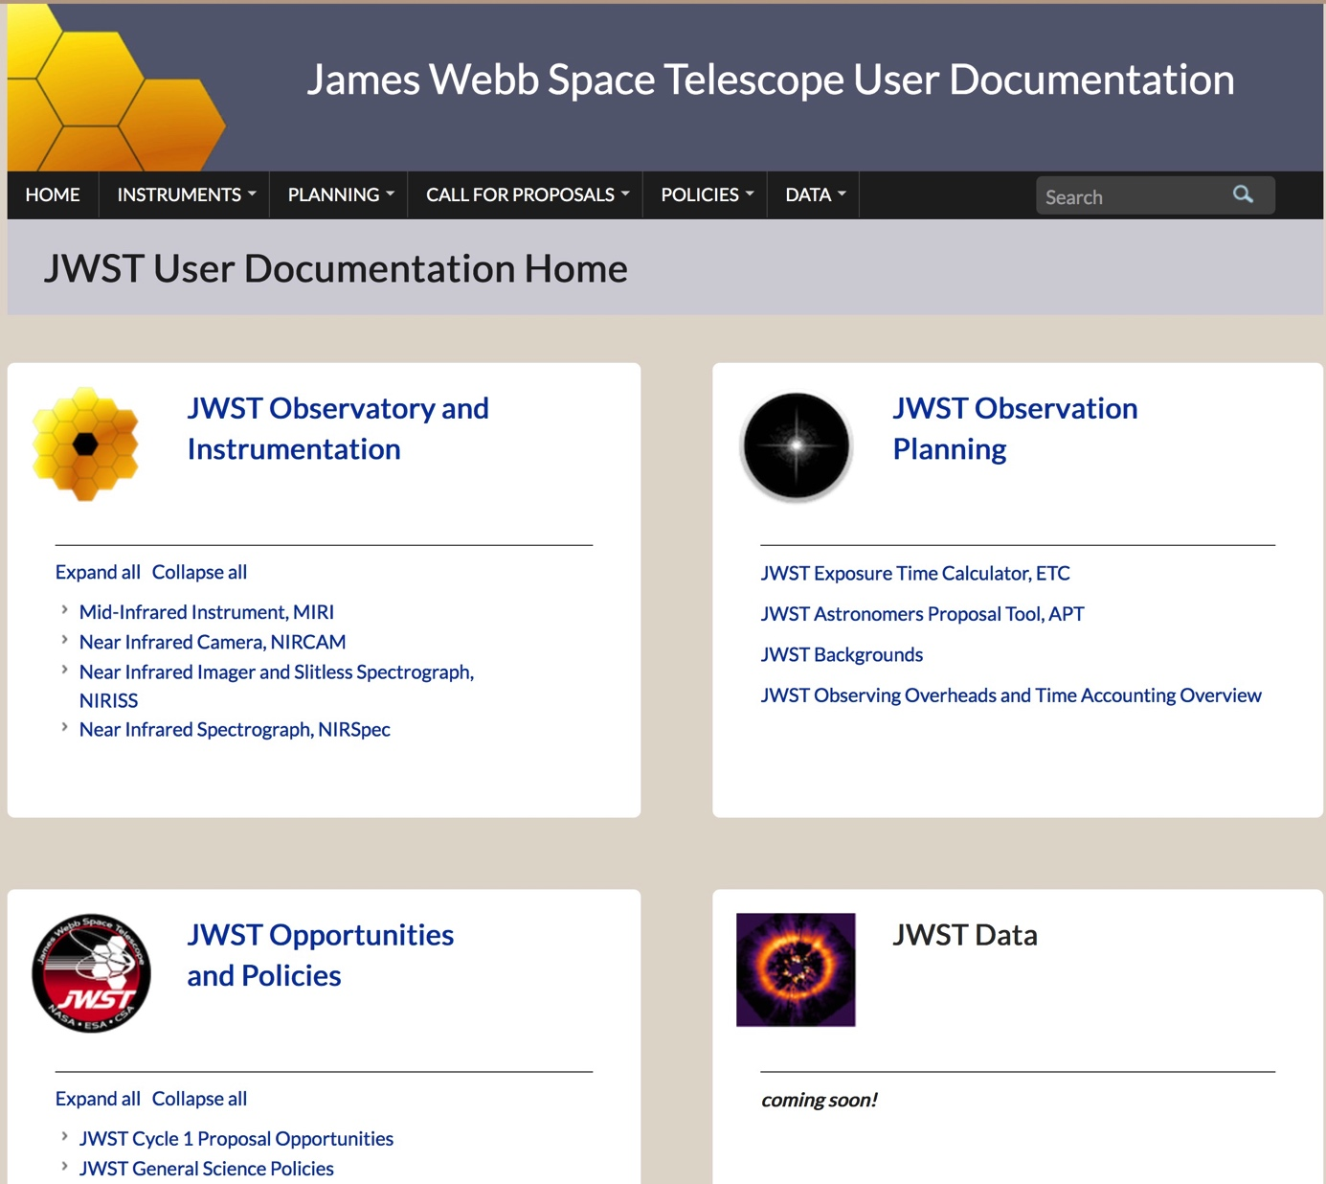
Documentation
https://jwst-docs.stsci.edu/

Slide 4
Tools
https://jwst.stsci.edu/science-planning/proposal-planning-toolbox

Slide 5
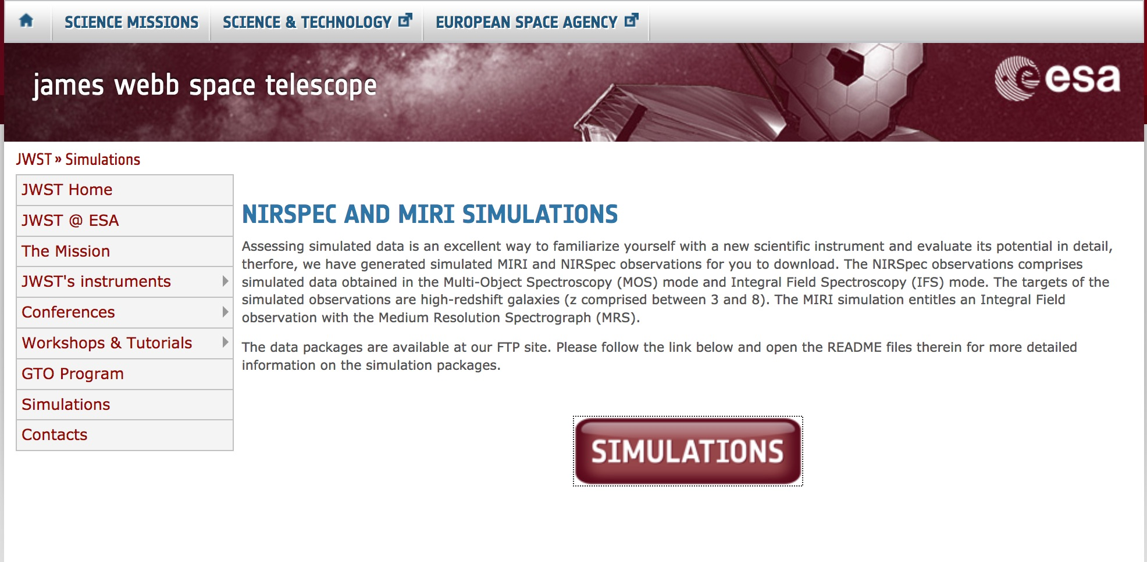
Simulations
https://www.cosmos.esa.int/web/jwst/simulations

Slide 6
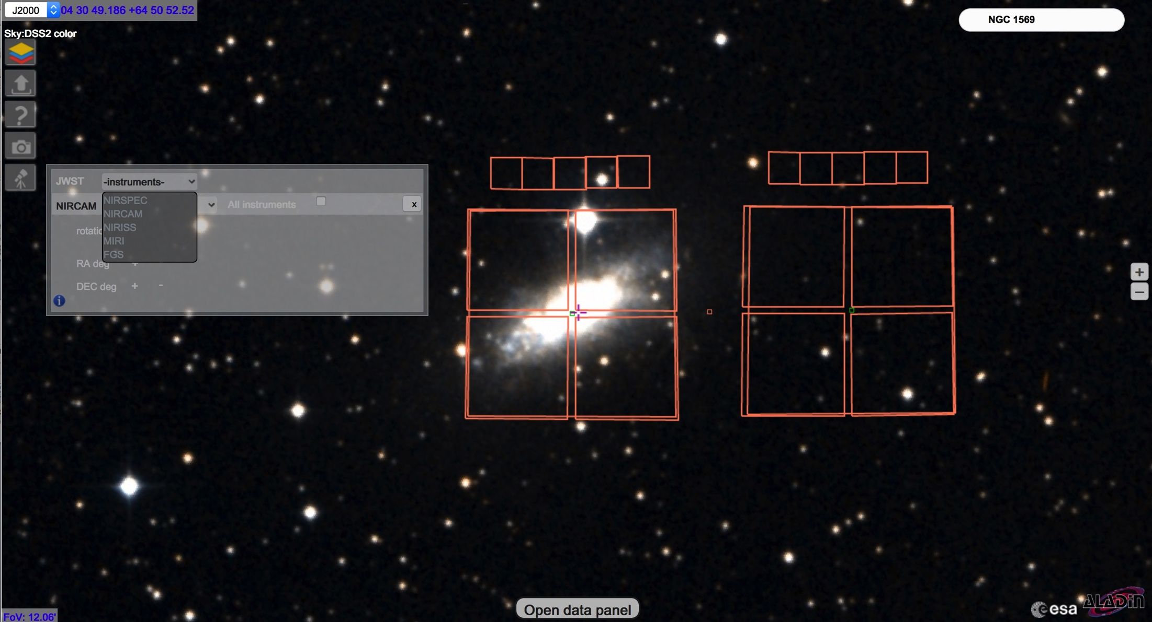
Sky.esa.int

Slide 7
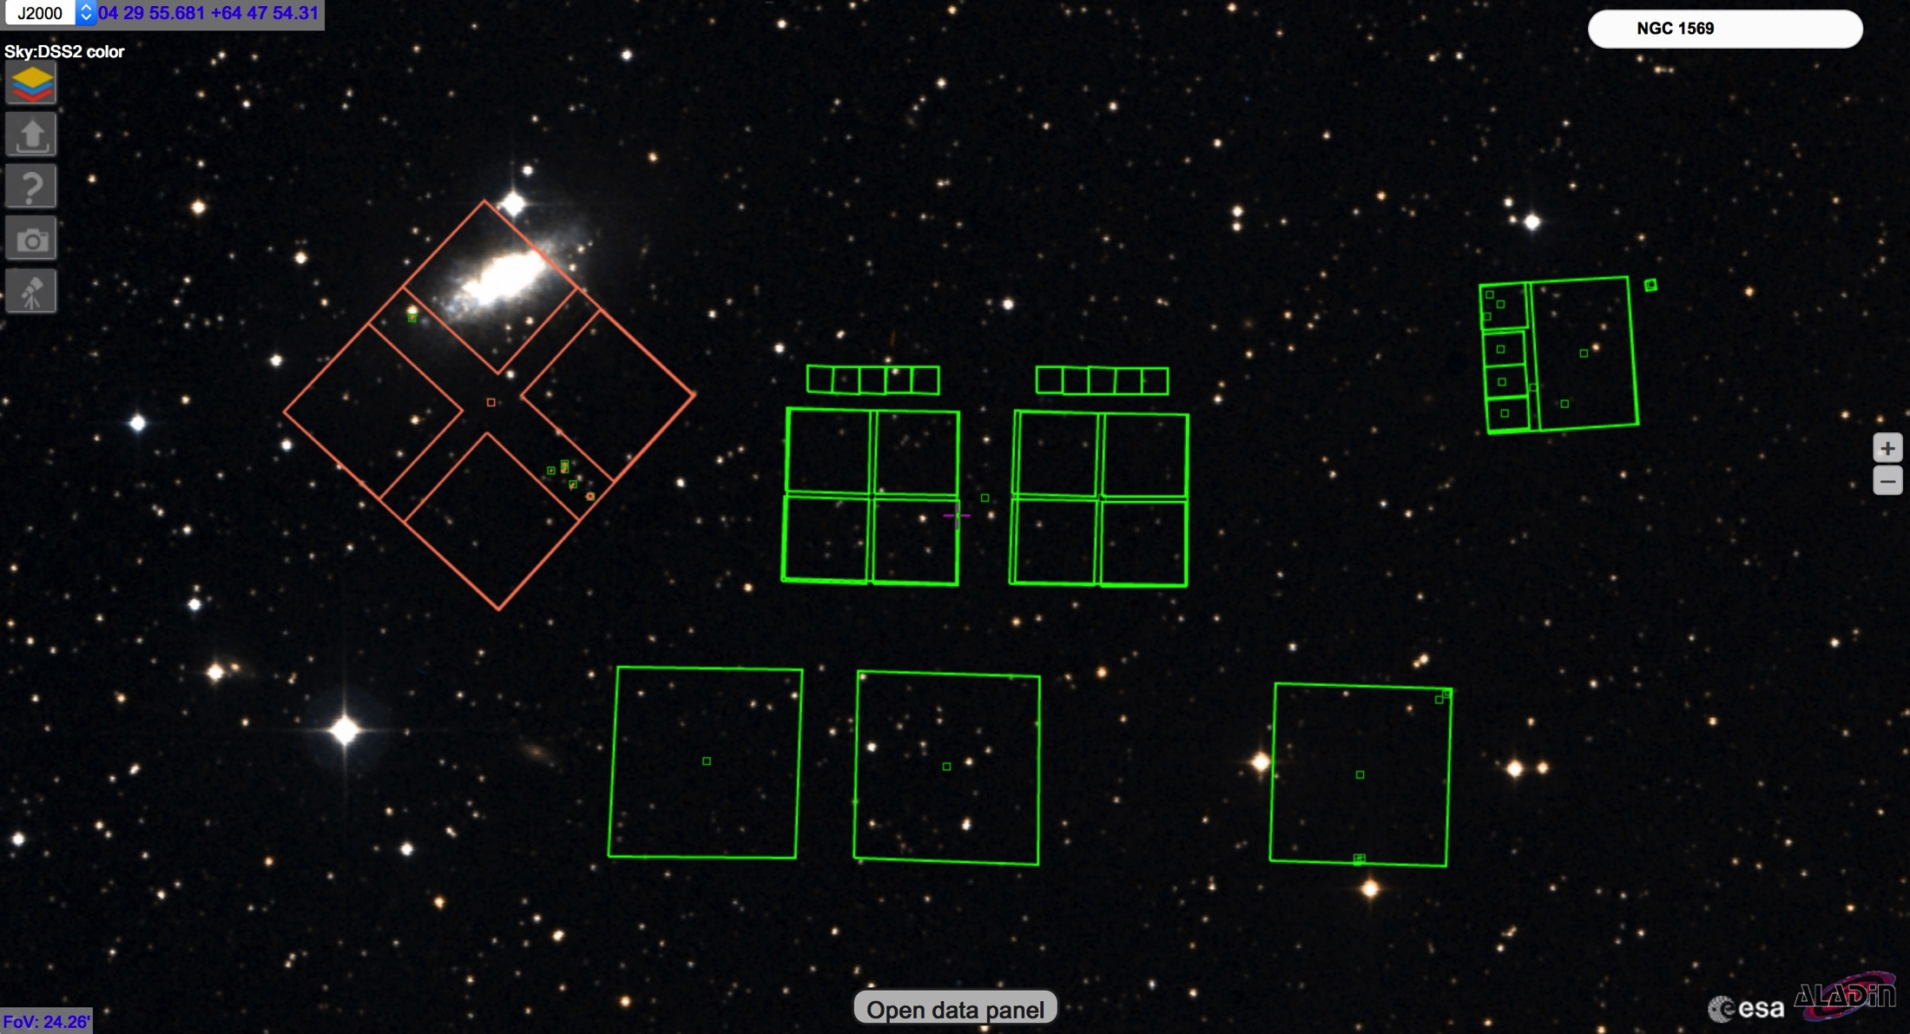
Sky.esa.int

Slide 8
My suggested path
Documentation
ESA SKY
Visibility Tool
ETC
APT

Slide 9
Webinars and workshops
Webinars and material from previous conferences and workshops are
extremely valuable source for off – line, self paced training
Workshops are the ideal venue to get your questions answered and learn hands on

Slide 10
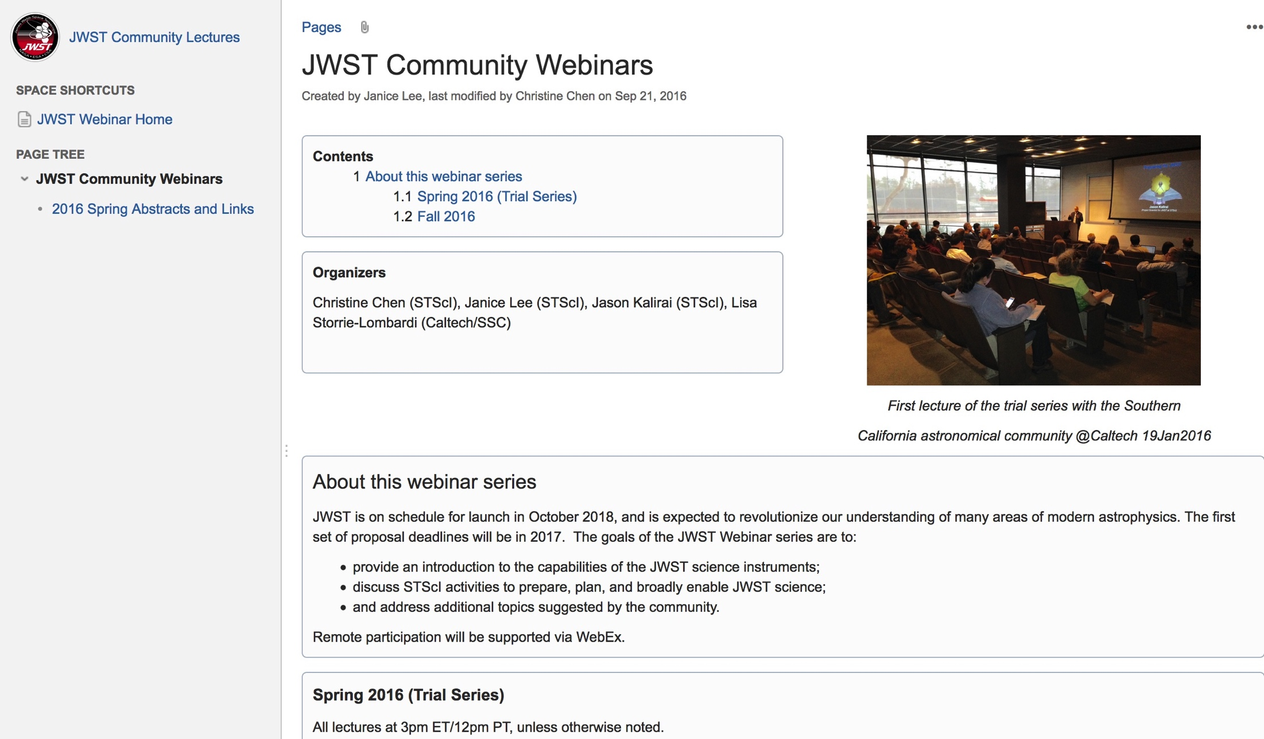
Webinars
Past Events
Preparing for JWST
NIRCAM
NIRSpec
NIRISS
Data Analysis Tools
MIRI
ERS
JWST Coronagraphs
JWST IFUs
Absolute flux calibration
Astrometric Calibration
NIRSpec MOS
ETC
https://jwst.stsci.edu/science-planning/workshops-and-lectures/jwst-community-lectures

Slide 11
ESA JWST Workshop Series
1st of the Series
On your Mark, get ready, go !
Focus on observing modes
and policies
30+ Online presentations
https://www.cosmos.esa.int/web/jwst-2016-esac/home

Slide 12
ESAC WJST Workshop Series
ESAC 2017 JWST WORKSHOP
ESAC Oct 4-6
Focus on Proposal Tools
Hand on sessions
Time with experts

Slide 13
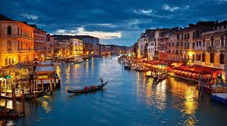
Other events in Europe
Workshop with demos during the last day of the meeting
EWASS 2017 - Prague 26-30 June
Workshop with demos during the last day of the meeting
Abstract submission deadline Oct 1st
Workshop with demos during the last day of the meeting
Abstract submission deadline Oct 1st
Workshop with demos during the last day of the meeting
Abstract submission deadline Oct 1st

Slide 14
In the US
May 15, 2017 STSCi
JWST Early Release Science - Proposal Preparation Workshop STScI
Jun 12 2017 Austin TX
AAS Summer Meeting / proposal planning workshop
Dec 14, 2017 Pasadena CA
JWST Proposal planning workshop Pasadena, Ca
Full List of Future events
https://confluence.stsci.edu/pages/viewpage.action?spaceKey=JWST&title=JWST+Events

