Slide 1
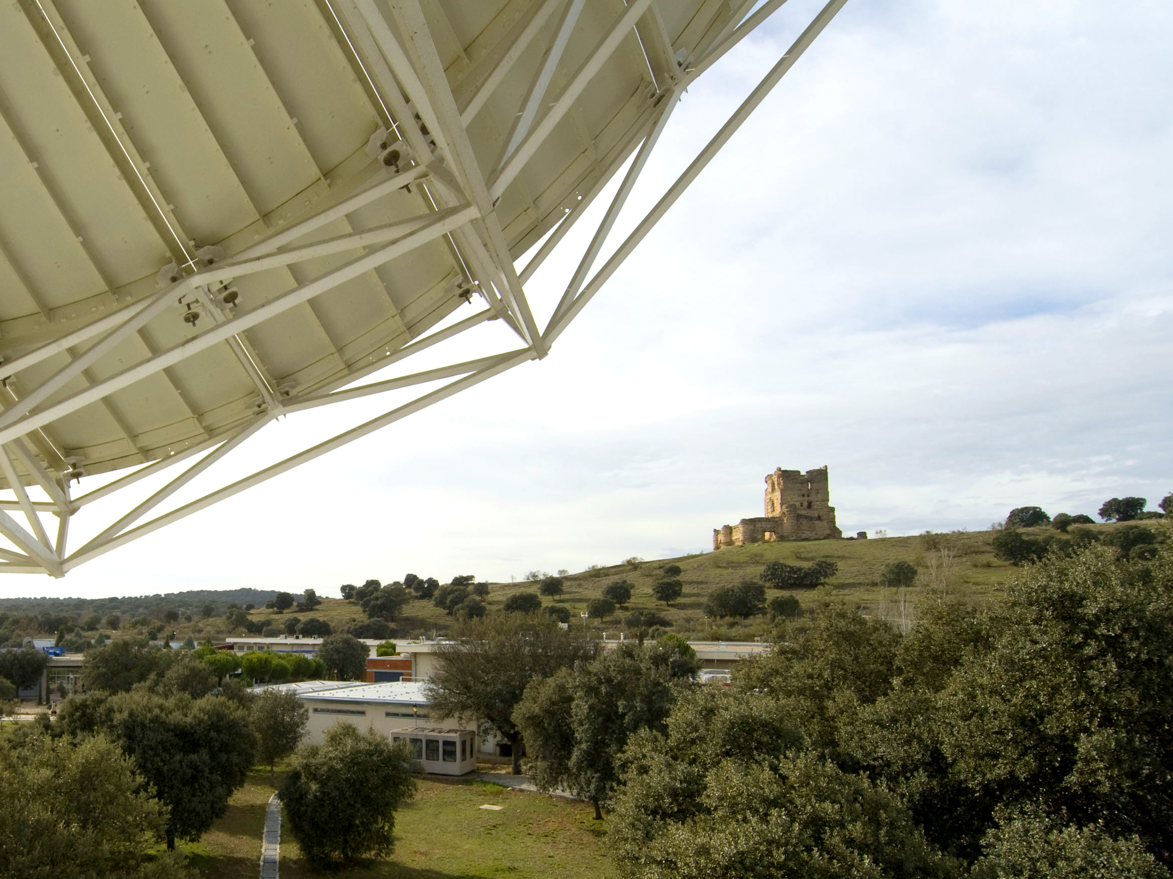
ESA’s Science Programme and ESAC
Welcome to European Space Astronomy Centre
Martin Kessler, Operations Department
ESA Unclassified – For Official Use

Slide 2
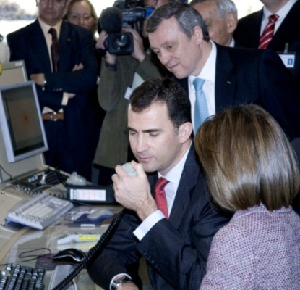
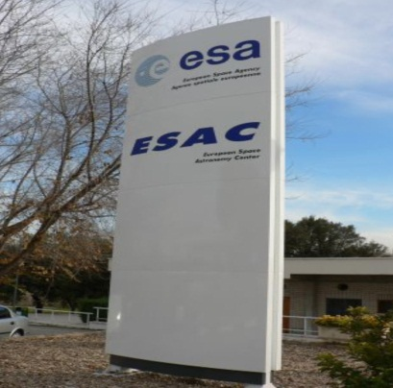
ESAC: History and Current Activities
1978: Opening of ESA VILlafranca SPAin Satellite Tracking Station, VILSPA.
1970s, 1980s, 1990s: Support to various astronomy missions.
Early 2000’s: Expansion to planetary missions.
2005 – Cebreros Deep Space Antenna (DSA) inaugurated.
2008: VILSPA became ESAC, European Space Astronomy Centre.
ESAC’S main activities now:
Satellite Tracking,
Earth Observation:
SMOS Spanish National Centre,
INTA/CSIC Astrobiology Centre (CAB)
Space Situational Awareness,
Galileo Science Office,
Science Operations Centres,
Science Data Archives,
Management of D/SCI in-orbit missions.
ESA Unclassified – For Official Use

Slide 3
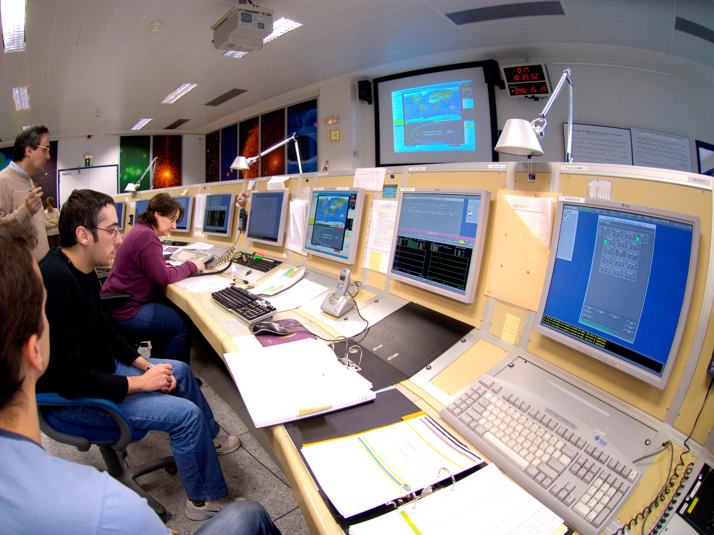
ESAC: Core Mission
Science Operations Centres (SOC) for ESA’s
Astronomy,
Heliospheric, and
Planetary missions.
Science Data Archives
provide long-term access to vital data for the world’s scientists.
Overall management of D/SCI’s missions once commissioned in orbit.
ESA Unclassified – For Official Use

Slide 4
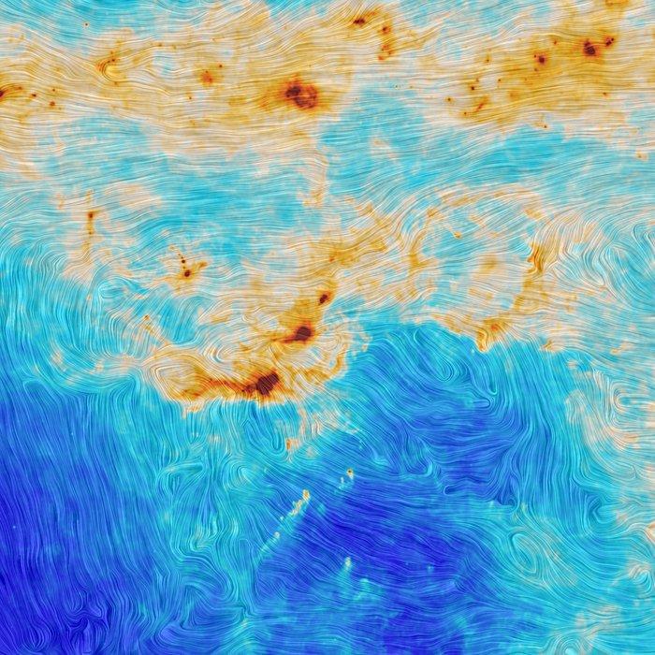
Basics of Science Programme
The Programme is science-driven:
bottom-up processes for long-term science planning and mission calls,
rely on broad scientific community input and peer review,
Science Programme Committee (SPC) decides programme content.
The Programme is mandatory:
all member states contribute pro-rata to GDP providing budget stability, allowing long-term planning of its scientific goals and,
being the backbone of the Agency.
The Programme is planned long-term:
necessary for science missions to be manageable and to achieve the goals of broad scientific community. Long-term planning since 1980’s.
Key words: Continuity and stability
ESA Unclassified – For Official Use

Slide 5
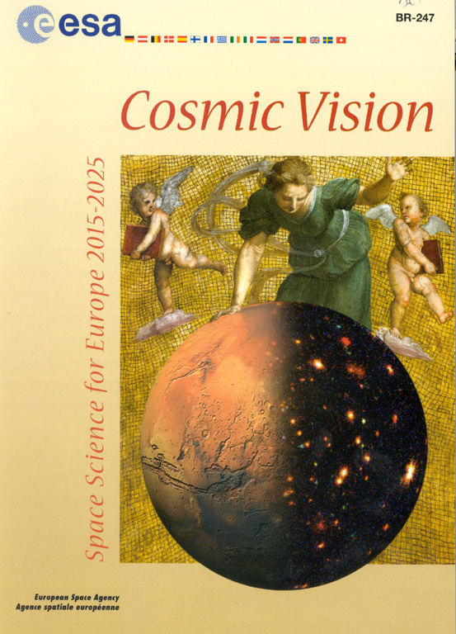
Current Long-Term Plan
“Cosmic Vision Space Science for Europe 2015–2035”
Four fundamental questions:
What are the conditions for planetary formation and the emergence of life?
How does the Solar System work?
What are the physical fundamental laws of the Universe?
How did the Universe originate and what is it made of?
ESA Unclassified – For Official Use
Notes:
Since late 1980’s, plan 1-2 decade at a time and 1-2 decades in advance.
This is our 3rd long-term plan.
CV published October 2005.
Cover: A fresco painted 1509-1511 by Raphael (1483-1520) in the Vatican (Stanza della Segnatura, Palazzi Pontifici) perhaps depicts the embodiment of Astronomy. (Copyright Photo SCALA, Florence)
Replacing the original astronomical globe is Mars viewed by the High Resolution Stereo Camera (ESA/DLR/FU Berlin,G. Neukum) carried by the ESA Mars Express spacecraft,merging into an image (G. Hasinger, Astrophysikalisches Institute, Potsdam) of X-ray sources in the Lockman Hole made using the Newton X-ray Observatory spacecraft.

Slide 6
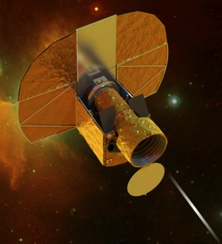
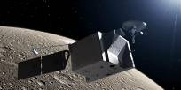
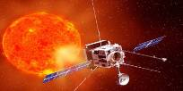
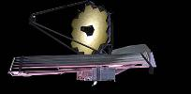
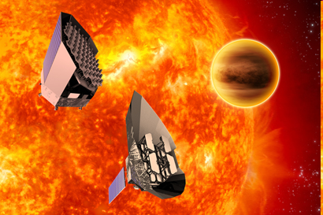
Science Missions in Development
(in launch date order)
2017 CHEOPS (CHaracterising ExOPlanet Satellite)
2018 BepiColombo (Closing in on Mercury)
2018 Solar Orbiter (Closest to the Sun)
2018 JWST (Observing the First Light)
2020 Euclid (Mapping the geometry of the Dark Universe)
2022 JUICE (JUpiter ICy Moons Explorer)
2024 PLATO (PLAnetary Transits and Oscillations of Stars)
(still to be adopted)
ESA Unclassified – For Official Use

Slide 7
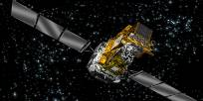
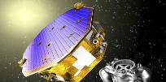
Astronomy & Physics Missions in Orbit
1990 Hubble Space Telescope (UV/Optical/NIR Observatory)
1999 XMM-Newton (X-ray Observatory)
2002 INTEGRAL (Gamma-ray Observatory)
2009 Herschel (FIR Observatory) – now in post operations
2009 Planck (Mapping microwave background) – now in post ops
2013 Gaia (astrometry – charting a billion stars)
2015 Lisa Pathfinder (demonstrate gravitational wave technology)
ESA Unclassified – For Official Use

Slide 8
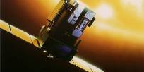
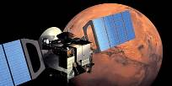
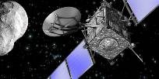
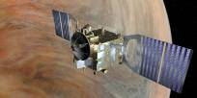
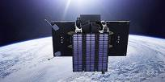
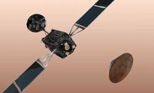
Helio/Planetary Missions in Orbit
1995 SOHO (Solar and Heliospheric Observatory)
1997 Cassini-Huygens (Saturn and probe to Titan)
2000 Cluster (Sun-Earth Environment)
2003 Mars Express
2004 Rosetta (Comet exploration) – EoM: 30 September!!
2005 Venus Express – now in post operations
2009 PROBA-2 (technology and solar observations)
2016 ExoMars2016 (Trace Gas Orbiter (TGO) and
Schiaparelli EDM demonstrator – Landing: 19 October!!
ESA Unclassified – For Official Use

Slide 9
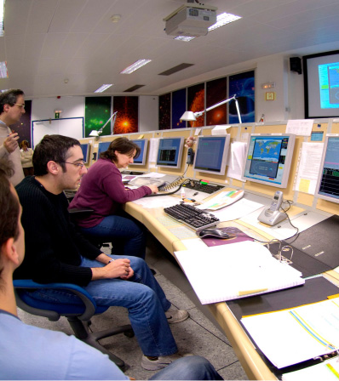
Operations Department
Science Operations Centres for
Astronomy,
Heliospheric, and
Planetary missions.
Science Data Archives
long-term access to data and information.
Overall management of ESA’s operational space science missions.
Involved in >25 missions/studies.
Over 250 scientists and engineers involved at European Space Astronomy Centre (ESAC), Madrid,
and at STScI, GSFC, ESTEC, …
ESA Unclassified – For Official Use

Slide 10
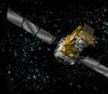
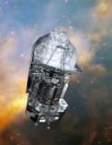
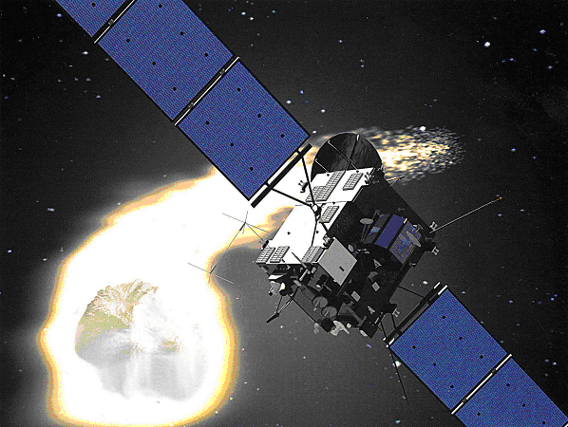
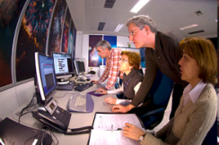
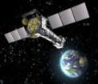
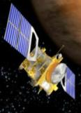
Science Operations Centres
Provide, often with partners, some/all of following elements:
Interfaces to users,
calls for proposals, information, workshops, training, helpdesk, …
Payload operations,
scientific scheduling and optimisation, payload monitoring, quick-look data analysis, …
Payload data acquisition and processing,
calibration and cross-calibration, interactive and pipeline processing tools, …
Science data archiving and distribution,
archive development, population and maintenance, …
Plus associated software (and procedures).
development, integration, test, operation and maintenance.
ESA Unclassified – For Official Use

Slide 11
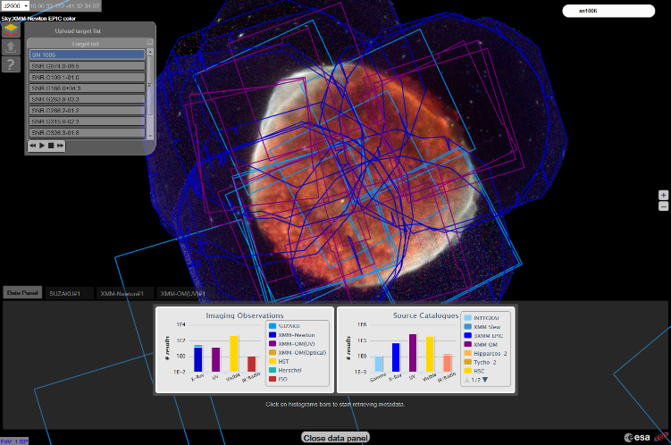
Science Data Archives
http://archives.esac.esa.int

Slide 12
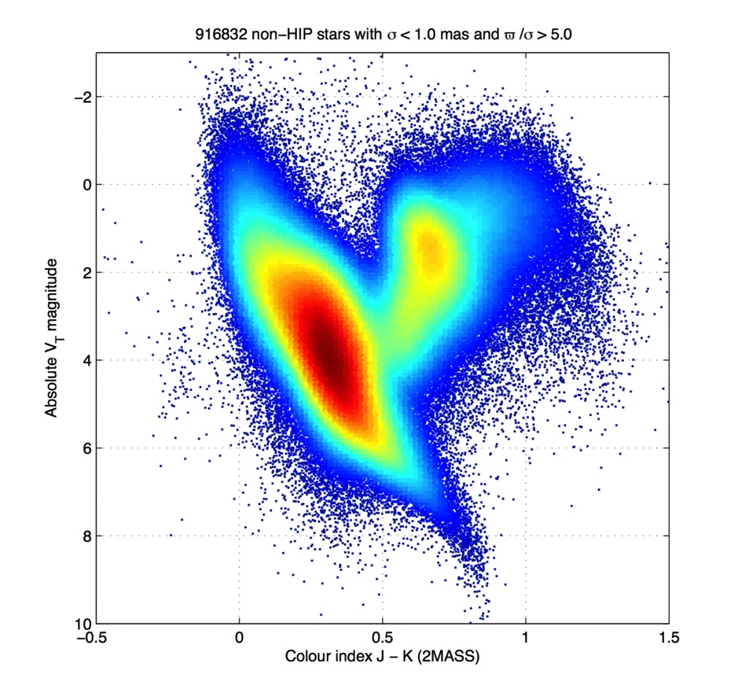
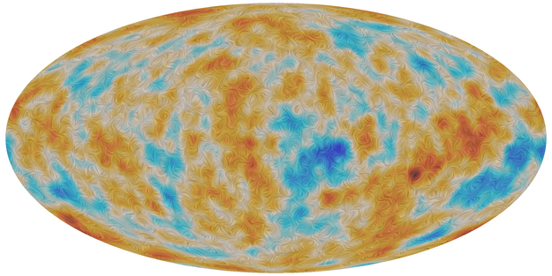
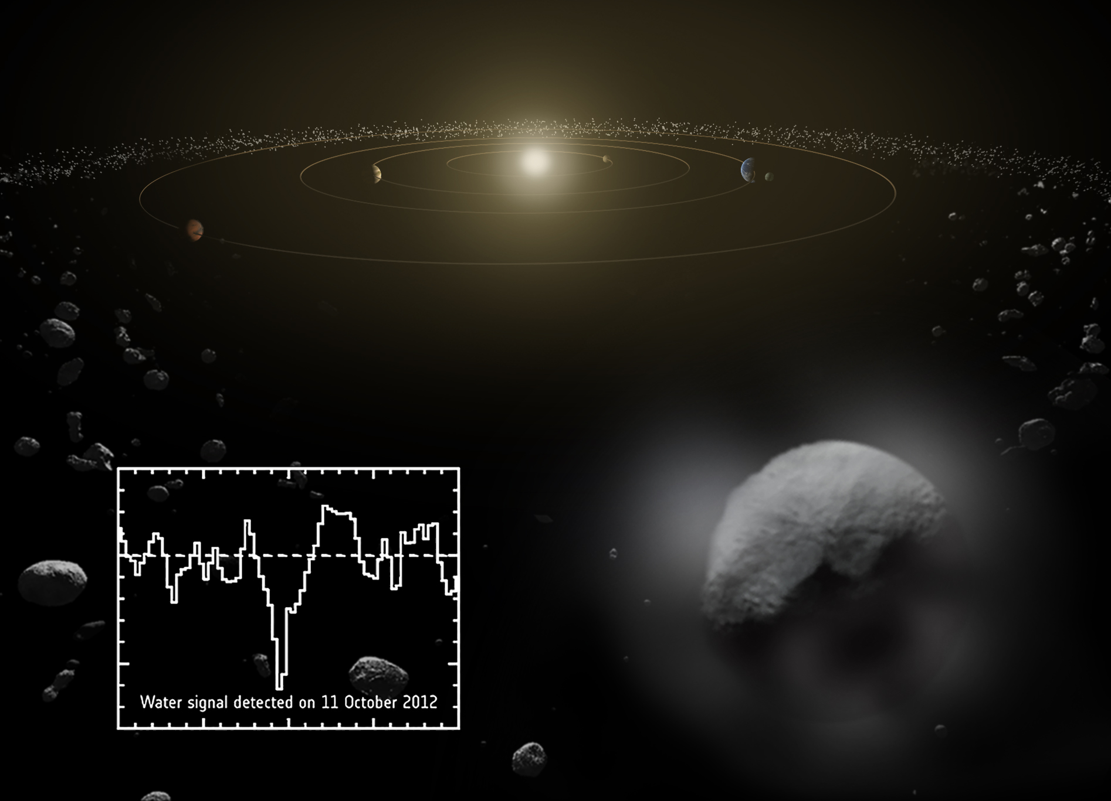
Why We Do (Science) Operations!!
ESA/Gaia/DPAC/IDT/FL/DPCE/AGIS
ESA and the Planck Collaboration
SOHO (ESA/NASA)
67P/C-G 3D shape model and surface
model based on Rosetta images /
Mattias Malmer, ESA/Rosetta/NAVCAM
, MPS for OSIRIS team
ESA/ATG medialab/Küppers et al.
ESA/Rosetta/MPS for OSIRIS
Team MPS/UPD/LAM/IAA/SSO
/INTA/UPM/DASP/IDA
ESA Unclassified – For Official Use

Slide 13
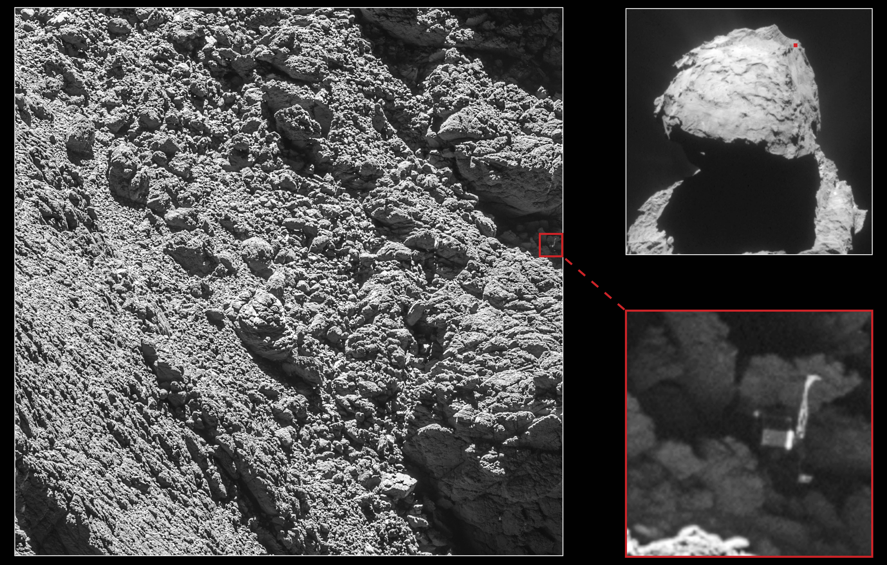
Rosetta’s Philae Found!
ESA Unclassified – For Official Use

Slide 14
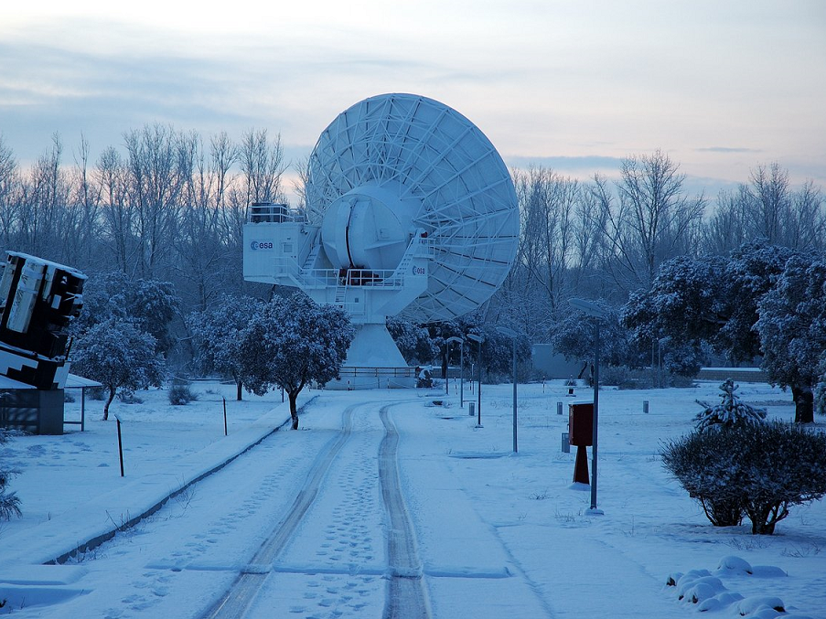
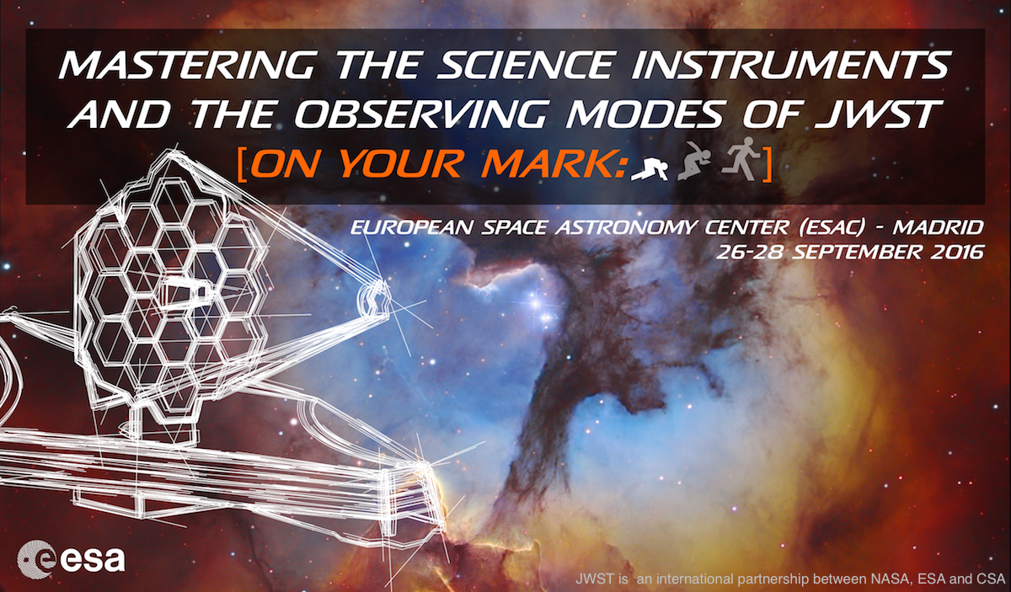
Good luck with your JWST preparations!
Thank you!
ESA Unclassified – For Official Use

