Slide 1
Detectors of JWST Near IR Instruments
Marco Sirianni
ESAC 2016 JWST Workshop
ESAC, September 26-28, 2016

Slide 2
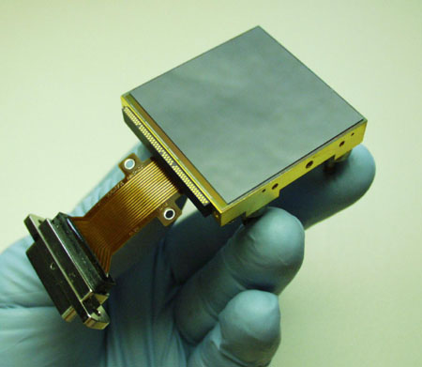
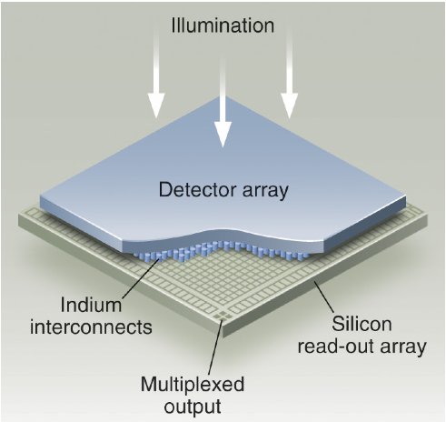
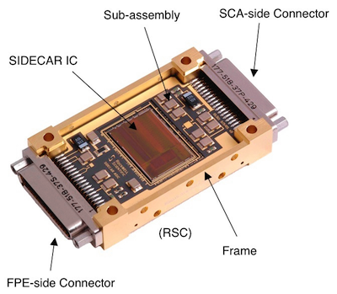
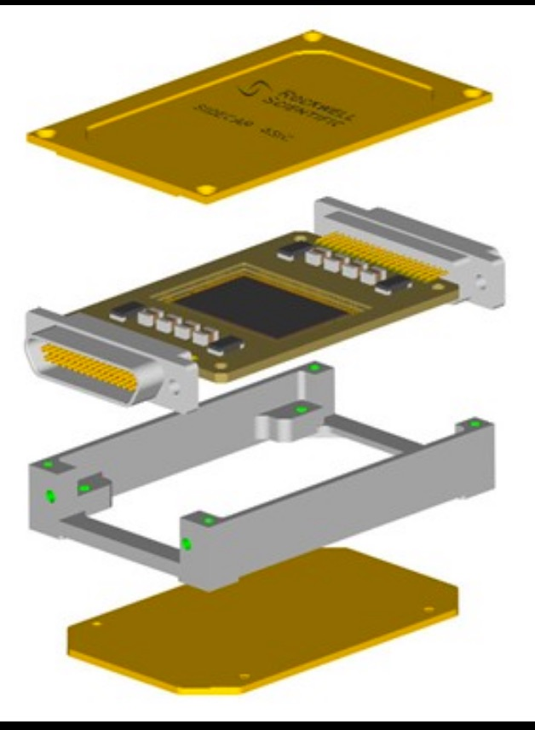
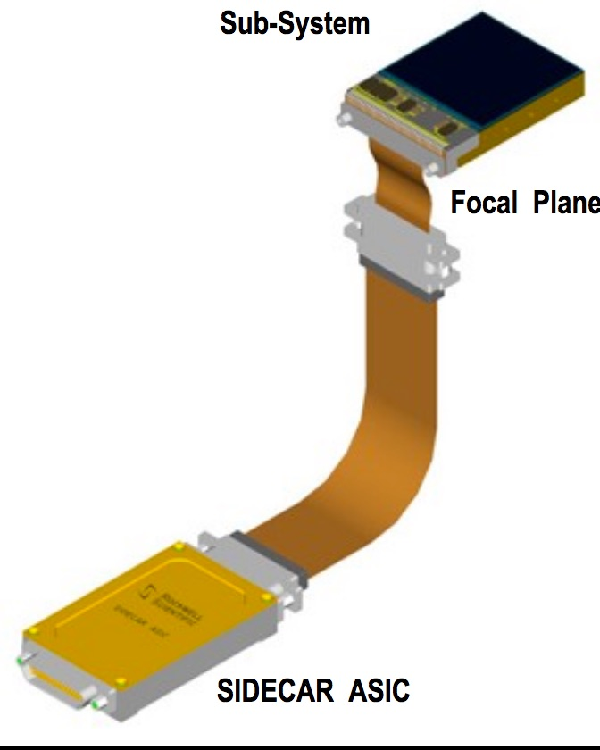
JWST NIR detectors
All JWST NIR Instruments uses one or more Teledyne
HgCdTe 2048x2048 18μm pixel detectors (H2RG)
Hybrid CMOS architecture:
HgCdTe detector layer
2.5μm or 5.3 μm wavelength cutoff
Silicon Readout integrated circuit (ROIC)
multiplexing
Each detector is controlled by a dedicated Teledyne
programmable SIDECAR ASIC
Provides clock and biases to the detector
Provides 16 Bit A2D conversion
Transmits digital data to the Instrument detector electronics
Each ASIC-detector pair is “tuned” for optimal performance

Slide 3
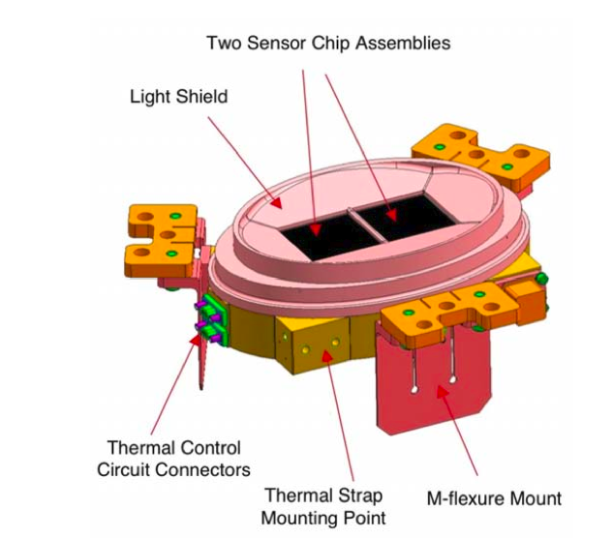
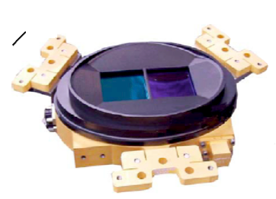
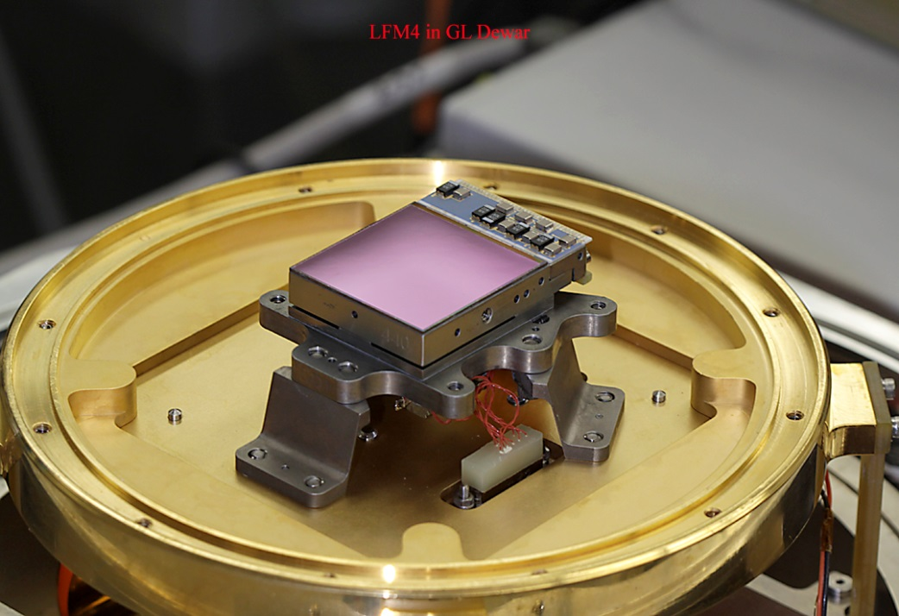
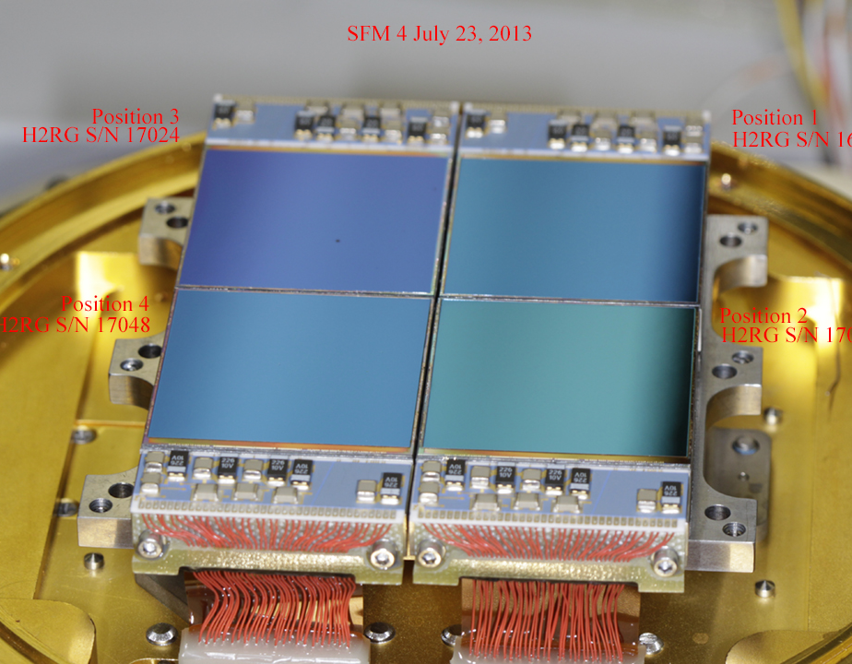
SCAs and FPAs
Each detector is called Sensor Chip Assembly (SCA)
The Focal Plane Array (FPA) of a given SI can have one or more SCAs
Instrument | FPA/SCA | λ cutoff
NIRISS | 1 / 1 | 5.3
NIRCam | 2 / 4 2 / 1 | 2.5 5.3
NIRSpec | 1 / 2 | 5.3
NIRSpec FPA
NIRcam LW FPA (1 of 2)
NIRcam SW FPA (1 of 2)

Slide 4
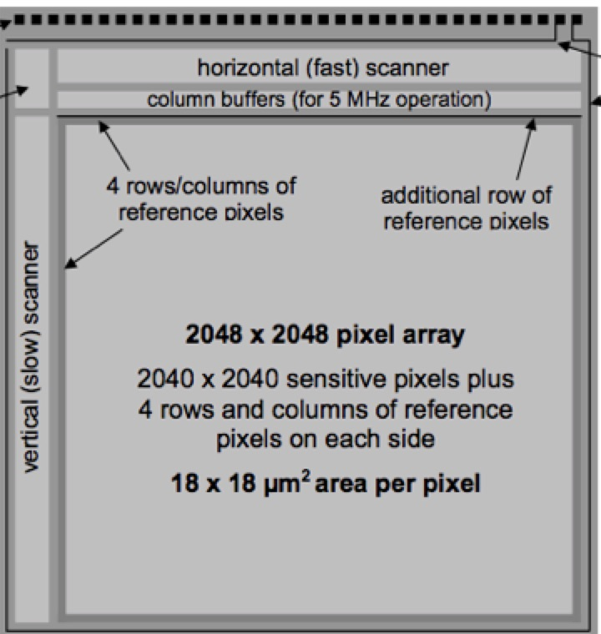
Anatomy of a SCA
I/O pads
2048x2048 pixel array
2040x2040 sensitive area
4 rows and columns or reference pixels on each side to track electronic bias and temperature drifts to correct science data
2040
JWST H2RG read out using 4 outputs, each one taking care of a 512x2048 region
Pixels are continuously clocked at 100Khz rate to hold power dissipation constant
2040
4 rows and columns or reference pixels
The four outputs are operated in parallel
The ASIC re-order the pixels

Slide 5
Readout Modes
Output
j
j
Horizontal fast scanning direction
Horizontal fast scanning direction
Standard Full Frame Readout
4 outputs
10.73 seconds to read the frame
HDIR=0
HDIR=1
HDIR=0
HDIR=0
HDIR=1
i₀ ROWCORNER
VDIR=0
Subarray mode
1 single outputs
Rules on size of window:
Min NCOLS, NROWS=8
NCOLSxNROWS = multiple of 64
Frame time depends on size
(2ms to 42s)
Available subarrays listed in APT
VDIR=0
j₀ COLCORNER
Vertical slow scanning direction
Vertical slow scanning direction
NROWS Δi
i
NCOLS Δj

Slide 6
Non destructive “up the ramp” readout
CMOS allows to monitor the accumulated charge without “erasing” it
Signal
Non destructive
reads during
integration
12
Fit of the slope provides
the count rate
Multiple samples averaged down the noise
reset
3
1
2
Non destructive reads
“maintain history of integration”
idle
Time
Signal
Cosmic
ray hit
Signal
Saturation
12
3
3
1
2
1
2
Time
Time

Slide 7
Integration & Exposure
One exposure can have multiple identical integrations
Exposure
Integration #1
Integration #2
Integration #3
Signal
reset
idle
reset
reset
idle
Time

Slide 8
Data Cube
Signal
Each read is saved as a slice of a 3D data cube
12
Non destructive
reads during
integration
12
2
1
Time
reset
3
1
2
idle
Time
Getting all the reads in the ramp is the optimal situation, but
it is not always feasible

Slide 9
Dealing with data volume
12
Signal
12
Signal
12
Non destructive
reads during
integration
12
11
11
11
11
10
Reads not
saved- “dropped”
10
10
10
“Groupgap”
3
3
2
2
1
1
Time
reset
Time
reset
3
3
2
1
2
1
idle
idle
Time
Time
Signal
12
Signal
12
11
11
3
Groups of reads
can be averaged
on board
10
10
9
3
9
2
“Nframes”
4
2
3
4
2
3
1
1
Time
reset
2
Time
reset
1
1
idle
idle
Time
Time

Slide 10
Different instruments, different requirement, different readouts patterns
Each instrument has different number of SCAs, different requirements and different “tuning”.
Data volume restrictions also dictate readout patterns that define the structure of an integration
SI | Pattern name | Nframes | Group Gap
NIRISS | NIS-RAPID NIS | 1 4 | 0 0
NIRCam | RAPID | 1 | 0
 | BRIGHT1 BRIGHT2 | 1 2 | 1 0
 | SHALLOW2 SHALLOW4 | 2 4 | 3 1
 | MEDIUM2 MEDIUM8 | 2 8 | 8 2
 | DEEP2 DEEP8 | 2 8 | 18 12
NIRSpec | NRSRAPID NRS | 1 4 | 0 0
 | NRSIRS²RAPID NRSIRS² | 1 5 | 0 0
SI # - λ_{co} | Gain e/DN | Total Noise e-
NIRISS 1-5.3 μm | ~1.6 | ~8.5
NIRCam 8-2.5 μm 2-5.3 μm | ~ 2 | 5-6 8-8.5
NIRSpec 2-5.3 μm | ~1 (FF) ~2 (sub.) | 6-7.5 (trad) 5.3-7 (IRS²)

Slide 11
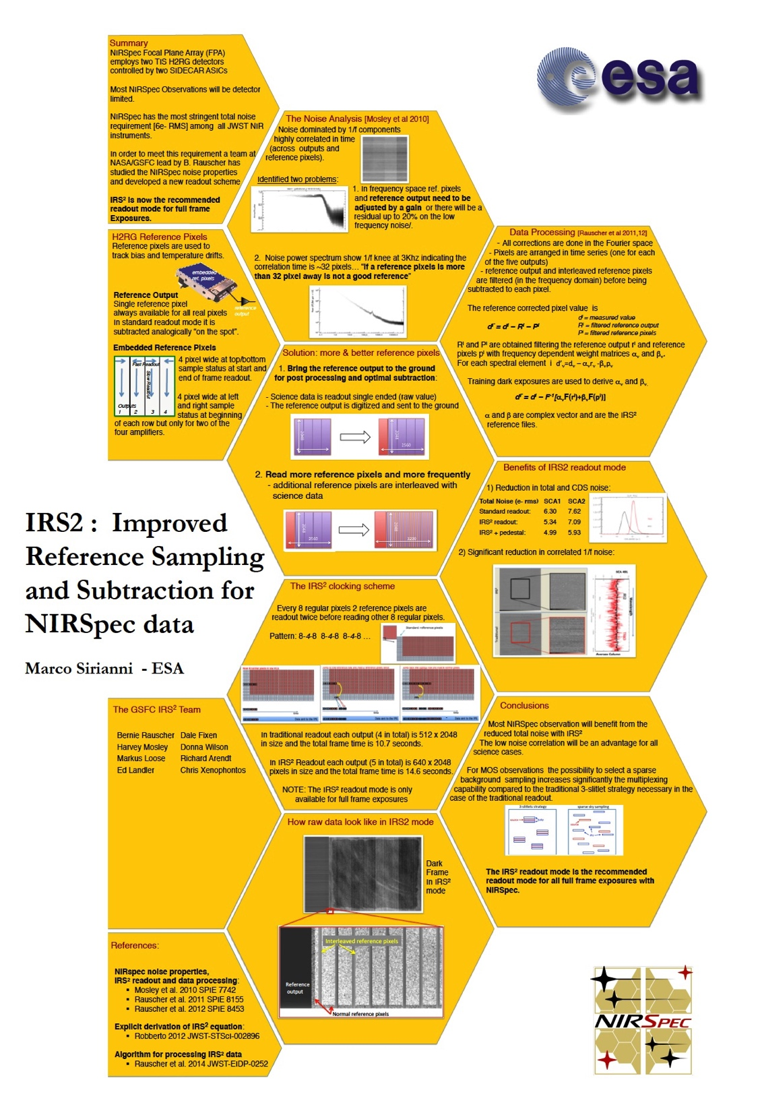
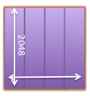
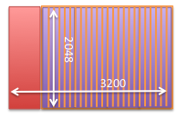
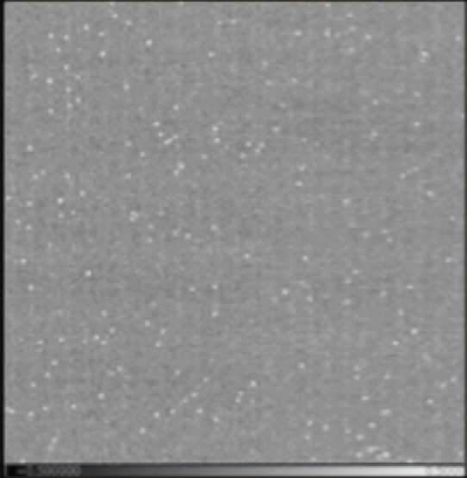
NIRSpec Low Noise readout : IRS²
Most NIRSpec observations are detector limited -> most stringent noise requirement
GSFC group analyzed noise properties of NIRSpec detector system and developed a new low noise readout scheme for NIRSpec Full Frame exposures.
“High level” recipe to reduce noise and noise correlation:
Send more reference pixels “to the ground” for post processing
Read reference pixels more frequently
IRS²= Improved Reference Sampling and Subtraction
Poster #3
Raw data
format
Traditional
IRS²
Frame Time 10.7s
Frame Time 14.6s
Processed dark
exposure
Traditional
IRS²

Slide 12
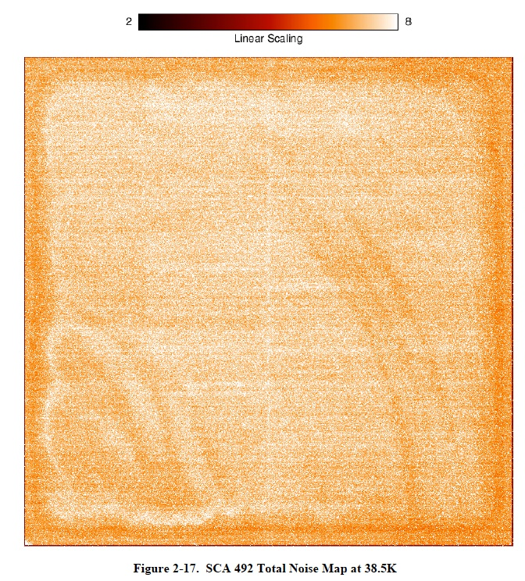
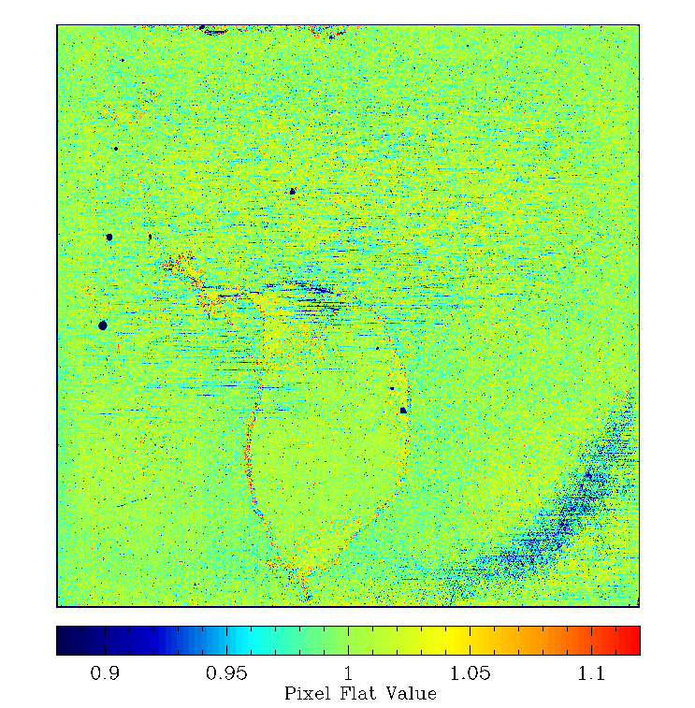
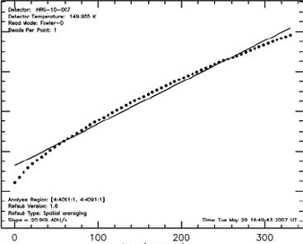
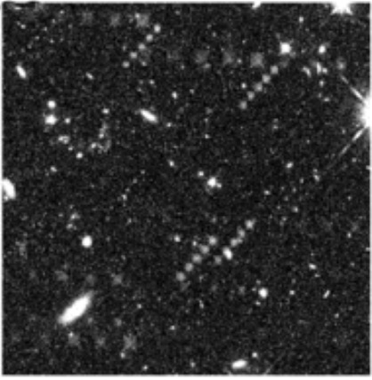
Non ideal behavior to familiarize with….
These detector are the state of the art for NIR space mission with a 2018 launch
They are however not perfect:
“Cosmetics”
Variation in sensitivity
Variation in full well
Generally mitigated with dithering and reference file corrections
Bad Pixels
Dead pixels
Hot/noisy pixels
RC or RTN pixels
< 0.5% on average, flagged in DQ arrays
Non Linearity
Persistence

Slide 13
Summary
JWST NIR instruments have state of the art H2RG detectors
ASIC SIDECAR controllers add flexibility and tuning of the performances (but also some correlated noise)
Each SI has different requirements
They are in general met with significant margin
Some operational aspects are different between various SIs
Some of the detector non ideal behaviors are still under full characterization and they will be corrected, mitigated and /or flagged
Ground detector labs will be operative during JWST operations to support investigation of possible issue and develop operational improvements

