Slide 1
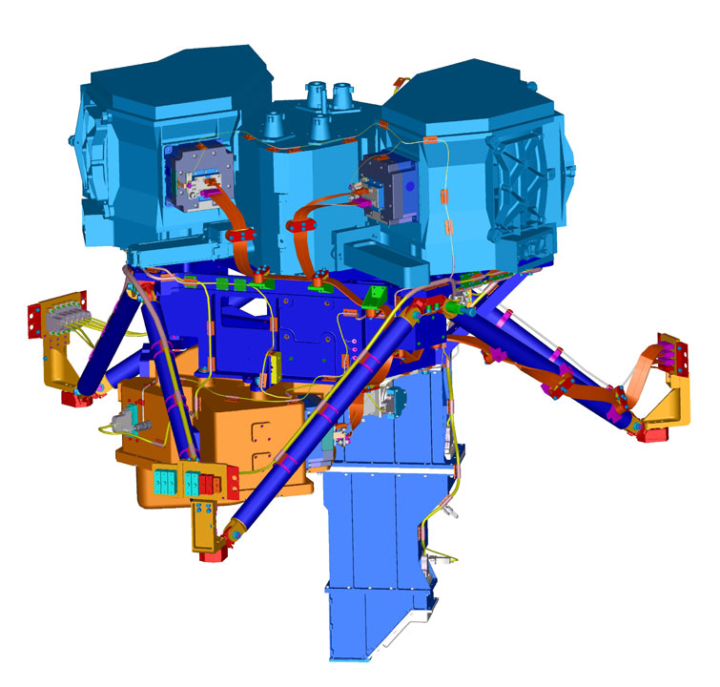
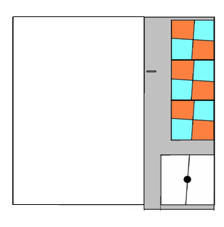
MIRI Coronagraphs
Patrice Bouchet
On behalf of Anthony Boccaletti, P.-O. Lagage, P. Baudoz & the MIRI consortium, Laurent Pueyo & the Coronagraphic Working Group at STScI
1

Slide 2
IMPORTANT PRELIMINARY NOTICE
My role in the JCWG is limited in participating in the meetings, teleconferences and discussions, and to collect as much informations as possible relative to the JWST MIRI Coronagraphs.
Therefore, it must be said that the full credit for the results presented here has to be given to Laurent Pueyo and formerly to Remi Soummer who built the CWG at STScI: Bill Blair, David Golimowski, Dean Hines, Charles-Philippe Lajoie, Jon Morse, Marshall Perrin,, and John Stansberry (+ Anthony Boccaletti and George Rieke from the MIRI European Consortium).
I want to take this opportunity to warly thank them all for letting me presenting new results today (some not yet published), and to congratulate all of them for their excellent work.
PASP, Volume 127, Issue 953, pp. 633-645 (2015)
2

Slide 3
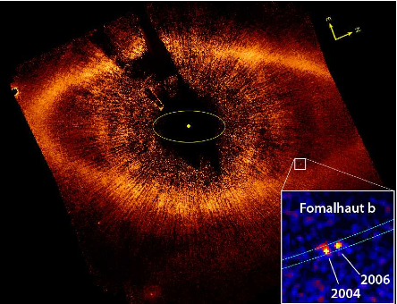
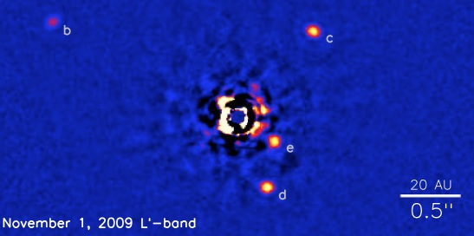
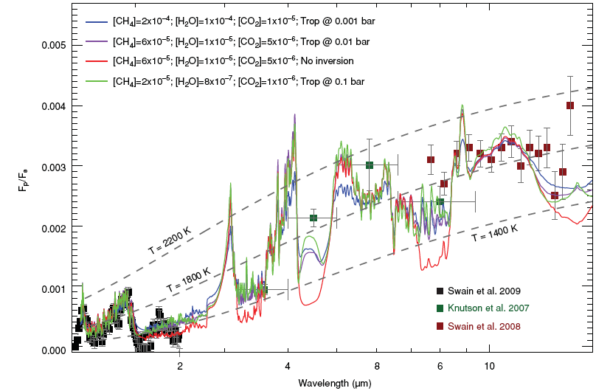
Motivations for a mid IR coronagraph
several YOUNG planets already imaged
more to come with GPI / SPHERE / HiCIAO
- planets in young associations (<100 Myrs, <50-100 pc)
- long period / nearby stars
from RV surveys & GAIA
no observation at λ > 5 μm prior to JWST
at λ > 5 μm the star to planet contrast is getting more favorable
=> JWST and especially MIRI can produce unique observations (photometry, low/med res. spectra)
molecular species :
Water bands: 6-8 μm Methane: 7.7 μm
Ammonia: 10.65 μm CO₂: 15.0 μm
Silicates: 10.0 μm PAH: 11.4 μm
improve constraints on atmospheric modeling
3

Slide 4
Principle of the 4QPM

Slide 5
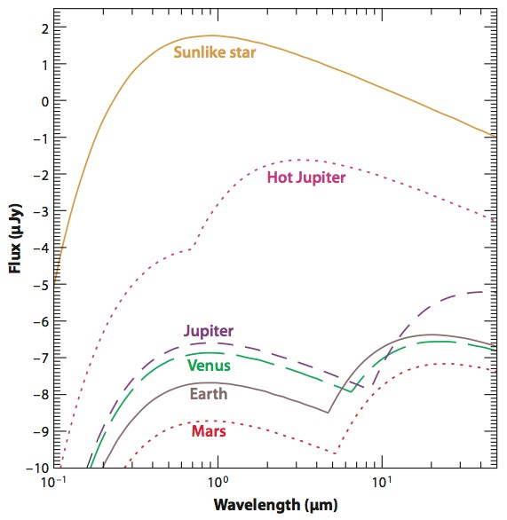
Instrumental choice
Seager et al. 2009
small Inner Working Angle to take advantage of mid IR
4QPM was (2002) the only affordable technology (Rouan et al. 2000)
4QPM gives the same IWA as NIRCAM but at midIR
We will be able to characterize the same scales from 1.4 to 15 microns. This is really cool.
MIRI spectral range
But 4QPMs are chromatic
narrow band filters (5%)
4

Slide 6
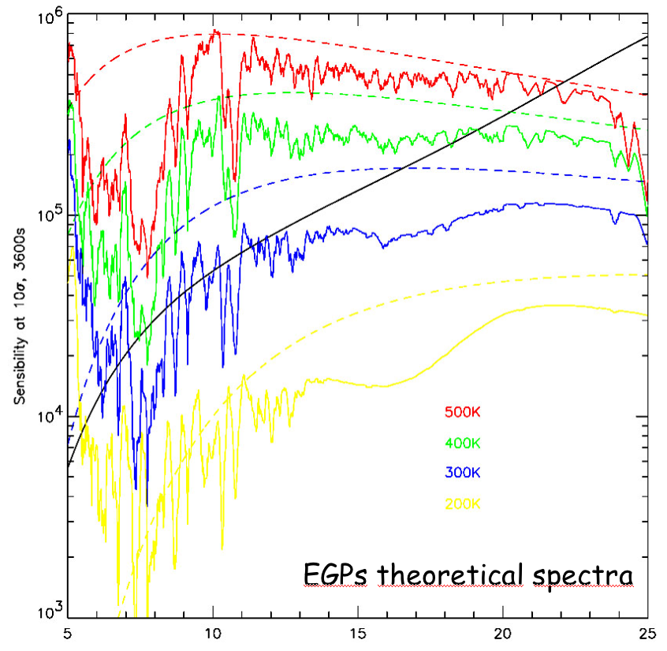
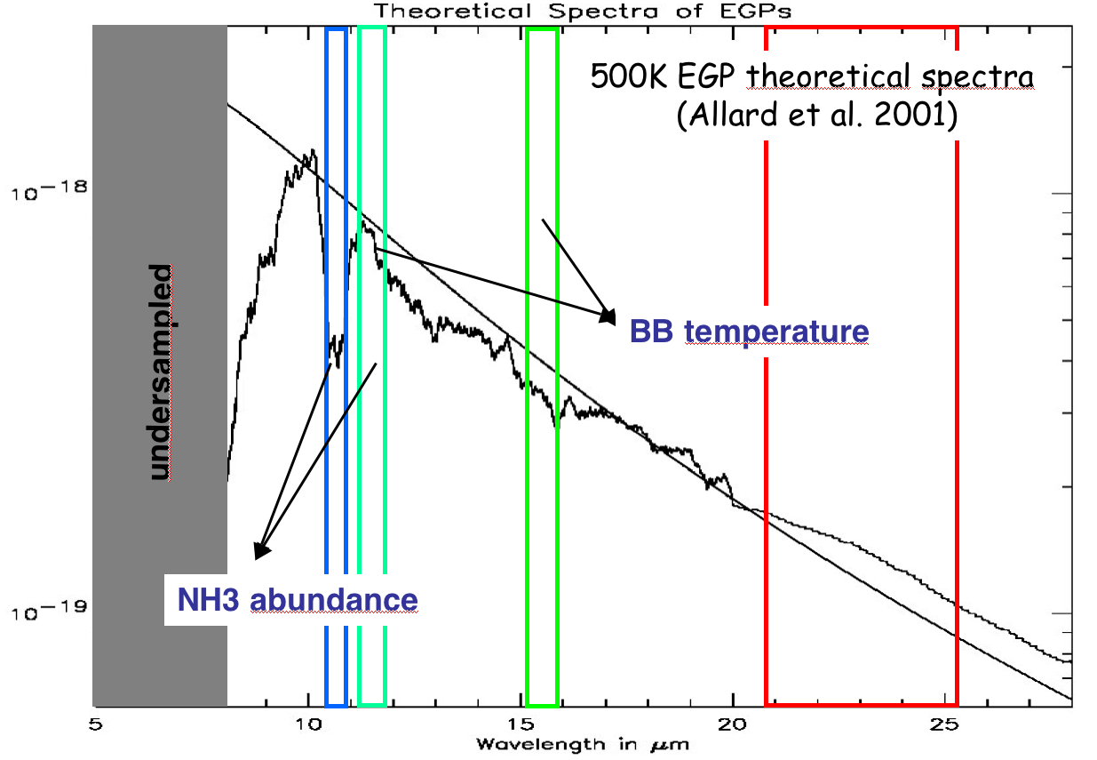
Main coronagraphic modes
Filter 1 (10.65 µm) : NH3 line
Filter 2 (11.4 µm) : continuum
Filter 3 (15.5 µm) : continuum
Filter 4 (23 µm) : cold silicates in disk
1 filter + 1 coronagraph
5

Slide 7
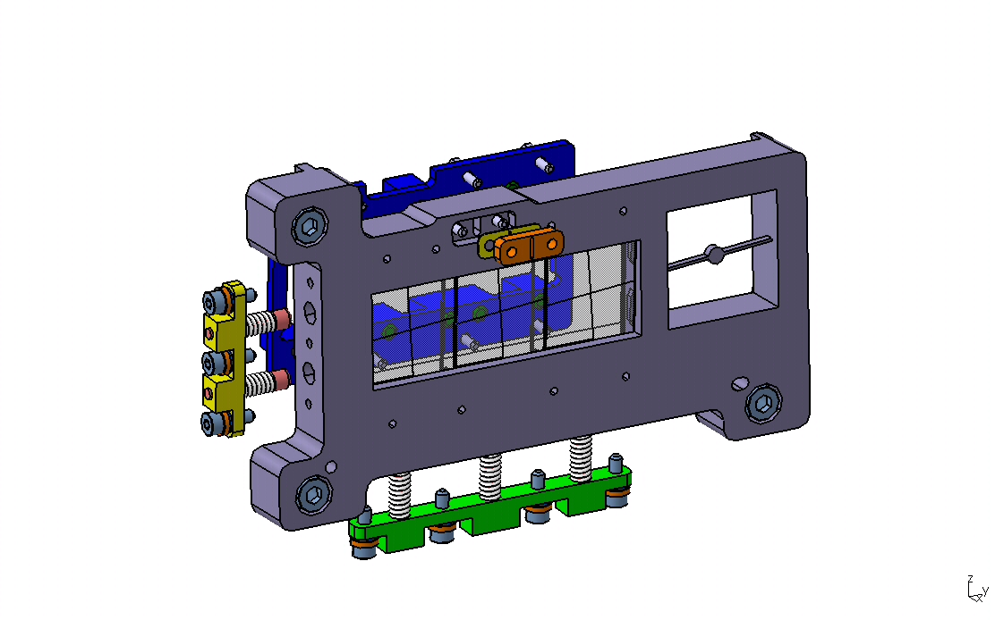
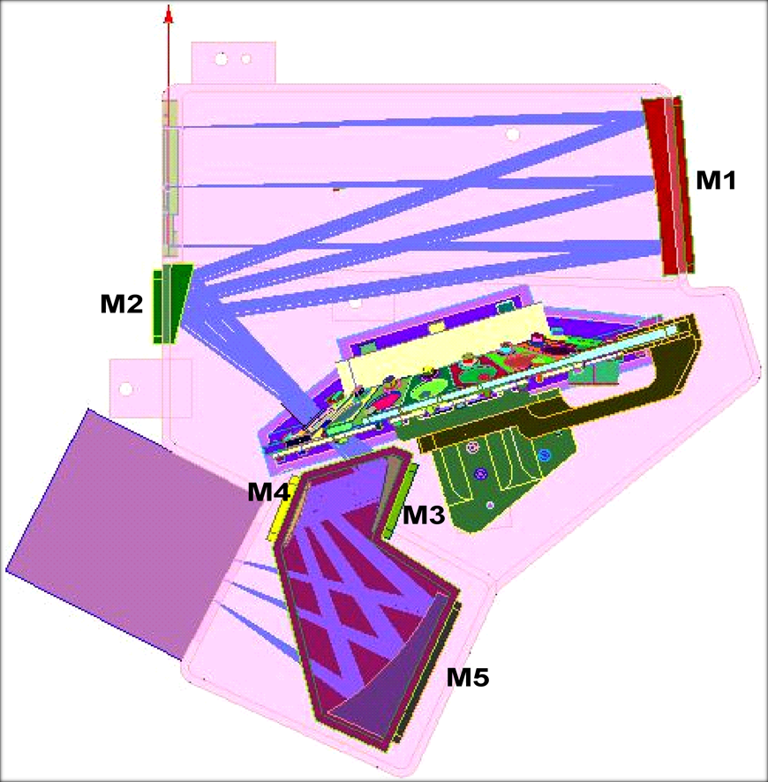
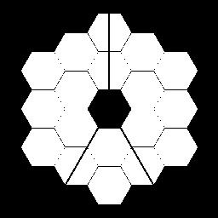
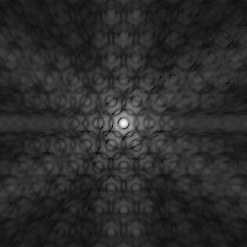
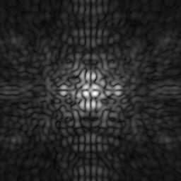
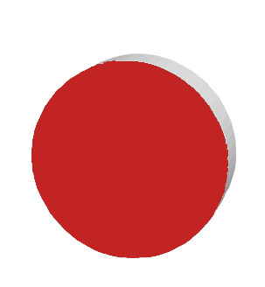
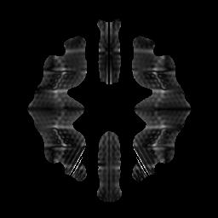
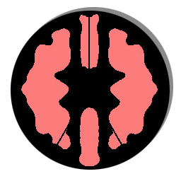
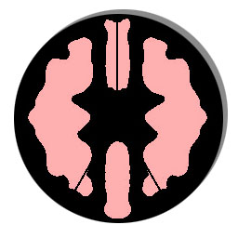
Design of MIRI
monochromatic coronagraphs
4 masks in focal plane
ND
Lyot diaph.
+
23 µm filter
4Q diaph.
+
15.5 μm filter
4Q diaph.
+
11.4 μm filter
4Q diaph.
+
10.65 μm filter
7

Slide 8
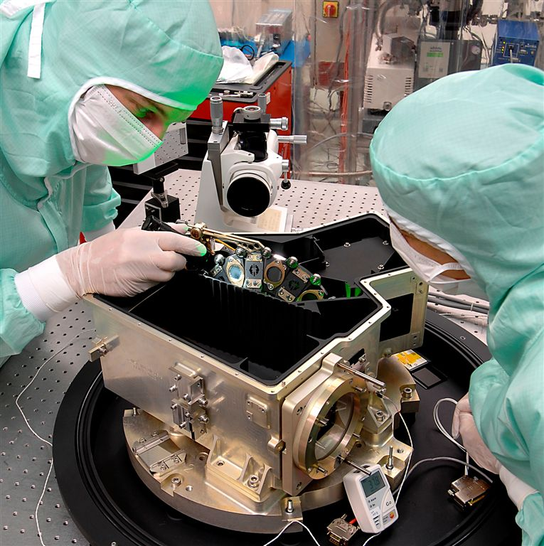
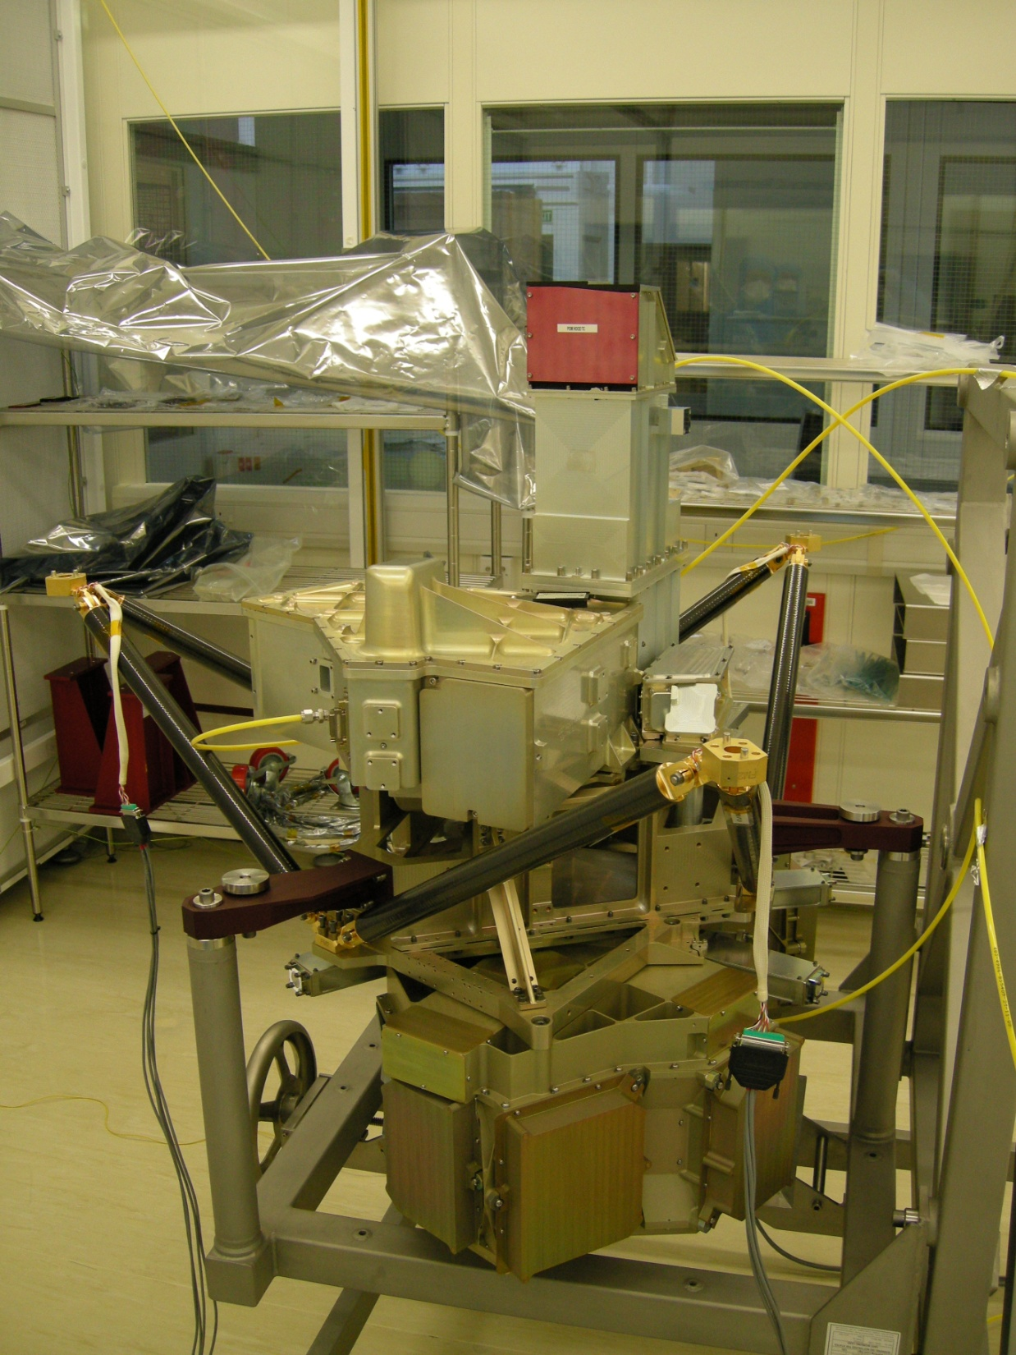
The instrument !

Slide 9
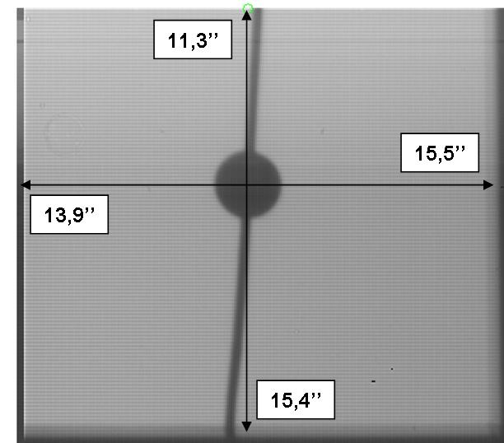
Additional coronagraphic modes
The 50% transmission radius, defined as the IWA, is about 1λ/D for the 4QPMs and 3.3λ/D for the Lyot spot mask. 100% transmission (relative) is achieved at 3 and 5λ/D for respectively the 4QPM and the Lyot spot.
8

Slide 10
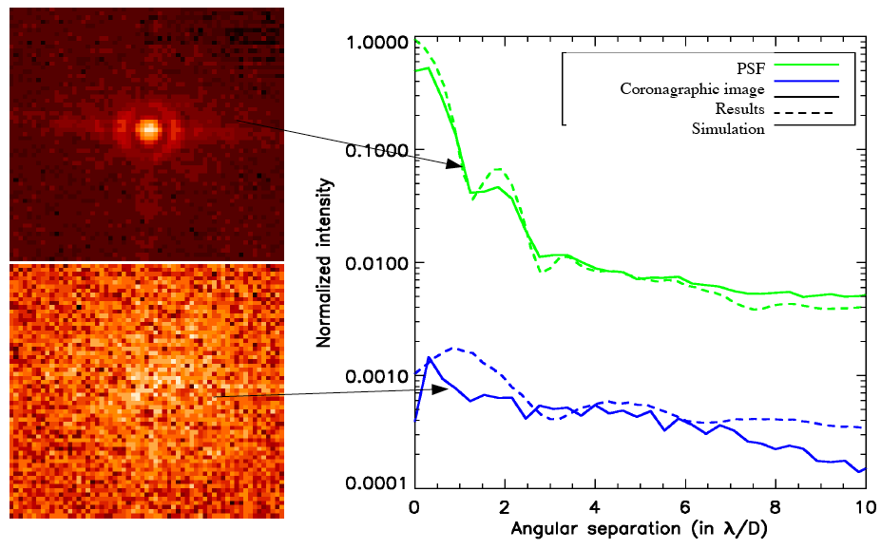
Tests of MIRI-4QPM at 11.4 μm

Slide 11
OPERATIONS
For optimal performances, the target object has to be positioned as close to the center of the 4QPM as possible.
The reference star used for subtraction must also be as close as possible to the target.
➔ Challenging because:
Limited slew accuracy
The 4QPM induces a non linear distortion of the PSF, effectively limiting our ability to precisely measure the centroid (for positions ≤ 500mas)
The position of the center of the 4QPM is only known to within 1 – 2 mas.
11

Slide 12
Operation : peakup
Peakup :
Center the star onto the coronograph = calculate the offset between mask and PSF
1 / Determine the centre of the coronagraph (estimation done from the background)
2/ Use dedicated filters to avoid 4QPM attenuation
- Neutral density for bright stars (mag<4.5 in N band)
- N filter for fainter stars (mag<7.5 in N band)
Two effects make the TA process complex:
1) for the 4QPM coronagraphs, the phase mask can distort the image of a star close to its center and undermine the accuracy of the centroid determination;
2) the detector arrays have latent images that could mimic planets or other exciting astronomical phenomena if the centroiding process left them close to the target star.
12

Slide 13
CENTROID ERRORS
➔ The 4QPM can introduce errors as 100 mas on the centroid measurement depending of the position of the star relative to the 4QPM center
One should avoid the axes of the 4QPM and aims for region with the smallest errors (e.g. diagonal)
The 100 mas is a lot on the centroid measurement error. Makes the whole Target Acq discussion quite scary. It is actually close to zero in the corners of the figure.
Centroid errors as a function of position on the 4QPM at 11.4µm with the latest wavefront error maps. The vectors point from the true position to the actual centroid (measured) position.
The errors on the observatory slews is also an important factor during TA.
(Lajoie et al., 2014)
13

Slide 14
That Means…
we do not want to do TA in the phase jumps of the 4QPM.
we want the image taken for TA to be as far as possible from the center of the 4PQM.
the problem is that “The errors on the observatory slews is also an important factor during TA.”, e.g. the farther the TA image is from the center mask, the harder it is to get it precisely aligned.

Slide 15
TARGET ACQUISITION
Several strategies have been explored to make the alignment as precise as possible. The Twin TA is what will be implemented in the end, it is not more precise per-se, but reduced possibilities for confusion in the case of latency associated with the TA (e.g. to void people to confuse a let net associated with the TA for a planet)
Lajoie et al., 2014
14

Slide 16
THE QUASI-STATIC SPECKLES
Direct imaging of the faint close vicinity of a bright star is limited by a swarm of bright quasi-static (long-lived) speckles caused by the imperfection of the optics that mask it out.
These speckles add coherently with increasing exposure time and their intensity eventually dominates over signal that add incoherently (sky, RON, and general (non static) speckles.
The problem is more important closer to the star.
However, these quasi-static speckles still vary with time due to temperature or pressure changes, mechanical flexures, guiding errors, or other phenomena, which makes it difficult to obtain a PSF highly correlated with the target.
Even when a PSF is acquired simultaneously (at other wl. or polarizations) differential aberrations within the camera decorrelate it.
to subtract speckles one must always work with a decorrelated PSF.
18

Slide 17
Operation : calibration
Subtraction of the speckle pattern is mandatory. Several techniques :
Reference star : not very accurate, large overheads, impact of centering
Roll : not much amplitude for MIRI wavelengths but could be useful at separations >1-2"
Build local PSF reference with LOCI algorithm. Need a sample of targets observed in a similar fashion. Less stringent wrt centering
19

Slide 18
“Locally optimized combination of images’’ : LOCI
Combining PSFs optimizes the noise attenuation (Lafrenière et al., 2007).
One target, N PSFs; the target is divided into subsections and an algorithm obtains independently for each subsection a linear combination of the PSFs whose subtraction from the target image will minimize the noise.
The best PSF is obtained by optimizing the weights given to the N PSFs according to the residual noise.
The correlation between the target and the PSF generally varies with position within the target image, hence it is advantageous to optimize the coefficients of the linear combination for subsections of the image.
This algorithm is referred to as “Locally Optimized Combination of Images”, LOCI (Lafrenière et al., 2007)
21

Slide 19
Small Grid Dithering
Use LOCI to mitigate both the quasi static sparkles and the TA uncertainty
P
20

Slide 20
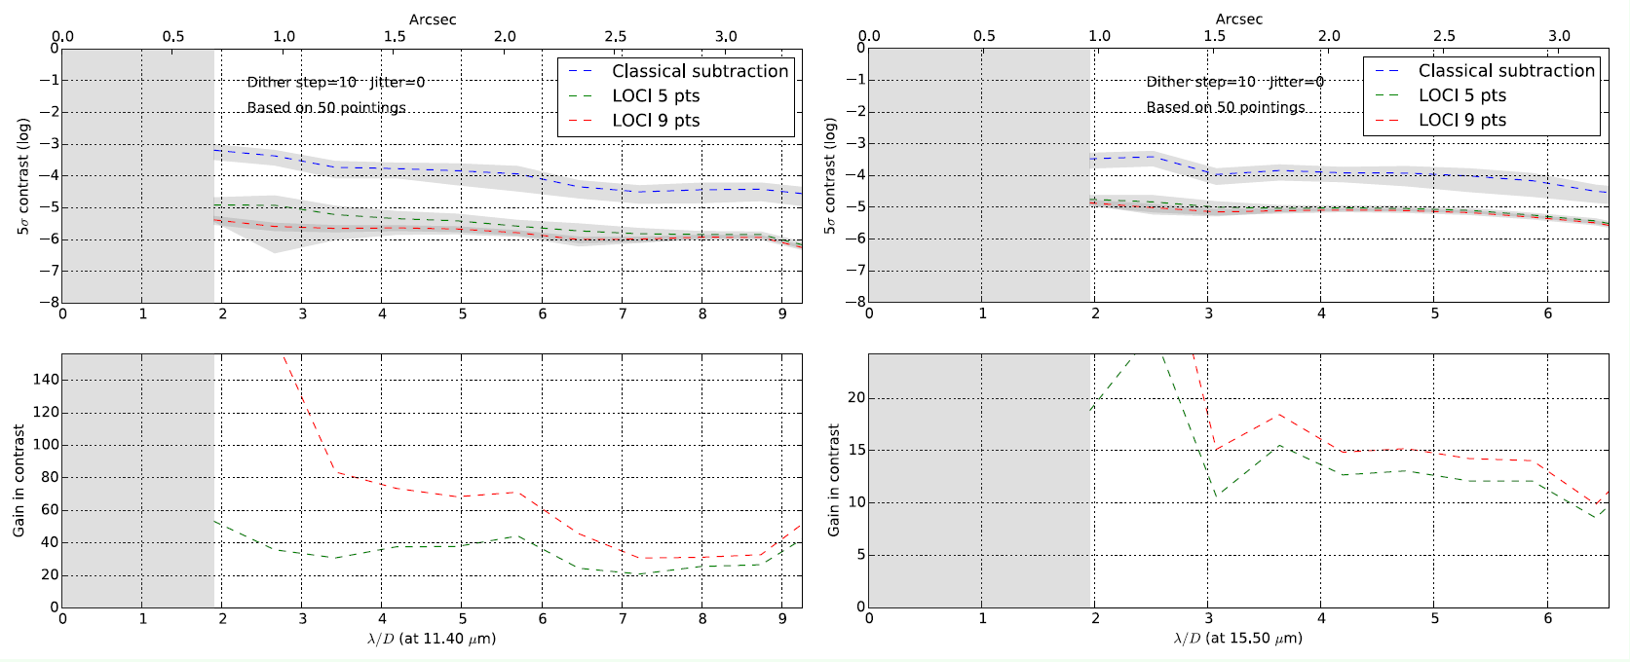
SGD + LOCI : Simulations for MIRI
Soummer et al., 2014
22

Slide 21
THE ASTROMETRIC ERRORS
Small astrometric errors of 1 to 5 mas (1-σ) are of concern for the exoplanet discovery science; knowledge of the host star position needs to be available at the 3-5 σ level to unambiguously establish or rule-out common proper motion.
JWST’s Small Angle Maneuvers (SAM) used in TA have a predicted radial accuracy of 5 mas, 1- σ/axis: 7 mas radial, worse than the requirement
Final position post-SAM can be known to a higher accuracy by analyzing the FGS data: not achieved with telemetry alone, but with a re-analysis of the FGS postage stamp images (from the ground with better tools).
➔ The accuracy of the SAM after the fact ~ 3 mas 1- σ/axis (5 mas radial)
29

Slide 22
ASTROMETRIC CALIBRATION OF MIRI USING NIRCAM
The reason why we are using NIRCam in parallel is that we need an exposure longer than the TA image to have enough SNR on the reference background sources. This is fine when the bright source in the coronagraph scene is under the mask, but might create latencies during the TA exposure. As a consequence we played it safe and recommended a parallel with NIRCam.STScI will revisit this concept when we have updated numbers for latencies.
31
(JWST-STScI-004166)

Slide 23
CALIBRATION with MIRI ALONE
JWST-STScI-004166
32

Slide 24
ASTROMETRIC CALIBRATION
JWST-STScI-004166
33

Slide 25
CORONAGRAPHIC OPERATIONS
Coronagraphic templates and super-templates in the Astronomer’s¨Proposal Tool (APT) : NOT READY FOR CYCLE 1?
Coronagraphic pipeline architecture, data products and algorithms
PSF libraries
ETC
Coronagraphic policies
Coronagraphic Observations can make use of a default roll of +/-5 deg off-normal telescope orientation.
Observations can be ordered in several ways in the APT, with significant impact on overhead and potentially performance:
Minimum time between each target-reference pairs with every sequence scheduled back-to-back
Minimum number of rolls and slews to maximize efficiency with observations grouped by instrument for simplicity
35

Slide 26
MIRI EFFICIENCY : 2 CORONAGRAPHS
(JWST-STScI-004165)
39

Slide 27
MIRI EFFICIENCY: 3 FQPM + 1 LYOT
(JWST-STScI-004165)
40

Slide 28
PERFORMANCES: SIMULATIONS
(Boccaletti et al., 2015, PASP)
42

Slide 29
PERFORMANCE: SIMULATIONS
43

Slide 30
SIMULATIONS: CONTRASTS
44

