Slide 1
The Brown Dwarf Kinematics Project (BDKP)
Learning from the Motions of Ultracool Dwarfs:
Companions, Ages, Higher Order Multiplicity
By: Jackie Faherty
Stony Brook University/American Museum of Natural History
Collaborators: Adam Burgasser/MIT, Michael Shara/AMNH, John Bochanski/MIT, Andrew West/MIT, Kelle Cruz/Hunter, Fred Walter/Stony Brook

Slide 2
The Brown Dwarf Kinematics Project (BDKP)
One Minute Introduction to the BDKP
Objectives:
To measure the proper motion for all known L and T dwarfs
To measure parallaxes and radial velocities for all dwarfs within 20 pc and a select sample of scientific interest
Status Update:
Proper Motions published for 427 L and T dwarfs combined with previous measurements forms the BDKP catalog of 841 UCDs (see Faherty et al 2009)
Parallax frames underway since January 2007 and March 2008
Radial Velocity data acquired since March of 2009

Slide 3
The Brown Dwarf Kinematics Project (BDKP)
Science Motivation
Primary:
Use the main sequence star as an age-calibrator for the brown dwarf secondary
Secondary:
Use the secondary as a check on age-dating for main sequence stars

Slide 4
The Brown Dwarf Kinematics Project (BDKP)
Widely Separated Brown Dwarf Companions

Slide 5
The Brown Dwarf Kinematics Project (BDKP)
Requirements for a Match:
μ components within 2 sigma: typically +/-30 mas/yr
Distances within 2 sigma: typically within 10 pc
Angular Separation < 10 arcminutes
4) Reliability Check performed with a Monte Carlo simulation of the PM catalogs

Slide 6
The Brown Dwarf Kinematics Project (BDKP)

Slide 7
The Brown Dwarf Kinematics Project (BDKP)
Follow-Up:
Echelle Data with 4.0m
Mage data at 6.5m
Near IR data with Spex
Photomtetric Data with SMARTS
Literature
Age-Dating Stars:
X-ray activity
Chromospheric Activity (using Ca II H & K Lines)
Lithium Abundances
Theoretical Isochrones (using T_{eff}, M_{v}, and [Fe/H])
Gyrochronology
Kinematics
Metallicity
Age-Dating UCDs:
Lithium Absorption
Hα Activity
Surface Gravity Features
Kinematics
J-K_{s} Photometric Color

Slide 8
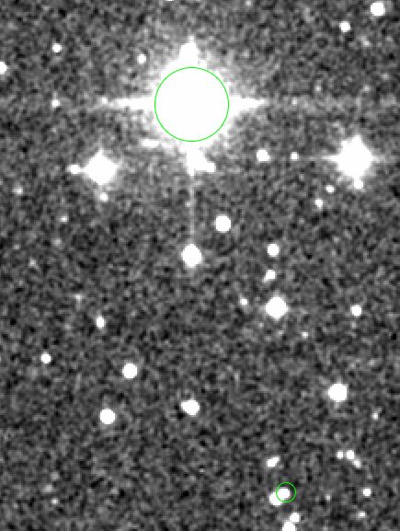
The Brown Dwarf Kinematics Project (BDKP)
2MASSJ0025+4759 with G 171-58
Separation: 218’’ or 9202 AU
Primary:
Spectroscopic Binary: F8 Seperation 200 mas
Orbital Period < 1 yr
AGE
Lithium: 0.6<age<2.0
Ca II H & K: 1.5<age<3.5
Theoretical Isochrone: 0.2<age<1.5 Gyr
Metallicity: ([Fe/H]=0.22) < 2 Gyr
Kinematics: < 2 Gyr
Secondary: L5/L5
Close binary: ~10 AU (0.33’’)
AGE
Lithium: Age<0.5 Gyr

Slide 9
The Brown Dwarf Kinematics Project (BDKP)

Slide 10
The Brown Dwarf Kinematics Project (BDKP)

Slide 11
The Brown Dwarf Kinematics Project (BDKP)
Higher Order Multiplicity
We compiled a list of 44 known companion systems with a UCD at a distance > 100AU
20 of these have been looked at with AO or HST for resolution at projected separations <20AU
Frequency Field Wide-Field
Binary 10-20% 50+/-11%
(Ref for Field frequency: Burgasser et al. 2003, 2006b; Bouy et al. 2003; Close et al. 2003)

Slide 12
The Brown Dwarf Kinematics Project (BDKP)
Higher Order Multiplicity
Recent work by Whitworth & Stamatellos (2006) suggests that for a low-mass primary fragment formed in the cooler outer parts of a circumstellar disk (ρ > 100 AU), and spinning at a fast enough rate, H2 dissociation is likely to trigger a Secondary Fragmentation phase, thereby potentially giving rise to a closely-separated (a ∼5 AU (m/0.1M) UCD binary.
We find 20 binaries; 12 triples; 5 quadruples
Ratio Our Sample 8 pc sample
Triples:Binaries 3:5 1:4
Quadruples:Binaries 1:4 1:26

Slide 13
The Brown Dwarf Kinematics Project (BDKP)
THEORY vs. Observation
Courtesty of Stamatellos

Slide 14
The Brown Dwarf Kinematics Project (BDKP)
New benchmark stellar-UCD companion systems have been discovered with a novel optical to near-IR proper motion search.
Main Sequence stars used to estimate Brown Dwarf ages as well as test UCD age diagnostics
Higher order multiplicity found amongst wider systems
Model Predictions seem to fit higher frequency of brown dwarf binaries in widely separated systems
Thank you!!!!!!!!
Conclusions

